Slide 1
General Overview of Quality control
Labs For Life Project
Quality Control Training

Slide 2
Do you know?
About Standardization?
ISO?
Laboratories can be standardised?
ISO 15189?
Quality Management System?
Management requirements?
Technical Requirements?

Slide 3
Quality Control
A part of quality management focused on fulfilling quality requirements
Quality Management System
Management and Technical Requirements
Quality Control
A part of the Technical Requirements

Slide 4
Technical:
ISO Clause 5
Pre analytical
ISO:5.1-5.4
Analytical
ISO: 5.5,5.6
Post Analytical
ISO: 5.7-5.10
Internal Controls
5.6
Proficiency Testing
5.6
QMS
Method Evaluation
5.5
Managerial
ISO: Clause 4

Slide 5
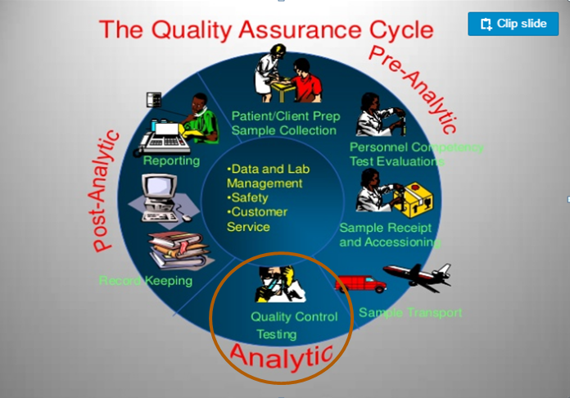
QMS: Technical(ISO: Clause 5)

Slide 6
5.6 Quality control- materials/data required
QC
Hematology
Cytology
Biochemistry
Clinical Pathology
Histo-pathology
Microbiology
Wherever testing is done

Slide 7
Examination Processes (5.5)
Ensuring the Quality of Examination Results (5.6)
ISO 15189: : Processes and Procedures
ISO 15189: 5.5, 5.6
Processes- It is a set of interrelated or interacting activities which transform inputs into outputs
Procedure- It is a sequence of steps that complete a task. Each step is a sequence of activities and each activity a sequence of actions
Process to monitor and evaluate the analytical phase
Sets of procedures intended to ensure that performed service adheres to a standard set of quality criteria: Quality Specification

Slide 8
Factors Affecting Quality
Equipment, reagents
Personnel
Right reagent
Stored at right temperature
Inventory stock management
Right personnel
Training
Competency assessment
Right requirement
Right equipment
AMC/CMC/Calibration
PROCESS
INPUT
OUTPUT
Using of Quality Controls
Environment
Procedures
Right temperature/humidity
Adequate space
Separate incompatible activities
Right SOPs
Document control
Record maintenance
Internal and External
Notes:
Choosing right type of equipment, Reagents at right temp, personnel, storage and transport temperatures, SOPs

Slide 9
Quality in Equipment
Right equipment(meeting all quality parameters)
Right performance as per defined protocol
Maintenance
Calibration

Slide 10
Quality for Reagent
Right reagent as per Quality Specifications
Integrity of reagents maintained
Supply, storage and transportation as per defined protocol
Acceptance Testing
Inventory stock management
Right use as per protocol
QCs as per protocol

Slide 11
Quality in environment
Right temperature/humidity
Adequate space
Separation of incompatible activities
Appropriate BMW management
Infection control measures in place
Safety measures followed

Slide 12
Quality in Personnel
Right personnel for right job
Training
Competency assessment
Retraining/reassessments
Occupational and health safety measures

Slide 13
Quality in Documentation
Right policies/procedures/SOPs
Document control
Record maintenance
Timely review
Confidentiality

Slide 14
“Quality is never an accident-it is always the result of high intention, sincere effort, intelligent direction and skillful execution; it represents the wise choice of many alternatives”
William A Foster

