Slide 1
Overview of QMS
Quality Management Systems

Slide 2
Why DO WE NEED TO HAVE QMS in a Lab?
To avoid any error or any mismanagement in laboratory during patient services we need to establish QMS

Slide 3

Is 1% error acceptable?

Slide 4
What is THE SOLUTION?
LABORATORY QUALITY MANAGEMENT SYSTEMS

Slide 5
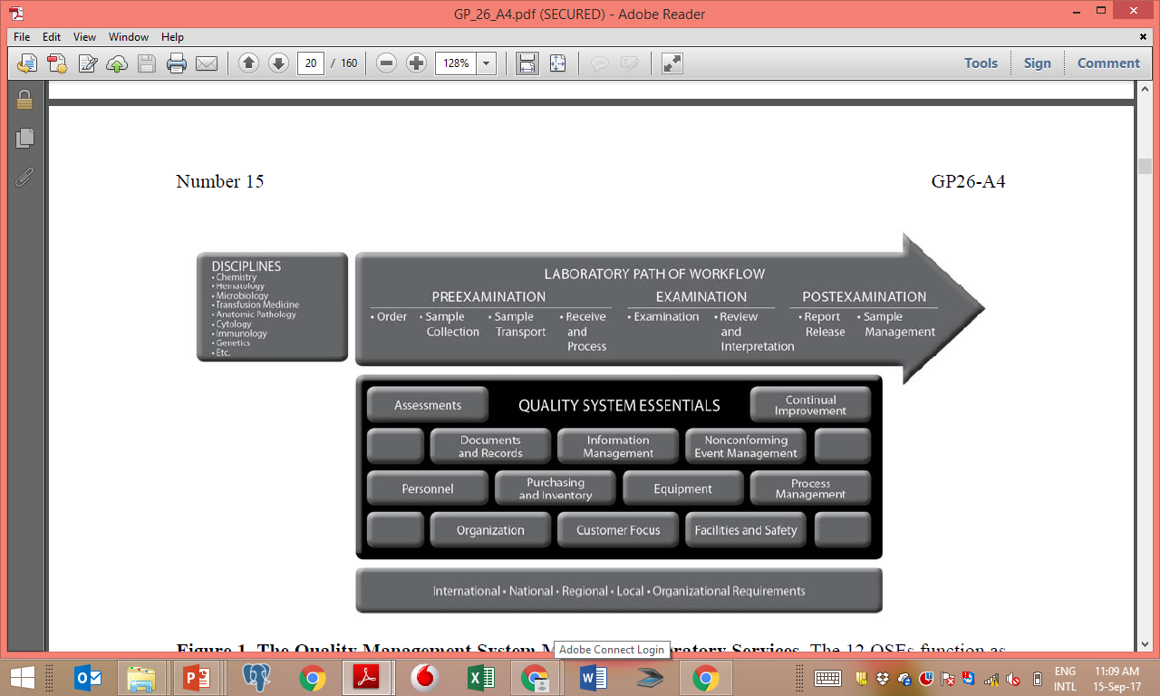
Standardise

Slide 6
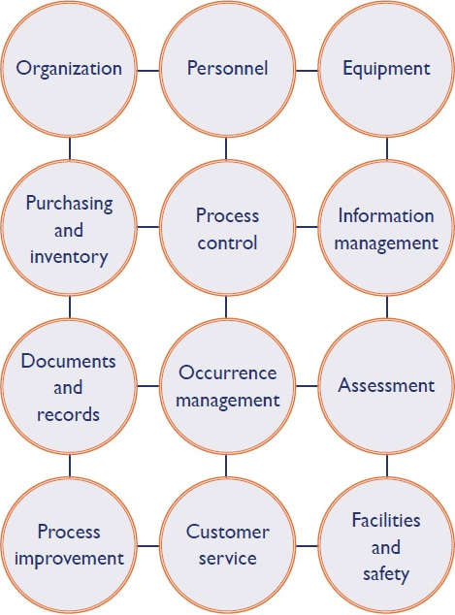
Standardise

Slide 7

Synchronise

Slide 8

Synchronise

Slide 9
Standardize, Synchronize
Competency and efficiency of lab staff
Environmental Conditions
Quality of reagents and equipment.
Pre- analytical, analytical and post analytical processes
Quality control procedures
Advocacy Services
Resolution of complaints
Procedure of documentation and record keeping

Slide 10
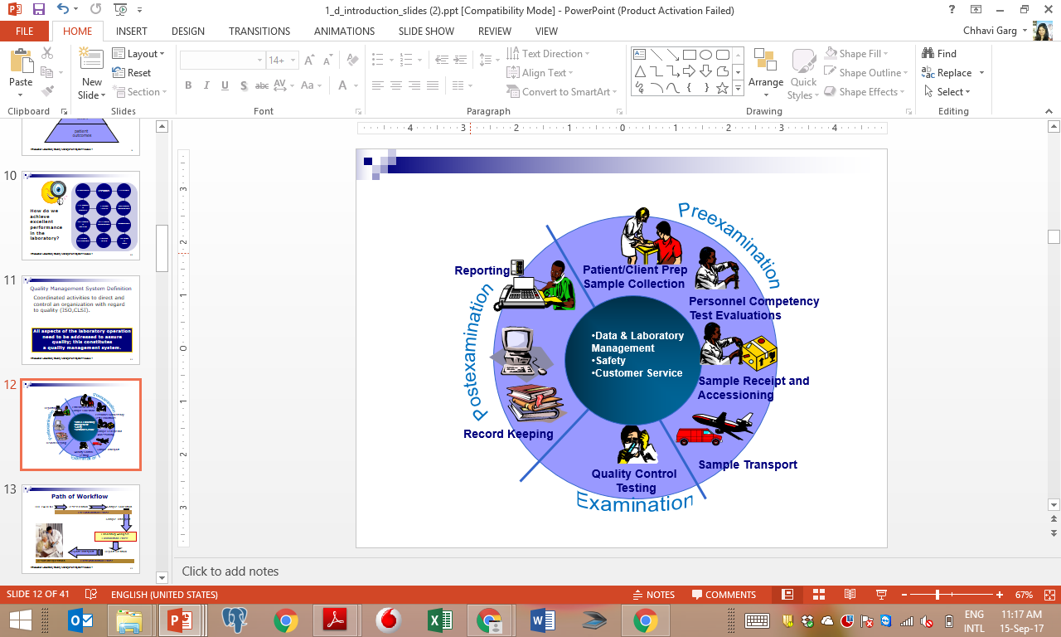
Process Workflow in a Laboratory

Slide 11
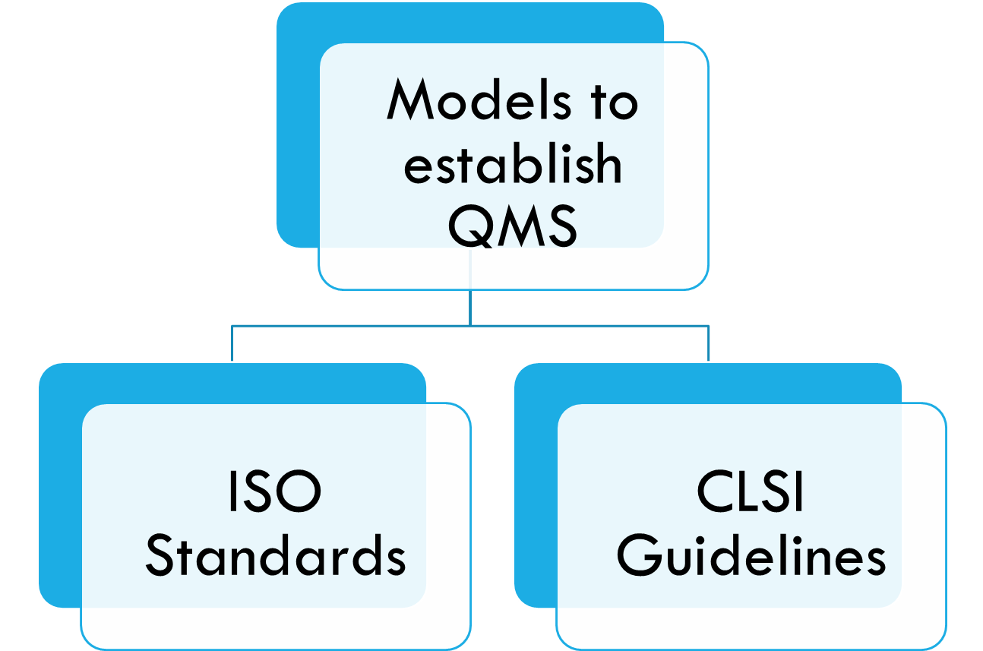
QMS Models (ISO & CLSI)
ISO Standards
(International Organization for Standardization)
ISO 15189 (Laboratory Quality and Competence)
ISO 9001 (QMS) + ISO/IEC 17025 (Competence of Testing)
Followed in India for Accreditation of Laboratories
CLSI Guidelines
(Clinical and Laboratory Standards Institute)
GP26 (Application of Quality Management System Model for Laboratory Services)
Specific Guidelines for each QSE

Slide 12


Quality
As per ISO definition “quality is the degree to which a set of inherent characteristics fulfils requirements”
Competence
As per ISO definition “competence demonstrated ability to apply knowledge and skills”

Slide 13
Thanks

