Slide 1

General Overview of Quality controls
Labs For Life Project

Slide 2
5.6 Controlling is required…..
QC
Hematology
Cytology
Biochemistry
Clinical Pathology
Histo-pathology
Microbiology
Wherever testing is done

Slide 3
QCs can be classified in several ways
Internal Quality Controls
      Quantitative / Qualitative
      Lyophilized / ready to use
      Commercial/ in-house
      Assayed/unassayed
      First Party/ Second party/ Third Party
External Quality Assurance (Inter Lab Comparison)
      EQAS
      Peer Group Comparisons
      Exchange of Samples
      Split testing

Slide 4
Internal and External Controls
Internal Quality Control: For monitoring precision, calculating the measurement uncertainty, understanding shifting accuracy: Daily Process
Inter-laboratory Comparison: For monitoring accuracy, calculating bias: Periodic Process
All these will be discussed in the next 2 days

Slide 5
Internal Quality Control
IQC is the measure of precision, or how well the measurement system reproduces the same result over time and under varying operating conditions.
S.no | Analyte
1 | 100
2 | 101
3 | 102
4 | 98
5 | 100

Slide 6

Internal Quality control
Internal QC results are used to validate whether the patient test results are reliable.
S.no | Analyte
1 | 100
2 | 101
3 | 102
4 | 98
Today | 110

Slide 7
Internal Quality Control
Once the test system is validated, patient results can then be used for diagnosis, prognosis, or treatment planning.
IQC thus forms the backbone of PERFORMANCE EVALUATION of analytical systems on a day to day basis

Slide 8


Slide 9
Classifications of Internal Quality Controls
    As per Process: Quantitative / Qualitative
    As per Stability: Lyophilized / ready to use
    As per Source: Commercial/ in-house
    As per Target definition: Assayed/un-assayed
    As per Vendor: First Party/ Second party/ Third Party

Slide 10
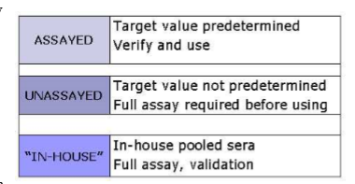
IQCs as per Source & Target Definition :
Commercial (assayed and un-assayed) & In-house

Slide 11
IQCs as per source/ Target Definition : Commercial Controls
Assayed
  Tested by manufacturer using multiple methods before sale
  Sold with results of the testing
  Common formats used with package inserts
    Mean and ±2 SD range
Unassayed
  NOT tested by manufacturer before sale
  Control values must be determined by the individual laboratory without having the guideline information from the insert (A target may be specified, but no SD or range)

Slide 12
IQCs as per source: Commercial Controls Cont.…
  Un assayed
  Usually less expensive than assayed
  Used to evaluate precision only
  Avoids manufacturer errors in determining control values
  Assayed
  More expensive than un-assayed controls
  Used to evaluate accuracy and precision
  Avoids laboratory errors when determining control values
Will be discussed later.

Slide 13
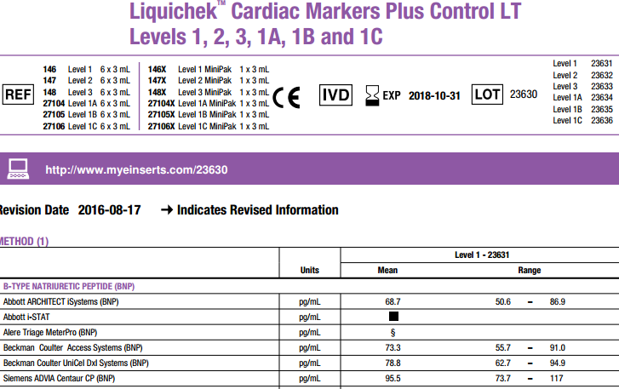
Notes:
Assayed, target and range

Slide 14
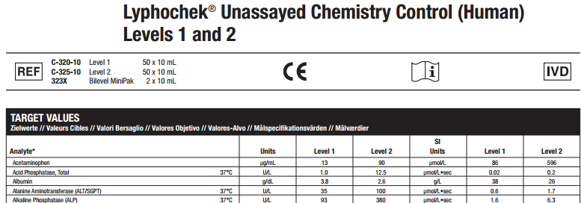
Notes:
Target defined but not range

Slide 15

IQCs as per source: In-house Controls
Pooled sera is collected in the laboratory characterized, validated for the analyte and preserved in small quantities for daily use
E.g. Borderline positive controls in serology

Slide 16
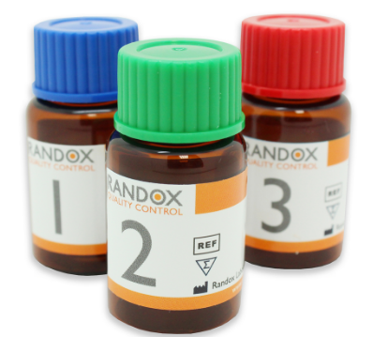

IQCs as per process:
Quantitative, Qualitative and Semi Quantitative
  Quantitative
  The measurement of Quantitative QCs produce a numeric value as an end-point
  The quantity of an analyte is statistically analyzed for accuracy, precision, total error etc.
  These are called Statistical Quality Controls
  Ex. Glucose, TSH etc.

Slide 17

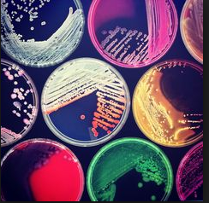

  Measure the presence or absence of a substance, or evaluate cellular characteristics such as morphology.
  ‘Reactive’ or ‘Non-Reactive’, ‘Positive’ or ‘Negative’, etc.
  Ex. Microbiology culture, Serology Report etc.
Notes:
Widal , RA, CRP, ASO ,Clinical pathology, Cultures, Cavity Fluid,Smears,Parasitology

Slide 18
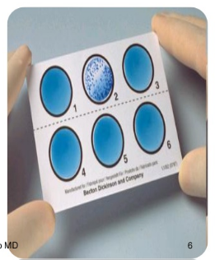
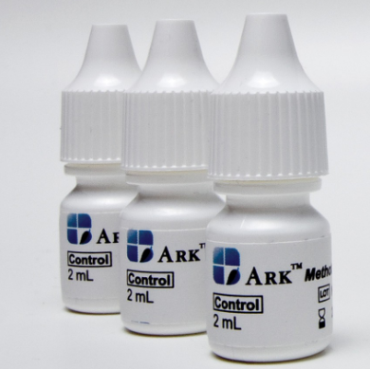
IQCs as per process:
Semi Quantitative
These are similar to qualitative examinations,
Here, the test results are expressed in semi-quantitative terms, as an estimate of how much of the measured substance is present.
QC procedures also can be aligned to this
E.g. Developing Borderline Control using E Ratio in serology
Urine controls giving reports as 1+, 2+….

Slide 19
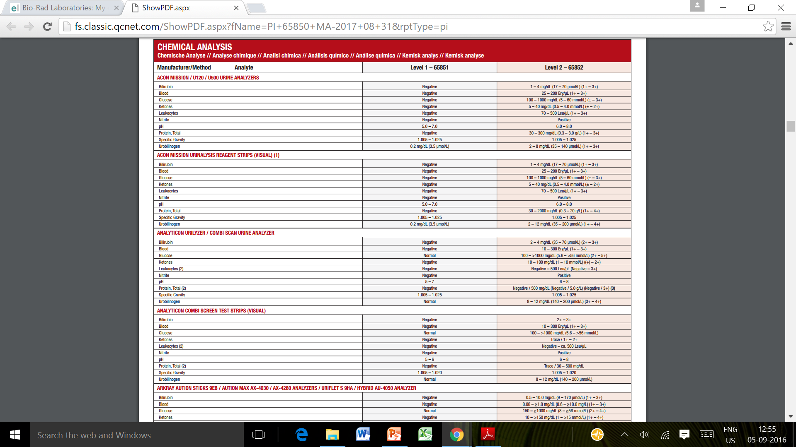

Slide 20
IQCs as per Vendor:
Quality Control Types
Third Party Control
These are designed and manufactured free of any method manufacturer involvement. Therefore, they can often readily detect changes in reagents, instruments function, and calibration.
Second Party Control
The manufacturer of the method provides another company to produce the control based on the manufacturer’s specifications and instructions for production. Again, the controls may be insensitive to changes that can affect patient samples.
First Party Control
Risk when the controls and calibrators share a common manufacturing pathway is that they may be insensitive to change affecting patients samples.
Control
Control
Calibrator

Slide 21

IQCs as per Vendor:
Dependent control material (First Party)
Typically provided by the instrument manufacturer.
Dependent control materials are often manufactured from;
    the same lot of raw material,
    using the same manufacturing process, and
    made in the same facility used to manufacture the instrument, kit or method calibrators.
Notes:
It is the material manufactured under the same quality system as the instrument, kit or method it is intended to monitor and whose performance depends on design inputs from the instrument, kit or method manufacturer

Slide 22
IQCs as per Vendor:
Semi-dependent control material (Second party)
It is manufactured outside the quality system used to manufacture the instrument, kit or method.
But on behalf of; and with input from the instrument, kit or method manufacturer.

Slide 23
IQCs as per Vendor:
Independent control material (Third Party)
These Control Material is manufactured outside the quality system used to manufacture the instrument, kit or method.
Its performance is independent of any design inputs from the instrument, kit or method manufacturer.

Slide 24
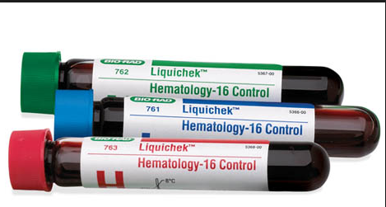
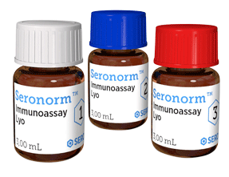
IQCs as per Stability:
Liquid Stable/ Lyophilized
Ready to use
Lyophilized material
Liquid medium, no reconstitution needed
Usually more costly per box than lyophilized.
Eliminates many of the handling and reconstitution errors.
Influence of matrix effect may be greater with the method you use.
Freeze dried, needs to be reconstituted
Require special diluents or deionized Type I water
The material more convenient for transport.
Usually less costly per box than liquid.

Slide 25
Lyophilized material Cont.…
Frequently has a shorter open-vial expiry interval
May result in discarding unused portion (hidden cost consideration)
May experience more vial-to-vial variability (increase imprecision), especially if improper handling and reconstitution occurs
Reconstitution to be done with expertise and care

Slide 26


Reconstitution is to be done at ambient temperature without losing even minute constituent particles.
Proper mixing is a must after reconstitution and before aliquoting.
Care should be taken that the QC/aliquots made will not be used beyond the date of expiry

Slide 27
Aliquot small volumes so that a small amount can be thawed and used daily.
Decide on appropriate volumes as per tests to be controlled
Store at -10 °C to - 20°C or as specified by the manufacturer.
The frozen samples should be thawed at room temperature before being used for assays and Do not thaw and re-freeze control material.

Slide 28
Pipettes should be calibrated
Diluent material should be deionised/injection water or whichever is provided by the manufacturer
The instructions of the manufacturer should be followed for storage of both unopened and opened vials.
Staff must be trained for the specific task

Slide 29
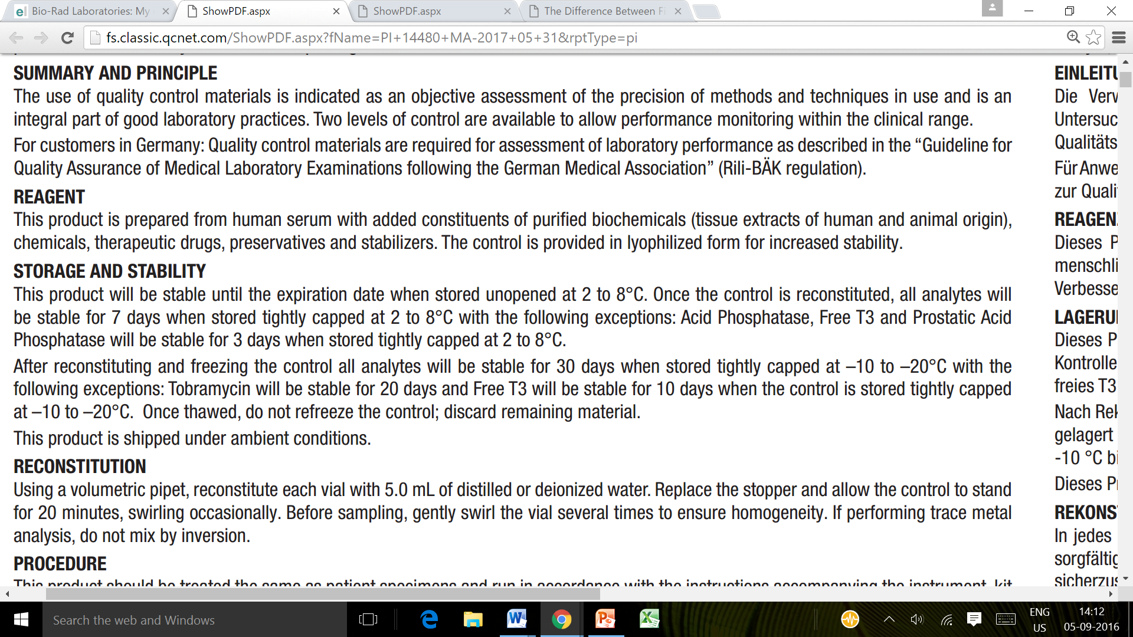



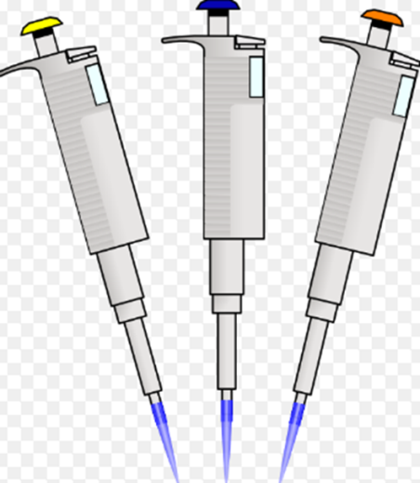

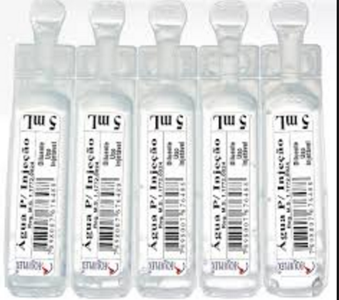
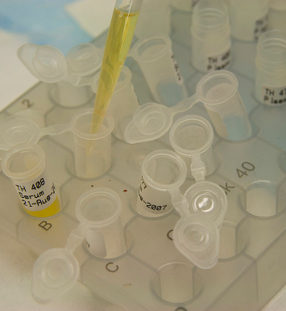

Slide 30
Liquid Stable Controls
Follow the expiry date rerquirement
In the case of hematology controls, the guidelines on the maximum number of cap opening or piercing should be understood and followed.

Slide 31
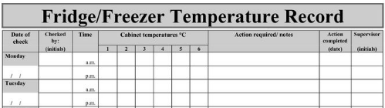
Monitor and maintain the freezer/fridge temperatures to avoid degradation of the analyte in any control material.

Slide 32


Slide 33
Purchasing and selection of QC Material:
Matrix
The QC matrix should be
patient-like material
ideally made from human serum, urine or spinal fluid as the case may be
Relevant Clinical Decision Levels
The QC values should monitor Normal, Low and High levels of all anlytes examined

Slide 34
Purchasing and selection of QC Material:
Lot Stability:
It is ideal to have a QC lot be available for long periods of time
Availability Of Inter-laboratory Comparison Programs
The ideal IQC provider will make ILC programs available through peer group data
Should be cost Effective with capacity to avoid waste

Slide 35

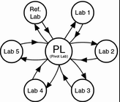

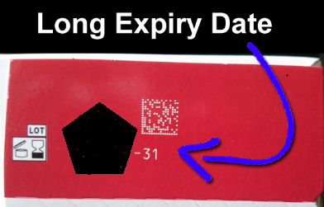

Purchasing and selection of QC Material

Slide 36
External Quality Assurance

Slide 37
Inter Laboratory Comparison (5.6.3)
The laboratory shall participate in an inter-laboratory comparison programme(s) (such as an external quality assessment programme or proficiency testing programme) appropriate to the examination and interpretations of examination results.
The laboratory shall monitor the results of the inter-laboratory comparison programme(s) and participate in the implementation of corrective actions when predetermined performance criteria are not fulfilled.
  ISO: 15189

Slide 38
Inter Laboratory Comparison
Major mechanisms
Enrolling in an EQA (PT)
Exchange of samples
Peer Group Comparisons (using internal control values: Will be explained later)
Notes:
Split Sample Testing done in lieu of ILC (5.6). Labile analytes, difficult samples and very rare test.

Slide 39
Other Mechanisms for assessing proficiency
Whenever an interlaboratory comparison is not available
Certified reference materials
Samples previously examined
Material from cell or tissue repositories

Slide 40
EQAS/EQA/EQAP
The external quality assurance is used to evaluate your lab performance with reference to other participant labs.
This allows for comparison of the laboratory's testing to a source outside the laboratory.
Notes:
Discussed later

Slide 41

Exchange of Samples
Sample (reports) results are compared to other laboratories using the same methodologies, instruments, and reagents

Slide 42
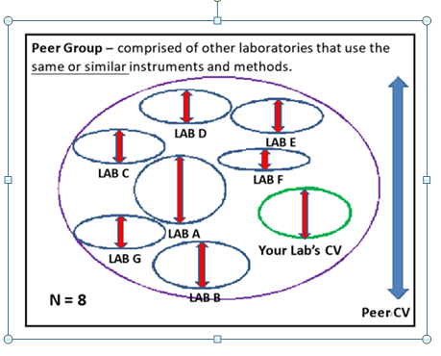
Peer Group Comparisons
This comparison can be made to the performance of internal controls of a peer group of laboratories .
ILC Peer group

Slide 43
