Slide 1

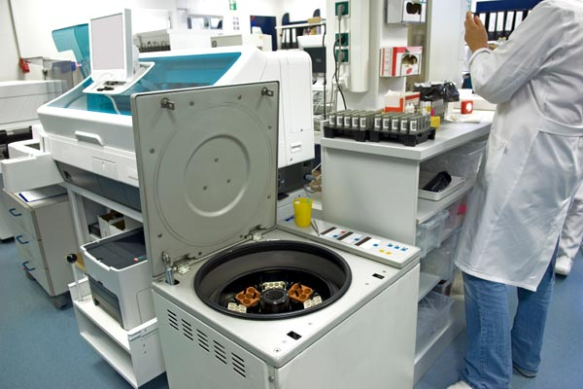
Equipment
Management
Overview

Slide 2
Equipment Management
Equipment Management
Training and Skill Development
Selection, Procurement and Acquisition
Installation
Preventive Maintenance
Calibration
Troubleshooting
OQ and PQ
Documentation
Service, Repair, Safety
Retirement & Condemning

Slide 3

Selection, Procurement and Acquisition
    Selection Criteria
  Performance Characteristics
  Accommodation and Environment requirements
  Maintenance & service
  Sample load & Throughput
  Bench top/Floor model
  Closed system/ Open system
  Cost - includes Running costs, Reagents, Spares
  Power consumption
User Specific requirements (USRs)

Slide 4
Selection, Procurement and Acquisition
What level & quality of support/ backup is available for;
  Training
  Technical advice
  Rapid call out
  Reliable supply of reagents & spares

Slide 5
Equipment Management
Equipment Management
Training and Skill Development
Selection, Procurement and Acquisition
Installation
Preventive Maintenance
Calibration
Troubleshooting
OQ and PQ
Documentation
Service, Repair, Safety
Retirement & Condemning

Slide 6
Equipment Qualification:
Acceptance
Equipment Qualification
Pre-installation verification
Installation Qualification (IQ)
Operational Qualification (OQ)
Performance Qualification (PQ)
Maintenance Qualification (MQ)
Equipment Qualification through IQ, OQ, PQ and MQ practices is a part of GMP and GLP through which Manufacturers and laboratories can assure that their equipment delivers consistent quality

Slide 7
Pre-installation
Specifications for physical environment
Temperature tolerances
Humidity
Dust
Vibration
Load bearing
Light, direct sun
Space & ventilation
Voltage and power backup (UPS?)
Water pressure & purity
Drainage

Slide 8
Installation Qualification(IQ)
Responsibility: Manufacturer
Never open the equipment before the vendor arrives
Procedures for unpacking the instrument
Detailed component list, hardware, software, accessories
Spare parts inventory
Electrical circuits
Instructions on what to do if the instrument is damaged - insurance?
Specifications of service requirements
Documents: Signatures

Slide 9
Equipment Management
Equipment Management
Training and Skill Development
Selection, Procurement and Acquisition
Installation
Preventive Maintenance
Calibration
Troubleshooting
OQ and PQ
Documentation
Service, Repair, Safety
Retirement & Condemning

Slide 10
Equipment Qualification:
Acceptance
Equipment Qualification
Pre-installation verification
Installation Qualification (IQ)
Operational Qualification (OQ)
Performance Qualification (PQ)
Maintenance Qualification (MQ)
Equipment Qualification through IQ, OQ, PQ and MQ practices is a part of GMP and GLP through which Manufacturers and laboratories can assure that their equipment delivers consistent quality

Slide 11
Operational Qualification (OQ)
Responsibility: Manufacturer
Test configurations
Calibrations
Function Checks
Documents
Training of Personnel

Slide 12
Performance Qualification (PQ)
Laboratory’s Responsibility
Verifying the Manufacturer’s Claims of Performance Characteristics
  Precision
  Accuracy
  Linearity
  Biological Reference Ranges
Never start patient reporting before PQ is complete

Slide 13
Equipment Management
Equipment Management
Training and Skill Development
Selection, Procurement and Acquisition
Installation
Preventive Maintenance
Calibration
Troubleshooting
OQ and PQ
Documentation
Service, Repair, Safety
Retirement & Condemning

Slide 14
Training
Start-up & shut-down procedures
Cleaning & maintenance
Sample preparation & handling
QC & calibration procedures
Trouble shooting
Data acquisition and storage

Slide 15
Equipment Management
Equipment Management
Training and Skill Development
Selection, Procurement and Acquisition
Installation
Preventive Maintenance
Calibration
Troubleshooting
OQ and PQ
Documentation
Service, Repair, Safety
Retirement & Condemning

Slide 16
Equipment Qualification:
Acceptance
Equipment Qualification
Pre-installation verification
Installation Qualification (IQ)
Operational Qualification (OQ)
Performance Qualification (PQ)
Maintenance Qualification (MQ)
Equipment Qualification through IQ, OQ, PQ and MQ practices is a part of GMP and GLP through which Manufacturers and laboratories can assure that their equipment delivers consistent quality

Slide 17
Functioning Equipment is Vital to
Quality Service
Produces
reliable
test results
Quality
Results
Lowers
repair costs
Functioning
Equipment
Prevents
delays in
testing
Maintains
productivity
Notes:
A Good Equipment Program Achieves
Maintaining a high level of performance
Lengthening instrument life
Reducing interruption of services due to breakdowns and failures
Improving customer satisfaction
Improving the technologist’s confidence and knowledge

Slide 18
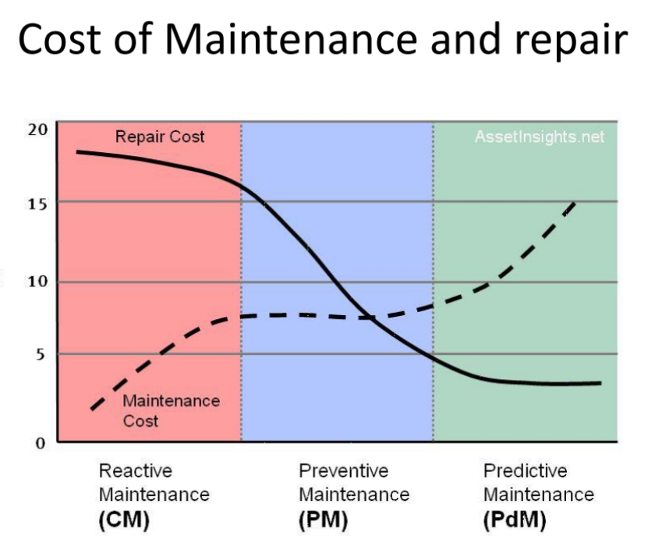
COS
T

Slide 19
Maintenance Plans
Train staff in all authorized maintenance steps
Maintenance plan for every equipment
  Daily
  Weekly
  Monthly
  As needed
Documentation of the maintenance
Verification by technical supervisory teams

Slide 20
Equipment Management
Equipment Management
Training and Skill Development
Selection, Procurement and Acquisition
Installation
Preventive Maintenance
Calibration
Troubleshooting
OQ and PQ
Documentation
Service, Repair, Safety
Retirement & Condemning

Slide 21
Process Map helps in Error Detection
Breaking down all phases of the test system into steps, so that weak points can be identified
Each step can be analyzed to find potential failure modes that could present significant risk to patients
Process can then be further analyzed to see if controls can be put into place to avoid the failures

Slide 22
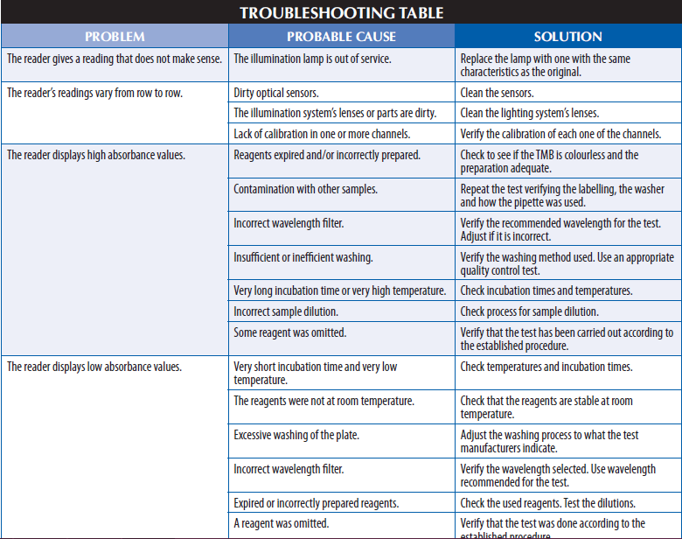

Slide 23
Troubleshooting Plan
Train staff in troubleshooting
Troubleshooting plan for every equipment
  Guidance from Operators Manual: Understand all flags
  WHO manual
  Ground level experience
Bench aids at workstations

Slide 24
Equipment Management
Equipment Management
Training and Skill Development
Selection, Procurement and Acquisition
Installation
Preventive Maintenance
Calibration
Troubleshooting
OQ and PQ
Documentation
Service, Repair, Safety
Retirement & Condemning

Slide 25

Which one is correct??

Slide 26
Calibration
What?
Which equipment?
Why?
When?
By whom?
How?
How is it verified?

Slide 27
What is Calibration?
The process of:
To provide a known comparison between a Reference Value and a Measured Value

Slide 28
Why Calibrate ?
Wear and tear…
  Temperature
  Humidity
  Mechanical Stress (Pipettes, Centrifuges, tubing)
  Dust
  Loss of alignment
  Volume discrepancies
  Pressure discrepancies
  Major Maintenance

Slide 29
When to calibrate?
  As per the manufacturers' recommendations
  As per accreditation body requirements (e.g. SLAB)
  After major maintenance processes
  Frequency will also depend on usage rate and conditions of use

Slide 30
Who calibrates?
The Manufacturer (Analytical Equipment)
Through an authorized agency, SLAB accredited (ISO 17025 accredited) for Ancillary Equipment
Demonstrate Traceability

Slide 31
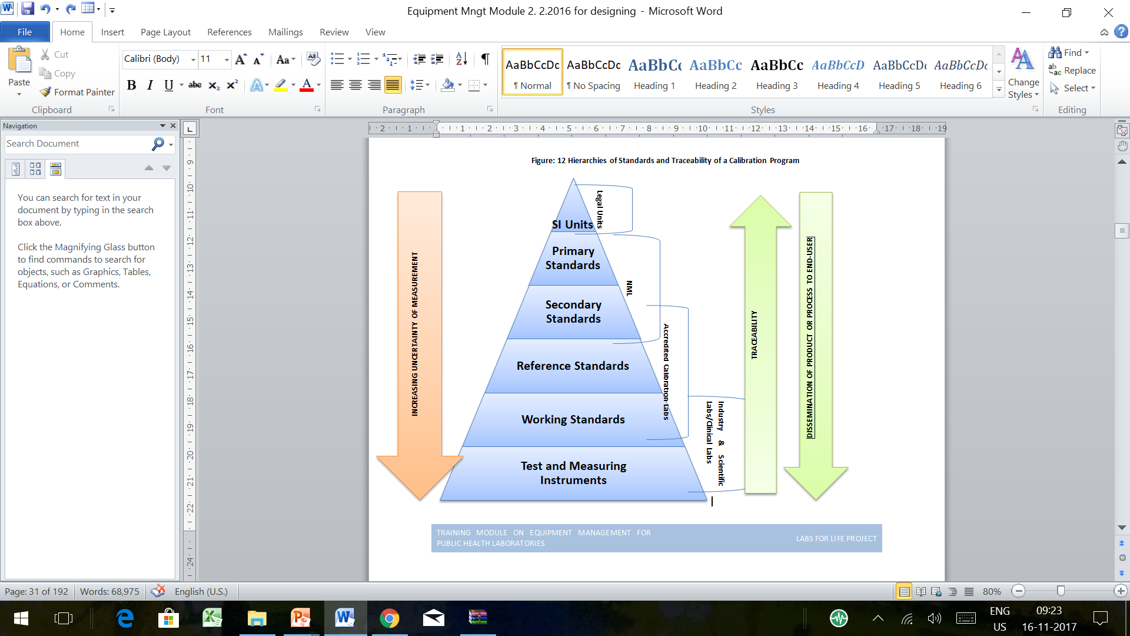
Traceability & Dissemination

Slide 32
How are calibrations done?
A reference is used which is traceable to the SI unit.
The unit under calibration is assessed with reference to the reference
Any discrepancies are noted and compared against acceptance criteria
If acceptable, calibration has passed
If not, the equipment has to be repaired and recalibrated

Slide 33
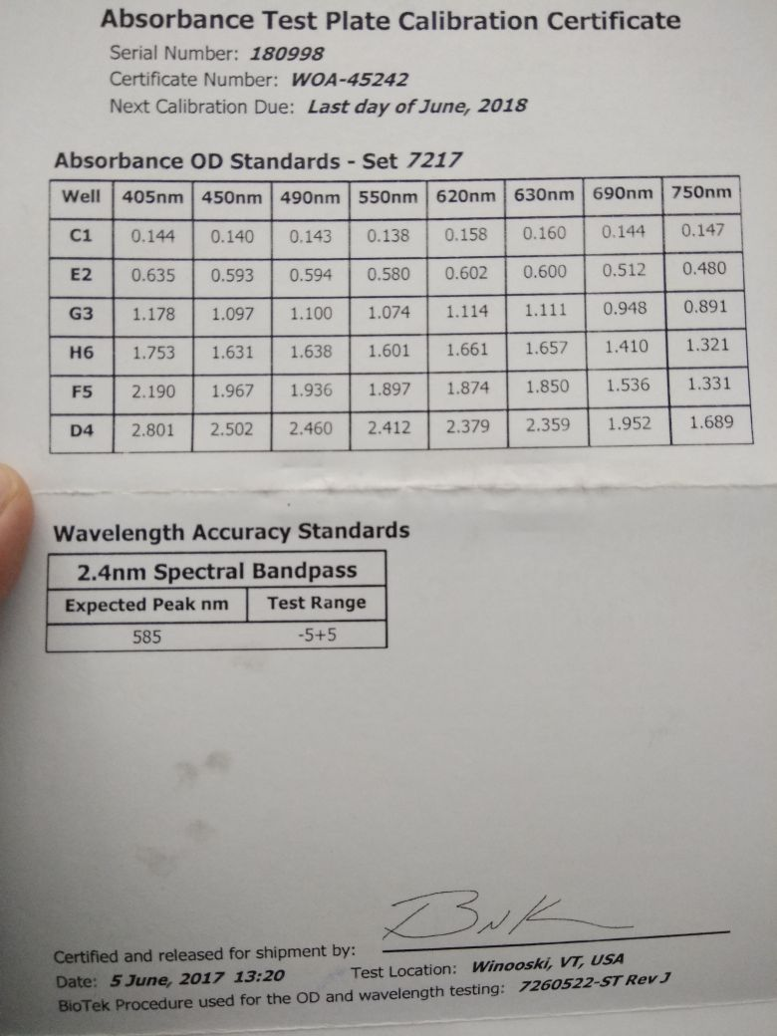
ELSIA Reader Calibration
Each calibration plate comes with a set of predefined reference values for each wavelength with appropriate traceability.

Slide 34
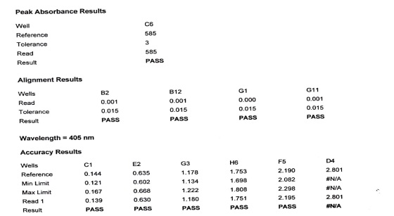
ELSIA Reader Calibration
The plate is then checked on the reader to be calibrated and the recovered values are checked against the reference values.
Any discrepancy will be assessed, accepted or rejected.
Troubleshooting done and corrected by the technical support team.

Slide 35
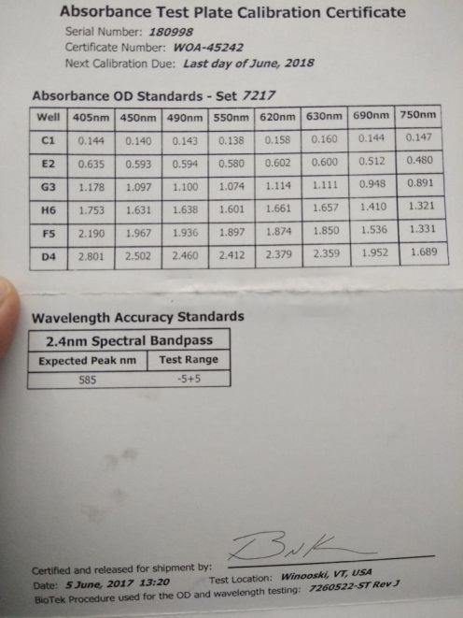
ELISA Reader Calibration Certificate
It is essential to get a certificate of calibration, as shown in the picture.
This also will show the next due calibration

Slide 36
Equipment Management
Equipment Management
Training and Skill Development
Selection, Procurement and Acquisition
Installation
Preventive Maintenance
Calibration
Troubleshooting
OQ and PQ
Documentation
Service, Repair, Safety
Retirement & Condemning

Slide 37
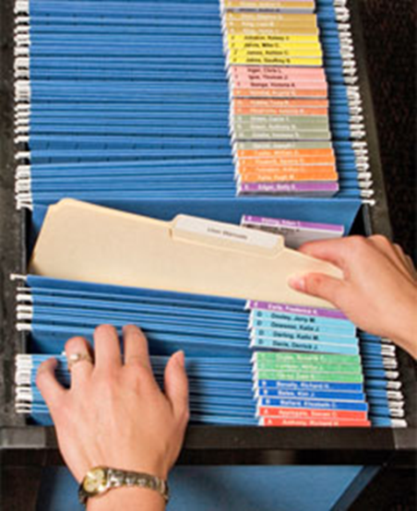
Service, Repair
Service:
  Scheduled Maintenance
  Availability of AMC and CMC will enable a smooth process
  Always file service reports
Repair
  Breakdown, when in-house efforts fail
  Availability of AMC and CMC will enable a smooth process
  Always file the breakdown and downtime reports

Slide 38
Breakdown
Look for options to continue service
  Obtain back-up instrument from central stores or manufacturer
  Refer sample to nearby laboratory
Reporting breakdown, reducing downtime
  Call log
  Avail remote support
  Training technicians on authorized steps
Monitor downtime
  From the time of breakdown to the uptime
  Set limits
  Set downtime as a Quality Indicator

Slide 39
Equipment Safety
Electrical Safety
Proper voltage regulators
UPS and surge protection
Periodic checks for their wiring, earthing, fuses and switches regularly.
Avoid using with wet surfaces or floors.
Any obvious damage or defects must be reported to supervisor and maintenance department for proper action. It is strictly forbidden to use equipment when in doubt.
Equipment are clearly labeled if found to be defective.

Slide 40
Equipment Safety
  Physical Safety
Interlock systems.
Examples of interlock systems includes the system that prevents the operation of Biological Safety Cabinet’s light when the UV lamp is turned on
  UV safety
Special work practices
Equipment hazard labeling
Use of PPE and training are required to avoid the hazards.
Never work in a BSC while the germicidal lamp is on.

Slide 41
Equipment Safety
  Bio-Safety
    Aerosols
    Breakages
    Spillages
  Decontamination schedule for all equipment

Slide 42
Equipment Management
Equipment Management
Training and Skill Development
Selection, Procurement and Acquisition
Installation
Preventive Maintenance
Calibration
Troubleshooting
OQ and PQ
Documentation
Service, Repair, Safety
Retirement & Condemning

Slide 43
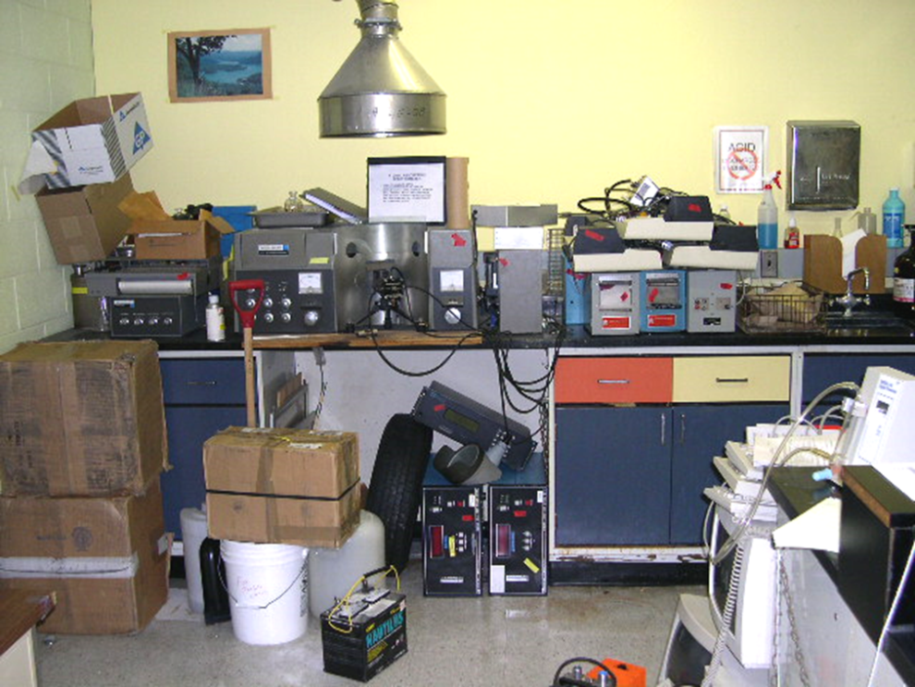
Decommissioning & Retiring
Retirement and decommissioning process is the last stage in application or product life cycle of the equipment
Retirement and decommissioning of unused / non-working equipment is critical to keep laboratories clutter free and safe

Slide 44
Decommissioning & Retiring
When to Retire Equipment?
  When experts certify Non-repairable: Unserviceable/Unreliable/”Unfit for Use”:
  Obsolete model, to be replaced with new model:parts are out of date or the clinical technique is no longer recommended
  Damaged through negligence or abuse
Why to Retire Equipment?
  Prevent inaccurate test results
  Free up valuable space

Slide 45
Decommissioning & Retiring
How to Retire Equipment?
  Label appropriately – Not in USE and keep safely
  Salvage any usable parts
  Consider biohazard, follow safety disposable procedures
  National and institutional guidelines
  Returning to manufacturer

Slide 46
Equipment Management
Equipment Management
Training and Skill Development
Selection, Procurement and Acquisition
Installation
Preventive Maintenance
Calibration
Troubleshooting
OQ and PQ
Documentation
Service, Repair, Safety
Retirement & Condemning

Slide 47
Equipment Documentation
SOPs for the equipment operation
Each major equipment will have its own specific equipment maintenance documents and records
Smaller equipment such as centrifuges and pipettes with common maintenance documents and records
Specific processes like troubleshooting, flags, key operation guidelines should be displayed as bench aids
Calibration Matrix: maintenance and calibration dates and the next due be made.

Slide 48
Maintenance documents
Step-by-step instructions for preventive maintenance, including frequency of performance and how to keep records of performance.
Directions for calibrating the instrument.
Guide for troubleshooting.
Any required manufacturer’s service and repair.
List of any specific items needed for use and maintenance, such as spare parts.
Bench-aids of flags.
MSDS sheets required.

Slide 49
Maintenance records
Dedicated logbooks
Preventive maintenance activities and schedule.
Recording of function checks and calibration.
Any maintenance performed by the manufacturer.
  Full information of problem
  Troubleshooting activity
  Information regarding resolution of the problem
  Downtime

Slide 50
Thanks

