Slide 1
DR. PARMINDER GAUTAM
NHSRC
PROCESS MAPPING
Process approach to Quality

Slide 2
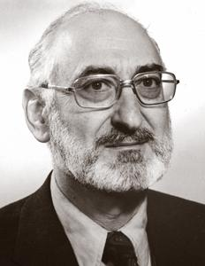
Donabedian’s Model of Quality of Care
Structure
Process
Outcome

Slide 3

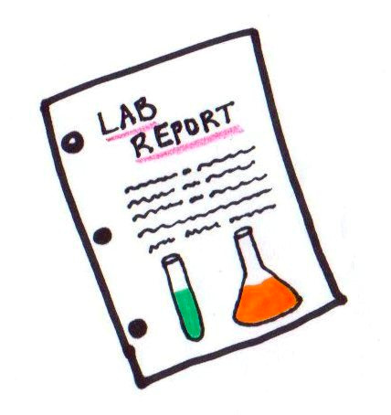
Input Process Output
Pre-Analytical
Analytical
Post-Analytical
Input
Process
Output

Slide 4
WHAT IS A PROCESS
A process is a set of interrelated or interacting activities which transforms inputs into outputs
A process is defined as “a series of steps which convert one or more inputs into one or more outputs.”

Slide 5
What is a process map ?
Graphical representation of the series of steps of a process
A pictorial representation of the sequence of actions that comprise a process.
It traces the flow of physical product and information through the steps
If there is no physical product, the map is used to document the step-by-step activities involved in providing a service

Slide 6
Why process mapping ?

Slide 7
Why Process Mapping?
  Visually represents the work process
  Before you can improve a process, you must understand it.
  Provides a common understanding of the entire process and specific roles and contributions of process participants.
  Identifies problem areas and opportunities for process improvement
  Process maps are a great problem solving tool
  Helps us determine what is the problem/what it is not
You don’t learn to Process Map,
You Process Map to learn. (Dr.Myron Tribus)

Slide 8
Why Process Mapping
Increase efficiency
Eliminate non-value-added activities
Reduce cycle time
Expand service capabilities
Simplify work flow
Minimize dependencies
Gain buy-in and organizational support for change

Slide 9
Why is Process Mapping Important?
It provides an opportunity to learn about work that is being performed.
Dr. Myron Tribus said
You don’t learn to Process Map,
You Process Map to learn.
Most processes today are undocumented.

Slide 10
Looking at patient processes
30 - 70% of work doesn’t add value for patient
up to 50% of process steps involve a ‘hand-off’, leading to error, duplication or delay
no one is accountable for the patient’s ‘end to end’ experience
job roles tend to be narrow and fragmented

Slide 11
Symbols used to Process Map
Start & End: An oval is used to show the materials, information or action (inputs) to start the process or to show the results at the end (output) of the process.
Activity: A box or rectangle is used to show a task or activity performed in the process. Although multiple arrows may come into each box, usually only one arrow leaves each box.
Decision: A diamond shows those points in the process where a yes/no question is being asked or a decision is required.
Break: A circle with either a letter or a number identifies a break in the process map and is continued elsewhere on the same page or another page.

Slide 12
Important Points
Process Map what is, not what you would like the process to be.
Process Mapping is dynamic. Use Post-it notes, dry erase markers, pencil, etc.
All Process Maps must have start and stop points.

Slide 13
Compiling a Process Map
Name of the person
completing task
+
verb
Who does what and when?

Slide 14
Process Bottlenecks
occurs when a step is the limiting
rate of the process
    The step takes a significant time, and slows the whole process down.

Slide 15
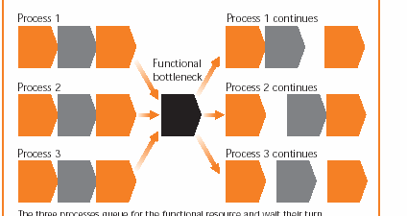
FUNCTIONAL BOTTLENECK

Slide 16
VALUE / NON-VALUE ADDING STEPS
Value adding
The activity transforms the patient and moves them towards the next defined outcome
The activity is something that the patient cares about
Non-value adding
Do not serve any purpose (aim to remove these)
Necessary non-value adding
Do not directly benefit patient but are necessary
e.g. completion of forms, logging patient details onto systems, numerous checks of details
Notes:
What is value in terms of a patient pathway then?
Activity that transforms the patient and moves then to the next outcome – ask what do people understand by this statement?
Ask for examples of value in their patient pathways, have discussion about value vs non-value. Explain about necessary but non-value added activity eg taking consent.
Something that patients care about -
An example from Bolton:
Discharge planning for patients with fractured neck of femur.
As everyone knows, good discharge planning starts at point of admission, so patients arriving in A&E with fnof were always asked about their discharge.
But when they began to re-examine the discharge process, they asked patients about the current process and they discovered that for many frail, elderly people coming to A&E with fnof, discharge was the last thing they wanted to talk about. It was in fact quite distressing for them to have to think about going home – some peoples’ circumstances would be completely changed from independence to dependency.
So they now talk to relatives and social services about discharge at time of patient’s admission, but not to patient.

Slide 17
Value-added Task
It is done right the first time with no waste or rework.
It is value-added or it is waste (non-value added)

Slide 18
WASTE IS A SENSITIVE ISSUE
Its critical to eliminate “waste”
Its also critical to recognise that the non value adding activities may have been a core part of someone job for many years
It’s the activities that are non value adding not the person
Notes:
When non value adding activity is identified care must be taken to ensure that individual employees do not see that as a criticism of them.

Slide 19
Wastes in Hospitals (MUDAS)
1. confusion
2. Motion/conveyance.
3. waiting
4. over processing
5. inventory.
6. defects
7. over production.

Slide 20
Wastes in Hospitals (MUDAS)
1. Confusion:
Nurses spend 65% of their time looking for things they could not find, clarifying unclear instructions and doing redundant paperwork. (Jimmerson et al. 2005). Confusion includes questions like:
What do I do with this requisition?
What does this order mean?
Where do I have to store this item?

Slide 21
Wastes in Hospitals (MUDAS)
2. Motion/conveyance:
Physical movement required to get a simple task done and to move people from place to place.
Redundant reaching for items.
Walking to another location only to return to the starting point.
Conveyance of patients and materials from room to room or department to department.

Slide 22
Wastes in Hospitals (MUDAS)
3. waiting:
Waiting for :
a procedure to be done,
a medication to arrive,
or a doctor’s order to be given.

Slide 23
Wastes in Hospitals (MUDAS)
4. over processing:
Doing more activities than is necessary to complete a work.
Multiple entries of patient’s demographic details during the hospital visit.

Slide 24
Wastes in Hospitals (MUDAS)
5. Inventory:
Stored supply that are:
Obsolete.
Duplicated.
Unnecessary.
Missed charges for items used.

Slide 25
Wastes in Hospitals (MUDAS)
6. defects:
Medication errors.
Wrong site surgery.
Leaving instruments in patient’s body.
Wrong blood group errors.
Bed sores.
Incidence of fall from bed.

Slide 26
Wastes in Hospitals (MUDAS)
7. Over Production:
Doing more work than necessary.
Redundant Paper work. (Waste of patient time, possibility of error, )

Slide 27
Analysing the process map
How many steps in your process?
How many duplications?
How many hand-offs?
What is the approximate time of or between each step?
Where are possible delays?
Where are major bottlenecks?
How many steps do not add value for patients?
How many types of wastes are there between each step?
Where are the problems for patients and staff?

Slide 28
Remember always aim to
Add value
Remove waste

Slide 29
Basic Process Redesign Techniques
Eliminate non-value-added activities
Eliminate duplicate activities
Combine related activities
Identify and remove waste at each step.
Process in parallel
Use decision-based, alternative process flow paths

Slide 30
Process mapping facts
Process mapping is basic and simple — the best way to learn it is to do it!
Process mapping is a repetitive process, maps should never be thrown away but reviewed and updated.
Display the maps so all staff can see them and contribute to ongoing improvements

Slide 31
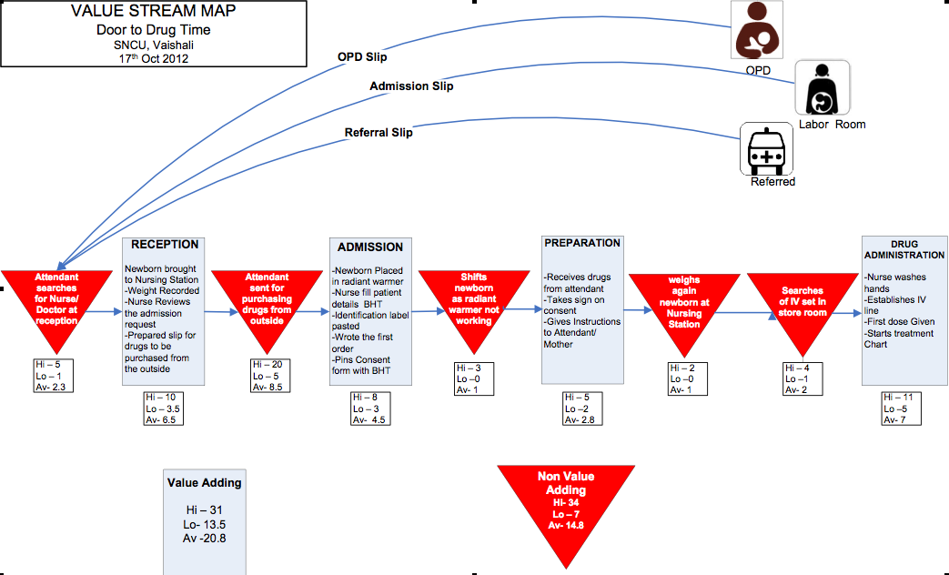
Value Stream Map

Slide 32
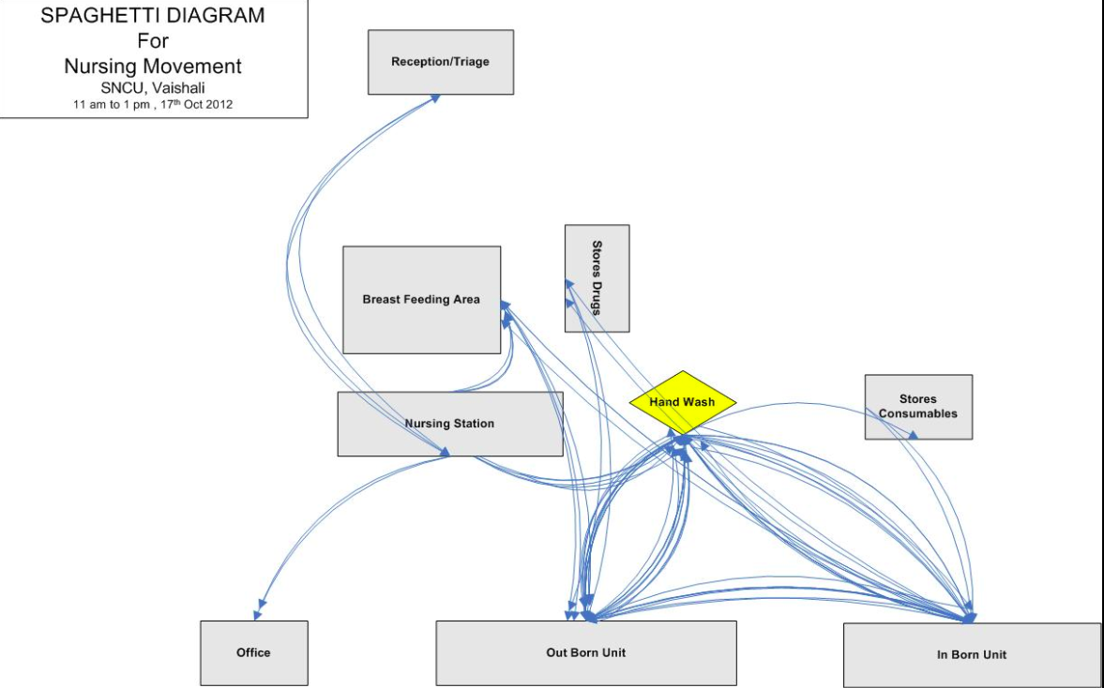
Movement of Nursing Staff

Slide 33
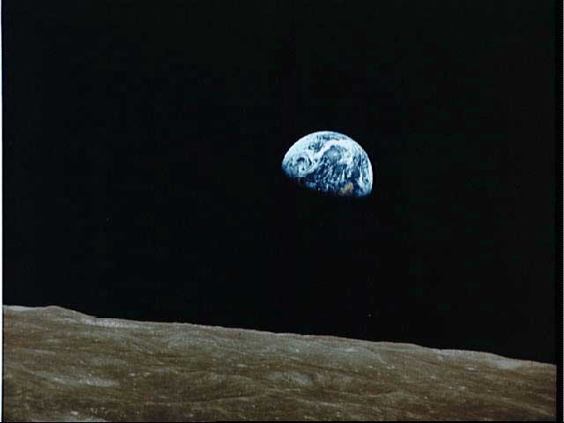
What gets Measured
Gets Focused
What gets Focused
Gets Improved
What gets improved
Gets Appreciated
What gets Appreciated
Gets Institutionalized
" If the world were perfect,
it wouldn't be”
  Yogi Berra
Thank You

