Slide 1
REVIEWs & AUDITs
ISO 15189: 4.14

Slide 2
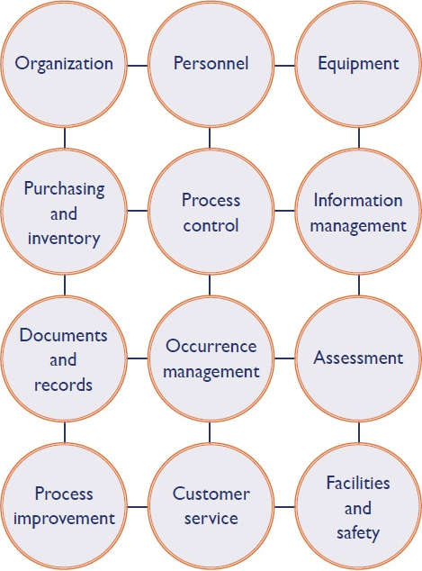

Slide 3
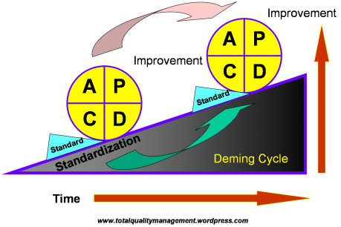

Slide 4
Why Review?
To Prevent:
Inadequate or inappropriate patient care
Repetition of laboratory results
More invasive testing
Inappropriate public health action
Undetected communicable disease outbreaks (in some cases)
Wastage of resources
Increased cost to patients and healthcare systems
Even death of an individual.
.

Slide 5
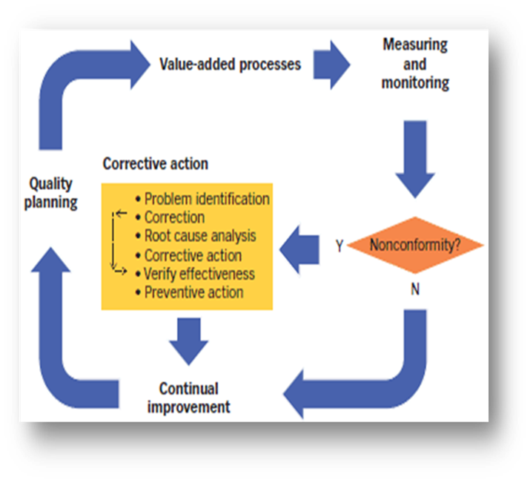
Continual Improvement

Slide 6
METHODS OF REVIEW
Daily/ Periodic Review of Non conformities
Assessment of user feedback and resolution of complaints
Staff suggestions
Risk Assessment
Monitoring of Quality Indicators
Internal Audits
Review by external organization
Management Review Meeting

Slide 7
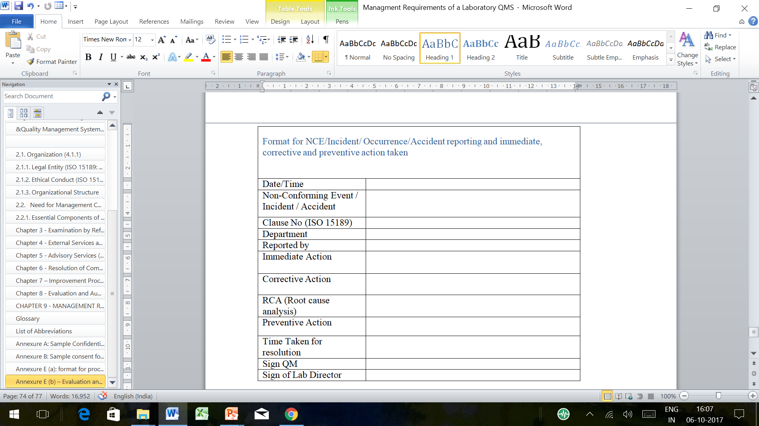
Capturing Non-Conformances routinely

Slide 8
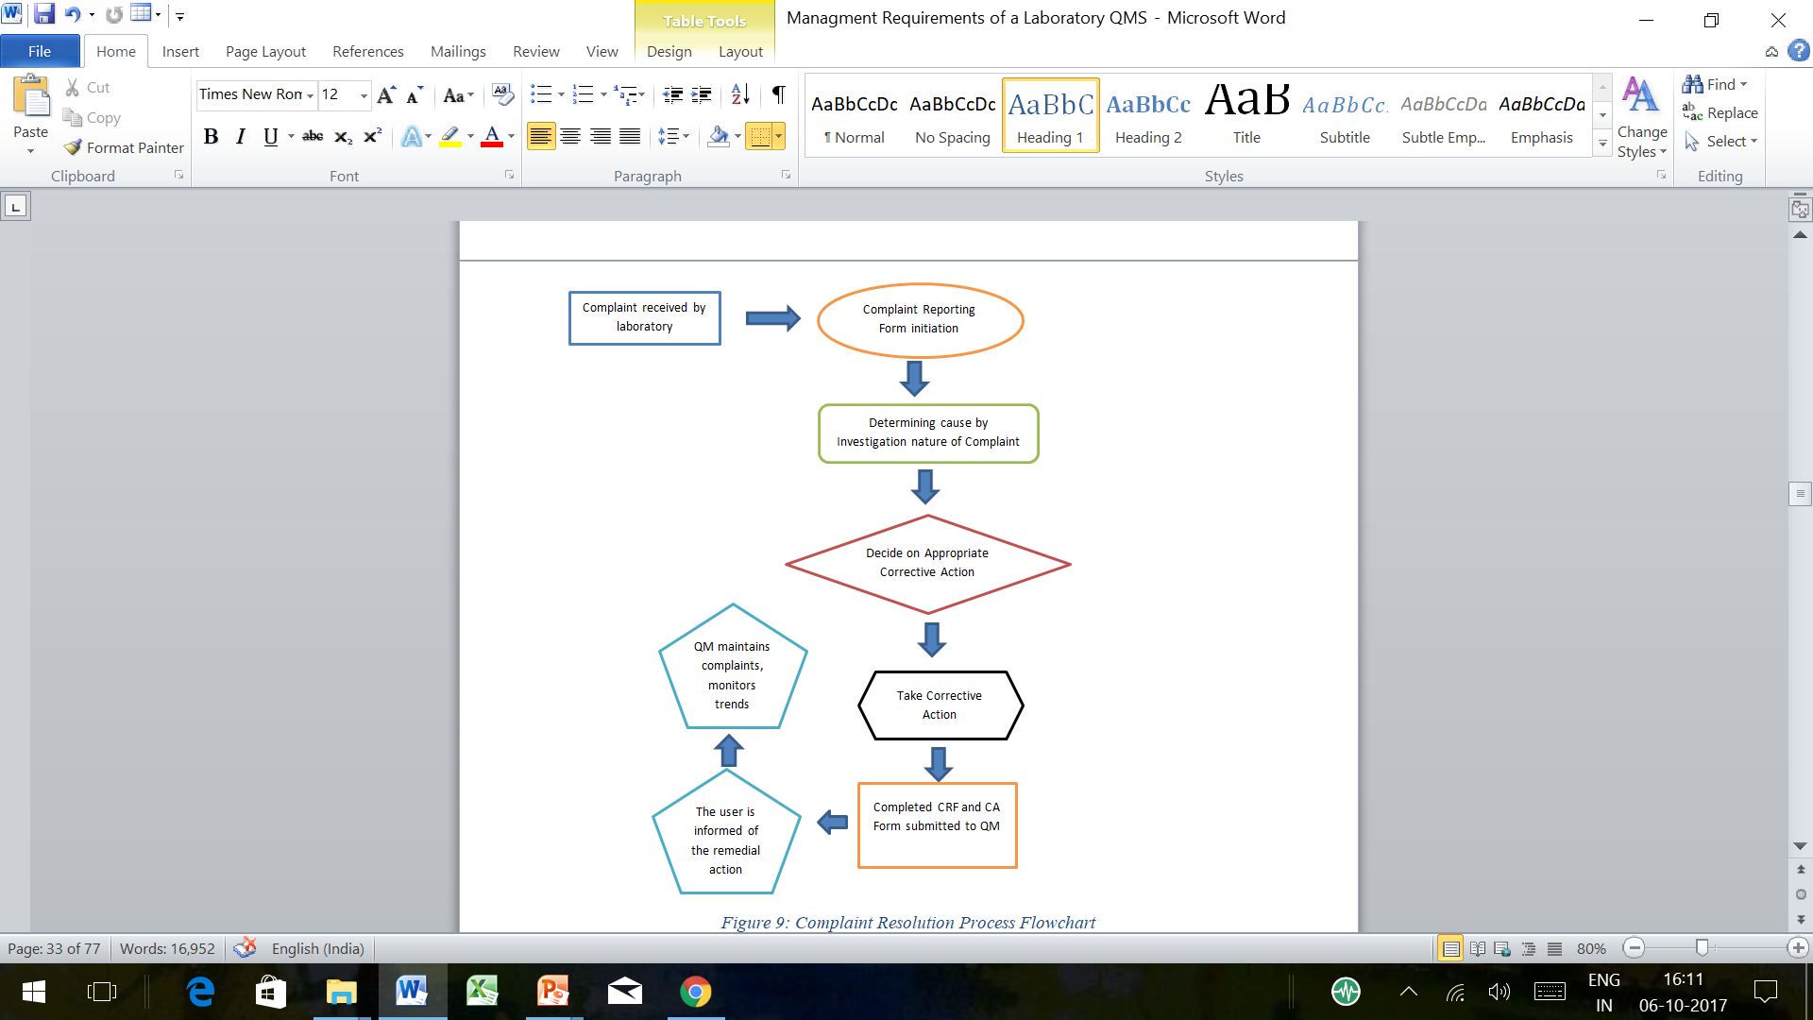
User Feedback and Complaints

Slide 9
Staff suggestions
Important for the review of an organization/institute which leads to improvement in QMS; which is inevitable
Generally taken through monthly meetings and reviewed by the head of the institution
Part of continuous quality improvement (CQI)
Comprises type of an internal audit
Improve Employee Morale
Increase Job Satisfaction
Create Ownership & Engagement
Build Team Spirit
Increase Profitability

Slide 10
RISK MANAGEMENT
Risk assessment is identifying potential failure modes, determining severity of consequences, identifying existing controls, determining probabilities of occurrence and detection, and evaluating risks to identify essential control points.
identifying the risk and its impact,
developing and establishing risk handling plans
monitoring for risk control.
It helps in preventing errors and clinical hazards.

Slide 11
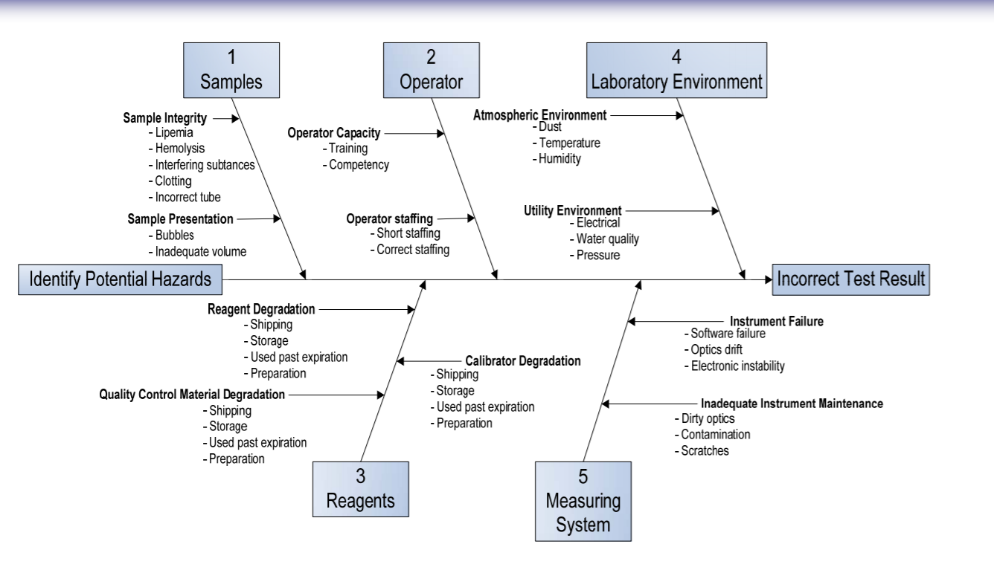
Assessing risk for wrong reports

Slide 12
Monitoring of Quality Indicators
Better for the monitoring of progress in lab
Link to factors needed for success
Based on customer and stakeholder needs
Change with changing environment and strategy
Have targets or goals based on need rather than
arbitrary values

Slide 13
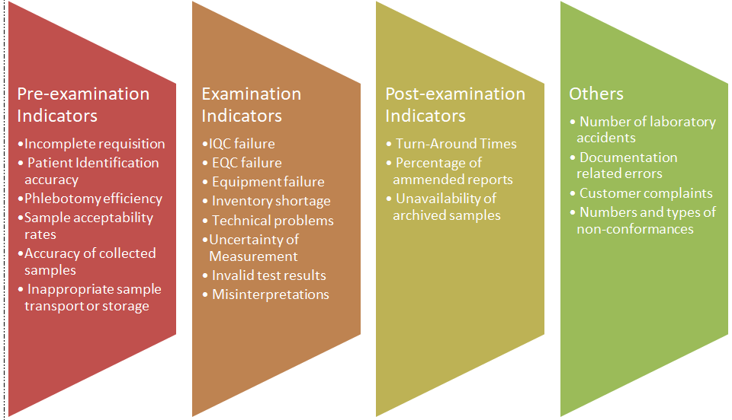
Quality indicators: examples

Slide 14
Audits: to understand Conformance with requirements
The ISO definition for audit is a “systematic, independent and documented process for obtaining evidence and evaluating it objectively to determine the extent to which required criteria are fulfilled.”
To look at your own processes, aims to improve the process and mainly passed on PDCA (Deming Cycle- Plan-Do-Check-Act/Adjust)

Slide 15
Types
Based on Auditor
Internal
(Also called first party)
External (Second & Third Parties audit)
Based on Scope
Horizontal
Vertical

Slide 16
Different Types of Audits:
First party audit : The laboratory auditing itself on a regular basis for continual improvement
Second Party Audit: It is an external audit performed by a customer or a contracted organization (e.g. Insurance agencies) on behalf of a customer to ensure meeting of requirements specified in the contract.
Third Party Audit: It is an external audit performed by an audit organization independent of customer-client relationship or certification bodies or regulatory agencies
Internal Audits: Internal quality audits are audits carried-out by the laboratory’s personnel. It may be decided by the Quality Manager.
External Audits: An assessment, by a body commercially and contractually independent of the organization, i.e. suppliers, regulators and customers
Horizontal audit – investigate one activity across all Labs (usually followed in planned internal audits)
Vertical audit - investigates all aspects of a lab activity (usually followed in emergency/incidental audits)
Notes:
like ISO (International Organization for Standardization), NABL (National Accreditation Board for Testing and Calibrating Laboratories), CAP (College of American Pathologists), etc. for certification, accreditation or regulatory purposes.

Slide 17
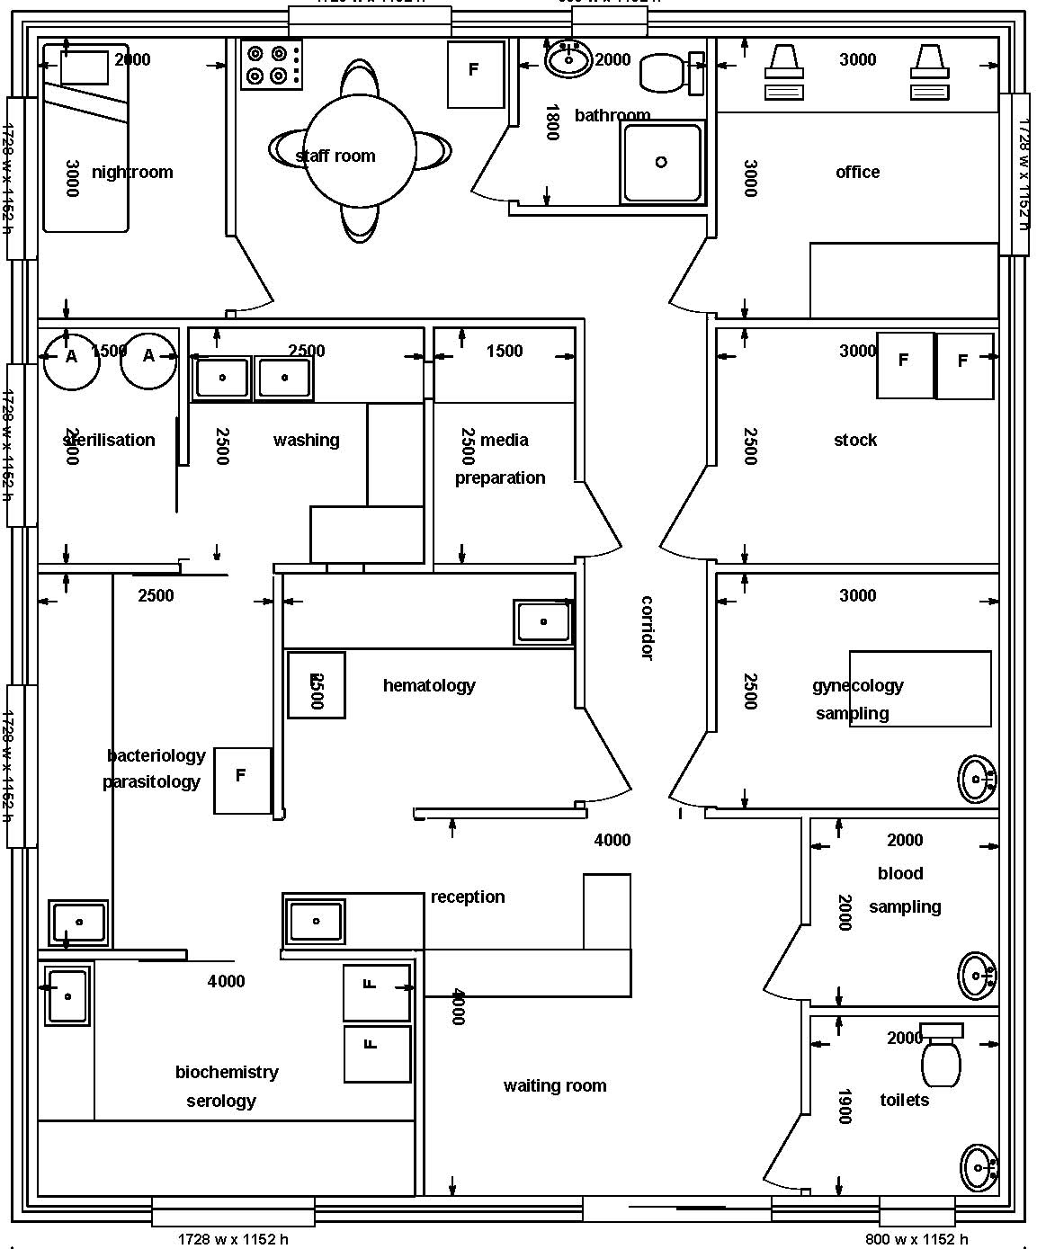
Quality Laboratory
External audit
Infernal audit
Outside group or agency

Slide 18
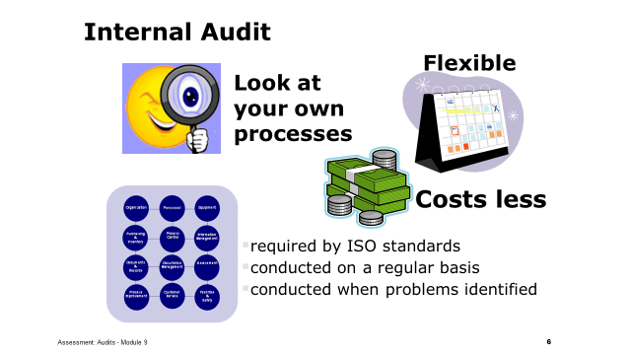
Internal Audit: (ISO 15189: Clause 4.14.5)
Internal audits examine the elements of the quality management system in the laboratory to evaluate how well these elements comply with quality system requirements and assure continual improvement in the quality system. They are also required by ISO 15189.
Note: The purpose of the internal audits is not to search for the guilty, or to find fault with individuals' performance. The system is being audited - not the individuals.

Slide 19
Value of Internal Audits
preparation for external audit
increase awareness
opportunity for improvements
preventive and corrective actions
opportunity for continuing education

Slide 20
What steps will be taken by quality manager to organize an internal audit.
Scope
Schedule
Checklist
MRM

Slide 21



Quality Manager Responsibility
establish and maintain an internal audit system
develop schedule
coordinate the
audit process
manage corrective actions
select trained auditors
internal
audit
outcomes
report to staff
report to management

Slide 22
This audit conducted by External Auditors
Can be a Second party audit or Third party audit
Requires lot of preparation
Usually involves cost
Have a larger implication
Accreditation body
Health authorities
External Auditors
Public health program
Funding
program

Slide 23
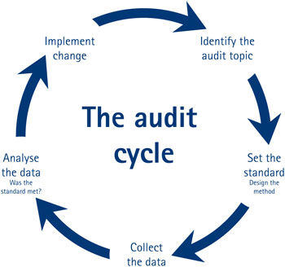
Audit Cycle
Documentation:
The laboratory should retain record of audits including audit programme, records of meetings, audit report, corrective and preventive action taken, follow-up report and verification.
The results of internal audits should be submitted to laboratory management for review.

Slide 24
Management Review Meeting
Management review is a formal meeting of key members of senior management
Purpose is to review status and effectiveness of the quality management system
Meeting provides a venue for management to evaluate and analyze practices for purpose of improvement.

Slide 25
Process of MRM
Step 1: Design and document the process and procedures
Step 2: Prepare a schedule
Step 3: Define the agenda
Step 4: Conduct the meeting
Step 5: Complete follow-up
Step 6: Assess the success
Step 7: Maintain the records
Step 8: Communicate the success

Slide 26

Continuous monitoring is the key element to success in the Quality System

Slide 27
“It isn’t what you find…
it’s what you do
about what you find.”
Philip Crosby

Slide 28
Thanks

