Slide 1
BIAS
Labs for Life Project
Quality CONTROL TRAINING

Slide 2
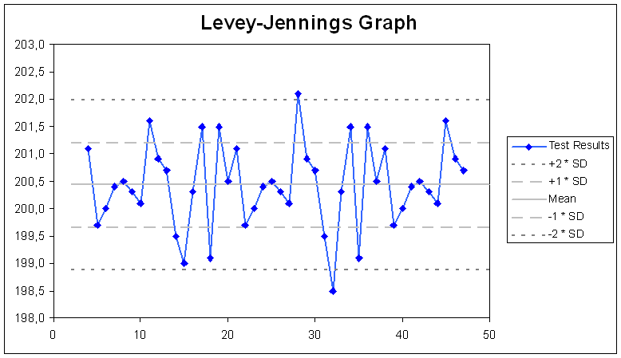
How can we determine if a change is acceptable or not?
Understanding Bias!!!
Monitors and evaluates method performance FULLY
Alerts us to changes in accuracy and precision

Slide 3


RECAP- Definitions of Terms
Accuracy | The closeness of measurements to the true value
Precision | The amount of variation in the measurements
Bias | The difference between the expectation of a test result and an accepted reference value
Reproduced from LQMS Toolkit :Quantitative QC - Module 7
Notes:
3

Slide 4
RECAP - Accuracy and Precision
Inaccurate but Precise
Inaccurate and Imprecise
SD
BIAS
Accurate and Precise

Slide 5
Leads to what errors and how to correct?
Error | Causes? | How do you detect and quantify? | Actions?
Inaccuracy leads to Bias (Systematic Errors) | Remember the causes? | Peer Group EQAS LJ | Easier to detect and correct. Many of the causes are correctable..
Imprecision (Random Errors) | Remember the causes? | LJ | More difficult to detect and eliminate..
Computable if you know the True Value
Notes:
5

Slide 6
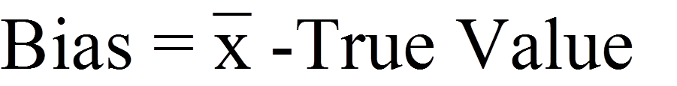
Computing
True Value
Bias

Slide 7
Bias has direction Positive (+) or Negative (-)
CALCULATION
Consistent change in the analytical system
Error in a given direction (negative or positive number)
Observed mean > True value: Bias is +
Observed mean < True value: Bias is -

Slide 8
CALCULATION
Since Total Error (TE) calculations involve the sum of Bias and Imprecision, Bias has to be converted to an absolute number
Positive number
Used in calculations for TE
Absolute Bias % = (Abs Bias /True Value) *100%

Slide 9
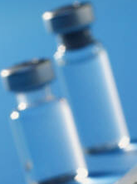
True Value
True Value of the XYZ QC material is 86 umol/L
86 umol/L
90 umol/L
Bias of + 4 umol/L

Slide 10
True Value
True Value of the XYZ QC material is 90 umol/L
86 umol/L
90 umol/L
Bias of - 4 umol/L

Slide 11
But where do you get the True Value from???? What makes it “true”?
Inter-laboratory comparison programs of the QC manufacturer.
Good QC providers give monthly as well as cumulative means.
The cumulative means are robust values and will give very good anchoring of the true value
Manufacturer assigned mean
Long term lab mean
Provided the QC lot has been running for a considerable duration

Slide 12
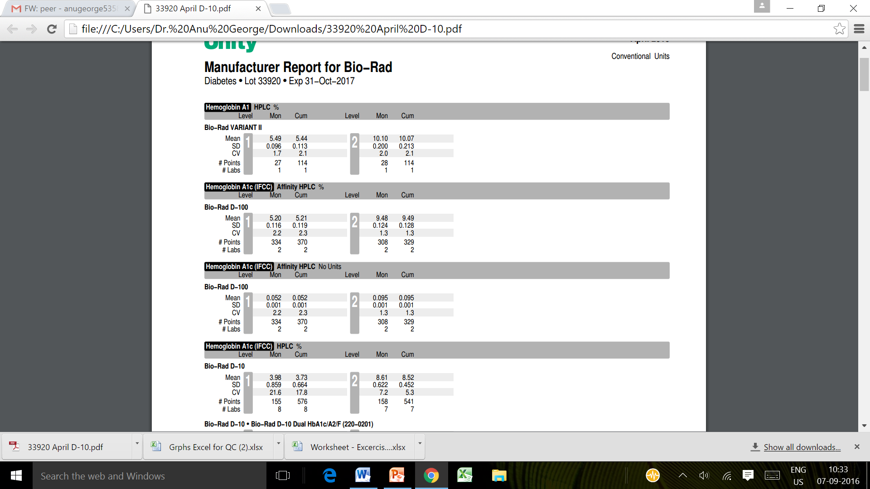
A Peer Group Report

Slide 13
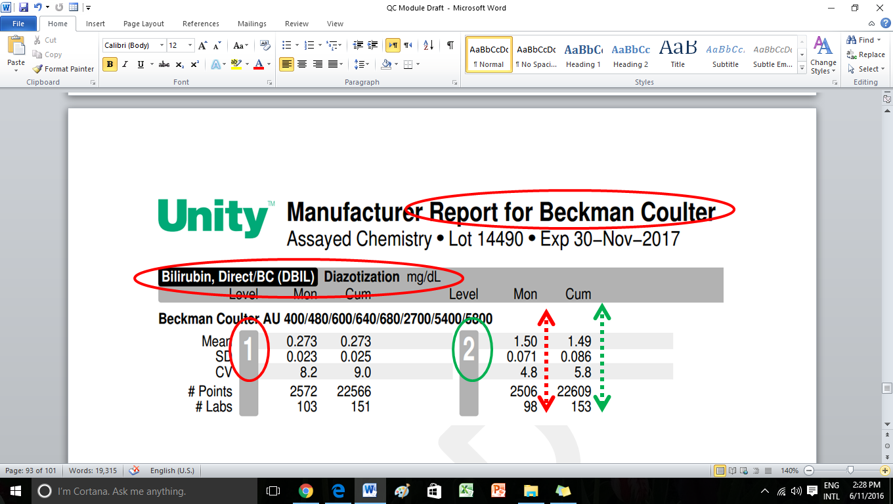
An example of Peer Group

Slide 14

Error | Causes | Actions
Inaccuracy leads to Bias (Systematic Errors) | Remember the causes? | Easier to detect and correct. Many of the causes are correctable..
Imprecision (Random Errors) | Remember the causes? | More difficult to detect and eliminate..
Notes:
14

Slide 15
Detecting Systematic Errors (Bias/ Inaccuracy)
Peer Group Data
EQA
LJ Charts: Shifting Populations, Rules pointing to systematic errors (daily and periodic)
      2:2s
      3:1s
      4:1s
      7T
      6x, 8x, 6 x, 10x, 12 x

Slide 16
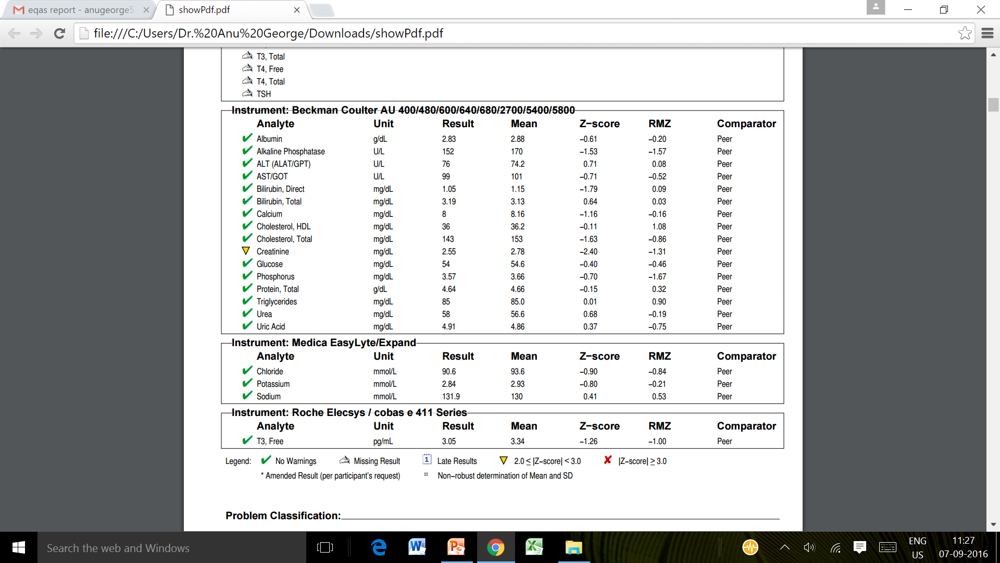
Looking for Bias on EQAS
Z score and RMZ…..

Slide 17
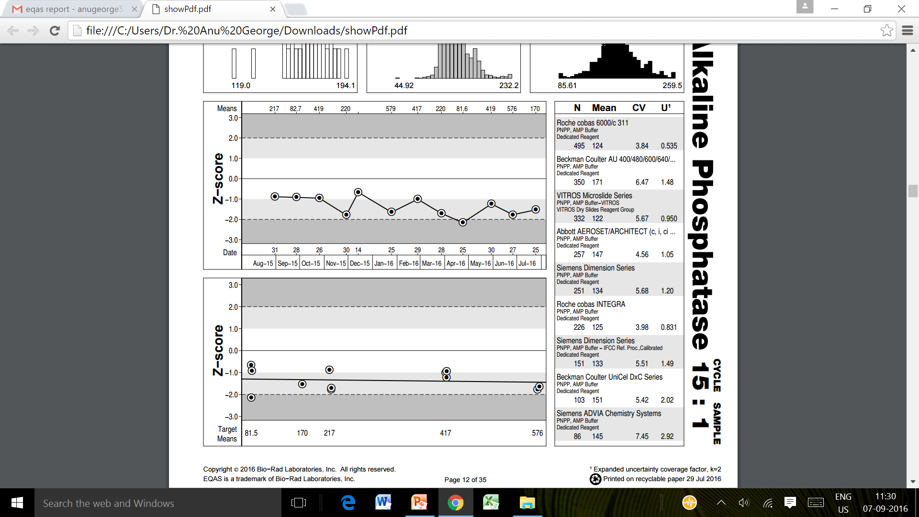
LJ-like graph and Yudnt Plot

Slide 18
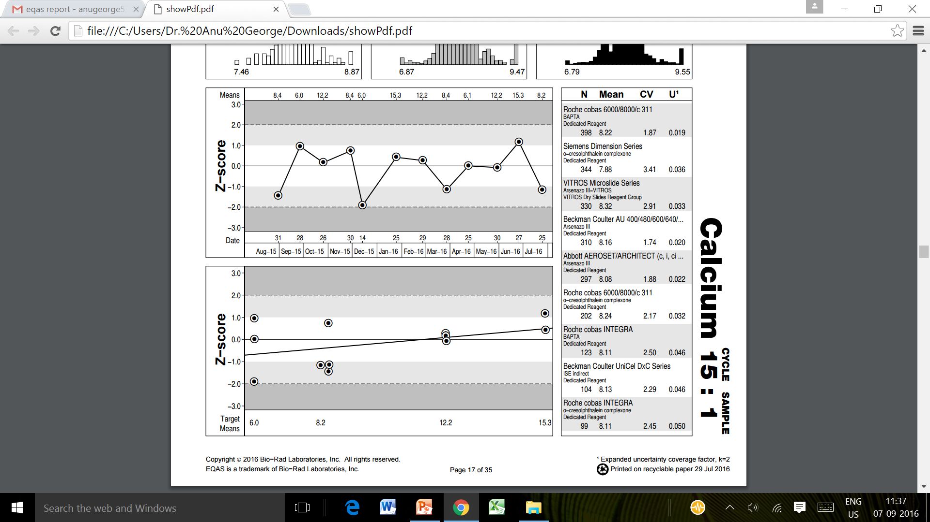
LJ-like graph and Yudnt Plot

Slide 19
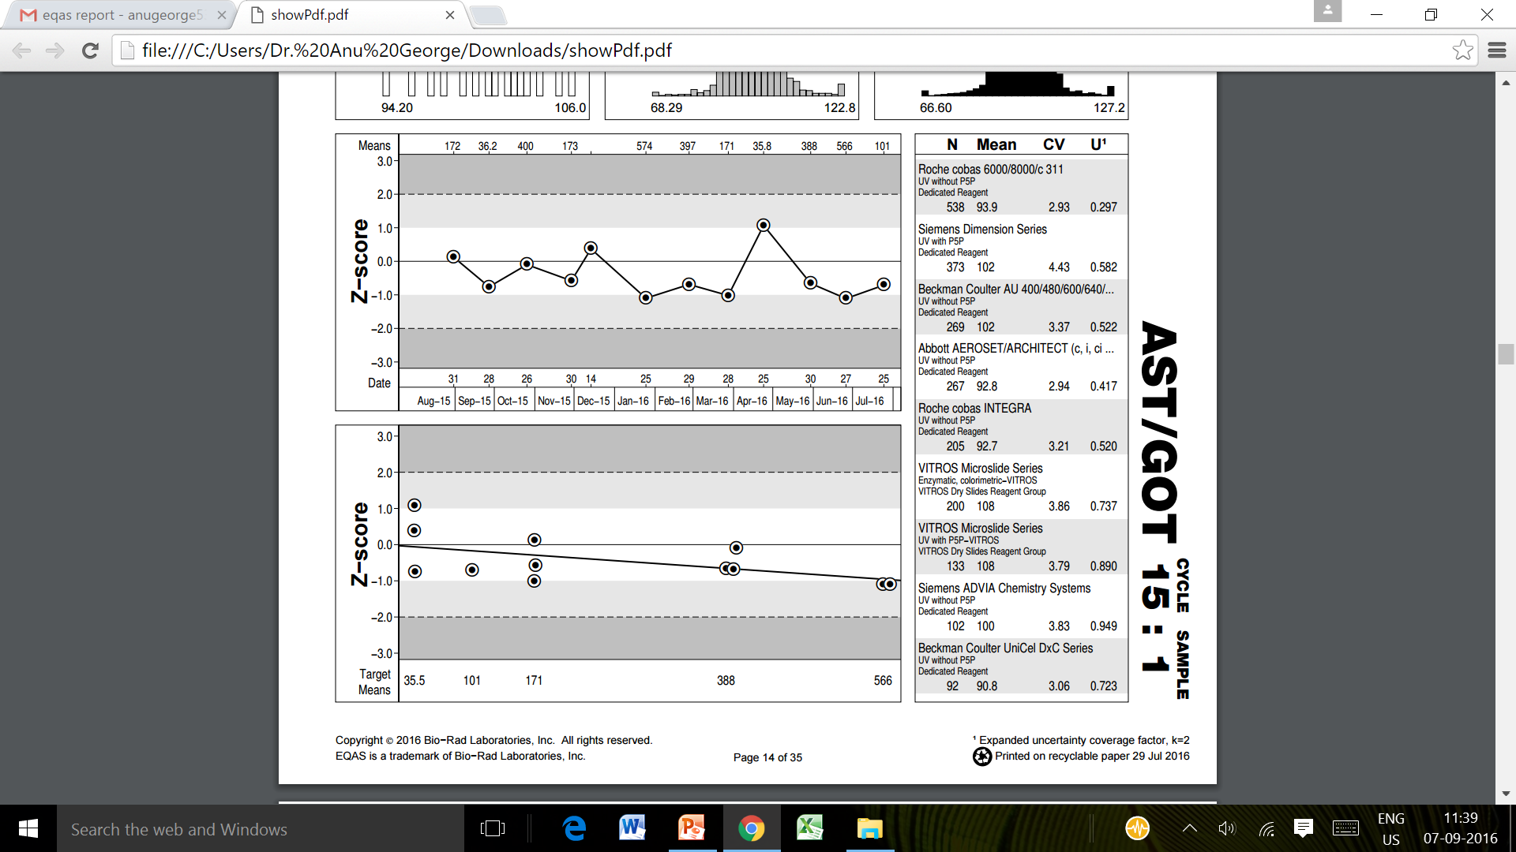
LJ-like graph and Yudnt Plot

Slide 20
Recap: Causes of Systematic errors (Trends and Shifts)
Trend :gradual loss of reliability in the test system
Cause :
Deterioration of the instrument light source
Gradual accumulation of debris in sample /reagent tubing
Aging of reagents
Gradual deterioration of control materials
Gradual deterioration of incubation chamber temperature(enzymes only)
Gradual deterioration of calibration

Slide 21
Action:
Eliminate Causes (1-5 )!!
E.g.Calibrate!!

Slide 22
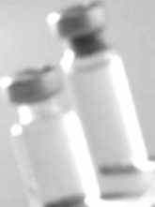
True Value
True Value of the HWD QC material is 110 umol/L
109 umol/L
103 umol/L
110 umol/L
Before Calibration
Bias of - 7 umol/L
After Calibration
Bias of 1 umol/L

Slide 23
?
THANK YOU
True Value

