Slide 1
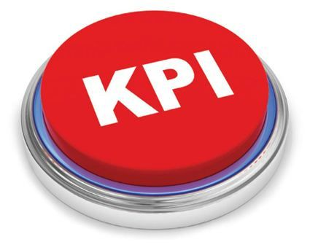
KEY PERFORMANCE INDICATORS (KPI)
OUTCOME

Slide 2
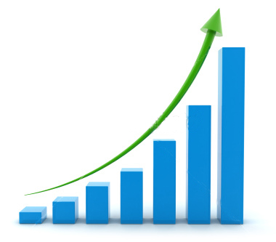
IF YOU CAN’T MEASURE IT
YOU CAN’T IMPROVE IT

Slide 3

KPIs, Dashboards………
KPI is a specific measure of a Organization's (Lab’s) performance in any area of its functioning.
At the facility level: It is a mechanism to understand the bottlenecks and improve
As a bridge: It is a mechanism of transmitting the data from the facility to the higher/highest management
At the management level: enablement of decisions, policies.

Slide 4
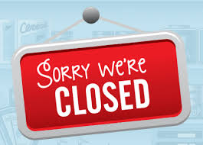

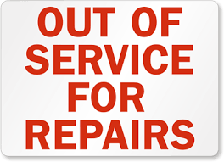
UPTIME and DOWNTIME!!

Slide 5
Examples for KPI in Equipment Management
Downtime: Mandatory (NHM Operational guidelines)
Preventive Maintenance Programs
Calibration Status
Decontamination Programs
Quality Assurance Programs
Availability of Tech Support
Availability of spare parts
Whatever is your bottleneck………..Check the checklist at the end of the module and decide…..

Slide 6
A KPI Dashboard example…..

Slide 7
How to get started?

Slide 8
Daily: Collect data
S. No/ Date/Reported by
Type of NCE/Incident**
Immediate Action
Corrective Action
Preventive Action
Root Cause Analysis
Time taken for resolution

Slide 9
At the end of the month: Calculate % Downtime
Equipment Days: total number of equipment selected (n) x 30 = 30n
Downtime day: One working day when the equipment was down.
% Downtime = Downtime days/Equipment Days x100
To be monitored monthly
*The learner is referred to QI monitoring tool on this site

Slide 10
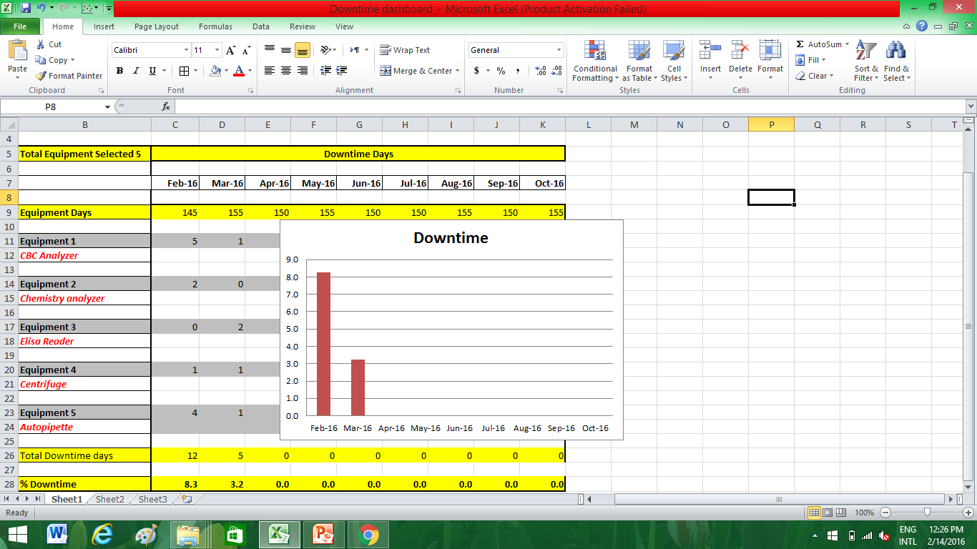
The Monthly Dashboard: An example
Put hyperlink to excel

Slide 11
Thank you

