Slide 1


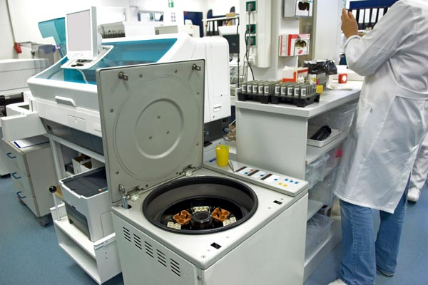



LABS FOR LIFE PROJECT - INDIA
Equipment Management
MoHFW /CDC / BD Partnership Project

Slide 2

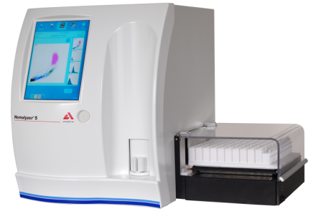
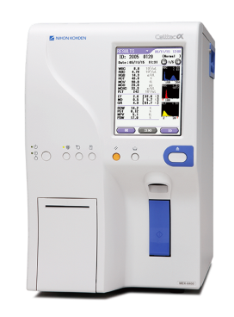
Complete Blood Count Analyzers
These analyzers are used to count the number of different types of red and white blood cells, blood platelets, hemoglobin, and hematocrit levels in a blood sample.
MoHFW /CDC / BD Partnership Project

Slide 3



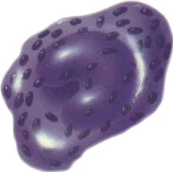
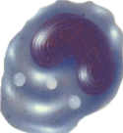
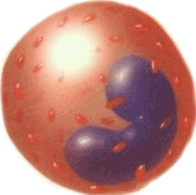
Types of Cell Counters
3-Part Differential Cell Counters
  Provides neutrophils, lymphocytes and mononuclear cell counts
  Unable to distinguish between monocyte, eosinophils, and basophils.
5-Part Differential Cell Counters
  Able to determine granularity, diameter, and inner complexity of blood cells.
  Able to differentiate all 5 population of WBCs
  Some cell counters are able to detect and abnormal cell populations
Erythrocytes
Neutrophils
Lymphocytes
Basophils
Monocytes
Eosinophils
Platelets
MoHFW /CDC / BD Partnership Project

Slide 4
Principle of operation of Cell counter
Impedance Principle:
Cells are non-conductive
Electrical resistance caused by cells is proportional to their volume /size.
Various blood cells could be differentiated based on this principle
MoHFW /CDC / BD Partnership Project

Slide 5
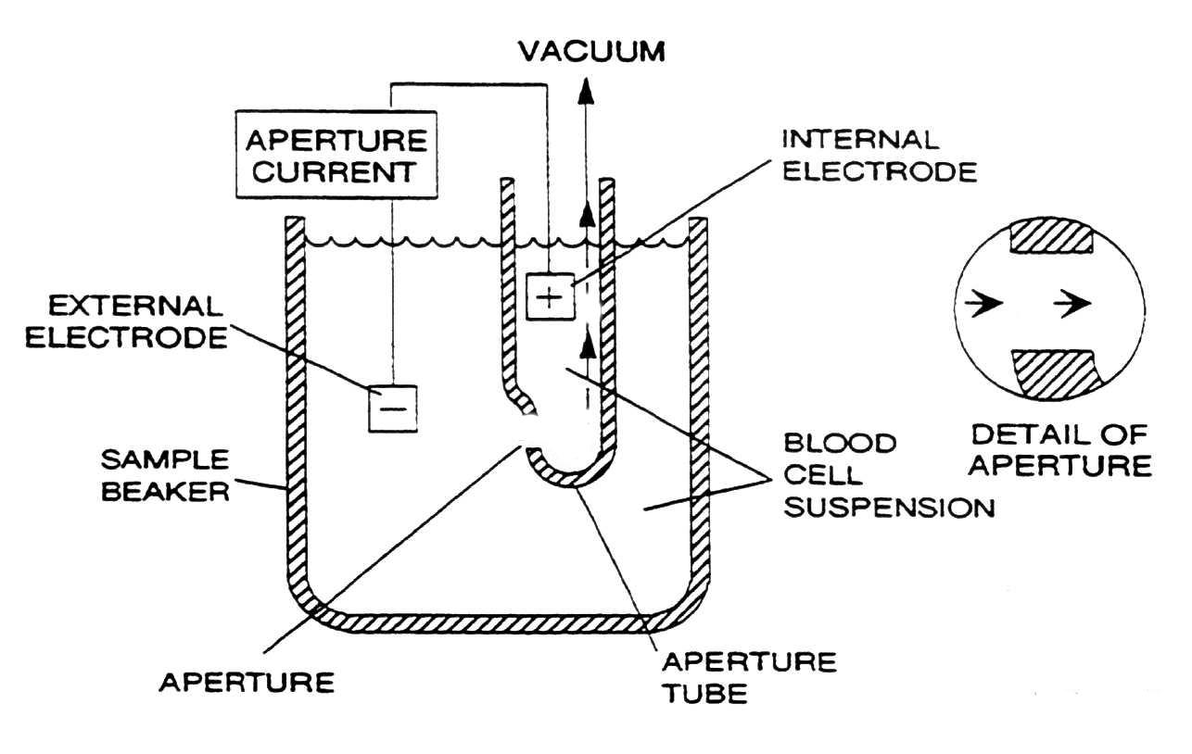
Principle of operation of Cell counter
Diluted blood is passed between two electrodes through an aperture
Impedance changes as a cell passes through is monitored.
A lytic reagent is added to the blood solution to selectively lyse the red cells (RBCs) leaving only white cells (WBCs), and platelets intact.
The platelet count is easily separated from the WBC count by the smaller impedance spikes they produce in the detector due to their lower cell volumes
Impedance principle is used for CBCs and three-part WBC differentials
MoHFW /CDC / BD Partnership Project

Slide 6

A red cell passes through RBC aperture
The Impedance principle
Red Blood Cell
Sensing Zone
Oscilloscope
Oscilloscope

Slide 7
A red cell passes through RBC aperture
The Impedance principle
Red Blood Cell
Sensing Zone
Oscilloscope
Oscilloscope

Slide 8


A White cell passes through WBC aperture
The Impedance principle
Neutrophil
Oscilloscope
Sensing Zone
Oscilloscope

Slide 9
A White cell passes through WBC aperture
The Impedance principle
Neutrophil
Oscilloscope
Sensing Zone
Oscilloscope

Slide 10
A White cell passes through WBC aperture
The Impedance principle
Neutrophil
Oscilloscope
Sensing Zone
Oscilloscope

Slide 11
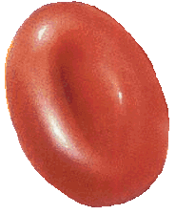

Applying Thresholds to separate Plt from RBC
20 fl
2 fl
Base line
Platelets
RBC of various
sizes

Slide 12

3-Part Differential Histogrm
Lymphocyte
Monocyte
Granulocyte
256 channel high resolution WBC histogram
display cell population data between 35 and 450 fl

Slide 13
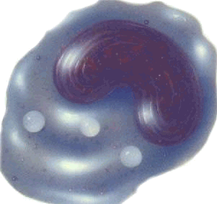
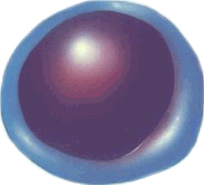
Coulter WBC histogram
Monocytes
Lymphocytes
Neutrophils
Basophils
Eosinophils

Slide 14
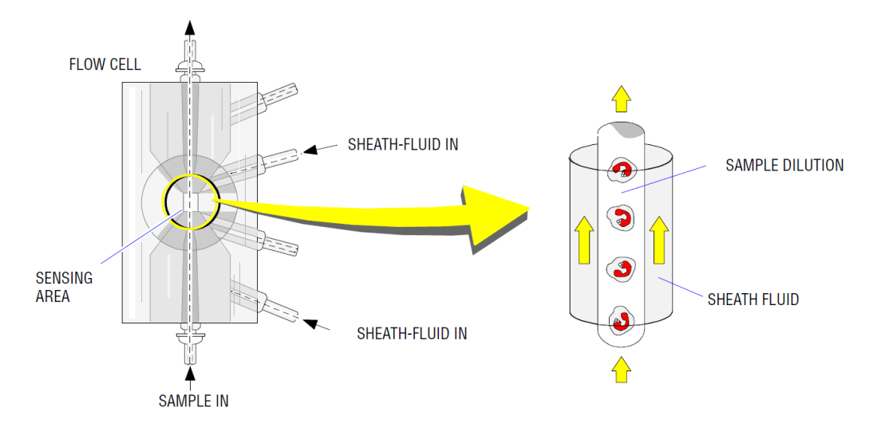
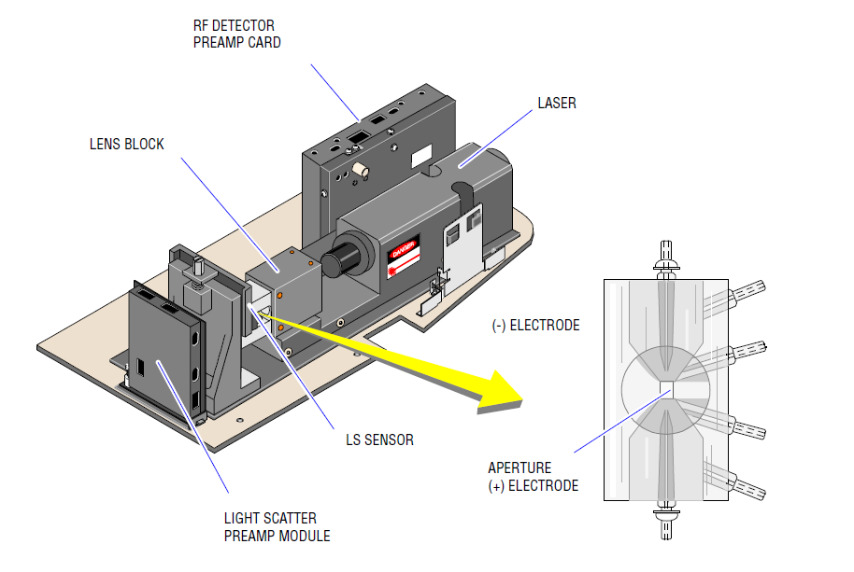
Principle of operation of 5-part Differential Counters
Besides using impedance principle, 5-part differential cell counters employ flowcytometric principles
Through hydrodynamic focusing cells are passed through an aperture in single file
Cells are subjected to laser beam which assists in:
  Identifying granularity of the cells
  Identify nuclear structure
Based on size, granularity and nuclear structure, cells are separated in 3-dimentional space
All five types of WBCs are identified based on their typical position in 3-dimentional space
MoHFW /CDC / BD Partnership Project

Slide 15
Hemoglobin Measurement
ADC
Signal
Processor
WBC Bath
HGB Lamp
Derivation
Absorbance= log ₁₀ ( VR / Vs )
Where VR = Reference voltage
  Vs = Sample voltage
HGB Sensor &
PRE-AMP
Sample
MoHFW /CDC / BD Partnership Project

Slide 16
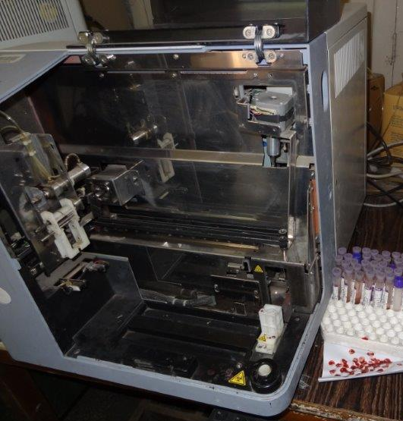
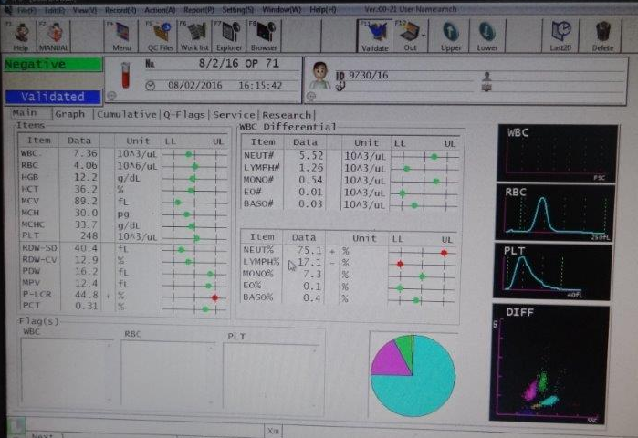
Cell counter – Key components
Tube cap piercer
Typical report
Single Sample port
Tube rack station
MoHFW /CDC / BD Partnership Project

Slide 17
Maintenance of Cell Counters
Follow your manufacturer’s instructions manual for specific maintenance needs of your analyzer – instructions given here are only indicative
Always use PPE while performing maintenance
Keep the cell counter surface and surroundings clean using 10% bleach.
Most of computerized cell counters have computer-controlled maintenance menu. Users must be familiar with these
Inspect the bottom of washing head for salt build up – should be wiped off with a damp cloth or wiper
Check tubing system and look for any liquid leakage. If you experience leakage, contact authorized technician.
Perform daily start-up and shut-down cycles – these cycles are important for auto-cleaning of tubing and apertures and hence in reducing blank values
Check reagent status and change if required
Empty waste container before starting the day
Waste contains human origin substances representing biohazard.
    Neutralization of biohazard waste:
    Put 2 ml per liter of hypochlorite solution into the waste. Close the cap and
    Shake the container., after 1 hour you can dispose of the Waste liquid into the drain.
MoHFW /CDC / BD Partnership Project

Slide 18
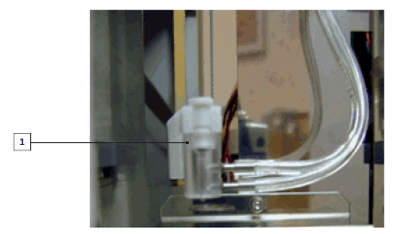
Example of Weekly Maintenance of Cell Counters
Follow your manufacturer’s instructions manual for specific maintenance needs of your analyzer – instructions given here are only indicative
Cleaning of Probe washing head:
  Salt build-up on the lower surface of wash head may cause malfunction during operation leading to carryover between samples.
  Use a soft cloth or wiper dampened with water to clean this area.
Inspect aspiration / dilution syringes for leaks or salt buildup
Clean sample auto-loader station and track
Probe wash head
MoHFW /CDC / BD Partnership Project

Slide 19
Calibration of cell counters
Automated hematology analyzers shall be calibrated using calibrator provided by manufacturer: Controls shall not be used for calibration.
Hematology calibrators have short expiry and very short open vial stability.
Ensure traceability of calibrators to ICSH.
Some 3 part equipment calibrators have a defined Uncertainty of Measurement and give a range for the target.
Calibrators with more accurate values give a single, equipment specific target value.
It is important to ensure adequate equipment performance in terms of precision, background values and carry over values before performing CBC analyzer calibrations.
Both closed and open modes should be calibrated whenever 2 modes are available.
Calibration should be followed by verification QC to verify acceptable performance
MoHFW /CDC / BD Partnership Project

