Slide 1


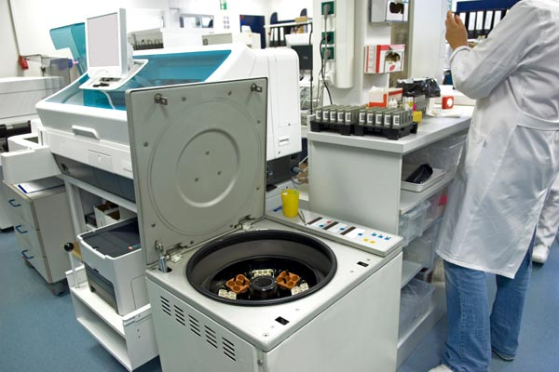



LABS FOR LIFE PROJECT - INDIA
Equipment Management
MoHFW /CDC / BD Partnership Project

Slide 2

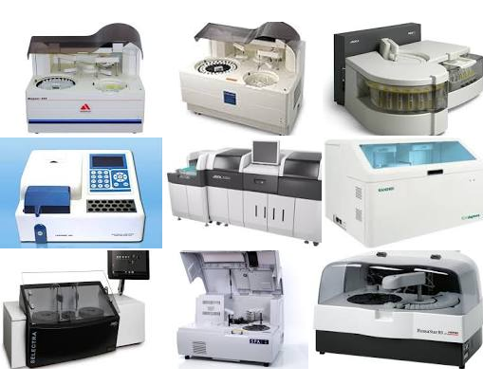
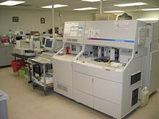
CLINICAL CHEMISTRY ANALYSERS

Slide 3
CLINICAL CHEMISTRY ANALYSERS
Introduction
Chemistry Analyzers are used to determine the concentration of various biochemical analytes, metabolites, enzymes, electrolytes, proteins, and/or drugs in samples of serum, plasma, urine, cerebrospinal fluid, and/or other body fluids.

Slide 4
CLINICAL CHEMISTRY ANALYSERS
Purpose
In the clinical laboratory, the chemistry analyzer is used to measure various analytes
Glucose, Urea, Creatinine, Cholesterol, Triglycerides etc.
The tests are usually performed as individual tests or panel of tests viz. Liver Function tests, Kidney / Renal Function tests etc.
Various sample types viz. Serum, Plasma, Urine and other body fluids could be used

Slide 5
CLINICAL CHEMISTRY ANALYSERS
Types based on Reagent System
There are two main types of Chemistry analyzers
Dry chemistry analyzers using sample-impregnated dipsticks onto which chemical reactions are detected. These analyzers employ reflectance photometry principle
Wet chemistry analyzers
It is called wet chemistry since most analyzing is done using liquid reagents.
Specimen and reagents are pipetted into reaction cuvettes where reaction takes place. The analyzer uses colorimetric / spectrophotometric principle to measure the concentration of analytes.

Slide 6
DRY CHEMISTRY ANALYSERS
Principle
Dry chemistry analyzers are based on reflectance photometric principle.
Reflectance photometry quantifies the intensity of a chemical or biochemical reaction generating color on a surface (e.g., slide, test strip, dipstick or test patch).
The more analyte in the sample, the more product (color) and the less the light is reflected.
The instrument’s detector measures the reflectance of this colorimetric enzymatic or chemical reaction on the test dipstick or strip and converts it into an electronic signal.
This signal is translated into the corresponding concentration of analyte in the bodily fluid tested and the concentration is then printed and/or shown on a LED digital display.

Slide 7
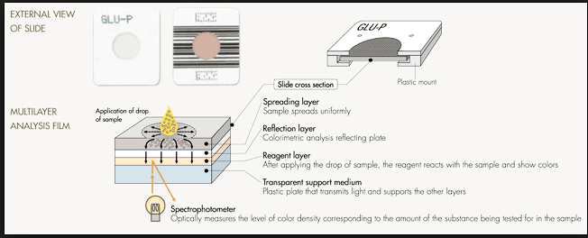
CLINICAL CHEMISTRY ANALYSERS
Dry chemistry analyser

Slide 8
CLINICAL CHEMISTRY ANALYSERS
Principle
The wet chemistry analyzers are based on photometric principle using liquid reagent system.
Wet chemistry analyzers usually use one or several optically clear cuvettes where the photometric readings of reaction mixture is taken.
The wet chemistry analyzers generally use a light source such as a halogen lamp or Xenon Lamp.
Depending on the size and capability of the analyzers, these may use filters, prism or diffraction grating as monochromators.
Typically, Spectrophotometric measurements are performed between 304 and 670 nm
Tests performed on wet chemistry analyzers are based on the production of a colored compound of the analyte with specific reacting reagents.

Slide 9
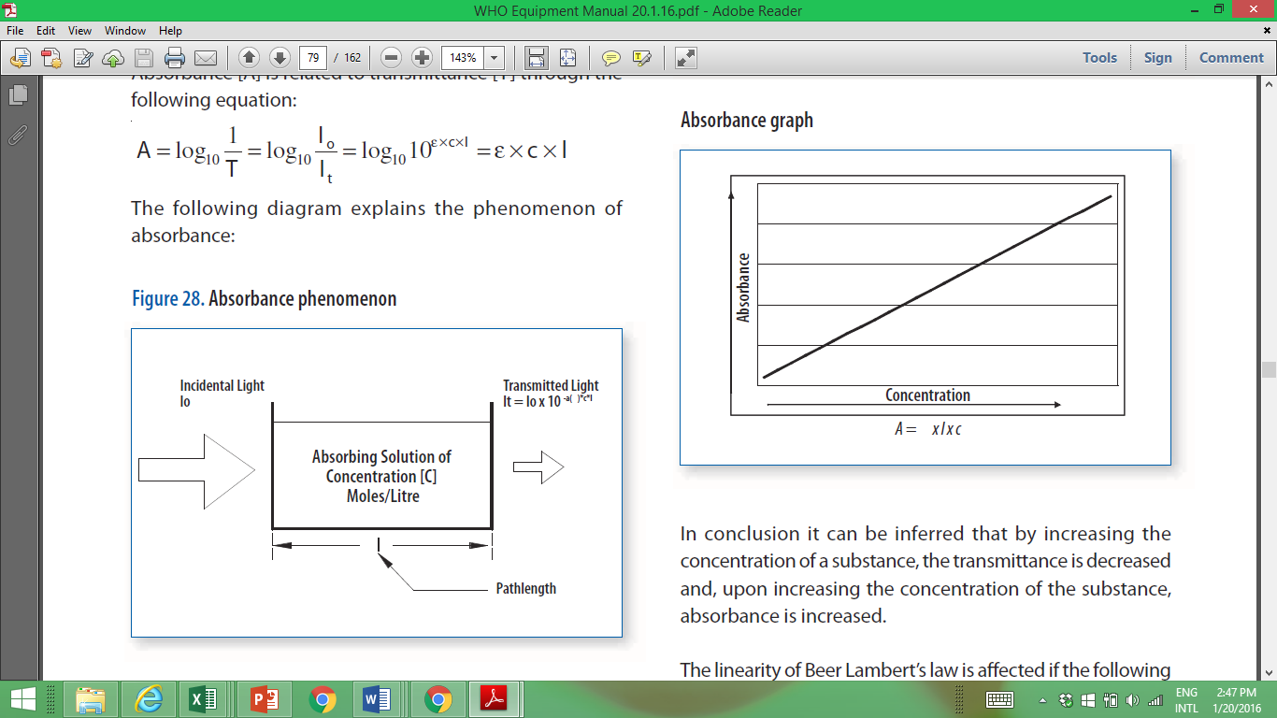
Photometry Principle :
When monochromatic light (light of specific wavelength / color) passes through a solution, there is usually a quantitative relationship between the solute concentration and the intensity of transmitted light.
The amount of light absorbed by the medium (solution) is directly proportional to the concentration of the absorbing material/solute present.
Absorbance vs Concentration Graph

Slide 10
Photometry Principle, Beer’s Law :
A (Absorbance) = ‘e’ x ‘C’ x ‘L’
Where,
A is the absorption of light with no unit.
e is the Molar absorptivity, a constant for a particular substance with units of L mol⁻¹ cm⁻¹
C is the concentration of the compound in solution, expressed in mol L⁻¹.
L is the path length of the sample - that is, the path length of the cuvette with unit of cm.
Based on the relationship of concentration of solute and light absorption using Standard/ Calibrator materials, the concentration of an analyte in an unknown specimen can be calculated.
Absorbance phenomenon

Slide 11
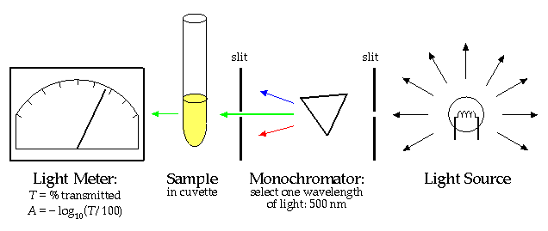
Basic Components of Photometry

Slide 12
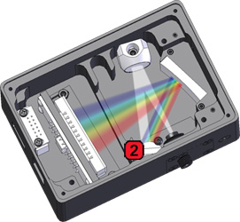
DIFFRACTION GRATING

Slide 13
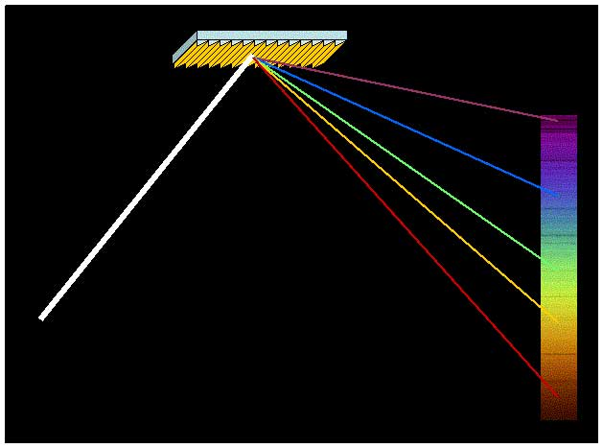
DIFFRACTION GRATING

Slide 14
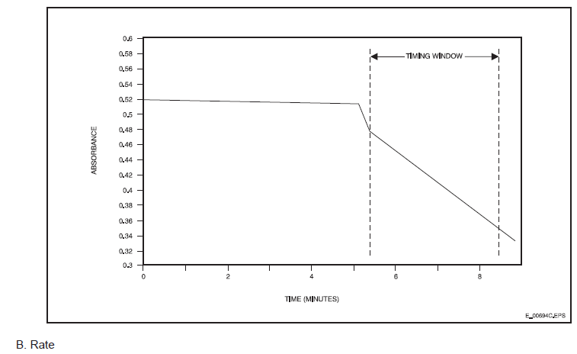
Measurement Modes – Endpoint Mode
End-point Measurements
The analyte reacts with the reagent leading to formation or disappearance of a chromophore.
The change in photometric absorbance from the beginning of reaction (initial reading) and end of reaction (end point reading) is proportional to the analyte concentration

Slide 15
Measurement Modes – Rate Mode
Rate Measurement
The rate of change of photometric absorbance after the mixing of analyte (specimen) and reagent is monitored. In this case the rate is proportional to the concentration of analyte.
Rate measurement could be carried out in two ways:
Two Point: Optical absorbance is measured at two time intervals and the rate of change during this period is calculated
Kinetic: Series of optical absorbance readings are taken over a period of several seconds. The plotted rate of change of optical absorbance is proportional to the concentration of analyte.

Slide 16
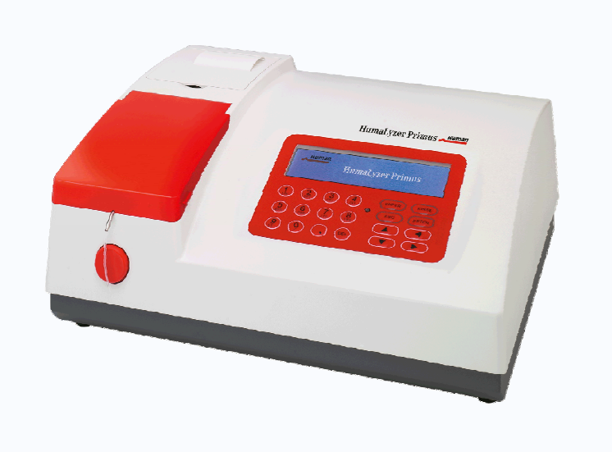
Semi-automated Chemistry Analyzers
Semi-automated Analyzers:
The semi-automated analyzer is composed of:
Optical system
A sipper system
Computer control system
Software
Specimen and reagent aspiration, mixing and in case of endpoint tests, reaction is carried out outside the analyzer (in test tubes)
Report Printer
Display
Sipper
Aspiration Key
Key board interface

Slide 17
Maintenance – Semi-automated analyzers
Please follow manufacturer’s instructions for the maintenance requirement for analyzer installed in your facility.
Usual daily Maintenance:
  Keep the instrument’s working environment clean.
  The surface of the instrument may be cleaned using a neutral cleaner and a wet cloth.
  Use only a soft cloth to clean the liquid crystal display.
  Check the exterior of flow cell for any leakage / salt buildup
  Clean the flow cell if required following manufacturer’s instructions
Usual Six-monthly Maintenance:
  Adjust peristaltic pump tubing
As required Maintenance:
  Changing of fuse
  Changing of aspiration tube of sipper

Slide 18
Troubleshooting – Semi-automated analyzers
Please follow manufacturer’s instructions for specific troubleshooting procedure for analyzer installed in your facility. Table given below is just an example
Problem | Solution
Analyzer can’t start | Check whether the instrument is switched on. Check whether the power plug is loose. Check the fuse. Check the voltage.
The photometer lamp does not shine. | Check the power supply before changing lamps. If the lamp is damaged, replace.
Internal printer does not print. | Check whether the plug is properly connected.
There is no fluid in the flow cell. | Check whether the peristaltic pump is functioning properly. Check the connection of the interfaces for the aspiration tube and flow cell, etc. Aspiration tube is too long or too short. Aspiration tube may be blocked, and should be cleared and purged. Flow cell is very dirty.
There is no reading on the photometer. | Check whether the photometer bulb works properly. Try another reading wavelength. Flow cell is not inserted in the bottom.
The OD value in water blank is too high. | Clean flow cell. Replace distilled water. Check the photometer bulb.

Slide 19
Troubleshooting – Semi-automated analyzers
Please follow manufacturer’s instructions for specific troubleshooting procedure for analyzer installed in your facility. Table given below is just an example
Problem | Solution
The result reproducibility is low. | There are bubbles inside the flow cell, and it needs to be washed. Check the aspiration status of the flow cell. Too little reagent is being used; the dosage needs to be increased. Change the bulb of photometer. The reaction fluid is contaminated. The aspiration tube is inserted relatively deep in the flow cell and pulls it out slightly.
The aspirate flow volume of the flow cell is not constant. | Check whether the aspiration tube is blocked. The peristaltic pump tube may need to be replaced.
Quality control results are not within the target value range. | Check the expiration date of the reagent. Check whether the settings are correct and whether they need to be edited. Ensure the quality control system is not contaminated. Repeat the measurement using other methods. Check the flow in the flow cell, and use another reagent and quality control system to repeat the measurement.

Slide 20
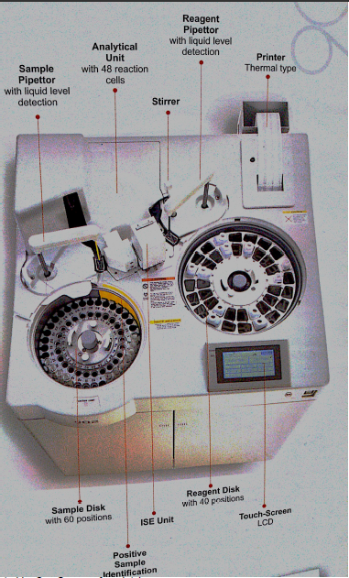
Major Parts of Chemistry Analyzer

Slide 21
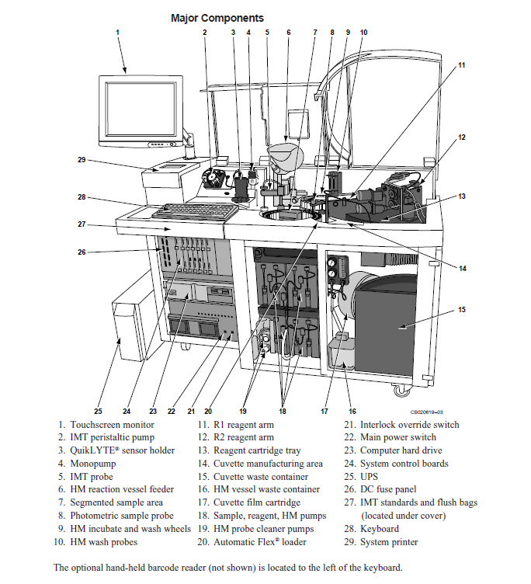
Key parts of Automated Chemistry Analyzer

Slide 22
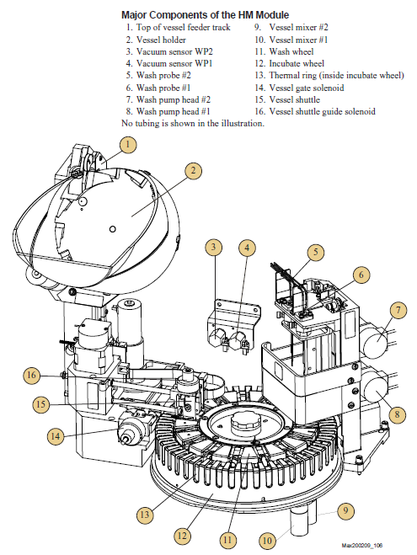
Key parts of Automated Chemistry Analyzer

Slide 23
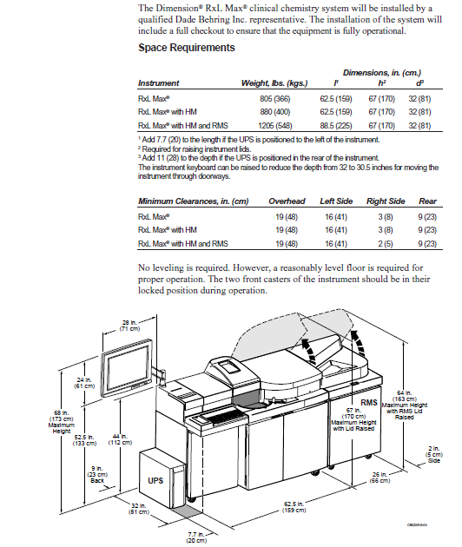
Understanding Installation Requirements
- Space Requirements

Slide 24
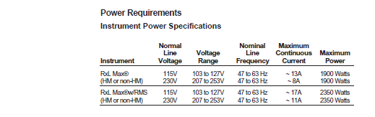
Understanding Installation Requirements
- Power Requirements

Slide 25
Understanding Installation Requirements
- Water Requirements
Water Requirements
Equipment may require an external source of water.
The system that provides this deionized water may need to be connected to the analyzer
Laboratory needs to be aware of the maximum rate of water consumption
Laboratory must be aware of the water quality requirements
Usual Specification
Ionic Purity megohm-cm, 25°C ≥ 10
Microbiological Impurities Colony Forming Units/mL < 10
Organic Impurities ng/gas < 500
Particulate Content μm < 0.22
Dissolved Oxygen ppm 5 to 8

Slide 26
Understanding Installation Requirements
- Room Temperature Requirements
Room Temperature Requirements
Usual room temperature ranges from 17°C and 30°C with a maximum fluctuation of 2.8°C per hour.
Relative humidity needs to be maintained at ≥ 20% and ≤ 80%.
Average thermal output of the instrument (Btu/hr.): (This BTU- British Thermal Unit is required to design Ac for the room.) Higher the BTU, more tonnage of AC required.
RxL Max® 4778
RxL Max® w/HM 4778
RxL Max® w/HM w/RMS 6318 (1540 RMS only)
The system requires 120 minutes (maximum) to warm up to operating temperature from a cold start.

Slide 27
Maintenance
Preventive maintenance
Routine maintenance of chemistry analyzers
Frequency: daily
Any spill on, or around the instrument should be cleaned immediately.
At the end of the day, disconnect the power source by switching off at the wall socket if applicable and removing the plug or disconnecting the battery terminals.
For dry chemistry analyzers: do not leave test strips in the instrument. Regularly clean the window or compartment where test strips are inserted and keep it closed. Use a soft, clean damp swab.
For wet chemistry analyzers: keep the sample chamber empty and closed when not in use.
Cover the instrument after use.
Store appropriately away from dust.

Slide 28
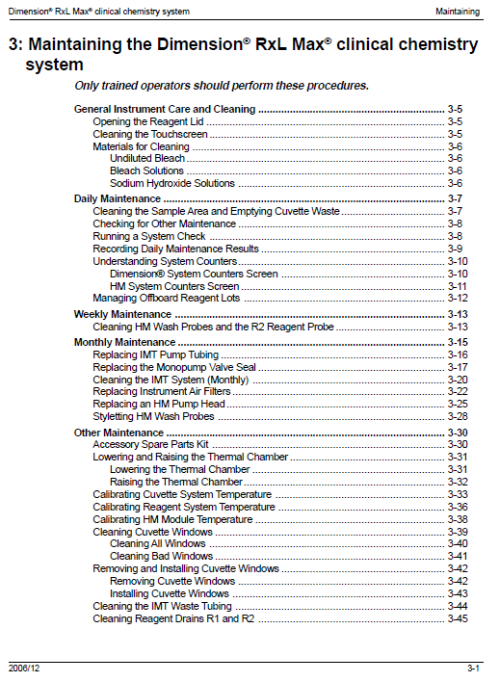
Maintenance

Slide 29
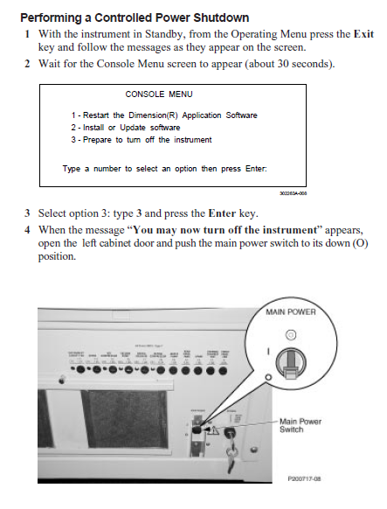
Shutdown
Be aware that the analyzers need to be powered off in a specified way
Please follow manufacturer’s instructions for the shut down procedure to avoid damage to the analyzer

Slide 30
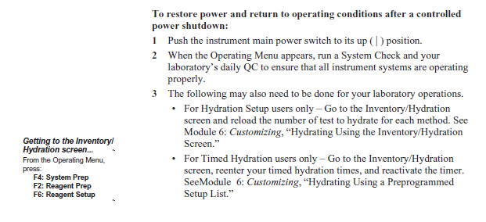
CLINICAL CHEMISTRY ANALYSERS

Slide 31
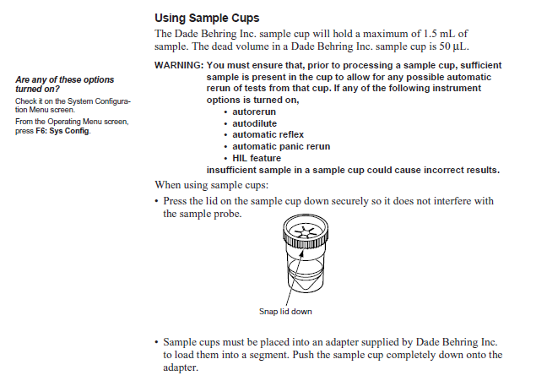
CLINICAL CHEMISTRY ANALYSERS

Slide 32
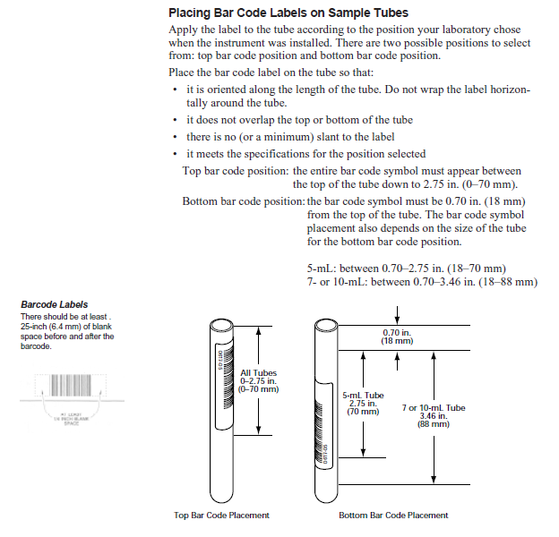
CLINICAL CHEMISTRY ANALYSERS

Slide 33
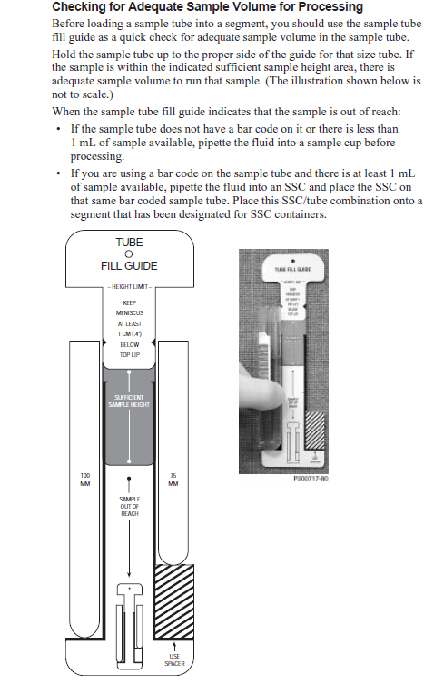
CLINICAL CHEMISTRY ANALYSERS

Slide 34
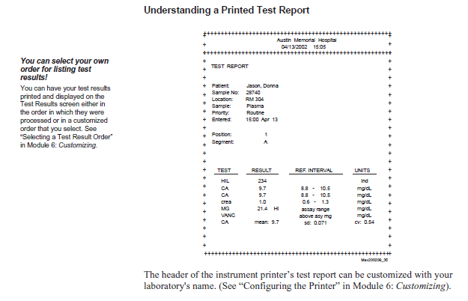
CLINICAL CHEMISTRY ANALYSERS

Slide 35
CLINICAL CHEMISTRY ANALYSERS
Calibration and Verification
Overview
Calibration/verification is performed to maintain the accuracy of the measurement
processes for methods used on the instrument.
You calibrate nonenzyme methods and verify enzyme methods as recommended by the reagent manufacturer
All methods on the instrument are referred to as photometric methods
except Na, K, and Cl, which are processed on the IMT system and
therefore require the IMT system to be calibrated before they can be processed.
Calibrating the IMT system involves calibrating the QuikLYTE®
integrated multisensor.

Slide 36
CLINICAL CHEMISTRY ANALYSERS
RxL Operator Maintenance

Slide 37
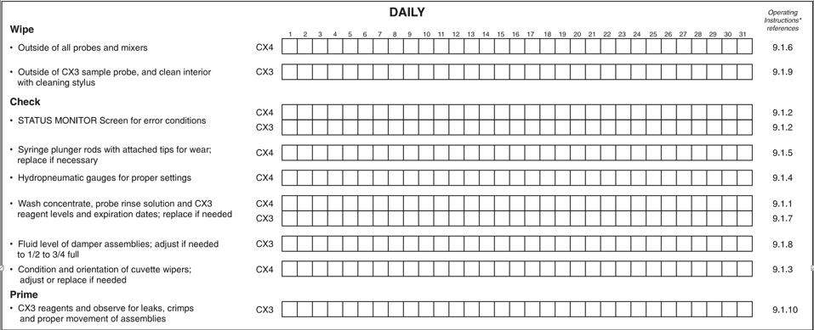
CLINICAL CHEMISTRY ANALYSERS
Preventive maintenance
Routine maintenance of chemistry analysers/LOG

Slide 38
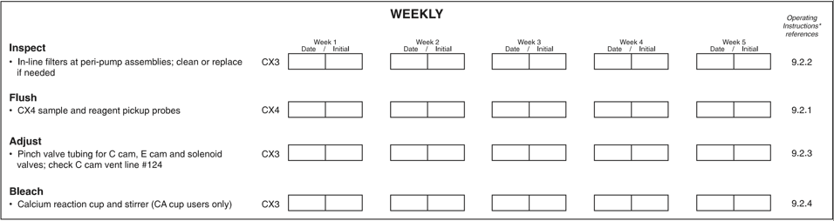
CLINICAL CHEMISTRY ANALYSERS
Preventive maintenance
Routine maintenance of chemistry analysers/LOG

Slide 39
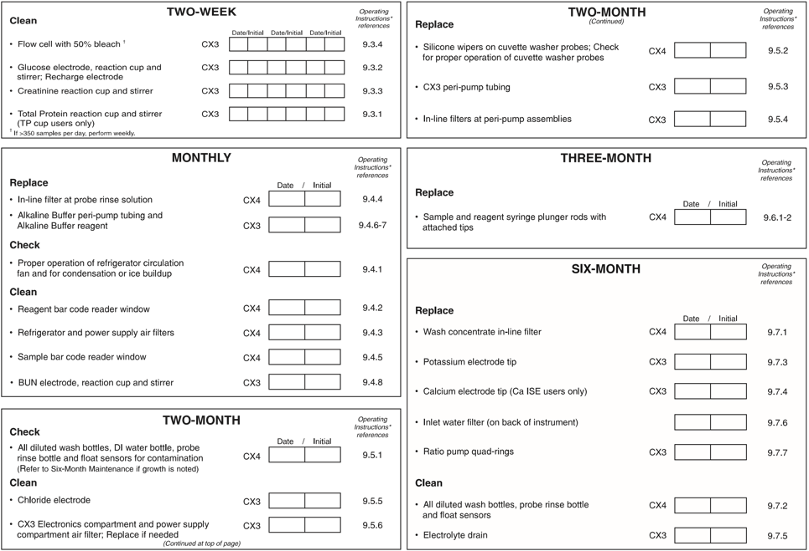
CLINICAL CHEMISTRY ANALYSERS
Preventive maintenance

Slide 40
CLINICAL CHEMISTRY ANALYSERS
Preventive maintenance
Routine maintenance of chemistry analysers/LOG
Frequency: annually
These tests must be performed by an electrician (for instruments using main power), engineer or other trained personnel. Results must be recorded and retained for follow up through time.
Check the installation location for safety of the electrical (for instruments using main power only) and the physical infrastructures.
For instruments using main power:
Check that the voltage is appropriate and does not vary more than 5% from the voltage in the equipment specifications.
Check that the polarity of the outlet is correct.
Check that there is sufficient space around the Instrument for the connecting cables and for adequate ventilation.
Test the integrity of the counter and its cleanliness.
Verify that the instrument is away from equipment generating vibrations and direct solar radiation.
Check that there is no excessive humidity, high temperature or dust.
Ensure that there is no source of smoke, gas or corrosive emissions nearby.

Slide 41
CLINICAL CHEMISTRY ANALYSERS
Preventive maintenance
Non-routine Maintenance and Troubleshooting
These instructions are general guidelines for troubleshooting Chemistry analysers. Since there are numerous models available, always refer to the instruction manual from the manufacturer and follow the steps recommended.
If there is no light passing through the system, or if its Intensity is not constant, change the bulb.
If there is light in the system but no display response,change the photocell.
Always replace blown fuses and bulbs according to the manufacturer’s instructions.
If the equipment is faulty, consult a qualified biomedical engineer.
If the chemistry analyser fails to switch on, check the electric socket outlet. Plug and check the fuse or the battery terminals.
In case of a major breakdown, consult a qualified Biomedical engineer.

Slide 42
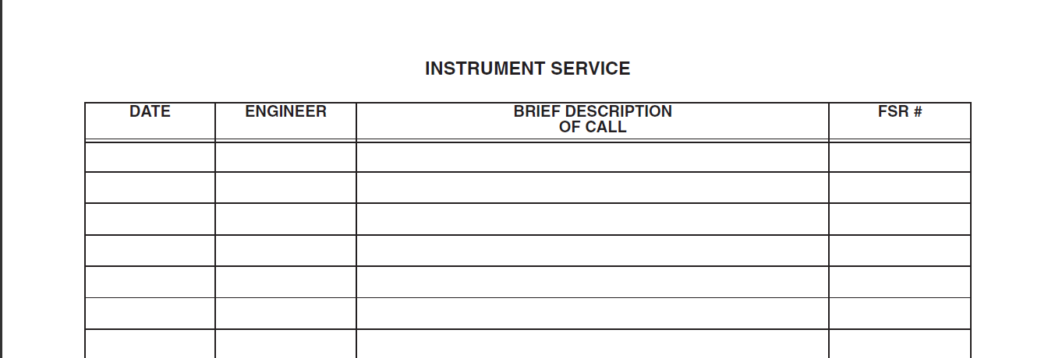
CLINICAL CHEMISTRY ANALYSERS
Non-routine Maintenance and Troubleshooting

Slide 43
CLINICAL CHEMISTRY ANALYSERS
Calibration
Automated Analytical Systems
Automated analyzers: the frequency of calibration at a minimum shall be done as per manufacturer’s guidelines

Slide 44
CLINICAL CHEMISTRY ANALYSERS
Troubleshooting
Basic:
INSTRUMENT DOES NOT POWER ON
  Check if Power is present in the Lab
  Check UPS is ON and output voltage is 230VAC
  Check Instrument is connected to UPS and Instrument Switch is ON
  If problem still persists, call qualified BioMedical Engineer/Log Call with Company.
NO READINGS
  Check Light Source in Instrument is ON
  Check Light Intensity. Replace if needed
  If problem still persists, call qualified BioMedical Engineer/Log Call with Company.

Slide 45
CLINICAL CHEMISTRY ANALYSERS
Troubleshooting
Calibration Error Detection
The analog signals generated by the calibrator measurements are converted into
digital form. The resulting ADC values are compared to the preprogrammed back-to-back, span and range limits to determine the calibration acceptability.
Back-to-Back Test for Precision
Range Test for Accuracy

Slide 46
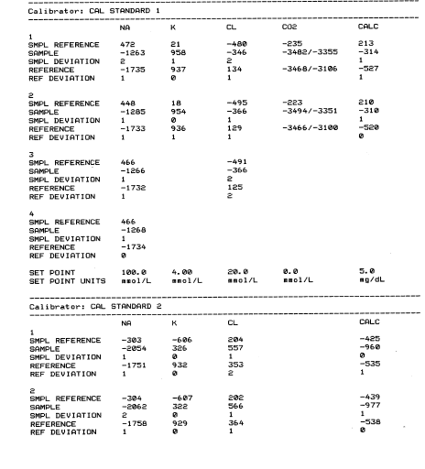
CLINICAL CHEMISTRY ANALYSERS

Slide 47
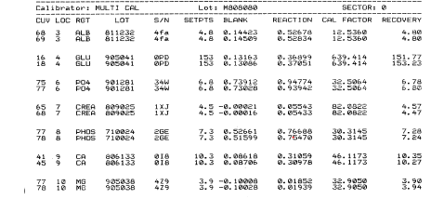
CLINICAL CHEMISTRY ANALYSERS

Slide 48
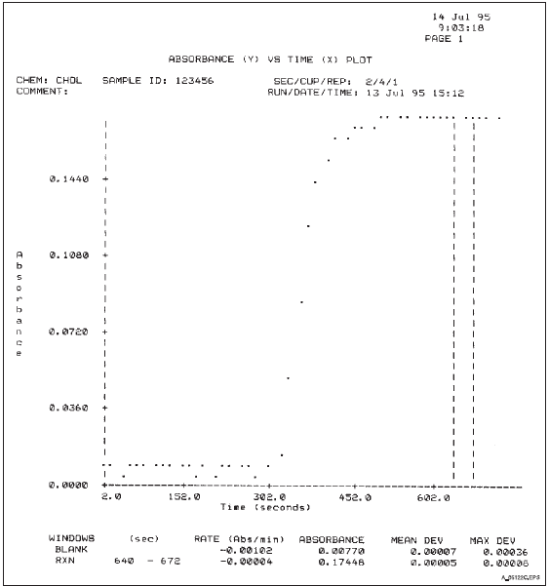
CLINICAL CHEMISTRY ANALYSERS
Troubleshooting

Slide 49
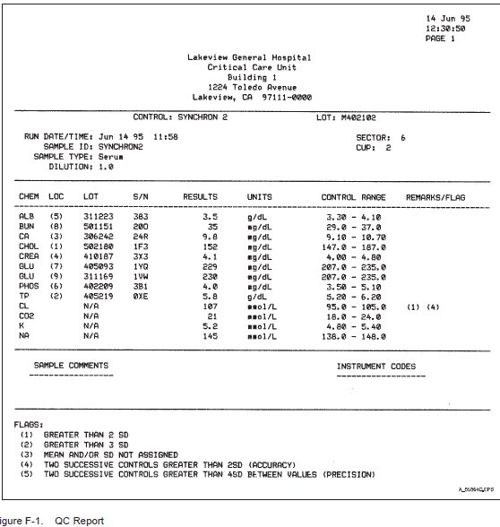
CLINICAL CHEMISTRY ANALYSERS
Troubleshooting- QC Reports

Slide 50
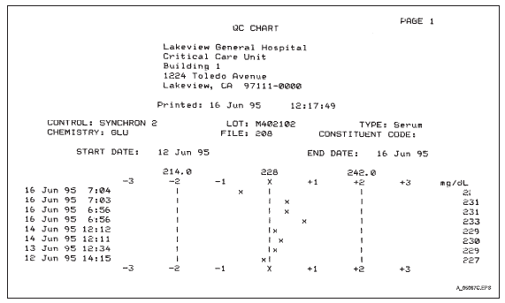
CLINICAL CHEMISTRY ANALYSERS
Troubleshooting- QC Report

