Slide 1
Developing a Safety Program
Dr. Anu George

Slide 2
Basics….
Understand of the components of a good laboratory safety program.
Evaluate your workplace and procedures to list hazards and formulate strategies: Safety Audits/ Risk Assessments
Understand the components required in training sessions
Create hazard awareness in management, technical supervisory and worker levels
Define management, technical supervisory and worker level safety responsibilities.
Evaluate compliance periodically
Plan, Do, Check, Act

Slide 3


Slide 4
Plan
State your hospital’s Safety Policy
Develop Protocols
Develop Safety Manual
Set up a Safety Committee
Define Roles & Responsibilities

Slide 5
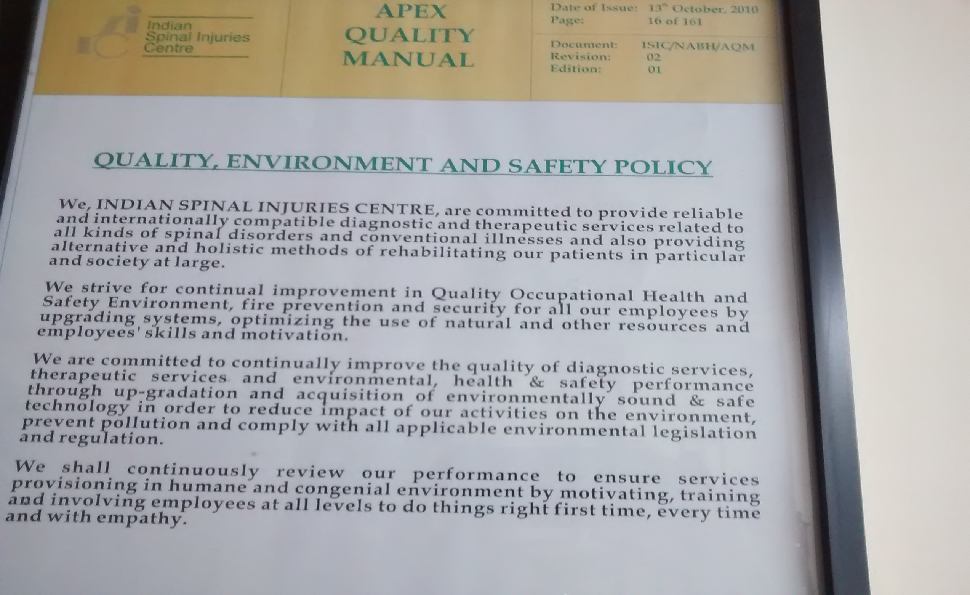
An example….

Slide 6
Do
Training
Facilitate Administrative Inputs
Setting and monitoring Quality Indicators
Implementing the Plans and Protocols in all aspects, in all departments
Facilitate reporting
Investigate Accidents
Facilitate Emergency Response

Slide 7
Check
Safety Audits
May use the checklist at the end of the Module / the ISO 15190 Checklist/ Make your own
Risk Assessments

Slide 8
Act
Management Reviews
Discussion with District and State Authorities
Review Program at fixed intervals

Slide 9
Repeat: The Key Words
Policies
Roles and Responsibilities
Administrative Requirements
Training and Orientation
Audits and Assessments
Accident Investigations
First Aid / Emergencies
Program Review

Slide 10
Statistics Speak…..
40 -70% of all safety violations go unreported
37.6% of Hepatitis B, 39% of Hepatitis C and 4.4% of HIV AIDS in HCW are due to needle stick injuries

Slide 11
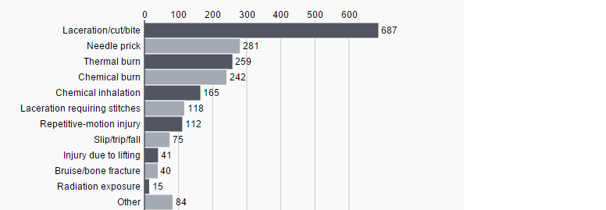
Lab Injuries, Some international Statistics

Slide 12
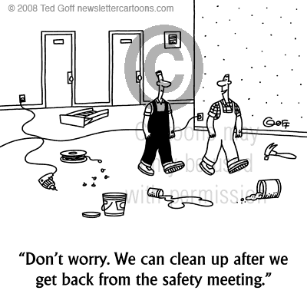
Procrastination?? No

Slide 13


Slide 14


Slide 15
The time is NOW!!

