Slide 1


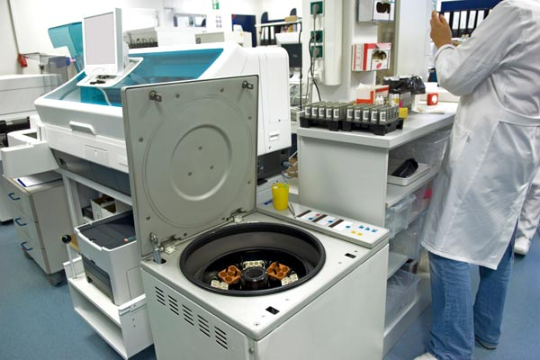



LABS FOR LIFE PROJECT - INDIA
ELISA Reader and Washer
MoHFW /CDC / BD Partnership Project

Slide 2

Analyzers for Immunoassay
Principle/Purpose
Immunoassays are based on antigen antibody reactions.
Immunoassays are used for measurement of hormones, drugs and serological markers etc.
Various immuno-detection markers are used in Immunoassays
  Radioactive – no more used!
  Enzyme Labeled Antibodies
    ELISA (Enzyme-Linked-Immunosorbant-Assay)
  Chemiluminescence
  Fluorescence

Slide 3
Classification and formats of Immunoassays
Immunoassays can be run in a number of different formats.
Generally, an immunoassay will fall into one of several following categories depending on how these are performed.
Sandwich Assays
Competitive Immunoassays
Indirect Assays
Immuno-capture Assays

Slide 4
Sandwich Assay (viz. TSH)
Y
Y
Y
Y
Y
Y
Y
Y
Y
Y
Y
Y
Y
Solid
Phase
Goat
anti-
mouse
IgG
MAb
anti-TSH
+
Sample
containing
TSH
+
Goat
anti-TSH
alk phos
conjugate
36.5°C
Y
Y
Y
Y
Y
Y
Y
Y
Y
Y
Y
Y
Wash
steps

Slide 5
Competitive Assay (viz. T4)
Y
Y
Y
Y
Y
Y
Goat
anti-
mouse
IgG
+
MAb
anti-T4
+
Sample
containing
T4
+
T4
alk phos
conjugate
Y
Y
Y
Y
Y
Y
Wash
steps
37 C
37 C

Slide 6
Indirect Assay (viz. Rub IgG)
Y
Y
Y
Y
Y
Y
Y
Y
PMP
Rubella
virus
+
Sample
containing
IgG
anti-rubella
antibodies
+
MAb
anti-
human IgG
alk phos
conjugate
Y
Y
Wash steps
Y
Y
Y
Y
Y
Y
Y
Y
Y
Wash steps

Slide 7
Two-Step Immuno-capture Assay (viz. Rub IgM)
Y
Y
Y
Y
Y
Y
Y
Y
Y
Y
Y
Y
Y
Y
Y
Y
Y
Y
Y
Y
Y
+
PMP
anti-
human
IgM PAb
+
Sample
containing
Anti-Rubella
IgM
Wash
steps
Rubella Ag-
Anti-Rubella
MAb Alkaline
Phosphatase
Y
Y
Y
Y
Y
Y
Y
Y
Y
Y
Y
Y
Y
Y
Y
Y
Y
Wash
steps
Complexes

Slide 8
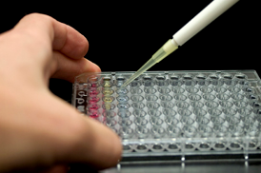
Usual Steps In Immunoassays
Washing to remove unbound materials
Pipetting of
Sample,
Reagents
Promote binding -Incubation
Addition of reagent to create signal
Incubation to promote signal generation
Detection
of
signal
Micro-plate ELISA:
The above-depicted steps are carried out 96 well Micro-plates

Slide 9
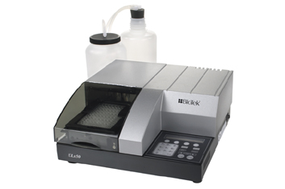
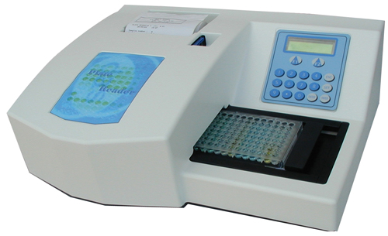
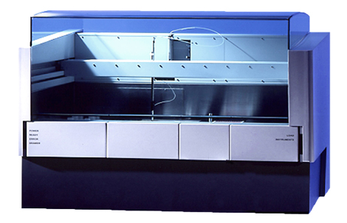
Analyzers used for ELISA Assay
Micro-plate ELISA Reader
Micro-plate ELISA Washer
Automated ELISA Processor

Slide 10
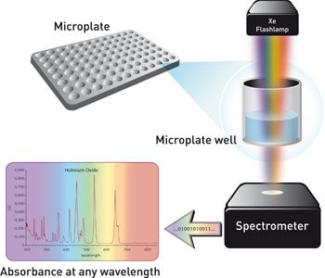
ELISA Readers
Based on Photometric Principle
ELISA readers are special photometric analyzer with following features
  Ability to take photometric readings on individual well in microplate
  The optics (light source and detector) are vertically mounted
Similar to photometer, ELISA readers are microprocessor controlled
Various analyte programs can be pre-programmed in the reader
Calibration, control data can usually stored in on-board memory

Slide 11
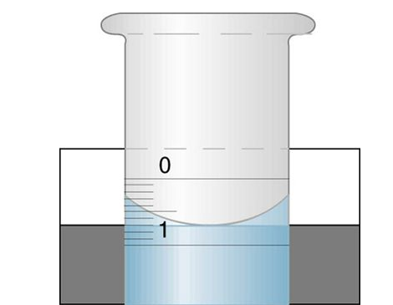
Achieving Maximum Performance of ELISA Readers
Microplate should be clean and free of dust or scratches at the bottom
Accuracy of pipetting has huge impact on results.
The micro-well should have minimum 100ul of liquid for better results
The inclination of the meniscus can cause loss of accuracy, especially with small volumes, agitate the microplate before reading
Maintenance:
ELISA readers require minimal user-maintenance. Routine user-performed maintenance is confined to keeping the microplate carriage area clean of any spillage and dust.
Decontamination is recommended using 0.5% bleach solution

Slide 12
Microplate ELISA Washers
Microplate washing is one of the most critical step in ELISA procedure
Inadequate or non-uniform washing step could lead to major errors in accuracy and precision
The washers are micro-processor controlled and volume of wash, time duration of cycle can be programmed

Slide 13
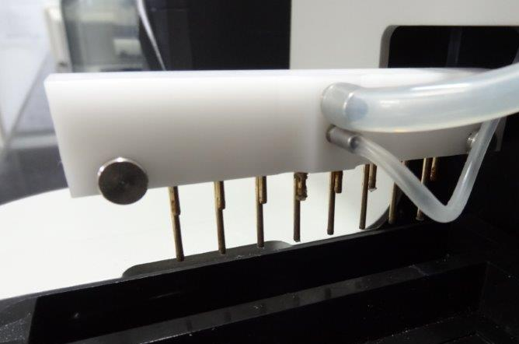
Microplate ELISA Washers
Automated plate washer employs eight pairs of tubes.
  One set for dispensing wash solution
  Other set to aspirate the contents

Slide 14

Preventive Maintenance – micro-plate Washer
General routine maintenance includes Rinsing and soaking the fluid path and cleaning the washer’s various components. Following table suggests usual maintenance schedule
Task | Daily | Overnight | Weekly | Monthly | Prolonged shutdown
Rinse fluidic lines
Empty waste bottle
Clean Bottles
Clean Plate Carrier system
Clean wash manifold
Decontaminate external surfaces

Slide 15
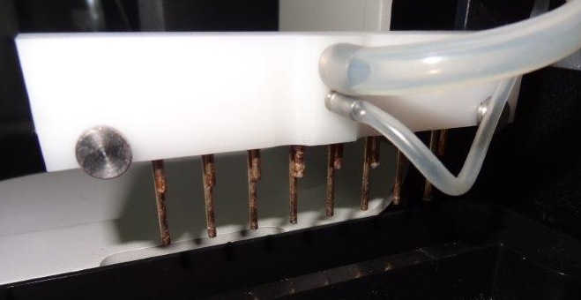
Preventive Maintenance – Cleaning of washer
Cleaning the washer components on a regular basis is critical to keep the washer running efficiently
The recommended frequency for cleaning washer components is at least monthly.
Non-compliance to this may lead to improper washing and contamination and carry over

Slide 16
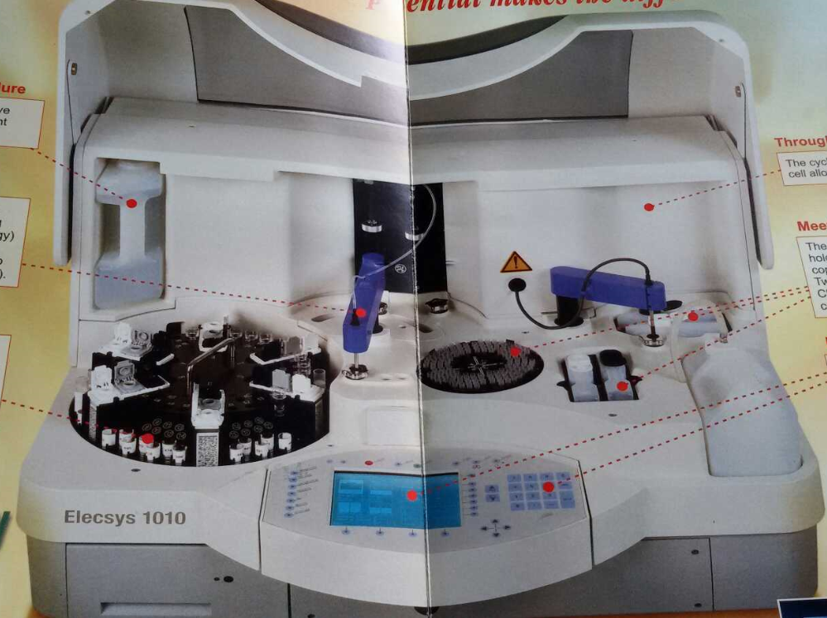
IMMUNOASSAY ANALYSERS - Instrumentation
Major Parts of IMMUNOASSAYAnalyser

Slide 17
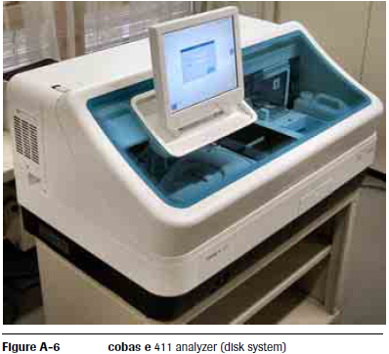
IMMUNOASSAY ANALYSERS
Cobas e 411 IMMUNOASSAYAnalyser

Slide 18
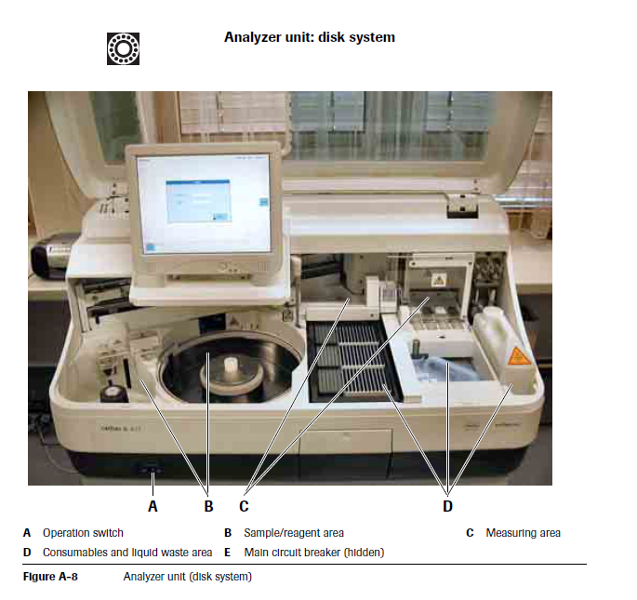
IMMUNOASSAY ANALYSERS
Cobas e 411 IMMUNOASSAYAnalyser

Slide 19
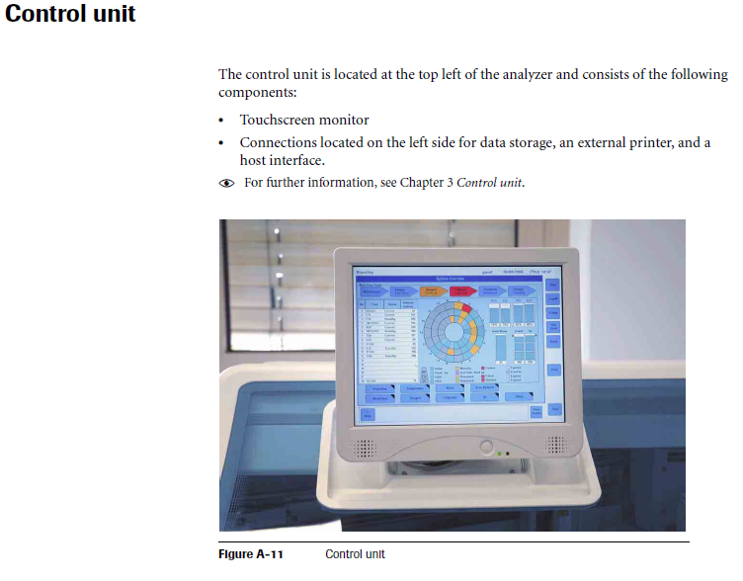
IMMUNOASSAY ANALYSERS
Cobas e 411 IMMUNOASSAYAnalyser

Slide 20
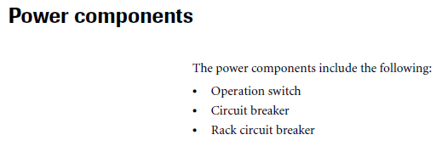
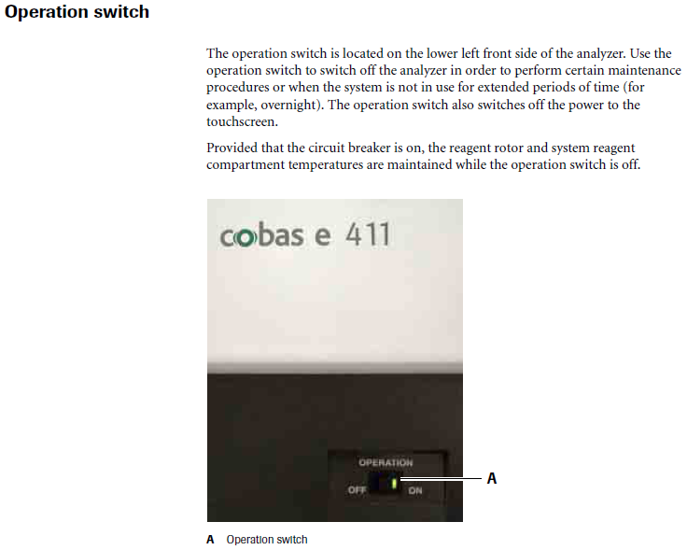
IMMUNOASSAY ANALYSERS
Cobas e 411 IMMUNOASSAYAnalyser

Slide 21
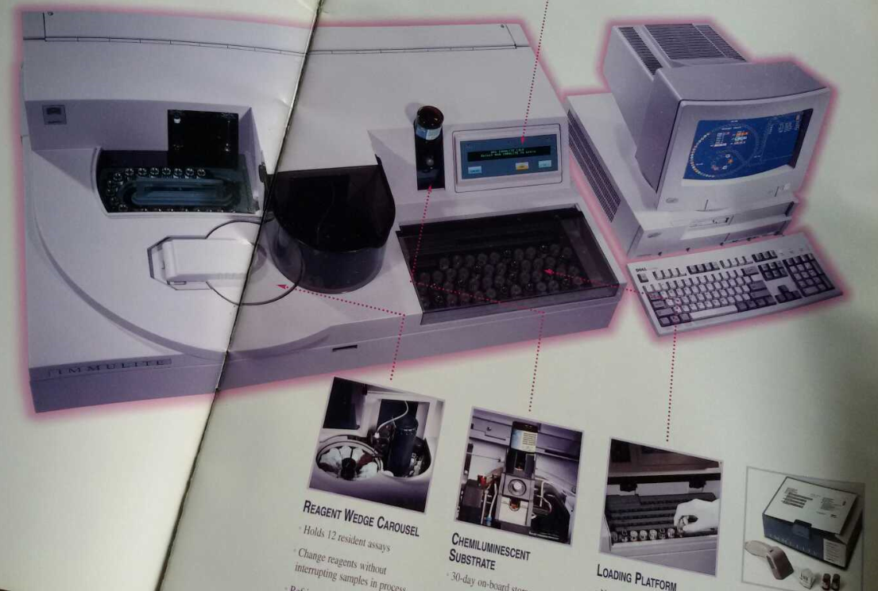
IMMUNOASSAY ANALYSERS
Major Parts of IMMUNOASSAYAnalyser

Slide 22
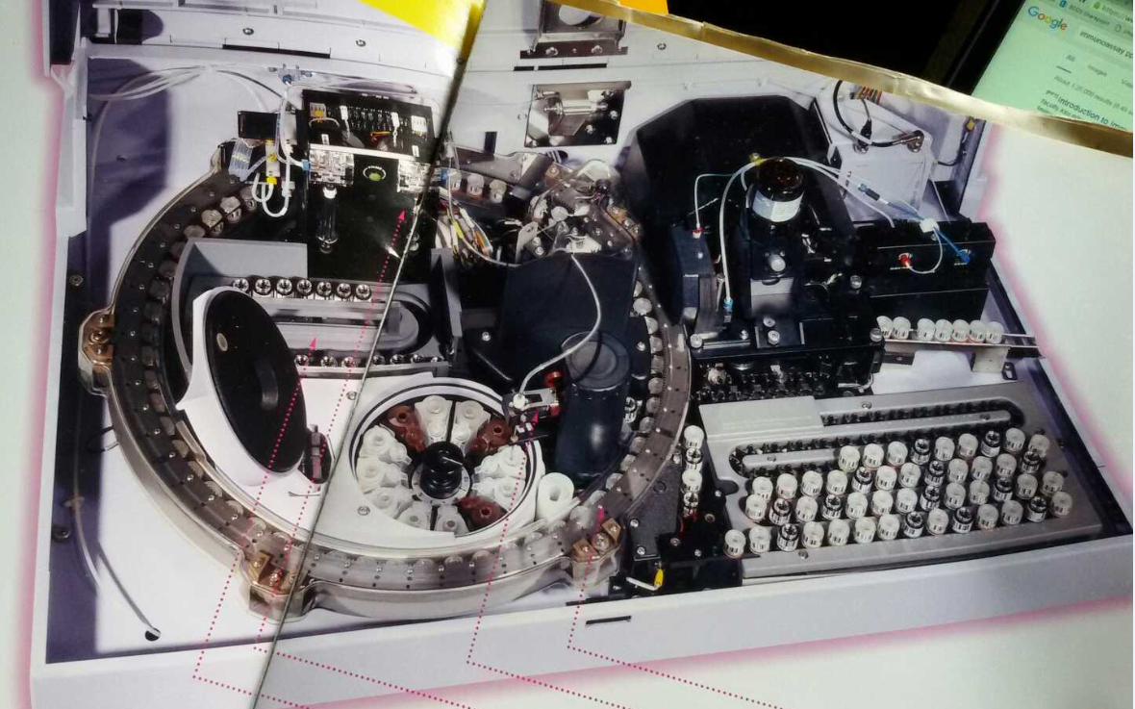
IMMUNOASSAY ANALYSERS
Major Parts of IMMUNOASSAYAnalyser

Slide 23
IMMUNOASSAY ANALYSERS
Calibration of Tests
Similar to clinical chemistry, the calibration of chemiluminescence tests may be single point (using single calibrator) or multiple calibrators. However, most of the assays may use up to six calibrators. This is because unlike clinical chemistry the immunoassay reactions usually follow a non-linear pattern.
The calibration frequency and stability is assay and analyzer dependent. The users must be aware of reagent and equipment manufacturer’s recommendations for calibration. Most of chemiluminescence analyzers in use in the country are closed systems (only allow manufacturer’s reagents), which offers uniformity of practices and performance.
The fully automated analyzers have an on-board ability to monitor calibration stability and highlight when it is time for re-calibration of tests. The users must ensure that the manufacturers’ recommendations are followed.

Slide 24
IMMUNOASSAY ANALYSERS
Calibration Verification
Unlike clinical Chemistry Analysers, Calibration must always be followed by re-running of quality control samples in order to ensure acceptable performance.

Slide 25
IMMUNOASSAY ANALYSERS
MAINTENANCE
Daily Maintenance of IMMULITE:
  Check Printer Paper
  Check the 2 Litre Water Container & REFILL if required
  Check Probe Wash Container. Replace if Required
  Check Fluidic Bottle levels from Detection window & from LED Indicator
  EMPTY Waste
  Tighten Syringes/Thumb Screws
  Prime the Syringes
  Check SUBSTRATE Bottle and level. Replace if required
  Check Substrate Dispensing Nozzle & Prime the Substrate & Water Pumps
  Clean the PROBE

Slide 26
IMMUNOASSAY ANALYSERS
MAINTENANCE
Weekly Maintenance of IMMULITE:
  Clean the Instrument FAN Filter on the right side of Instrument
  Clean the Computer Fan & Filter on the front of the Instrument

Slide 27
IMMUNOASSAY ANALYSERS
MAINTENANCE
Two Weekly Maintenance of IMMULITE:
  Clean the Water Bottle & Cap with 70% isopropyl alcohol followed by rinsing with distilled water thoroughly to prevent growth of algae and Bacteria.

Slide 28
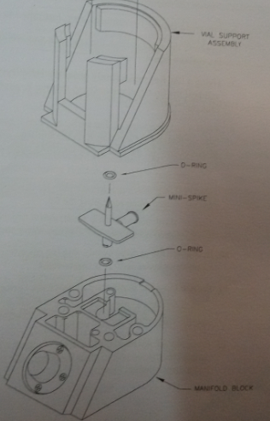
IMMUNOASSAY ANALYSERS
MAINTENANCE
Monthly Maintenance of IMMULITE:
  Clean Probe Wash Bottle
  Clean the Load Platform, Sample Collection Tray and
  sample pipetting area
  Change Substrate SPIKE
  Change small syringe TIP
  Decontaminate the system
  Test the Water for contamination
Refer to Page 8.7 of Operator Manual for Detailed description
of above procedures

Slide 29
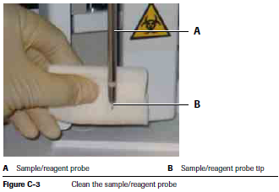
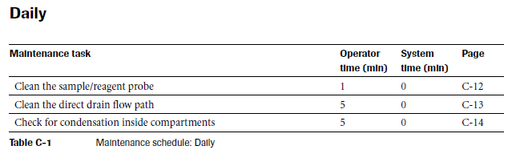
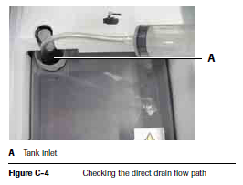
IMMUNOASSAY ANALYSERS
MAINTENANCE
Daily Maintenance of Cobas :

Slide 30
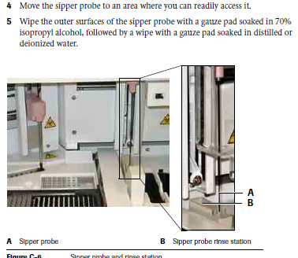
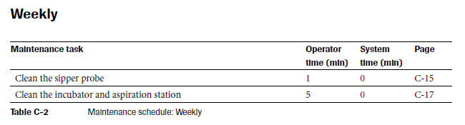
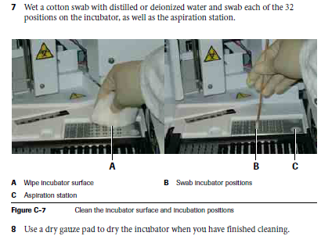
IMMUNOASSAY ANALYSERS
MAINTENANCE
Weekly Maintenance of Cobas :

Slide 31
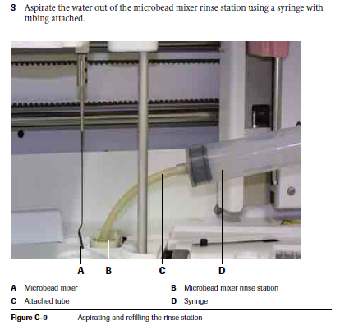
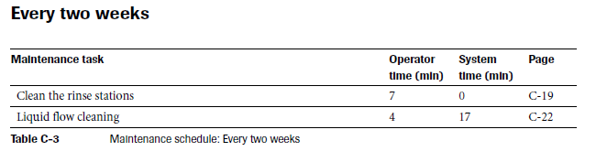
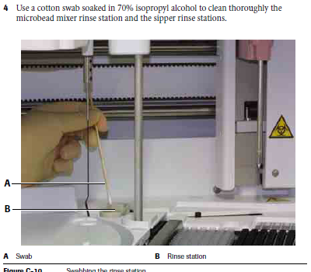
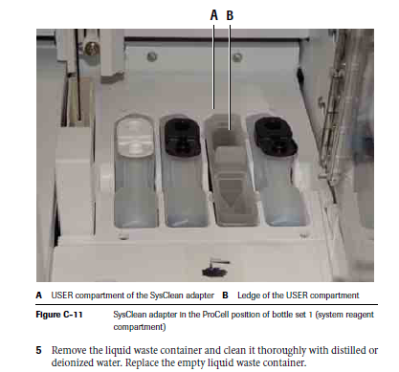
IMMUNOASSAY ANALYSERS
MAINTENANCE
Two - Weekly Maintenance of Cobas :

Slide 32
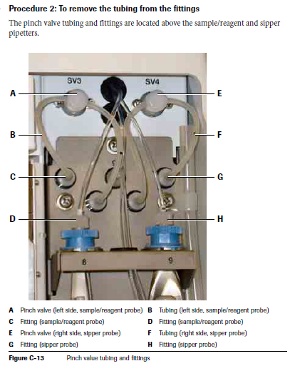
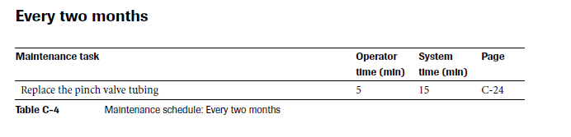
IMMUNOASSAY ANALYSERS
MAINTENANCE
Two - Month Maintenance of Cobas :

Slide 33
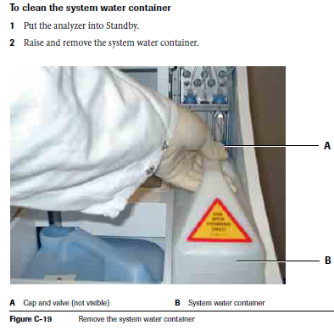
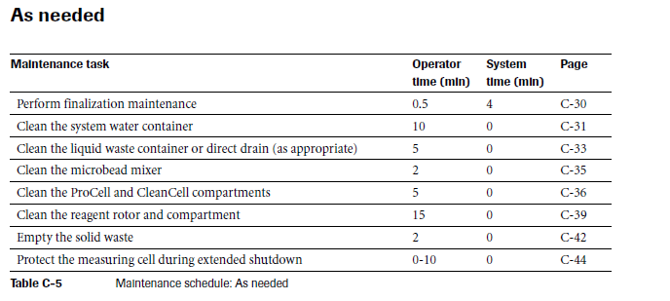
IMMUNOASSAY ANALYSERS
MAINTENANCE
As needed Maintenance of Cobas :

Slide 34
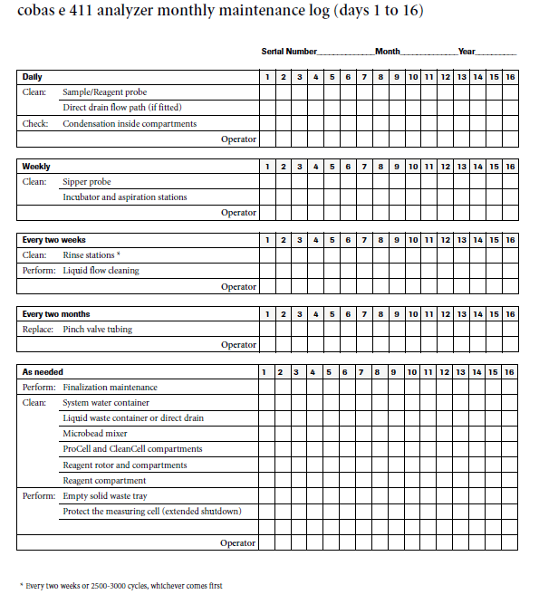
IMMUNOASSAY ANALYSERS
MAINTENANCE Logs

