Slide 1
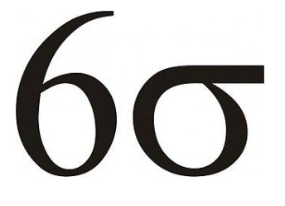
Sigma Metrics; the 5th Generation QC
Labs for Life Project
Quality Control Training

Slide 2
What is Six Sigma?
A 19th Century mathematical theory, but now used in today’s mainstream business world through the efforts of an engineer at Motorola in the 1980s.
One of the foremost methodological practices for improvement of services, manufacturing…

Slide 3
Why Sigma?
Emphasizes the need to define “tolerance limits” to describe intended use
Sets a goal of 6-sigma for “world class quality,”
Provides a uniform way of describing quality in terms sigma-scale.
A “sigma-metric QC selection tool” included in the CLSI C24A3 guidance for “Statistical Quality Control for Quantitative Measurements”.
There are manual tools, as well as computer programs.

Slide 4
Six Sigma
  To bring operations to a “six sigma” level – bring down the number of defects to > 3.4 defects for every one million opportunities (occurrences)
  Providing Methods for systematically identifying and Eliminating Errors through
  Define Quality Specifications

Slide 5
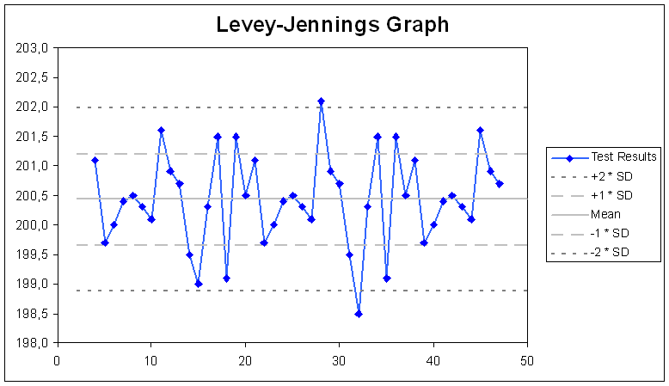
Systematically Identifying Errors

Slide 6
What are some Quality Specifications?
Total Allowable Error (TEa) which is derived for clinical decision thresholds is a very useful Quality Specification that can be adopted for labs: TE< TEa
Sigma-metrics, to define the tolerance limits
DPMO (Defects per Million Occasions / Opportunities)

Slide 7
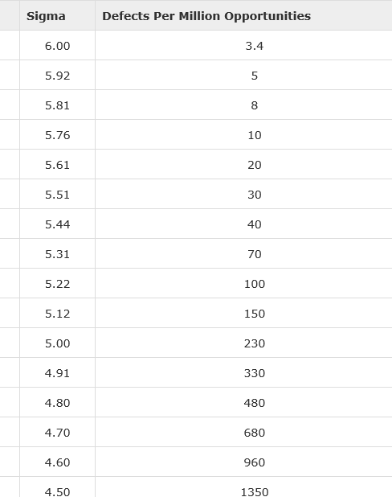
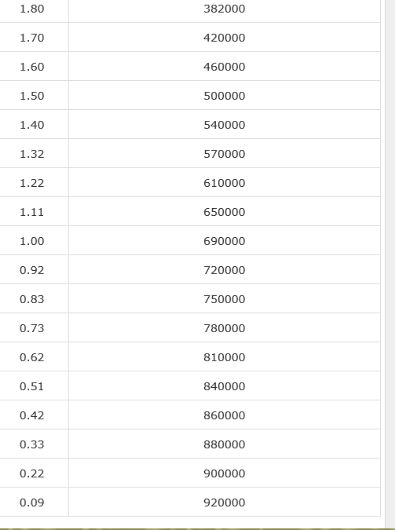
DPMO to Sigma Conversion

Slide 8
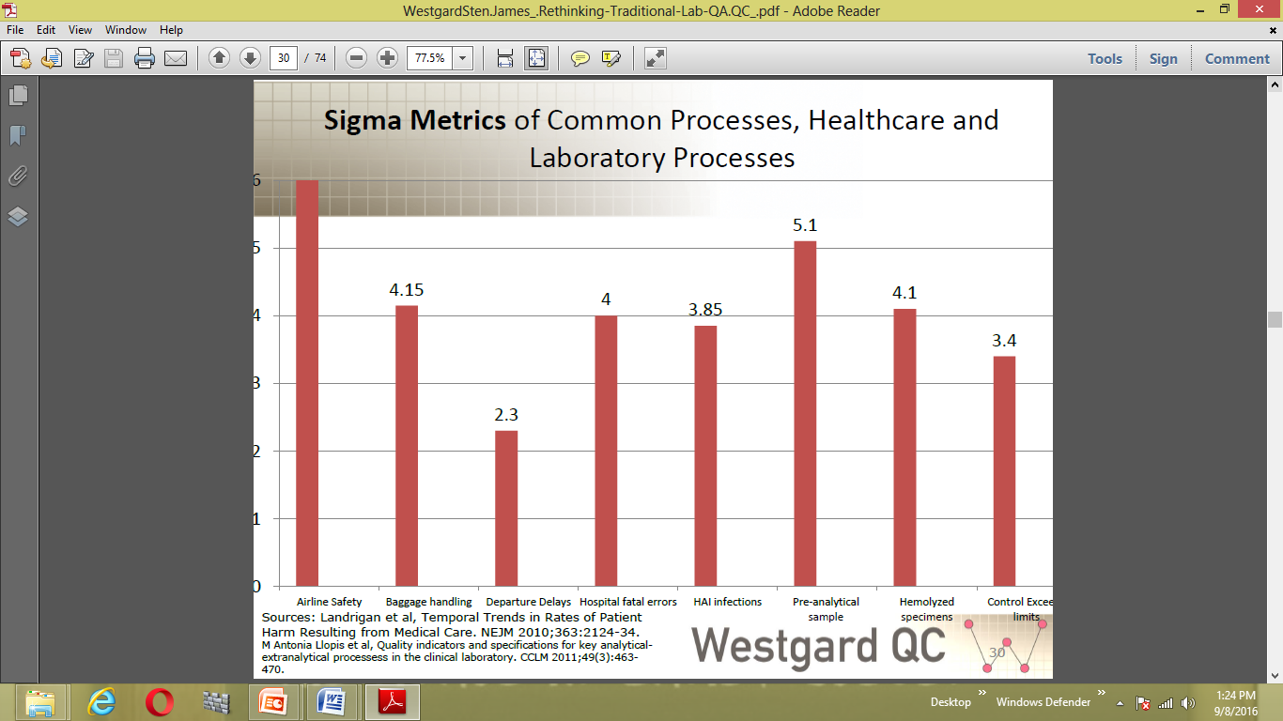
So how do labs compare?

Slide 9
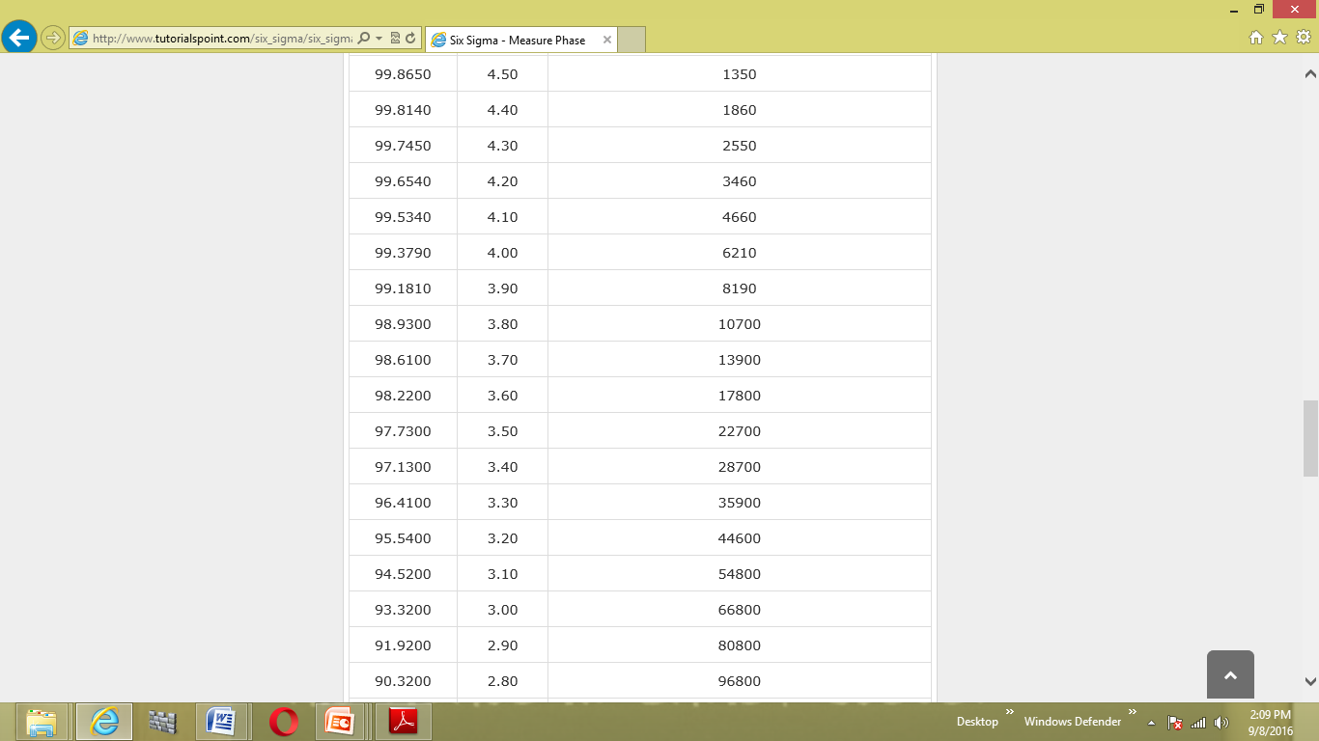

Slide 10
How about your lab?
Average load per day = 1500 patients
Average tests per patient = 5
Total tests per day= 7500
Total tests/ year = 27,37,500
Assuming the average sigma is 3.4, the DPMO for your lab will be, 78351/ year
Which means approximately 215 tests are Defective per day
Acceptable?
Do you want to set a goal for yourself and work toward that goal?

Slide 11
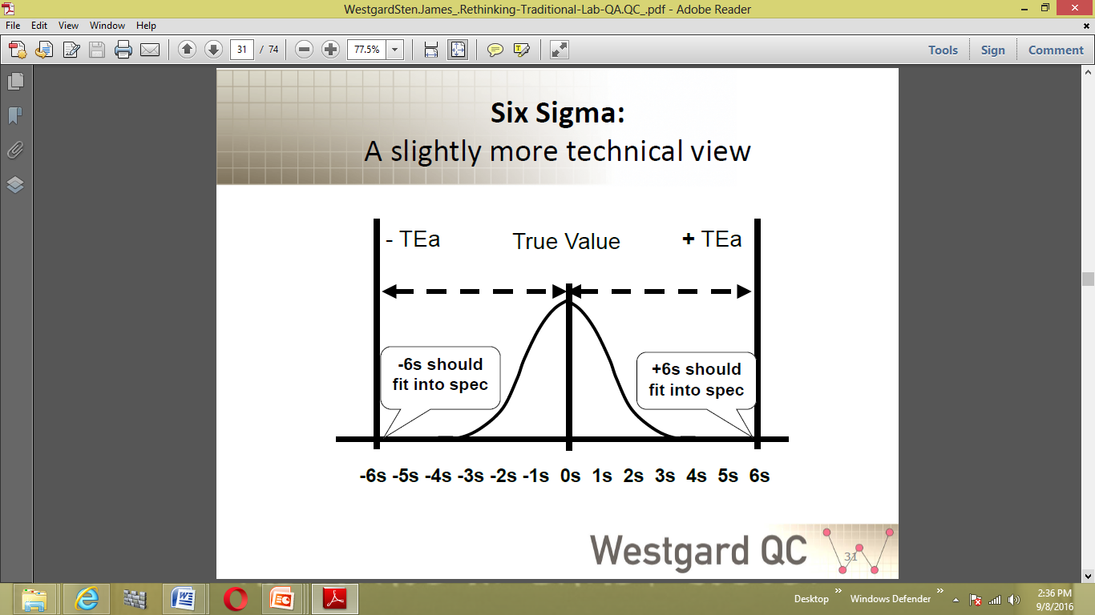
What exactly does Sigma mean in SQCs?
Which is, if the Bias is Zero and the SD is narrow enough that 6 SDs will fit in the Negative and 6 SDs will fit in the Positive regions between your Mean and the TEa limits, your performance is 6 Sigma. Your DPMO is just 3.4

Slide 12
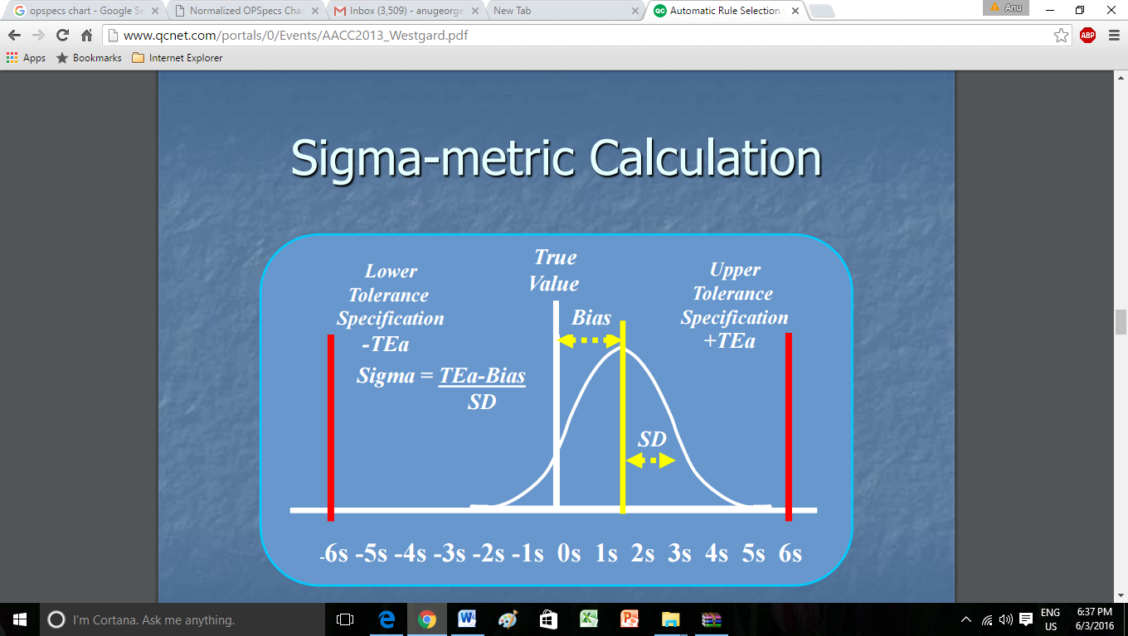

Slide 13
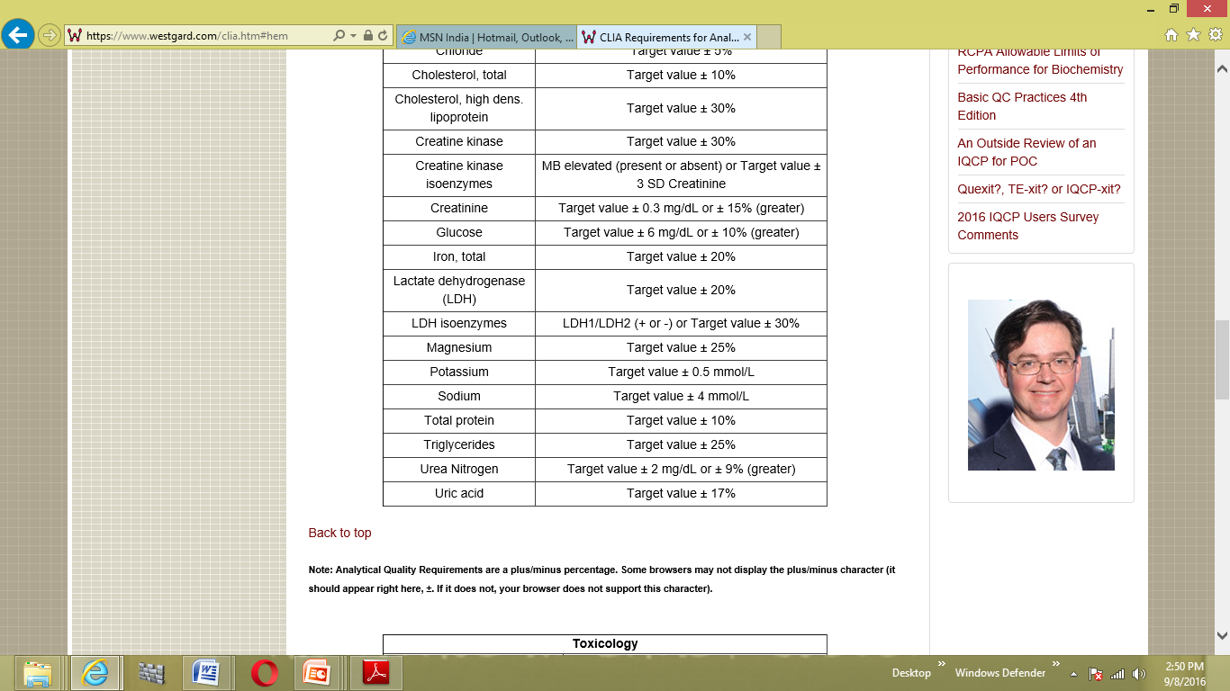
How do you calculate the Sigma?
2 formulae depending on how Total Allowable Error Data is Available
Sigma = (TEa% - Bias % )/ %CV
Glucose. Assume bias % is 5 (Obs Mean 190 and target 200 mg/dL) and CV% is 3
Sigma= (10 – 5)/3= 1.67
Sigma = TEa (in units)- Bias / SD
Potassium: Assume the bias is 0.3 (Obs Mean 6.3 and Target 6.0 millieq/L) and the SD is 0.05
Sigma is = (0.5 – 0.3)/ 0.05 = 4

Slide 14
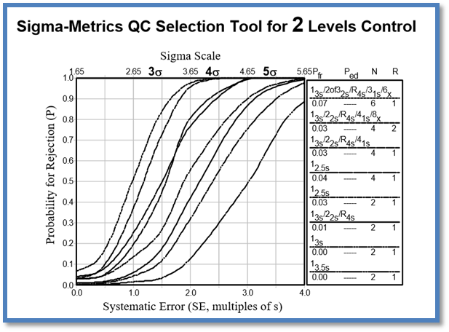
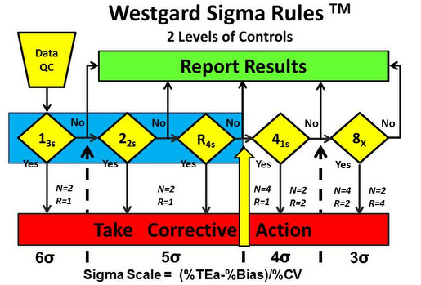
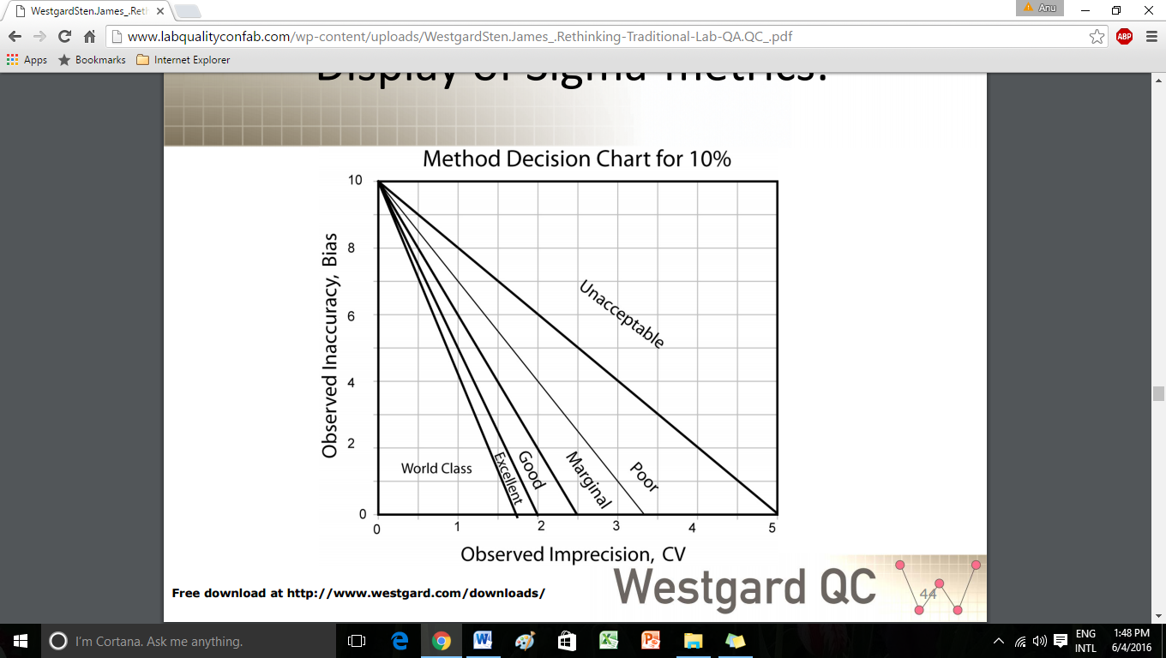
How do you put Sigma to Work in a lab?
2 major mechanisms
  Critical Systematic Error (SEc)
  Rule Selection Guidelines
    Manual
    Software

Slide 15
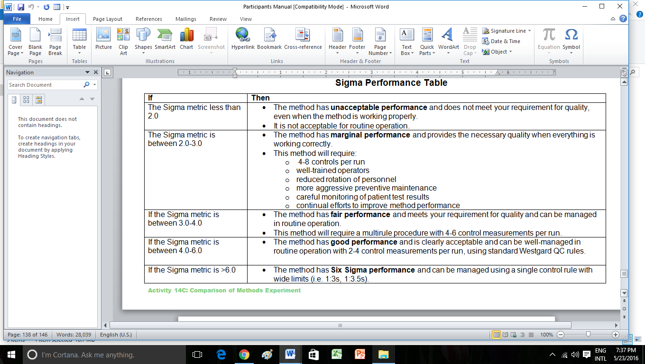

Slide 16
An Effective QC Design
  Ensures quality performance by quickly detecting medically significant errors (P ed > 90%)
  Generate few rule violations when there are no significant errors occurring (P fr < 5%)
  Fewest number of control measurements per analytical run possible to save on costs associated with
    QC materials
    Reagents
    Consumables
  Meet regulatory or accrediting body’s requirements for number of measurements per run

Slide 17
An Effective QC Design
If medically important errors can be detected (P ed) 90% of the time, then a single rule QC procedure is adequate.
If 90% error detection can not be provided by a single rule QC procedure, then a multi-rule QC procedure should be considered.
1:2s control rule should be avoided to minimize waste and reduce costs.

Slide 18
QC Rule Selection as per method performance to enable a P Ed > 90% and P Fr < 5%
Using Multi-rules
Using a Rule Selection tool
  Power Function graphs for Sigma Rule selection
  EZ rules (Westgard)
  OpSpecs tool
Understanding concepts of N and R

Slide 19
N represents the total number of control measurements that are available at a time a decision on control status is to be made.
Example: If 2 levels of control measurements are available within one run, N=2. If three are available then, N=3

Slide 20
                R represents the number of runs
Example: If 2 levels of control measurements are available and two runs are available , N=2 & R=2 and the total available data points are 4 per day

Slide 21
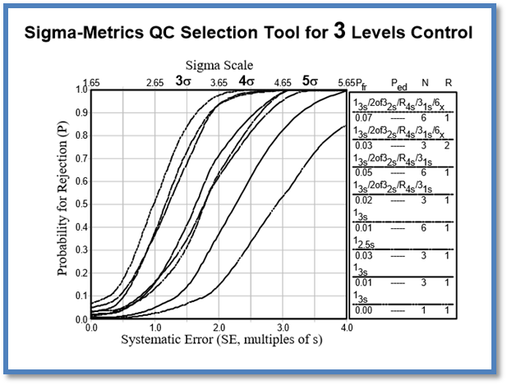
Rule Selection Power Function Graphs

Slide 22
X Axis shows Sigma at the upper end and SEc at the lower end
Y axis shows P ed and P fr
8 power function graphs are seen intersecting the graph at 0.9
Right hand column shows rules to be applied with P ed, P fr,

Slide 23
11
4
2
3
2
4
5
11
6
6
3
5
7
7
8
8

Slide 24
Recap: Rule Selection
The different lines represent the "power" of different QC rules and different numbers of control measurements per analytical run.
These QC procedures are identified in the key at the right side of the graph.
The power curves top to bottom correspond to the control procedures listed in the key top to bottom.

Slide 25
Recap: Rule Selection
In situations where the power curves for two different QC procedures are so close they are hard to tell apart’
  13s/22s/R4s/ 41s with N = 4 and 1_{2.5}S with N = 4 (Graph 3&4)
In these situations, the user should select whichever QC procedure is more practical to implement (e.g., a single rule may be preferred over multiple rules);
A minimum N of 2 may be required by regulations, even though an N of 1 QC procedure may provide the same error detection.

Slide 26
Recap:
Within run errors:
The power of daily monitoring
Stop and take corrective action if a single point exceeds a 3s limit.
Stop and take corrective action if two levels of control exceed the same 2s limit.
Stop and take corrective action if one point in the group exceeds a plus 2s limit and another exceeds a minus 2s limit:R₄s This is a range rule that is meant only to be applied within-run
Because N must be at least 2 to satisfy CLIA QC requirements, all these rules can be applied within a run and in the case of 22s, across materials.

Slide 27
Recap:
Across runs errors, Peer group:
The power of periodic review
Rules for Systematic Errors, within or across materials. 2:2S, 3:1S, 4:1S, 7T, 6,8,9,10,12 X
Looking for trends, shifts, emerging populations
Looking at Peer group ( mean, SD, CV) Calculating SDI, CVI

Slide 28
Multi-Rules
The power of daily monitoring PLUS The power of periodic review
Using all the data systematically,
Monitor Daily/ Periodically
Get CVs/SD
Get Target
Get TEa
Arrive at a Sigma /SEc
Set Goals
Select rules
Follow rules

Slide 29
Multi-Rules
The power of daily monitoring PLUS The power of periodic review
To reiterate, the advantages of multi-rule QC procedures are that false rejections can be kept low while maintaining high error detection.
This is done by selecting individual rules that have very low levels of false rejection, then building up the error detection by using these rules together

Slide 30
Recap: When Sigma is low
When an analyte shows <4 sigma, the lab must take special care and do risk analysis
  SQC Measures
  Multi rules
  Look-back to previous runs
  Increase N: Number of QCs
  Increase R: Number of QC runs
Non SQC Methods
  Staff with special training to be deployed for low sigma tests
  Increase the number of supervision

Slide 31
Recap: Developing an optimum QC plan
Define the quality that is needed for each test.
Know the performance of your method (CV, bias).
Get target value and Total Allowable Error from the best possible source
Calculate the Sigma-metric of your testing process.
Decide on the rules to be applied to each analyte from the Rule Selection Power Graph; Single Rule/ Multi rule
Decide the number of controls measurements(N) and (R), number of runs of each QC

Slide 32
Developing an optimum QC plan
Define explicitly the application and interpretation of rules within and across materials and runs
Interpret multi-rule to help indicate the occurrence of random error or systematic error
Train Staff
Set up a daily and periodic monitoring schedule and assign responsibilities

Slide 33
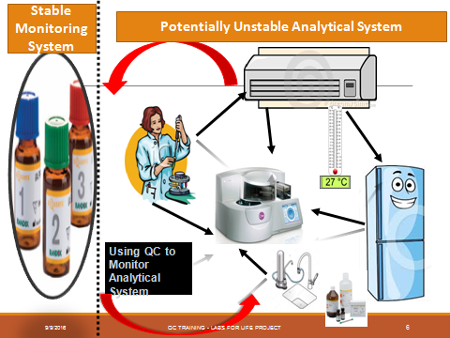

Slide 34
Thanks

