Slide 1


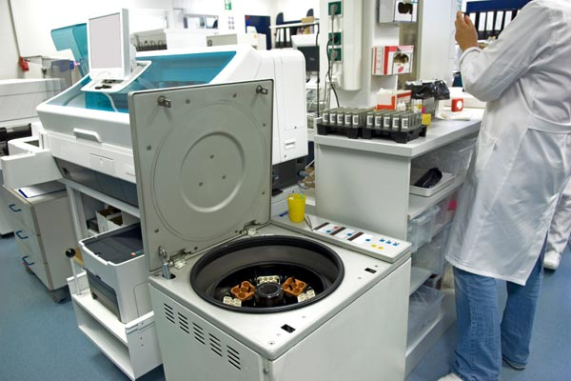



LABS FOR LIFE PROJECT - INDIA
Equipment Management
MoHFW /CDC / BD Partnership Project

Slide 2

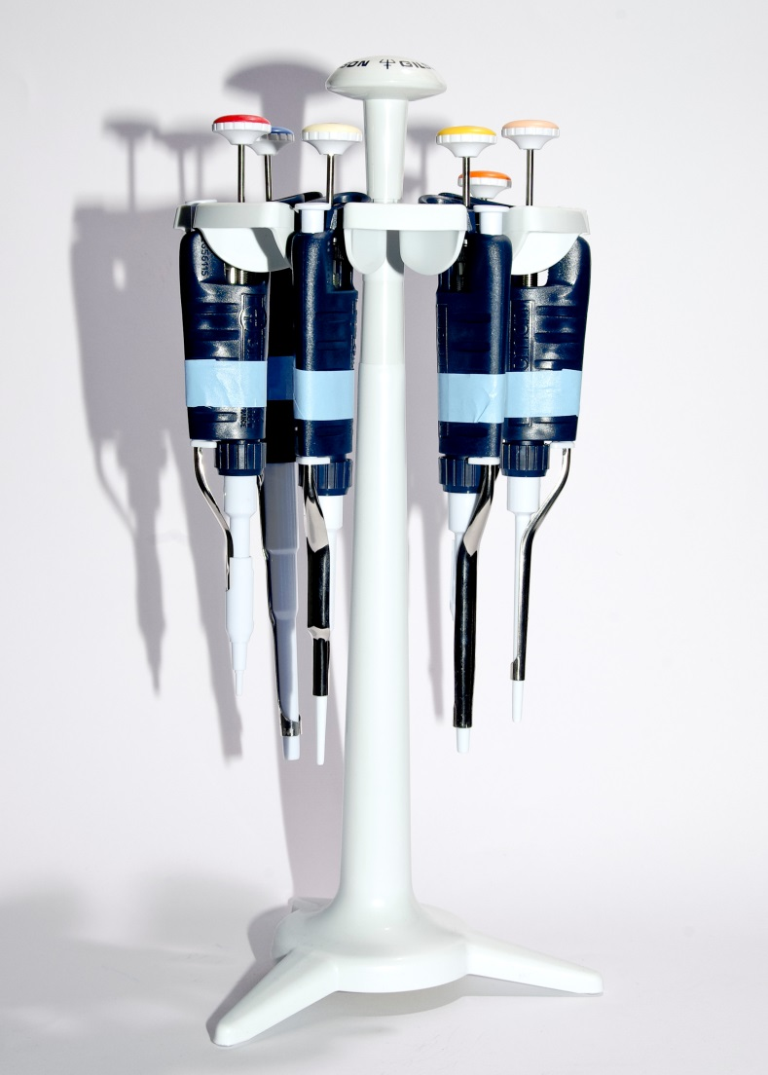
Pipettes – Volumetric Measurement Equipment
Equipment used to measure and transfer small volume of liquid from one container to another with high precision and accuracy
Pipettes are widely used in Clinical laboratories
MoHFW /CDC / BD Partnership Project

Slide 3
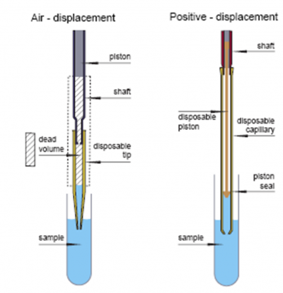
Types of Pipettes
Fixed Volume Pipettes
  Manufactured to dispense only fixed volume of liquid.
  Fixed Volume Pipettes are of two types:
  Air Displacement Pipettes: There is a volume of air between the piston and the liquid
  Positive Displacement Pipettes: The piston is in direct contact with the liquid
Variable Volume Pipettes
  Allow adjustment of the volume dispensed within a determined range.
  Volume adjustment is achieved by modifying the range of the piston’s movement inside the plunger
MoHFW /CDC / BD Partnership Project

Slide 4
Types of Pipettes
Air Displacement Pipettes
Positive Displacement Pipettes
Present less risk of contamination
Useful for general clinical lab use
Not good for viscous and volatile liquids
High risk of contamination
Are more precise than air displacement for smaller volumes
Could be used for viscous and volatile liquids
Most of pipettes used in Clinical Laboratories are air displacement type.
Use disposable tips for minimizing risks of contamination.
Exclusively use tips provided by the manufacturer
Recently Pipettes with electronic controls are also available
MoHFW /CDC / BD Partnership Project

Slide 5
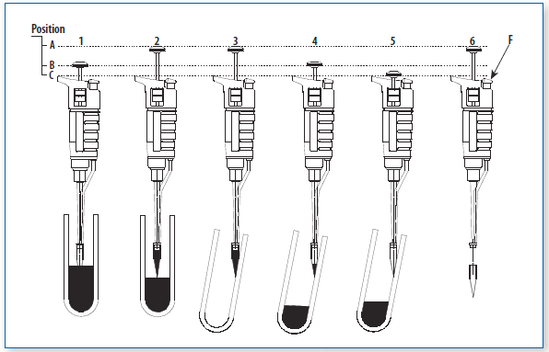
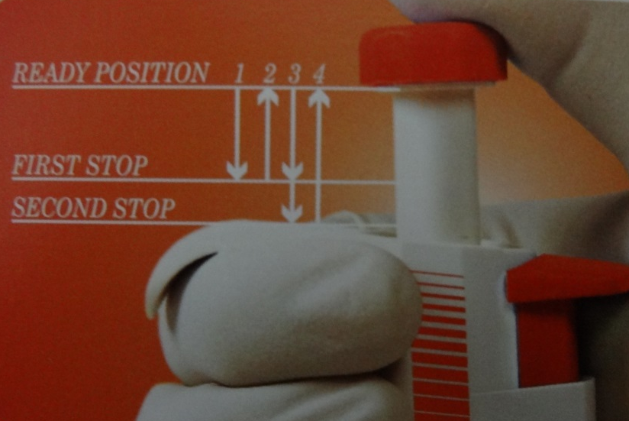
Correct Use of Pipettes
MoHFW /CDC / BD Partnership Project

Slide 6
Important operational tips
Always follow manufacturer’s instructions for use and care of pipettes
When not in use, always store pipettes upright in a stand.
Never leave a pipette on its side with tip attached containing fluid.
Keep the pipette clean, particularly the nozzle.
Every few months, depending on usage, arrange for the pipette to be checked for accuracy and precision.
Do not use a tip unless it forms a complete seal with the pipette.
In variable volume pipettes, the volumes set should be within the limits of operation. Otherwise piston could jam.
MoHFW /CDC / BD Partnership Project

Slide 7
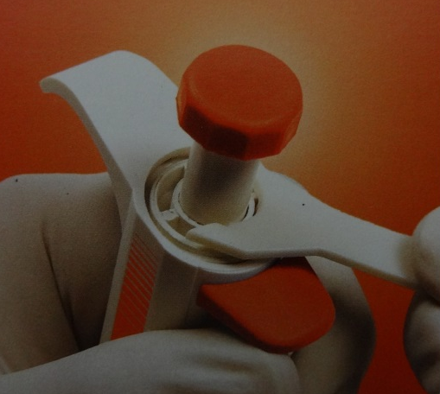
Maintenance of Pipettes
Daily Maintenance | Specialized Maintenance (Follow manufacturer’s instructions)
Verify that adjustment mechanisms move smoothly | Disassemble the pipette using manufacturer’s instructions and tools
Confirm no distortions or signs of being worn out of tip holder | Clean the ‘O’ ring, plunger and cylinder and change if needed
Attach a tip and fill it with distilled water. The pipette must not show any leakage | Lubricate the plunger and piston using silicone grease approved by manufacturer
Verify that the pipette is clean, if not, it must be cleaned using a suitable solvent or a mild detergent solution | Reassemble the pipette
Document the cleaning process. | Recalibrate the pipette after such maintenance
MoHFW /CDC / BD Partnership Project

