Slide 1
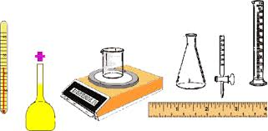
Uncertainty of Measurement (Mu)
Labs for Life Project
Quality Control Training

Slide 2
What is uncertainty of Measurement?
“Uncertainty” -
Not a Doubt of Validity
Assertion of Confidence
3% uncertainly translates as 97% CONFIDENCE !!

Slide 3

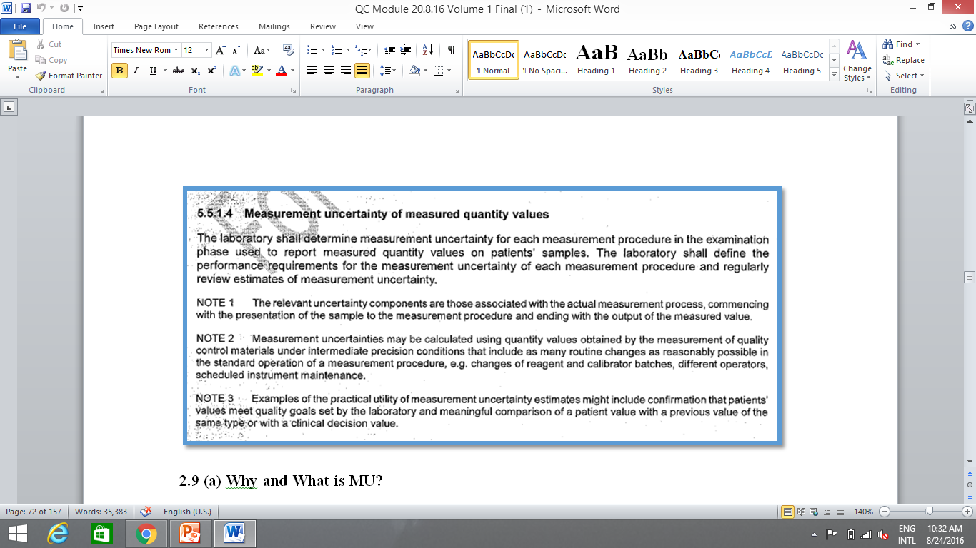
ISO 15189:2012 Says…….

Slide 4
5 key points to note
Uncertainty of Examination phase
To be reviewed periodically
Using Control material
Through Intermediate precision
Applications:
Monitor Quality Goals
Comparison of patients values with previous reports
Comparison of patients values with clinical decision levels

Slide 5
What are the uncertainties?

Slide 6
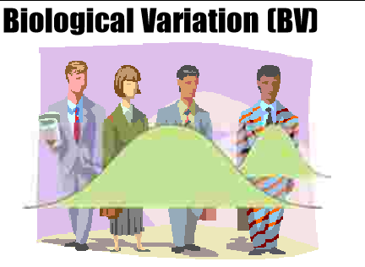
Variations within an individual:
Pre-pre analytical!!

Slide 7
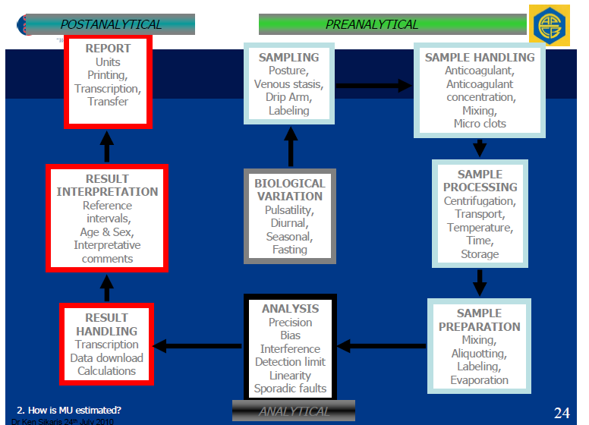
Start here
MU calculable is just this
Notes:
PLEASE REDO

Slide 8
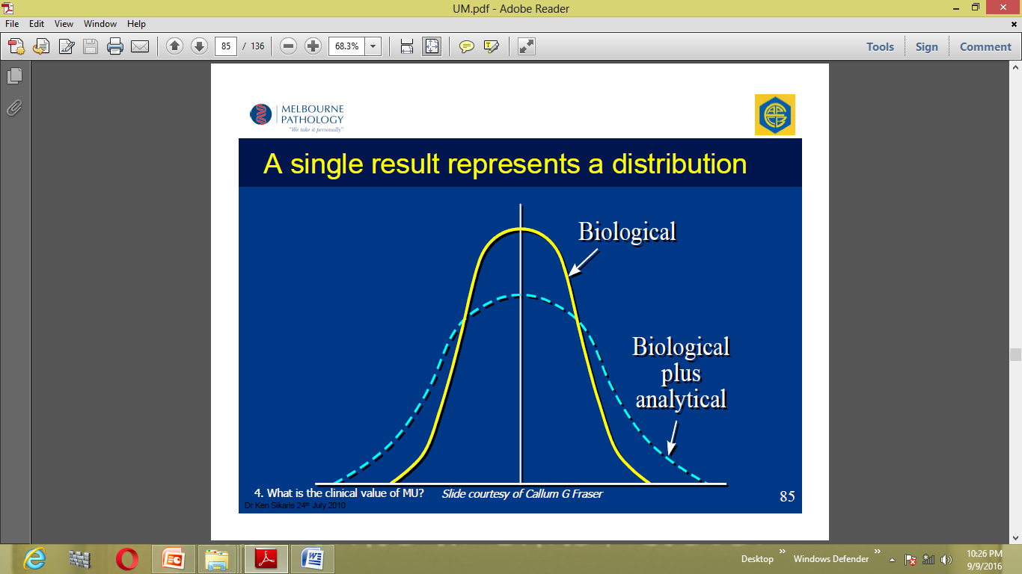
Can be here or anywhere in the Gaussian
Can be here or anywhere in the Gaussian
Notes:
PLEASE REDO

Slide 9
Analytical Components
Analytical:
Reagent
Calibrator
Operator
Equipment
Environment

Slide 10
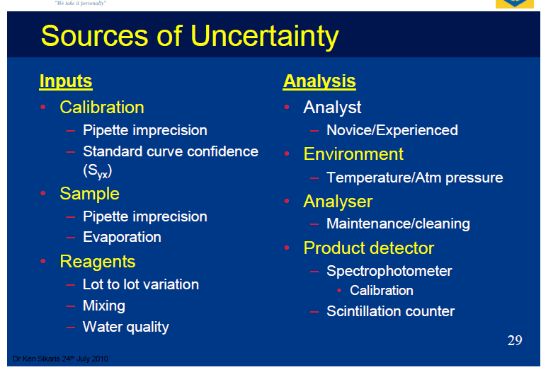
Notes:
PLEAS REDO THIS

Slide 11
Why does MU matter in routine clinical laboratories?
Clinicians compare most measurement results with reference values and with previous results from the same patient
Variability in repeats confuse clinicians
Notes:
A patient report shows serum potassium results on two samples collected a week apart as 3.7 mmol/L and 3.5 mmol/L; No QC issues in either levels on both days. The lab’s lower reference value is: 3.7 mmol/L. The clinician asks the laboratory: Is the first result definitely low and is the second result really lower than the first? The laboratory can’t answer without having some quantitative knowledge about the measurement uncertainty associated with each of the results.

Slide 12
Why does MU matter in routine clinical laboratories?
Some analytes have very narrow range, example therapeutic ranges for drugs; narrow effective range between insufficiency and toxicity
Some analytes have sharp cut-offs making clinical decisions difficult
Notes:
A patient report shows serum potassium results on two samples collected a week apart as 3.7 mmol/L and 3.5 mmol/L; No QC issues in either levels on both days. The lab’s lower reference value is: 3.7 mmol/L. The clinician asks the laboratory: Is the first result definitely low and is the second result really lower than the first? The laboratory can’t answer without having some quantitative knowledge about the measurement uncertainty associated with each of the results.

Slide 13
Why does MU matter in routine clinical laboratories?
MU can also be an indicator of the Quality Assurance of the laboratory, conveyed to its users
However, MU has more to do with interpretation of the reports than monitoring of the analytical system
Notes:
A patient report shows serum potassium results on two samples collected a week apart as 3.7 mmol/L and 3.5 mmol/L; No QC issues in either levels on both days. The lab’s lower reference value is: 3.7 mmol/L. The clinician asks the laboratory: Is the first result definitely low and is the second result really lower than the first? The laboratory can’t answer without having some quantitative knowledge about the measurement uncertainty associated with each of the results.

Slide 14
How can you measure Uncertainty
Points to remember
We are trying to capture only analytical uncertainty
How can you measure the uncertainty of the result of an analyte, say glucose?
If the dispersion in the glucose could be repeatedly analyzed over a period of time, say over 20 day that SD could indicate the degree of uncertainty
Since it is not practical to do that, how else can one conclude the degree of uncertainty?

Slide 15
How can you measure Uncertainty
What material is available in the lab for repeated examination?
Internal Quality Controls!
Look at the degree of dispersion, standard deviation, of glucose at the corresponding level.
The data from the Internal Quality Controls (with which we monitor the analytical phase), reflects the degree of uncertainty
This number can be informing that to the clinician

Slide 16
Concepts in Precision:
To arrive a number to specify as the degree of dispersion, ISO recommends Intermediate Precision.
There are 3 concepts in Precision
Repeatability
Intermediate Precision
Reproducibility

Slide 17
Repeatability
Repeatability: is precision when using
  Same operators
  Same measuring system
  Same operating conditions
  Same location
  Over a short period of time.
Repeatability is expressed in terms of standard deviation.
Within-run/ Intra-serial/Intra-run precision condition are synonyms

Slide 18
Reproducibility
Reproducibility : is precision when
  Test results are obtained with the same method
  By different operators
  Using different equipment
  In different laboratories
  On different days.
Reproducibility is expressed in terms of standard deviation but will be considerably larger deviations than Repeatability
Between Laboratories/ Inter Laboratory/Among Laboratories are synonyms

Slide 19
Intermediate Precision:
Intermediate Precision: Is something between the 2 states,
  One lab
  With changes of reagent
  Changes of calibrator lots
  Changes of operators
  Changes of operating conditions
All acceptable laboratory variables will be captured if at least 100 measurements are included.
Intermediate Precision is expressed in terms of multiples of the standard deviation
The Uncertainly of Measurement (MU) uses intermediate precision as the basis for its calculation

Slide 20
Repeatability | Intermediate Precision | Reproducibility

Slide 21
Using mathematical Models to Estimate MU
2 Estimates of MU: Combined MU and Expanded MU
Ideally the MU should capture all the elements of uncertainty
In practice, MU is concerned with only analytical uncertainty (Biological and Pre and post analytical uncertainties are not included)
Within the analytical uncertainty itself, those arising from systematic effects that contribute to the error are not included (Only SD is considered).
The calculations of MU assumes that the bias cannot be estimated correctly and hence is not considered in the estimate of MU
To circumvent all of the above, Uncertainty of a Measurement result is usually evaluated using a mathematical model using the law of propagation of uncertainty

Slide 22
Combined MU
Combined MU (μc):
Most measurement procedures MU is simply the Intermediate Precision assessed using QC, usually expressed as 1 SD or CV %
Why is it called combined??
All acceptable laboratory variables (intermediate precision) will be captured if at least 100 measurements are included. All these are combined and reflected in such an SD.
Notes:
Measurement procedures are often automated ‘black box’ systems that do not permit components (e.g. sampling/reagent probes, water-baths, spectrophotometers etc) to be individually studied to ascertain their uncertainty. Fortunately, we are interested in the combined effect of the individual sources of variability on measurement results, and this is adequately reflected in the dispersion of results obtained for QC samples. A minimum 30 QC results is required before an approximate Gaussian distribution of data points can be reasonably assumed.

Slide 23
99.7%
95%
68%
2.5%
13.5%
34%
34%
13.5%
2.5%
Notes:
Normal distribution as seen in L-J chart #1

Slide 24
Expanded MU
To have 95% of possible values covered, expanded uncertainty is used with a coverage factor of 2
2* μc which can be
2 * SD = U
Or
2* CV = U

Slide 25
Coverage factors and confidence limits
Applying the following coverage factors will offer the corresponding confidence limits:
  k=1.00 ----68.27%
  k=1.64 ----90%
  k=1.96 ----95%
  k=2.00 ----95.45%
  k=2.58 ----99%
  k=3.00 ----99.73%
  (GUM 6.3.3)

Slide 26
Expanded MU at CDPs
If several levels of QC are used the MU should be calculated for each
Judgment made as to whether they are sufficiently different to warrant their use with patient results

Slide 27
Review of MU (NABL 112)
It is recommended that a minimum of six months internal QC data should be used to calculate routine imprecision,
To be updated annually
For non quantitative set of tests, the laboratory shall enlist the factors which could contribute to the uncertainty of the results and also ensure that they were given due attention while performing the test.

Slide 28
Some examples: Clinical Decision
Therapeutic Range of Digoxin is 0.9-2 ug/mL.
Your lab is reporting a level of 1.8 with a SD of 0.2 ug/mL.
Does the clinician need to know this?
Does the clinician have to cut the dose?
1.8 +/- 0.4 = The actual result could be 1.4 – 2.2 ug/mL

Slide 29
Some examples: Clinical Decision
ADA cut off for Gestational Diabetes FBG is 92 mg/dL.
You have a report of 90 mg/dL and a CV of 3%. Does the obstetrician need to know?
Will there be consequences?
90 +/ - 6% = 84.6 - 95.4

Slide 30
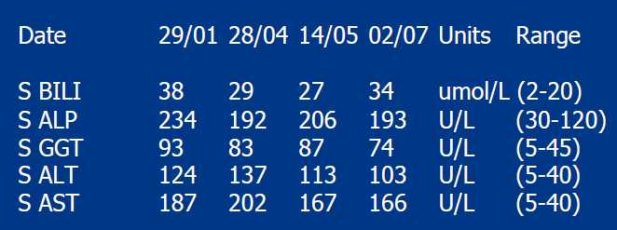
Some examples: Comparison with previous results
Assume this is patient with a chronic liver disorder. What are you conveying? Is the patient responding to treatment or worsening or is it status quo?
Notes:
PLEASE REDO. Show the S. Bilirubin values as 3.8,2.9 etc instead of 38, 29….

Slide 31
Should MU be routinely reported to clinicians?
Not Required “on the reports”
Should be available if requested
Clinicians should be made aware of the concept

Slide 32
5 key points, Recap
Uncertainty of Examination phase
To be reviewed periodically
Using Control material
Through Intermediate precision
Applications:
Monitor Quality Goals
Comparison of patients values with previous reports
Comparison of patients values with clinical decision levels

Slide 33
Thanks

