Slide 1


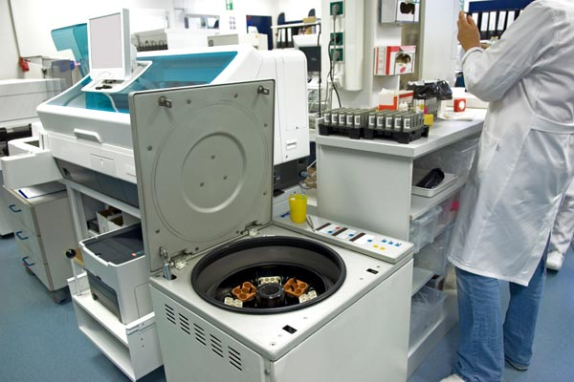



LABS FOR LIFE PROJECT - INDIA
Temperature controlled Equipment
MoHFW /CDC / BD Partnership Project

Slide 2

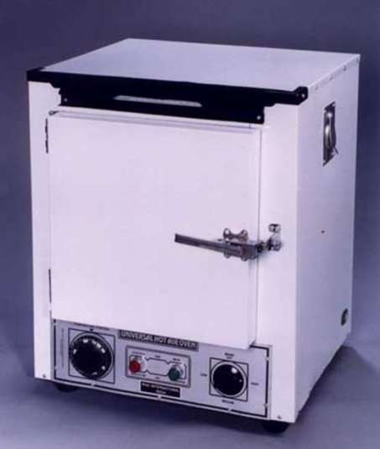
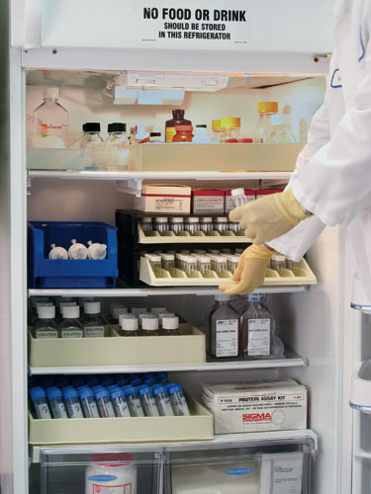
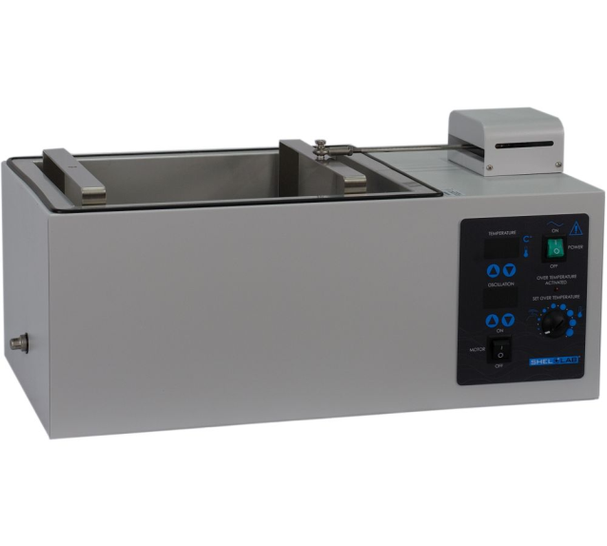
Temperature controlled equipment
Commonly used in Laboratories
Water baths
Hot air Ovens
Refrigerators
Freezers

Slide 3

Water Bath
Water bath is used for carrying out reactions that require controlled temperature such as serological, agglutination and inactivation reactions in the Clinical Lab
Water Bath is sometimes used to incubate samples in water at a constant temperature over a long period of time.

Slide 4
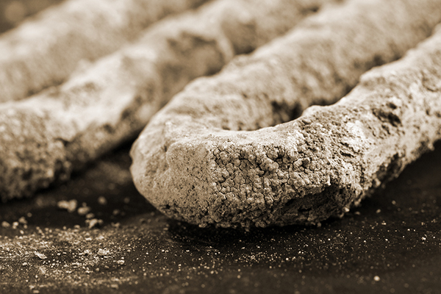
Use and care of a water bath
To avoid scaling, avoid hard water and use distilled water
Regularly addition of water helps replenish oxygen and maintain protective layers
Check that the temperature of water before use.
Water level should be above the level of liquid in tube
Use the lid to prevent loss of heat from the bath
Use capped tubes to avoid water enter the tubes.
Clean the water bath regularly
Any build up of scale can be removed by using 10% w/v citric acid and leaving it until the deposit has dissolved.

Slide 5
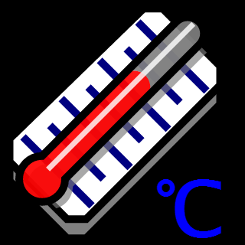
Temperature Monitoring: Using Thermometers
Routinely monitoring performance
The thermometer used must be calibrated
Initial check must be at sufficient points to cover the expected working range followed by six monthly checks.
Thermometer should be calibrated once a year.
Check temperature at different points within the load period
Continuous temperature monitors is recommended critical materials e.g. during sample transportation

Slide 6
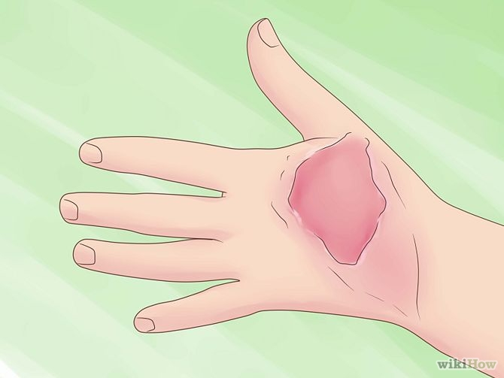
Water bath - Safety
Use the water bath exclusively with non-corrosive or non-flammable liquids.
Use personal protective elements when working with the water bath
Remember that the water bath is designed for use with a liquid inside the tank. If the inside is dry, the temperature of the tank can become very high
Remember that liquids incubated in the water bath tank can produce burns if hands are inadvertently placed inside it.

Slide 7

Hot Air Oven
Introduction
Ovens are insulated chambers
Circulating fans in oven help to distribute heat evenly throughout the chamber.
Use of Oven:
To dry glassware
Sterilize metal and certain high temperature stable glass objects
Recover palladium-covered alumina catalysts used in anaerobic chambers and jars

Slide 8
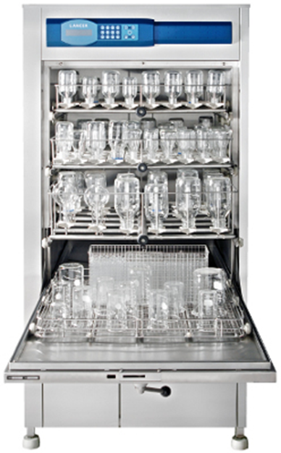
Good usage tips/practices
Check for proper temperature before loading oven.
Routine thermometer QC is a necessary control measure
Recommended sterilization times:
      At 160⁰C, 60 min
      At 170⁰C, 40 min
      At 180⁰C, 20 min
While loading the oven, start with the middle shelf.
Leave air space around each item to allow proper heat circulation.
If more space is needed, load other shelves, moving upward the middle.
To avoid breakage, do not stack glassware.

Slide 9
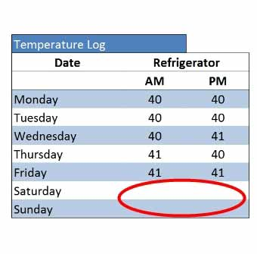
Maintenance and Calibration Verification
Maintenance
Once every 6 months, clean the oven thoroughly after removing all interior parts
Materials required for cleaning are soap, water, paper towels or rags.
Calibration Verification
Place calibrated thermometer on the middle shelf
Switch the oven and adjust it to the desired temperature
Check the thermometer every 15 min until the desired temp is reached
Quality Control
Record the oven temperature each time it is used

Slide 10
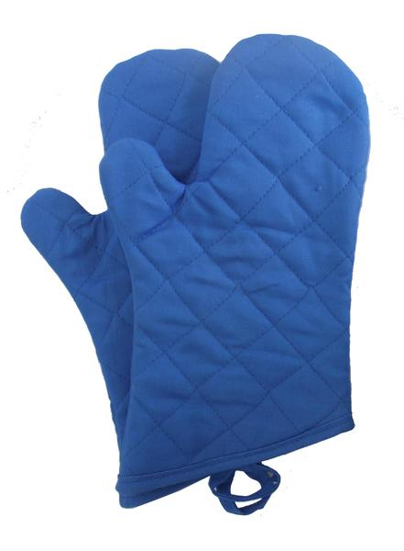
Safety
Wear heat resistant gloves
Do not place hot items on cold surface as the sudden change in temperature may cause breakage
Remove items from the oven only once the temperature falls to 60ºC.
Do not place explosive, combustible or flammable materials in the oven
Be careful of loose wires or connections.

