Slide 1
LOT VERIFICATION
Labs for Life Project
QUALITY CONTROL TRAINING

Slide 2
What Standards say….
ISO 15189: 5.3.2.3 (Reagents and consumables )
Acceptance testing
Each new formulation of examination kits with changes in reagents or procedure, or a new lot or shipment, shall be verified for performance before use in examinations. Consumables that can affect the quality of examinations shall be verified for performance before use in examinations.
NABL 112 :
The laboratory shall check each lot of control and reagent against an earlier tested in-use control / reagent lot. The laboratory can follow guidelines mentioned in Annexure III. Records of comparative data shall be maintained.

Slide 3



Factors which affect the Quality of Reagents
Transportation

Slide 4


Transportation Temperature and Storage temperature
Temperature Control in your store before issue
Temperature control during transport

Slide 5
NABL 112
Lot verification is needed for all reagents, Quantitative, Semi quantitative and qualitative analysis
In this video we will discuss only quantitative lot verifications
Please check details for other details

Slide 6
Do you have a QSP?
Specify acceptance testing for Qualitative and Quantitative tests
For SQCs
Decide the acceptance limits
The MDP of each analyte where verification is needed
The material you will use for Lot Verification
Quality Specifications eg..TE< TEa/ Sigma> 4

Slide 7
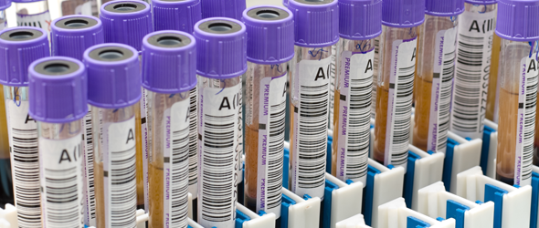
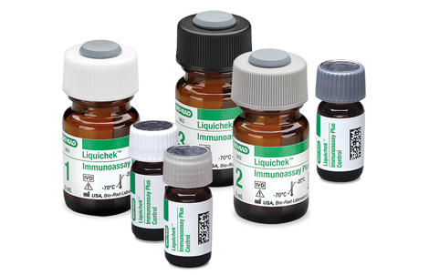
(CLSI EP 26 A) Lot to lot Verification can be done by:
Using Sample
Using QCs

Slide 8
New lot Reagent/ Calibrator
Sample
QC
Estimate difference and difference %
TE/ Sigma
Acceptable limits
OK
Not OK
Use for reporting of samples
Repeat/Root Cause/Reject

Slide 9
If You are using sample for lot verification
Samples to be done in triplicate with the old and new lots (CLSI EP 26 A)
Understand the MDPs
Understand acceptable percent differences

Slide 10
If You are using QCs for lot Verification
Can set better quality specifications like TE and Sigma
However,
Matrix Effect may be an issue especially in tests like immunoassays

Slide 11
Method: Using Samples
Run the same sample (individual or pooled) in triplicate using old and new lot reagents
Find the percent difference between each run using the formula
% Difference= (I new lot value- old lot value I)/ Old lot value *100
Set acceptance limits ( eg; 1SD at that level / < 10 %)

Slide 12
Method: Using QC
Using the new lot reagent run the QCs, at all levels, 8 times each
Find the mean and SD
Using the 4 key numbers, Mean, Target, SD and TEa calculate TE and Sigma
Target value ( is the Mean from old reagent/calibrator lot)
Calculate Sigma performance
Judge Acceptability as per Quality Specifications

Slide 13
Thanks

