Slide 1


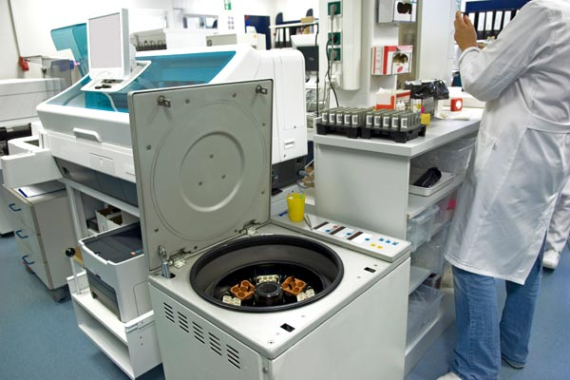



LABS FOR LIFE PROJECT - INDIA
Equipment Management
MoHFW /CDC / BD Partnership Project

Slide 2

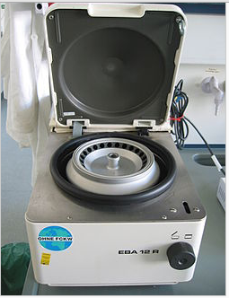
Centrifuges
Equipment used to separate suspended particles from their surrounding medium
Centrifuges are widely used for sedimentation of cells in body fluids, separation of serum / plasma from blood and performing hematocrit
MoHFW /CDC / BD Partnership Project

Slide 3
Types of Centrifuges
Based on Application / Size
  Table-top centrifuges
  Hematocrit centrifuges
  Cyto-centrifuges
Based on Design
  Fixed angle centrifuges
  Swing-out centrifuges
  Micro-hematocrit centrifuges
  Refrigerated centrifuges
MoHFW /CDC / BD Partnership Project

Slide 4
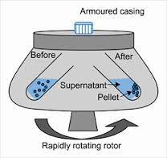
Principle of operation of Centrifuges
Centrifuge works using the sedimentation principle
Centripetal acceleration causes denser substances and particles to move outward in the radial direction.
The objects that are less dense are displaced and move to the center.
MoHFW /CDC / BD Partnership Project

Slide 5
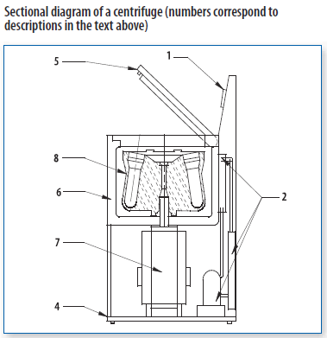
Key Components of Centrifuges
On and off control, operation time control (timer), rotation speed control (in some centrifuges), temperature control (in refrigerated centrifuges), vibration control (safety mechanism) and brake system.
Refrigeration system (in refrigerated centrifuges).
Vacuum system
Base
Lid cover
Casing
Electric Motor
Rotor.
3
MoHFW /CDC / BD Partnership Project

Slide 6
RPM vs RCF (g-force)
RPM
RCF
Depicts Revolutions per Minute – depicts how fast the rotor is rotating.
The force applied on the contents of rotor may differ from one model to another.
Depicts Relative Centrifugal Force - This is the force exerted on the contents of the rotor
Different centrifuges would result in similar separation at the same RCF
RCF depends on RPM and Radius of the rotor (calculations given below)
RCF = 1.1118 x 10⁻⁵ x r x rpm²
Where r is the rotor radius in centimeters
Use of RCF instead of RPM offers better indicator for centrifugation
MoHFW /CDC / BD Partnership Project

Slide 7
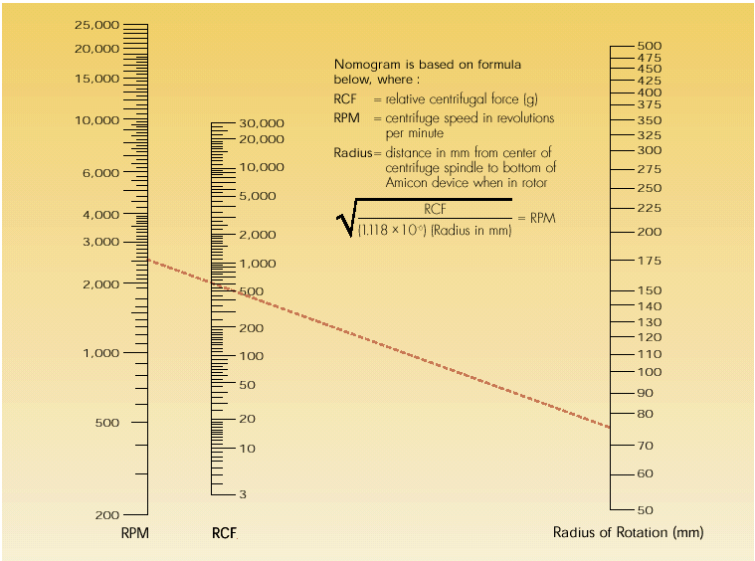
Use of Nomogram to calculate RCF
Easier to use
No calculator needed
MoHFW /CDC / BD Partnership Project

Slide 8
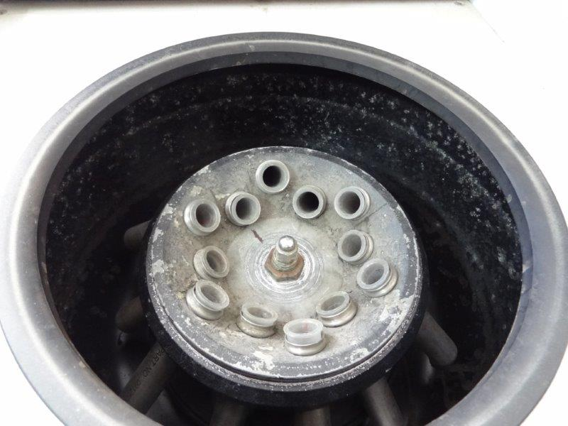
Good Centrifuge Practice
Centrifuges can be potentially dangerous - it is vital that they are properly maintained and used correctly.
Place the centrifuge on a firm level bench out of direct sunlight
Leave a clear area of 30 cm around the centrifuge
Always run with a full compliment of buckets, failure to do so can distort the rotor.
Ensure the rotor and all lids are tightened correctly before use.
Only use accessories intended for use in your particular centrifuge
Balance accessories and samples to within less than 2 gm per bucket.
Samples should be diametrically distributed evenly around the buckets.
High strength aluminum corrodes easily, to prevent this, remove adaptors and keep buckets clean and dry at all times.
Only clean aluminum buckets in a neutral pH cleaner. Do not use strong alkalis, acids or chlorine containing cleaners.
Condensation builds up in a centrifuge bowl will damage the motor and buckets. Allow this to evaporate by leaving the lid open at night with power switched off.
Corroded interiors
MoHFW /CDC / BD Partnership Project

Slide 9
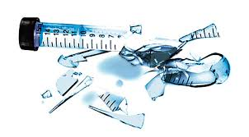
Good Centrifuge Practice
Use plastic tubes wherever possible.
Do not use thin-walled glass tubes or vials that are sold as ‘disposable’ to avoid breakage
While using glass tubes, use round-bottomed tubes as these are less easily broken than conical tubes.
Examine tubes and other containers for cracks or chips before using.
Discard any centrifuge tubes that have cracks in them.
When using a swing-out rotor centrifuge, make sure the tubes are not too long otherwise they will be broken when the buckets swing out to their horizontal position.
Place all tubes in safety buckets or sealed rotors when centrifuging infectious materials. Inspect the "O" ring seal of the safety bucket and the inside of safety buckets or rotors.
Do not overfill tubes, particularly when using a fixed angle rotor centrifuge. Leave a gap of at least 20 mm from the top of the fluid to the rim of the tube or container.
Do not insert a cotton wool plug or other loose fitting bung in a tube because this will be forced down into the fluid during centrifugation.
Cracked Tubes would break / leak
MoHFW /CDC / BD Partnership Project

Slide 10
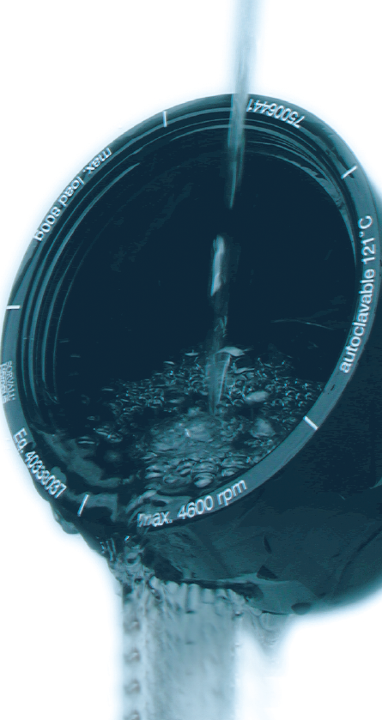
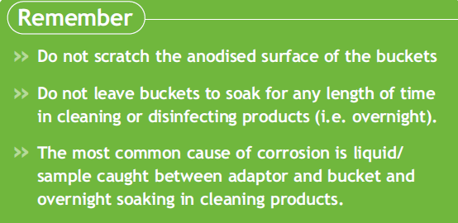
Procedure if breakage occurs
When a breakage occurs, great clouds of aerosols may be dispersed.
To reduce the risk of infection:
Switch off the centrifuge but do not open it immediately. Allow at least 30 minutes for the droplets to settle.
Wearing protective rubber gloves, remove and decontaminate the bucket and debris by autoclaving or boiling. Use forceps to dispose of the glass safely.
Clean the centrifuge rotor and bowl with a suitable disinfectant.
Centrifuge bucket cleaning
MoHFW /CDC / BD Partnership Project

Slide 11
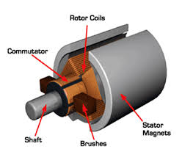
Maintenance of Centrifuges
Always disinfect the rotor bowl, centrifuge head, buckets and trunnion rings as applicable before any servicing of centrifuges
Most centrifuges become damaged and accidents occur because the buckets or rotor head have corroded or the buckets have not been placed correctly in the rotor.
Clean the centrifuge and tube holders weekly.
At least every 3 months, check the metal parts of the centrifuge for corrosion damage and cracks.
Examine regularly the electrical flex for signs of wear and check the plug for loose connections.
If the centrifuge is fitted with a brushed drive motor, the carbon brushes (as applicable) will require replacing periodically as instructed by the manufacturer. The motor will not run when the brushes have worn down. Prior sparking of the motor may occur.
Motor Brushes
MoHFW /CDC / BD Partnership Project

Slide 12

Calibration Verification of Centrifuges
Tachometer is an instrument used for measuring the rotation speed of a centrifuge.
The device displays the revolutions per minute (RPM)
Tachometers could be of two types:
  Contact Tachometers
  Non-contact Tachometer
The centrifuge tachometer reading should be within 5 % of the RPM reading obtained with the external tachometer.
Tachometer needs calibration from an accredited laboratory every six months.
Tachometer
MoHFW /CDC / BD Partnership Project

