Slide 1
Consensus Based Metrics
SDI and CVI
Comparing Yourself to Your Peers
Labs for Life Project
Quality Control Training

Slide 2
How do Inter-Lab Comparisons (Peer Groups) work?
Your laboratory enrolls in a inter-laboratory program offered by your QC manufacturer.
Your laboratory, along with other laboratories, analyze the same lot number of control materials for the month.
Your laboratory submits your QC results through a QC data management program to a central facility.
The central facility examines the data for outliers and calculates the means and SDs for the peer group and all-lab group, and SDI and CVI for your laboratory.
Your laboratory receives a report indicating your analytical performance.

Slide 3
How do you enroll?
Several IQC providers, make available ILC programs
Check with your IQC provider for such programs
Work it into the contract
Peer group comparison data may be considered as the most robust version of Inter Lab Comparisons.

Slide 4
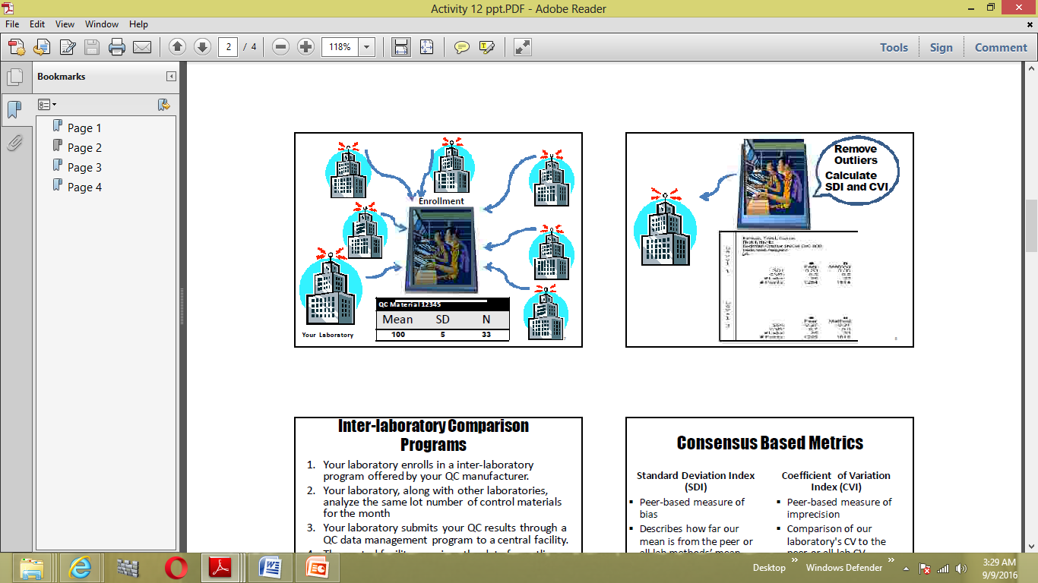

Slide 5
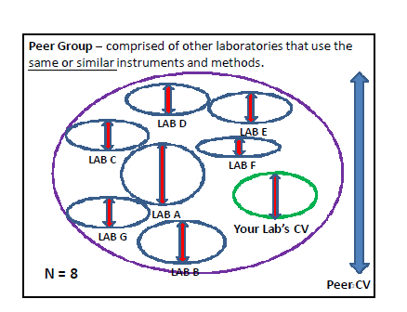
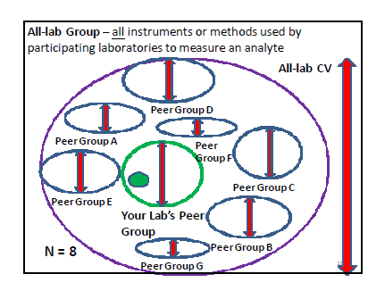
Many ways of comparing: within your method and equipment with all methods

Slide 6
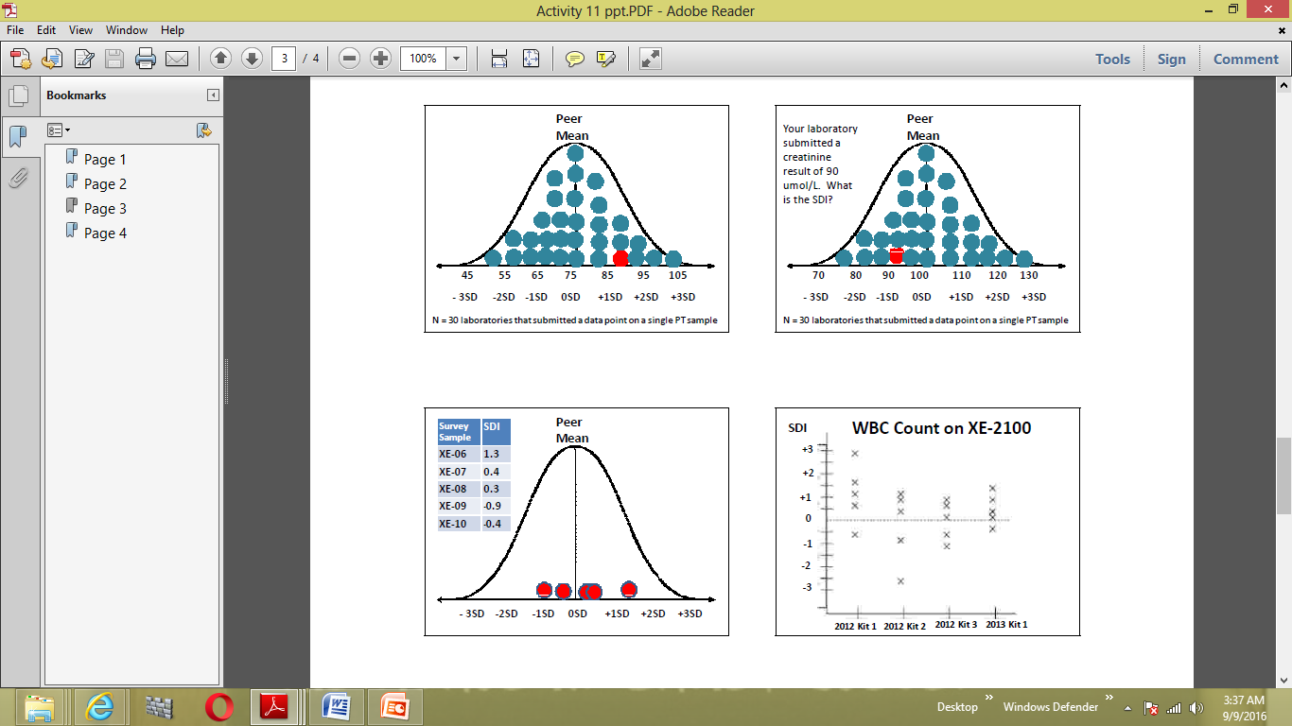
Standard Deviation Index
SDI: A check on Accuracy
SDI = (your result – expected result)/group SD

Slide 7
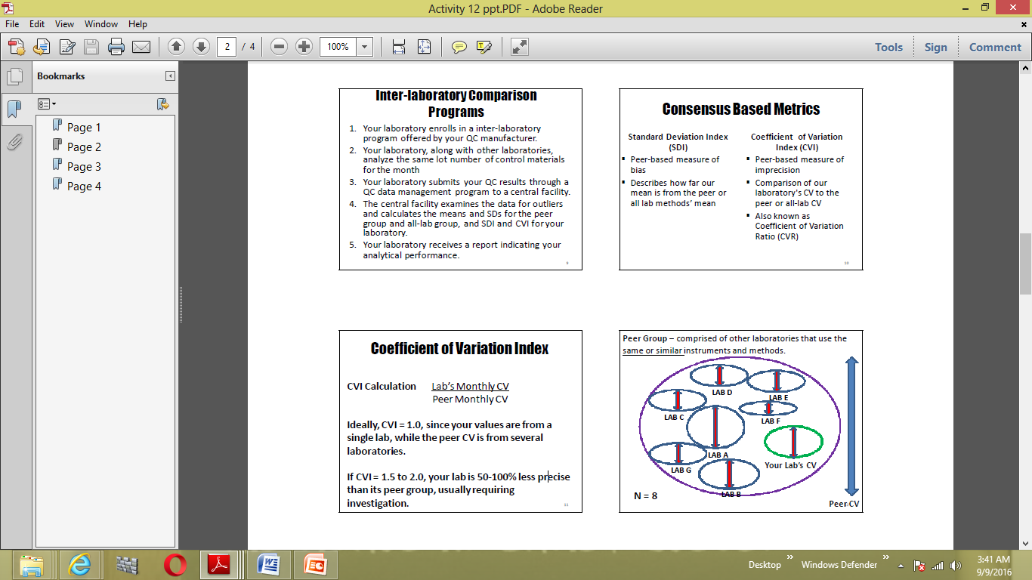
CVI: A check on Precision

Slide 8
Consensus Based Metrics;
The Differences
SDI
CVI
Peer-based measure of bias (Inaccuracy)
Describes how far our mean is from the peer or all lab methods’ mean
Has direction, + or -
Peer-based measure of imprecision
Comparison of our laboratory's CV to the peer or all-lab CV

Slide 9
Consensus Based Metrics;
The Acceptability
Any SDI of 2.0 or greater deserves some special concern, regardless what the test is.
Any test whose average (over a period of time) SDI is 1.0 or greater (+/-) deserves some special attention because your method shows a systematic difference from the group.
In the future, this bias might lead to unacceptable results.
Ideally, CVI ≤ 1.0, since your values are from a single lab, while the peer CV is from several laboratories.
The smaller the number, higher the precision in your lab.
If CVI = 1.5 to 2.0, your lab is 50-100% less precise than its peer group
CVI >2 is not acceptable

Slide 10
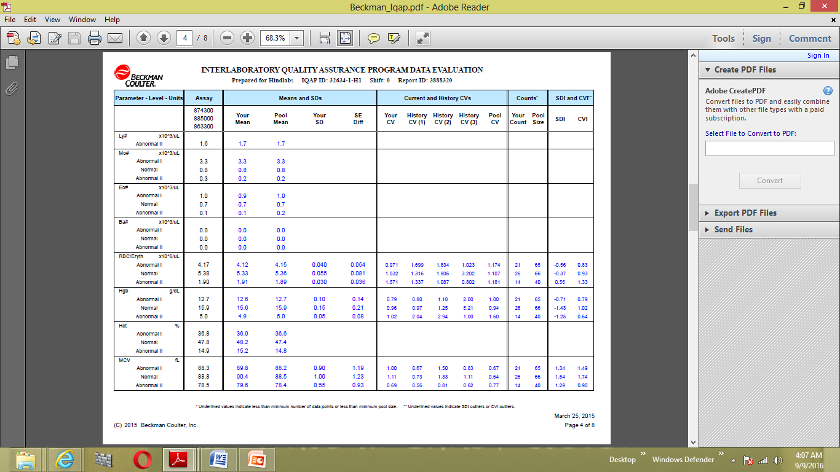

Using First Party Controls

Slide 11
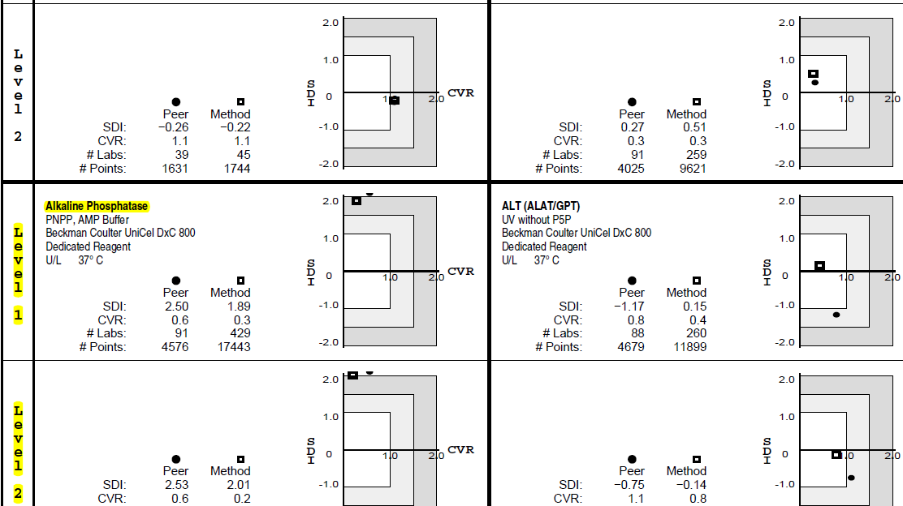
Using a Third Party Control; Enrolled
SDI and CVI for Peer as well as method

Slide 12
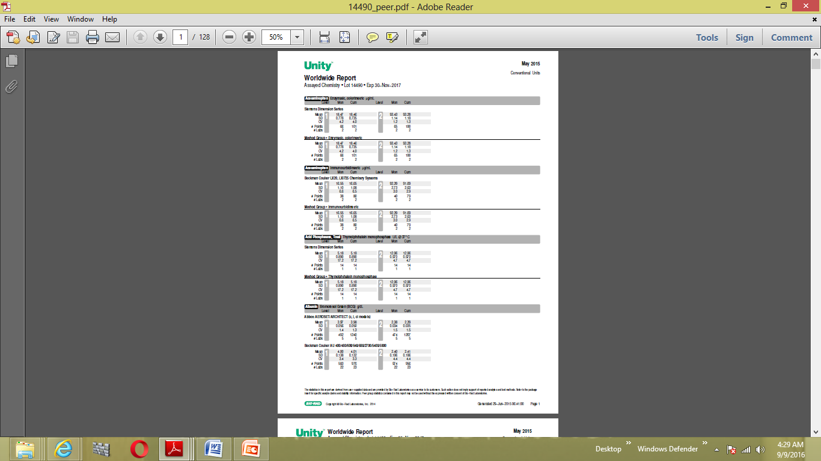
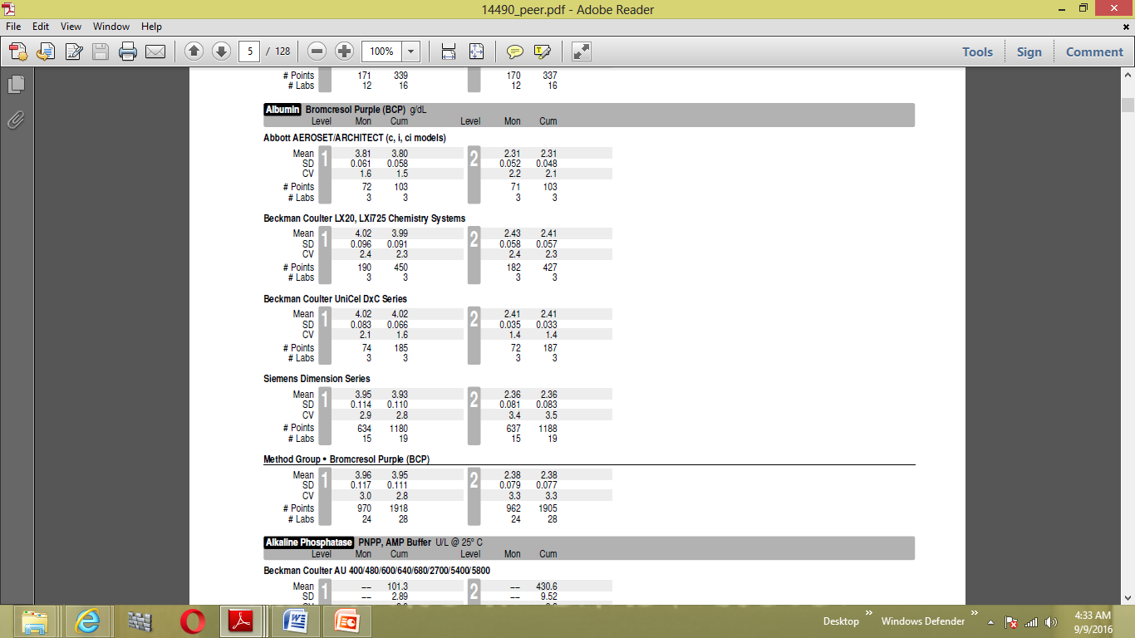
Using a Third Party Control; Not Enrolled
SD and CV for Peer as well as method. Calculations to be done by the lab

Slide 13
?
Thanks

