Slide 1
General Elements for Establishment of QMS
ISO 15189

Slide 2
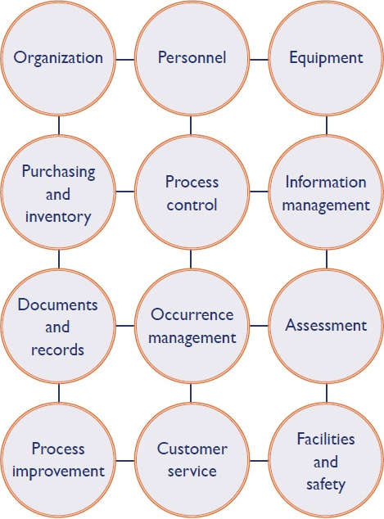

Slide 3
Contents
Legal & Ethical Requirements
Workflow, Assigning responsibilities and authorities
      Organogram
      Laboratory Director
      Quality & Technical Manager
Referral Laboratories
Service Agreements
External Services & Supplies
Summary

Slide 4
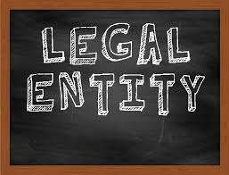
Legal Requirements
Legal entity is an association, corporation, partnership, proprietorship, trust, or an individual, that has legal standing in the eyes of law.
- Laboratory should comply with local / regional / national requirements, as applicable.
- A few statutory compliances have been listed below:
  No objection certificate from the Competent Fire Authority
  Authorisation under Bio-medical Waste Management Rules, 2016
  Clearance from State Pollution Control Board
- Other statutory requirements as per the state and national guidelines should also be followed.
(All district hospitals are government concerns and do not require separate legal identities)

Slide 5
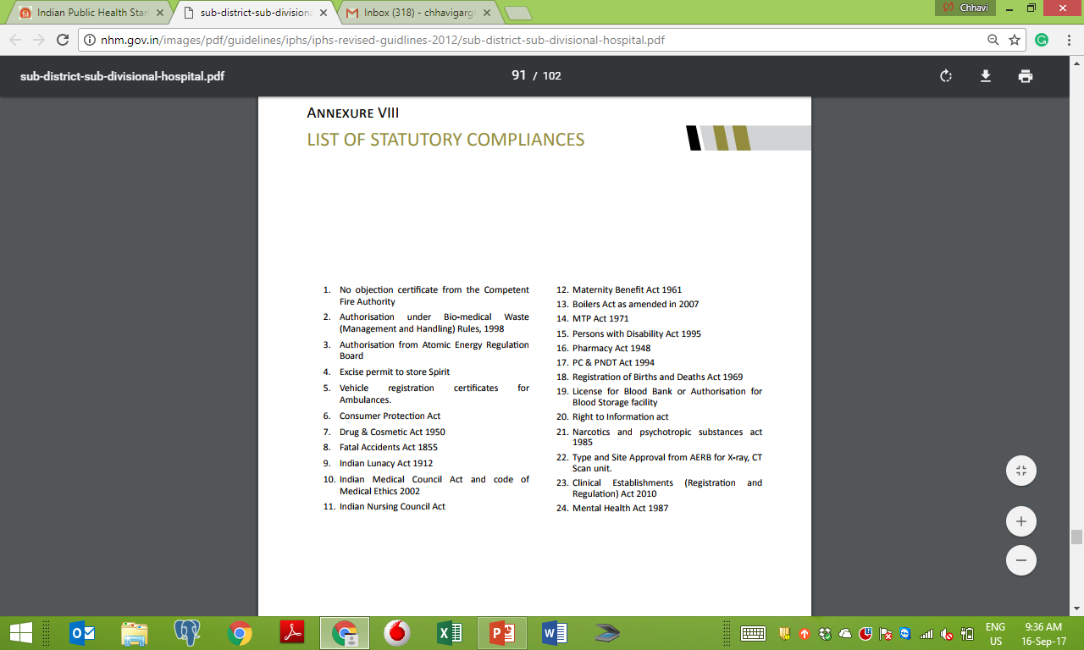
Excerpts from annexure 8, p.102, ‘List of statutory compliances – Indian Public Health Standards (IPHS): Guidelines for Sub-District/Sub-Divisional Hospitals

Slide 6

Ethical Conduct
Principle In Laboratory Ethics
Maintain Confidence in the Lab
Maintain Confidentiality
Avoid conflict of Interest
Statutory compliances
Autonomy
Beneficence
Non-maleficence
Justice
A discipline dealing with what is good and bad, with moral duty and obligation.”
“The set of moral principles by which people conduct themselves personally, socially or professionally.”

Slide 7
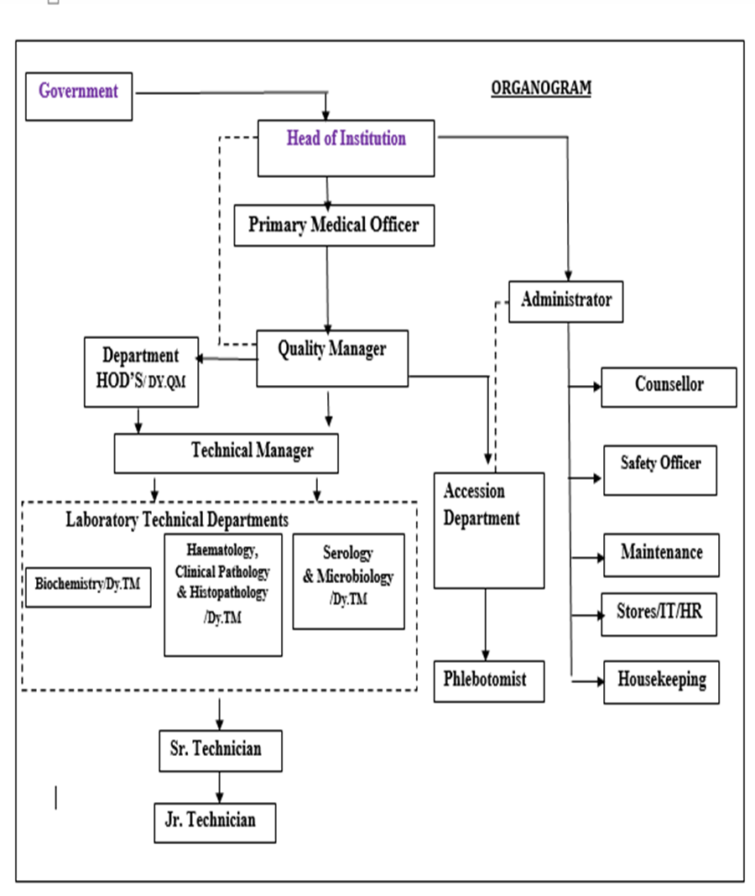
Organogram
Organizational chart defines
the work path flow for the organization;
organizes jobs along lines of authority; defines reporting structure and span of control;
defines authority to make decisions and accountability for results;
works together with job descriptions to define the working structure of the organization.
(Laboratory Quality Management System Handbook, WHO)

Slide 8
Laboratory Director
A LABORATORY DIRECTOR is a person/persons who directs the laboratory with the competence and skills and delegated responsibility for the services.
Professional & Scientific
Clinical Interpretation Of Laboratory Data
Consultative /Advisory
Communication with Physician and patient, if needed
Organization-al & Educational
Maintain QMS
Administrative
Availability of Resources
Monitoring of Lab Processes
Establish QMS
Request for additional Tests
Provide Safe work environment to lab staff
CME for lab staff
Implement QMS

Slide 9
Quality & Technical Manager
Quality Manager
Technical Manager
Quality Manager is the bridge between the management and the technical teams.
Holds a very key role
Designee shall be trained in 4-days Quality Management as per ISO 15189
  She / He should be a full time employee
  Can be delegated with additional responsibilities
Responsible for technical aspects of a lab (pre-analytical, analytical and post-analytical)
Work with management and technical teams
Support Quality Manager to maintain and implement QMS

Slide 10
Quality Policy & Objectives
The quality policy is the mission statement and expresses the intent of the management to establish a QMS
It should be
    Appropriate to the services
    Include commitment to good professional practice, quality of examinations, complies with the International Standard and continual improvement of the quality of laboratory services
    Provide a framework for establishing and reviewing quality objectives
    Communicated and understood within the organization
    Reviewed for continuing suitability
Lab should establish quality objectives in alignment with Quality policy and meet the needs and requirements of the user
Should be measurable and consistent with the quality policies

Slide 11
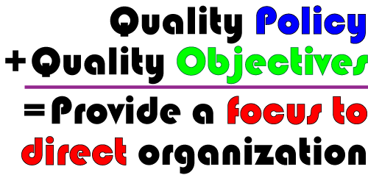

Slide 12
External Services & Supplies
The laboratory should have a procedure to select and approve suppliers
The services should be timely evaluated
The external services includes equipment, reagents and consumable supplies
Ensure quality assurance in every aspect of lab operations
Equipment
AMC/CMC
Onsite Support Services
Downtime etc.
Consumables
Timely supply
Quantity
Reagent
Maintenance of Cold chain
Long Expiry
Supply of Steady lots
Performance Characteristics

Slide 13

Service Agreements
The lab should have policy and procedures for preparation and review of service agreements with its users
Patient test request is a service agreement that the lab acknowledges to be committed for!
Few conditions must be met:
    Meets requirements of users and lab
    Adequate resources with the lab
    Skill and technical expertise to perform the test requested
    Test as per intended use
    Pre-information to users by lab in case of deviations from agreement
    Reference to referred lab/consultant

Slide 14
Referral Laboratories
Effective turnaround time
ISO15189
Accredited
No Conflict of Interest
Compliance to Safety requirements
Qualified and Competent Staff
Quality Management System
Provides timely advisory services
EQA & IQC practices (Precise and Accurate Testing Results)
Facility & Equipment Mngt. Program in place
Referral laboratory is an external laboratory to which a sample or sub-sample is submitted for a supplementary or confirmatory examination and is considered to have a similar or preferably better quality system
Implies to Sample referral not patient referral

Slide 15
SUMMARY
Legal and ethical requirements should be followed strictly
Every lab should define Quality Policy and Quality Objectives
Organogram should be displayed in lab
Role of Laboratory director, quality manager and technical manager is essential to establish, maintain and implement QMS
Fulfillment of referral services in accordance with lab defined criteria
Evaluation of external services and supplies

Slide 16
Thanks

