Slide 1
Central Tendency
Labs for Life Project
Quality CONTROL TRAINING

Slide 2
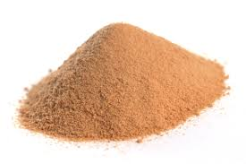
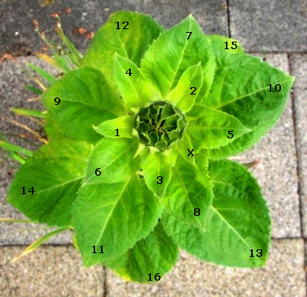

Why do things cluster around/ towards a point?

Slide 3
Clustering of Data around central points
What is data?
Facts and statistics collected together for reference or analysis
What is a data-set?
A data set (or dataset) is a collection of data.
Why and how do data sets cluster around a central point?
Let us see some examples

Slide 4
Data Set/Data Points: Some examples
1. Temperature of freezer for the month of July 2016.
    -2.0, -2.6,- 3.2, -3.0, -3.2, -3.0, -2.6, -2.4, -3.0, -3.2...
2. E.g. Data set of Hb value of 5 normal adult men.
    14,14.5, 15, 14.8, 14.9
3. Salaries of 6 people in an office
    13,000, 20,000, 25,000, 15,000, 17,000, 1,20,000
4. Transportation taken by people attending MGIMS OPD/day
    Car: 50, bus: 2000, train: 200, auto: 300, walking: 100

Slide 5
Central Tendency
The values of repeated measurements will be distributed around a single central point or location.
This characteristic of repeated measurements is known as Central Tendency.

Slide 6
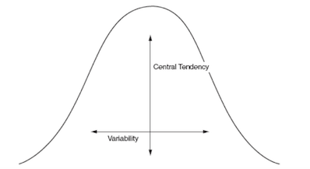
In the above examples (slide 4), There is a central point around which the data points arrange themselves with some amount of variability.
We have to choose the best central point. But how?

Slide 7
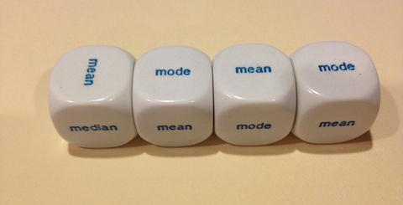
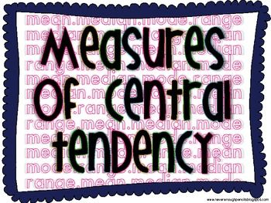
These single central points around which data cluster are:
Mean, Mode or Median.

Slide 8
Measures of Central Tendency
Three measures of the "center" of the data:
  The Mean (average)
  The Median (middle)
  The Mode (most)

Slide 9
Measures of Central Tendency
Mean
the calculated average of all the values in a given data set.
Median
the central value of a data set arranged in ascending order.
Mode
the value which occurs with most frequency in a given data set.
The mean, median and mode are all valid measures of central tendency, but under different conditions some measures of central tendency become more appropriate to use than others.

Slide 10
Measures – ‘Mean’
Mean = arithmetic average
= X bar (as spoken)
= X (as written)
X = Σ X
n
where Σ X = sum of X’s
and n = sample size

Slide 11
Example of a ‘mean’ value
Find the Mean value of: 4,6,7,9,4.
X
= Σ X
= 4 + 6 + 7 + 9 + 4
n
5
= 30
5
= 6

Slide 12
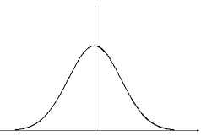
Some information on Mean:
Is the most popular and well known measure of central tendency
Mean may not be one of the actual values that observed in your data set.
It includes every value of the data set as part of the calculation.
It is the only measure of central tendency where the sum of the deviations of each value from the mean is always zero.
The mean has one main disadvantage: it is particularly susceptible to the influence of outliers
Let’s see in the examples……

Slide 13
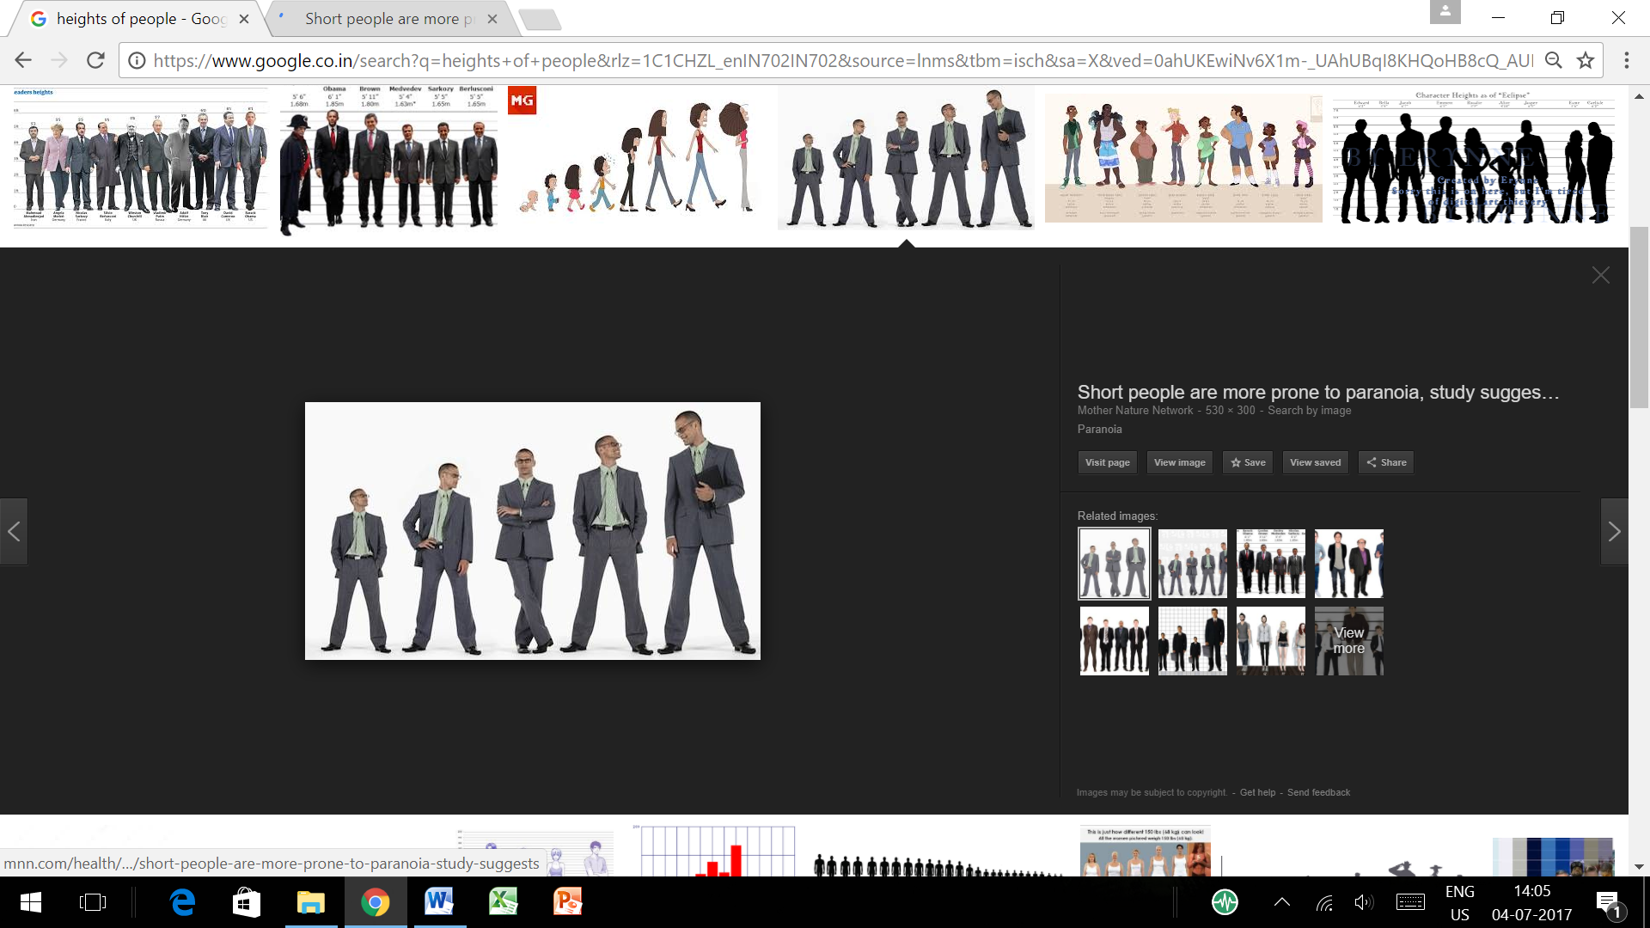

Slide 14
From the examples on slide 3
    Fridge temperatures:
    -2.0, -2.6,- 3.2, -3.0, -3.2, -3.0, -2.6, -2.4, -3.0, -3.2
    Sum is -28.2 and mean is - 2. 82 which was not a value in the data set, all data points are included in the calculation and produces the lowest amount of error from all other values in the data set.
    Hb Values:
    14,14.5, 15, 14.8, 14.9. Sum is 73.2 and Mean is 14.64 which was not a value in the data set, all data points are included in the calculation and produces the lowest amount of error from all other values in the data set.

Slide 15
From the examples on slide 3
    Salaries:
    23,000, 20,000, 25,000, 25,000, 27,000, 2,80,000
    Sum is 4,00,000 and Mean is 66,666. One high earner, pulls the mean to the higher side, misrepresenting the central point. This creates an error as none of the values are clustering around this number, giving rise to skewing.
    Here the choice of the central number is not the mean.
    Transport:
    Car 50, bus 2000, train 200, auto 300, walking 100
    Sum 2650, Mean: 662.5. This also gives a false impression as the values do not represent the central number
    Here the choice of the central number is not the mean.

Slide 16
Statistics – ‘Median’
Median = middle value
Half of the values are greater than the median and half are less than the median, when the values are placed in numerical order.

Slide 17
‘Median’
To find the median of a group of items:
1. Rank the items.
2. If the number of items is odd, the median is the middle item in the list.
3. If the number of items is even, the median is the mean of the two middle numbers.

Slide 18
Example of a ‘median’ value
Find the median value of: 4,6,7,9,4.
Put the numbers in numerical order:
4, 4, 6, 7, 9.
The middle number is the median:
4, 4, 6, 7, 9.
4, 4, 6, 7, 9.
The median number is 6

Slide 19
Example of Median
Find the median value of: 3, 2, 2, 1, 1, 6, 3, 3, 4, 2.
Data in order: 1, 1, 2, 2, 2, 3, 3, 3, 4, 6
Median = (2+3) / 2 = 2.5

Slide 20
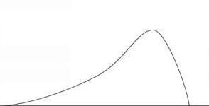
Some information on Median:
The median is the middle score for a set of data that has been arranged in order of magnitude.
The median is less affected by outliers and skewed data.
It is an actual value that observed in your data set.
The sum of the deviations of each value from the median is variable.
Let’s see in the examples……

Slide 21
From the examples on slide 3
    Salaries:
    23,000, 20,000, 25,000, 25,000, 27,000, 2,80,000
    One values is far higher than the other 5, skewing the data and dragging the mean to a false high. The higher-earner provides a false representation of the typical income if expressed as a mean and not a median.
    The more skewed the distribution, the greater the difference between the median and mean, and the greater emphasis should be placed on using the median as opposed to the mean.
    20,000, 23,000, 25,000, 25,000, 27,000, 2,80,000
    The 2 mid values are 25,000 and 25,000. Hence the Median is 25,000 and can be considered to be the best representative of the central location of the data

Slide 22
From the examples on slide 3
    Transport:
    Car 50, bus 2000, train 200, auto 300, walking 100
    Median here is: 200
    50, 100, 200, 300, 2000
    This again is mis-representative as it does not give an idea about the popular mode of transportation, the central point where the data clusters.
    Here the choice of the central number is not the mean or median.

Slide 23
Statistics – ‘Mode’
Mode = most frequently occurring value
Find the mode of 4,6,7,9,4, 5, 3
The most frequent, or mode is 4

Slide 24
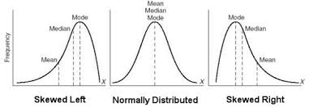
Some information on Mode:
The mode is used for categorical data where we wish to know which is the most common category
However, one of the problems with the mode is that it is not unique, if there are two or more values that share the highest frequency, it will show bi-modal/ multi- modal
Let’s see in the examples……

Slide 25
From the examples on slide 3
    Transport:
    Car 50, bus 2000,, auto 300, walking 100, train 200
    Here, as the data is captured it is evident that bus, with 2000 data points is the central point of the data set
    If on the other hand if the numbers were;
    Car 50, bus 1500, auto 300, walking 100, train 1400; the distribution would be bi-modal with both bus and train
Single mode
Bi-modal

Slide 26
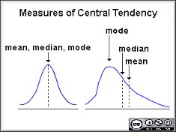
When mean=median=mode and when mean≠ median ≠ mode

Slide 27
Which measure of Central Tendency will you choose as a QC monitoring tool? And why?
Normal distribution is exhibited by well-preserved biological material on repeated examination where mean=median=mode
This property is used in the statistical quality controls.

Slide 28
What is Normal (Gaussian) distribution?
Normal distribution exhibited by well-preserved biological material on repeated examination.
This property is used in the statistical quality controls.
F
r
e
q
u
e
n
c
y
Measurement
Notes:
Normal distribution

Slide 29
Recap….Central Tendency
Normal or Gaussian Distribution
Bimodal Distribution
Mode ≠ Median ≠ Mean
Mode = Median = Mean
Skewed Distribution

Slide 30


