Slide 1
Quality System Essential:
Inventory Management
Quality Management of
Laboratory Material
ISO 15189: 2012

Slide 2
Inventory management
Quantity Management
Ensuring the quantity of supplies as required so as ensure smooth workflow
Serves to prevent stock outs and maintain turnaround times (TAT)

Slide 3
Quality management – WHY ?
Reliable diagnostic services require monitoring the quality of its inventory flow
Ensuring quality of material is an integral part of quality assurance in the laboratory
The primary error prevention step: Quality Reagents

Slide 4
Quality Controls (IQC/EQA) used for monitoring of the precision/accuracy of analytical system, are dependent on supply of quality reagents
  Checking the quality of reagents and consumables before procuring/using them
  Important interfering variable in the final patient report

Slide 5
Quality Management – HOW ?
Selection and procurement of diagnostic laboratory materials is challenging given the
  Wide choice of products and suppliers
  Procurement policies prevalent in the system
A series of steps must be followed to ensure the quality of materials used in the laboratory

Slide 6
Quality Management
Introducing a new method/ Retendering for an existing test
For tests already in use

Slide 7
Understanding Utility and Feasibility

Slide 8
Understanding requirements for the NEW test: Initial thoughts
Clinical utility
Understand the needs of patients and users
Understand the performance of a test
Feasibility
Test demand
Cost effectiveness
Operationalizing

Slide 9
Clinical utility
(Need and Performance)
Discovery of novel biomarkers e.g. Lp(a), homocysteine
Change in disease trends e.g. Swine flu
Recent advances in assay methods e.g. Immunoassay, quantitative Trop I
Different testing objectives e.g. screening, confirmatory, treatment monitoring, surveillance etc
Relevance: diagnostic sensitivity & specificity, positive & negative predictive values (Literature, guidelines, pilot studies)

Slide 10
Feasibility
Cost inputs
Reagents
Quality controls
Proficiency testing
Calibrators
Equipment
Cost cutting
Improved TAT
Better performance
Improved safety

Slide 11
Survey the market for products

Slide 12
Market survey
Researching the available test options by interacting with the vendors
Different product kit inserts should be consulted to understand the differences in performance characteristics of the various kits

Slide 13
Understand Operationalizing Requirements

Slide 14
Challenges in Operationalizing
Test complexity
Compatibility with current equipment/ infrastructure/LIS
Staffing/training requirements
Space/ Open system/ Closed system
IQC/EQA requirements/ availability
Type and quantity of sample required
Patient/sample preparation required
Pre-analytical acceptance criteria and possible errors
Sample storage criteria

Slide 15
Initial thoughts…..
Gathering Evidence
Ensuring quality of the manufacturing process

Slide 16


Ensuring quality of the manufacturing process
The specification may request products that have been approved by national and international regulatory agencies e.g. FDA, CE, WHO etc.

Slide 17
Understanding Performance Specifications stated by manufacturers

Slide 18
Quality requirements, Fitness for Purpose
All laboratory measurements carry some uncertainty/error
Different testing objectives e.g. screening, confirmatory, treatment monitoring, surveillance etc.
Lab must decide the level of error which could be acceptable/ allowable: Quality Specifications

Slide 19
Quality requirements/ Specifications,
Fitness for Purpose
  Precision (Dispersion of results in repeated examinations)
  Bias (Accuracy/ Comparability)
  Linearity (AMR)
  Analytical sensitivity, LoB, LoD, LoQ
  Analytical Specificity, interferences
  Biological Reference Interval (BRI)

Slide 20
Which reagents?
For all reagents: Sensitivity, Specificity
Tests with numerical results: Deliberation on Precision, Accuracy, Linearity, BRI

Slide 21
Precision
The agreement of the measurements of replicate runs of the same sample.
It may be understood as the dispersion of repeated measurements about the mean value.
Precision is measured in terms of coefficient of variation (CV).
Most reagent manufacturers specify
    repeatability (intra-assay/within-run precision)
    intermediate (inter-assay/between-run) precision.
This also will be specified for different clinical decision levels.

Slide 22
An example….

Slide 23
Accuracy
Comparability: Accuracy or trueness is the degree of closeness of measured values (using a given method) to the true/correct value and comparability of the method to the reference method
Bias is a quantitative measure of the average difference between results from a given measurement procedure and results from an accepted reference measurement procedure.

Slide 24
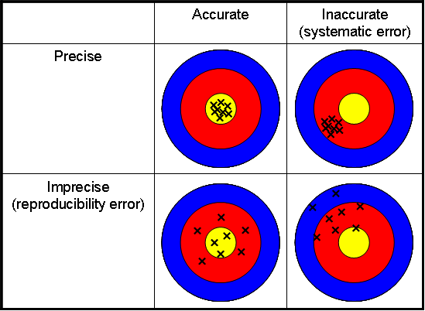

Slide 25
How is accuracy denoted on a kit insert?
‘Method comparison’ in the kit insert.
Data from Regression analysis (Correlation Coefficient, Slope, and Intercept)
Data from Difference Calculations

Slide 26
Data from Regression analysis (Correlation Coefficient, Slope, and Intercept)
The correlation coefficient denotes the comparability and should be > 0.975%. The ideal is 1.
The slope and the intercept denote the bias from the reference methods. The number of samples compared and the measurement range covered for comparison studies are also given.

Slide 28
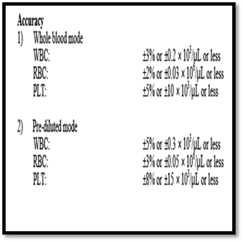
Data from Difference Calculations

Slide 29
Linearity
Analytical measurement range (AMR): Linearity is the range of analyte values that a method can directly measure on the specimen without any dilution, concentration, or other pretreatment not part of the usual assay process.
It indicates the consistency of imprecision and accuracy (bias) over the range of measurement.
A higher range gives better advantage in analysis

Slide 30
An Example…
The Glucose procedure is linear from 10 - 800 mg/dL for serum and cerebrospinal fluid determinations;
10 - 700 mg/dL for urine determinations. Samples exceeding the upper limit of linearity should be diluted and repeated. The sample may be diluted, repeated and multiplied by the dilution factor automatically by utilizing the AUTO REPEAT RUN.

Slide 31
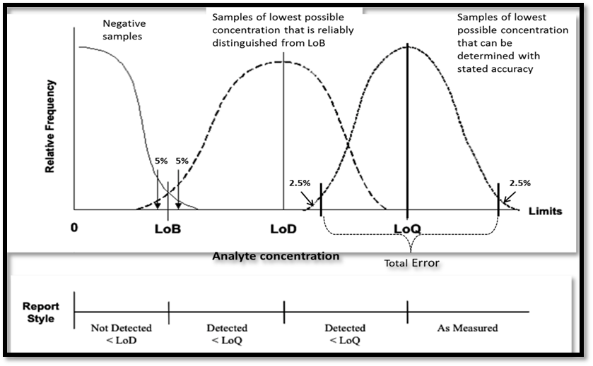
Analytical Sensitivity
It is defined as the lowest concentration of an analyte/ substance that can be distinguished from background noise.
Limit of Blank (LoB)
Limit of Detection (LoD)
Limit of Quantitation

Slide 32
Analytical Specificity
It is the ability of an assay procedure to determine the concentration of a target analyte without influence from other (potentially interfering) substances or factors in the sample matrix.
Includes:
  cross reactivity
  Interference
    Endogenous
    Exogenous

Slide 33
Cross reactivity
Cross Reactivity: refers to the erroneous recognition of antigenically similar substances e.g. genetically related microorganisms, cross reacting antibodies/ antigens, etc

Slide 34
Interference
Interference is an artefactual increase or decrease in the apparent quantity of an analyte due to the presence of a substance that reacts nonspecifically with the measuring system.
Endogenous interferences include hemolysis (hemoglobin), icterus (bilirubin), lipemia, medications, binding proteins
Exogenous interferences are caused by the introduction of external factors or conditions not normally present in native, properly collected and stored samples e.g. blood collection tube additives, serum separators.

Slide 35
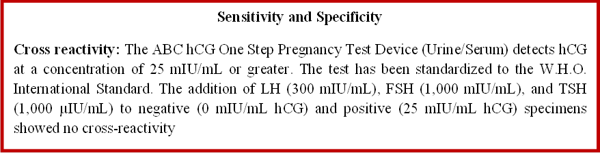
Sensitivity Specificity an example..

Slide 36
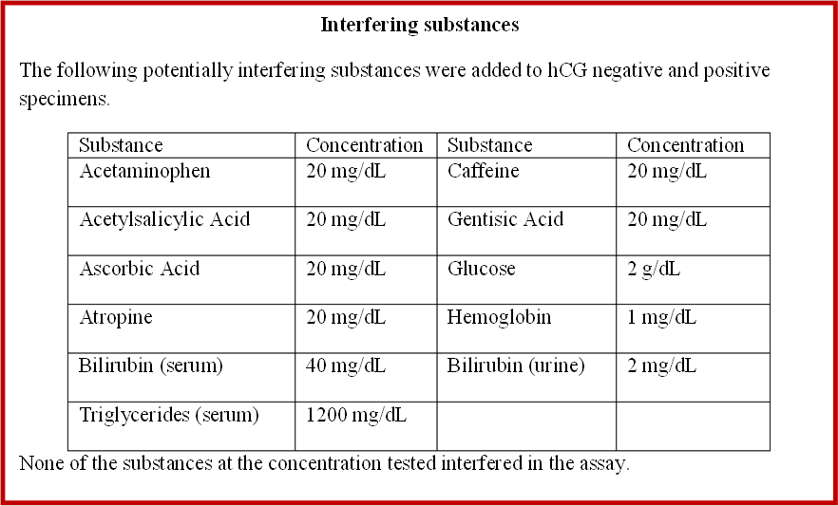
Specificity, an example..

Slide 37
Biological Reference Intervals
When measurement of an analyte is performed in a group of well-defined reference individuals, the central 95% interval of results obtained is referred to as the Biological Reference Interval for that analyte.
It is frequently provided as the interpretive information along with laboratory test results.
It may vary for different demographic samples according to genetic and environmental factors.

Slide 38
Deciding on which reagent to purchase
Quality requirements, Fitness for Purpose
Comparing the Stated Claims against Acceptable Error Specifications

Slide 39
Acceptable error – where to look ?
Published literature – documented quality specifications for the test e.g. BV database
Guidelines by international/national experts/ groups
Regulations e.g. CLIA
EQA/PT schemes: They recommend acceptable error based on participant provided data
Professional judgment

Slide 40
Milan Mandate 2015
Gives a hierarchy of sources to set performance goals
Goals based on analytical performance related to Clinical Outcomes
Goals based on Biological Variation
Goals based on everything else e.g. Expert group opinions/ guidelines, EQA/PT goals

Slide 41
Some resources
(online databases)
Biological Variation database
CLIA requirements for analytical quality
RCPA (Royal College of Pathologists of Australasia)
French/Belgian EQA performance specifications
European biologic goals
RiliBAK (Guidelines of the German Federal Medical Council)

Slide 42
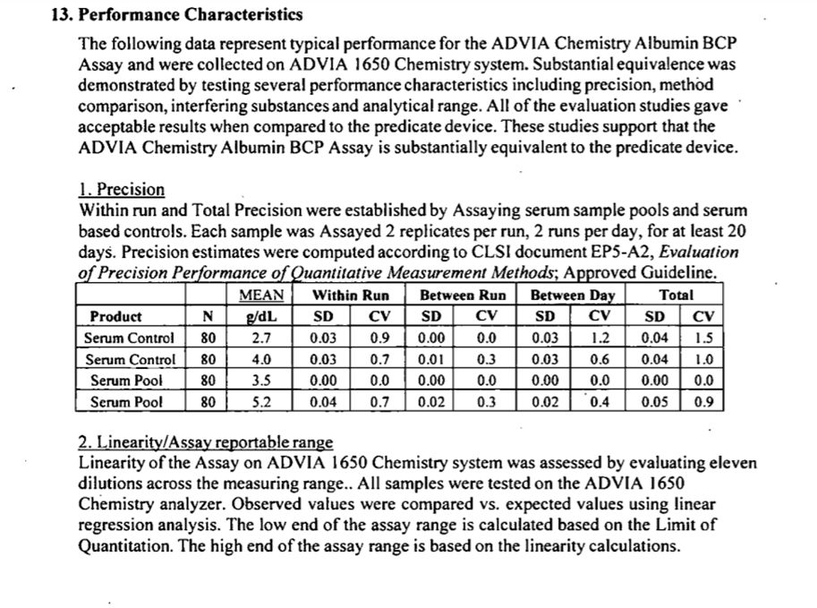
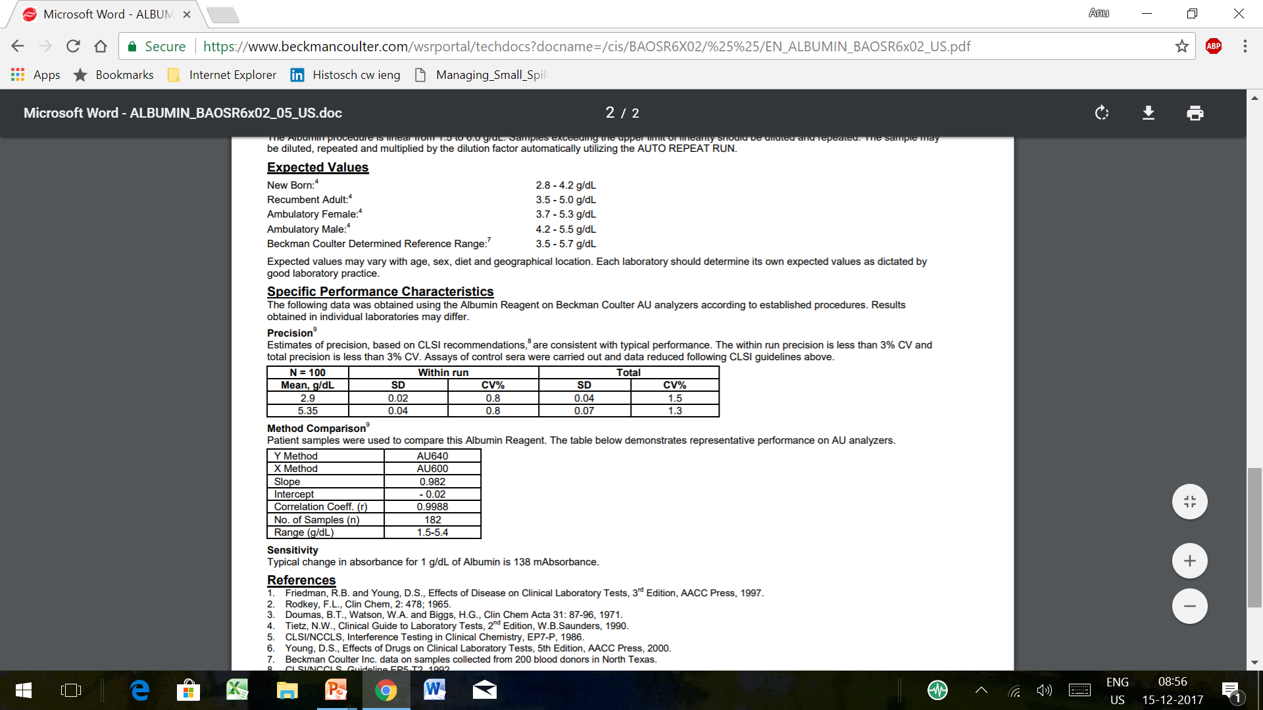
Comparing Manufacturers’ statements
Manufacturer A | Manufacturer B

Slide 43
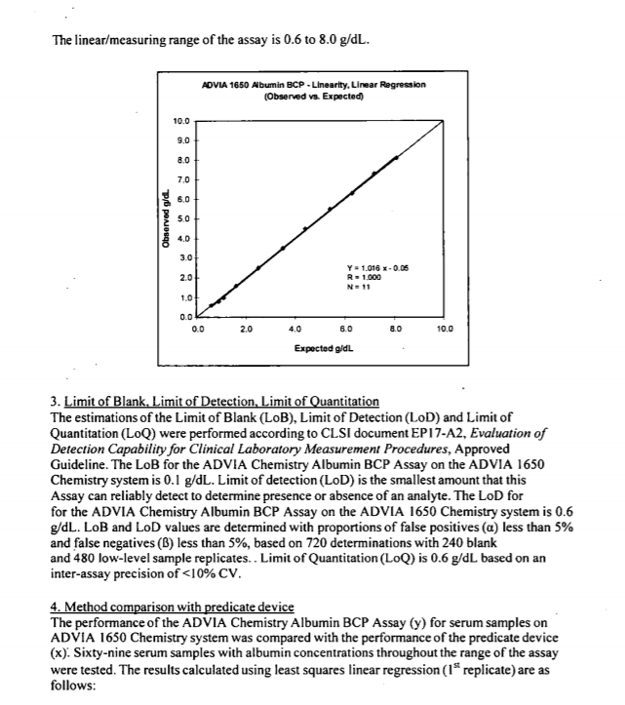
Comparing Manufacturers’ statements

Slide 44
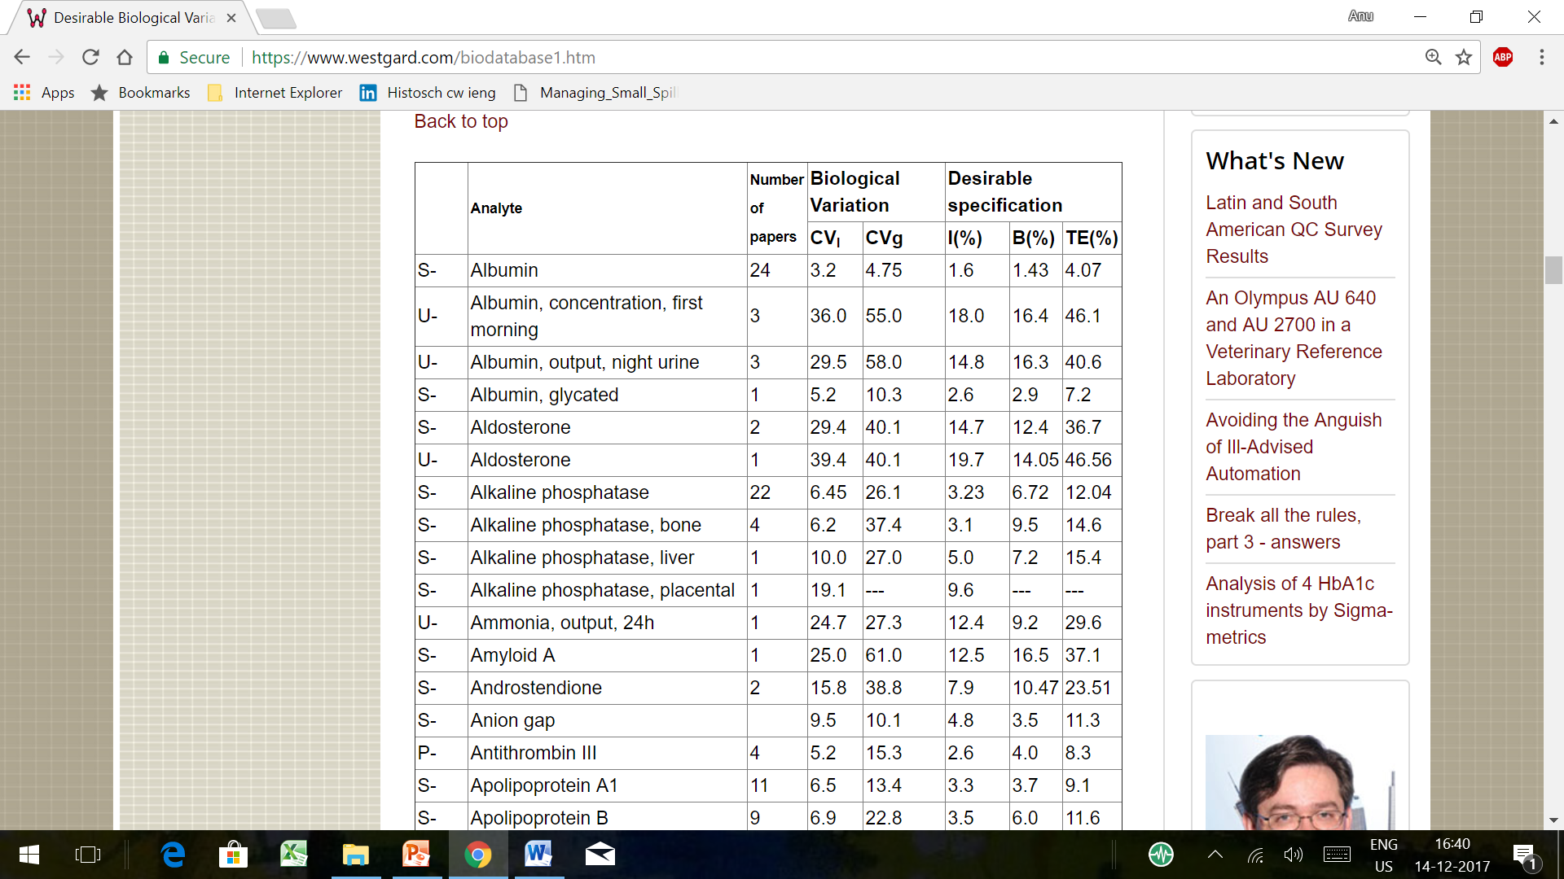
Understanding QUALITY REQUIREMENTS
Desirable Biological Variation Database specifications
CV_{I} = within-subject biologic variation CV_{G} = between-subject biologic variation I = desirable specification for imprecision | B = desirable specification for inaccuracy TE = desirable specification for allowable total error

Slide 45
Understanding QUALITY REQUIREMENTS
Published Sources

Slide 46
Develop Checklists, assess
Brand | FDA /CE/ Other approvals | Precision |  |  | Accuracy |  |  |  | Linearity | Sensitivity | Specificity | Score
 |  | MDP 1 |  | MDP 2 | r | Slope | Intercept | %Bias
X
Y
Z

Slide 47
Understanding how to include Commercial aspects

Slide 48
Extras that you can include into the process:
Post-purchase verification process
Quality assurance through acceptance testing
Application support
Complaint resolution mechanisms
Review of agreement
Supplier track record evaluation

Slide 49
Writing Technical Specifications Correctly, to your advantage
Writing Technical Specifications thus includes:
Quality Specifications
Operational Specifications
Commercial Specifications

Slide 50
Two bid systems
The procurement of reagents and consumables generally follows a two-bid system where tenders are invited in two parts
  Technical Bid
  Price/ Financial Bid

Slide 51
Tips…
Maintain transparency
Be objective: minimize extraneous undue influences on the process
Ensure reliability of suppliers, in terms of quality and service
Conclude the process within the shortest possible time span

