Slide 1


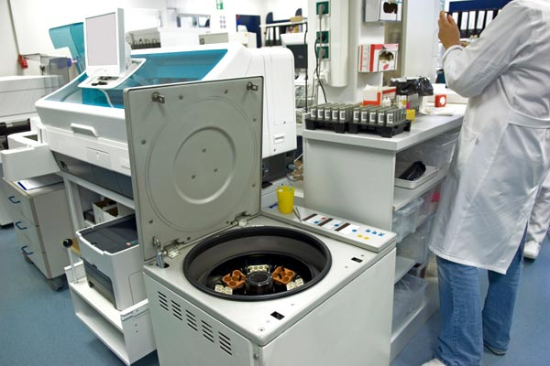



LABS FOR LIFE PROJECT - INDIA
Equipment Management
MoHFW /CDC / BD Partnership Project

Slide 2

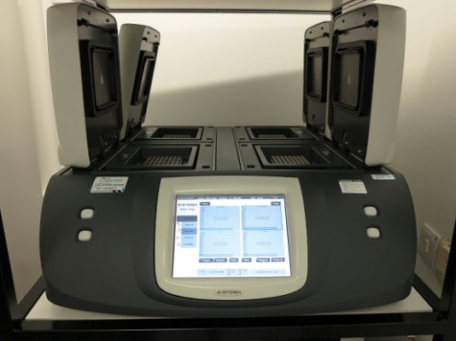
Thermocycler
Introduction
Thermocyclers are instruments used to amplify DNA and RNA samples by Polymerase Chain Reaction (PCR).
The device has a thermal block with holes where tubes holding the reaction mixtures can be inserted.
The cycler then raises and lowers the temperature of the block in discrete, pre-programmed steps.
Purpose
Detection of the microbe and drug resistance
Cloning
Sequencing
Genotyping

Slide 3
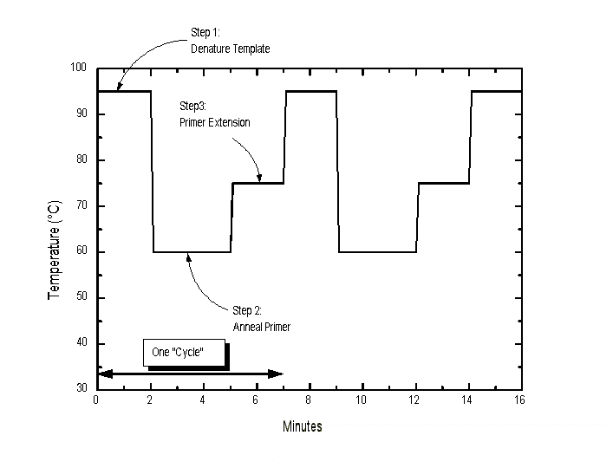

PCR Amplification Cycle
  3 major steps in a PCR cycling reaction, which are repeated for 30 or 40 cycles:
    Denaturation at 94°C
    Annealing at 55°C
    Extension at 72°C

Slide 4
Polymerase Chain Reaction
Logarithmic amplification of a specific DNA segment by a thermocyclic reaction
Components of PCR :
    Template DNA or RNA
    Sense and antisense oligonucleotide primers (18-30 nucleotides)
    dNTP monomers (A,C,G,T)
    Thermostable DNA polymerase (e.g. Taq) or rTth DNA Polymerase in case RNA is being amplified

Slide 5
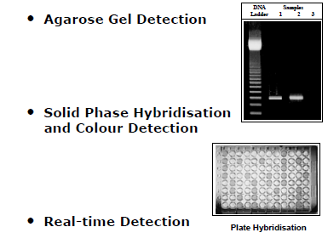
Detection of PCR Products

Slide 6
Real Time PCR
A method that allows to follow amplification of a target in real time
Real-time PCR thermocyclers can be used with both DNA and RNA.
When amplifying RNA, reverse transcriptase is used to make cDNA and then amplified DNA is analyzed
Amplification and detection of pathogens is carried out in the same cycler and same time, hence, the name “real time”.
Combining nucleic acid amplification and detection eliminates the post-amplification process.
Real-time PCR is the continuous collection of fluorescent signal from one or more PCR reactions over a range of cycles.
The presence of amplification products results in fluorescence which is detected and monitored as the PCR proceeds.
Quantitative Real-time PCR is the conversion of the fluorescent signals from each reaction into a numerical value for each sample.
This has many advantages including less time taken & minimal chances of contamination since the cycler does not open before the final product.

Slide 7
Real Time PCR machine
The Real Time PCR machine has the following main parts
  Thermal Cycler for amplification
  A light source for excitation of fluorescent dyes
  A camera for recording
  A computer to control the instrument and record/analyze data
Uses
Precise quantitation of DNA or RNA in samples
Estimation of gene number
Gene expression studies by quantification of messenger RNA

Slide 8
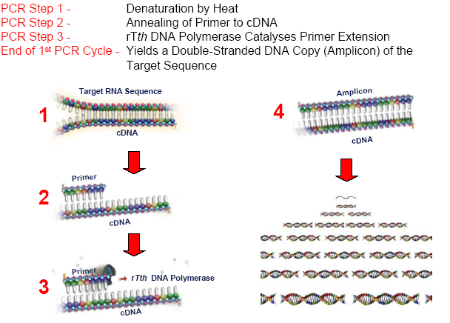
Summary PCR Cycle

Slide 9
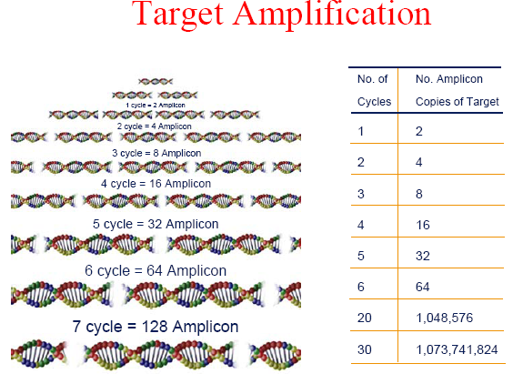

Slide 10
General Tips for Care and Maintenance
Keep the machine in a cool, dry place
Always use a UPS- Do not connect the machine directly to the power source
Keep the room and the area around the machine “dust free”
Switch off the machine when not in use. Disconnect from power supply at the end of the day
Keep the manual of the machine near the machine
Maintain a log book-Who? When?
Paste the business card of the service engineer on the side of the machine

Slide 11
Maintenance and Calibration
Maintenance
Ensure that unit is dry and cool and that the power supply is disconnected before performing any cleaning or maintenance.
Regular function checks to be performed to check critical characteristics and detect malfunctions before test results are affected.
An equipment maintenance and performance evaluation log should be maintained and kept for the duration of clinical use of thermocycler.
Thermal cyclers should be routinely monitored for :
    cycle time reproducibility,
    verification of temperature accuracy
    efficiency of heating and cooling rates.
These checks are incorporated into the instrument’s software and are a part of the manufacturer’s recommendations for instrument maintenance.
Calibration:
Annually
Procedure should be followed as per manufacturer’s recommendations.

Slide 12
Pre-Training Quiz
1. A thermocycler needs calibration :
Yearly
Six monthly
Quarterly
Only at the time of installation
2.The following is NOT one of the 3 basic PCR steps:
Denaturation
Coiling
Annealing
Extension
3. In Real Time PCR, Amplification and Detection happen separately using separate equipment-----True/False

Slide 13
Thanks

