Slide 1


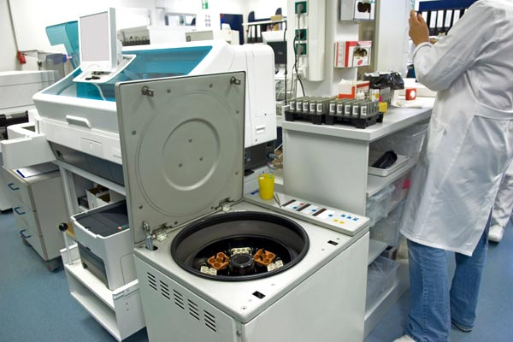



LABS FOR LIFE PROJECT - INDIA
Coagulation Analyzers
MoHFW /CDC / BD Partnership Project

Slide 2
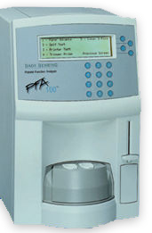
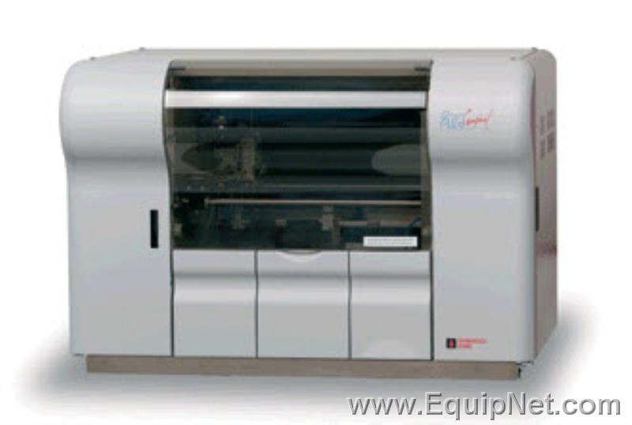
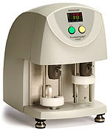
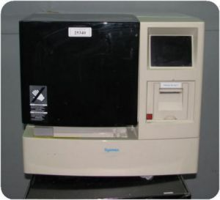
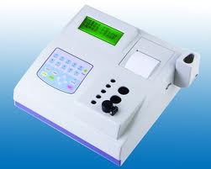
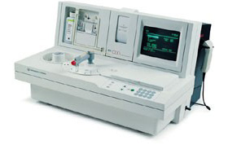
Current Instrumentation

Slide 3


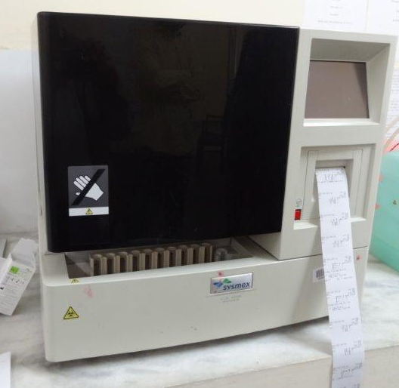
Coagulation Analyzers
Coagulation analyzers perform in vitro tests that are used to identify hemostatic defects and monitor anticoagulant therapy.
Fully automated coagulation analyzers:
  Capable of automatic delivery of reagents and plasma samples
  Positive sample identification
  Automatic dilution of samples
  Sample, Calibration and QC data management
Semi-automated analyzers:
  Manual mixing of reagent and samples
  Analyzer has capability to store calibration curve and basic sample results
MoHFW /CDC / BD Partnership Project

Slide 4

Basic Principle - To See or To Feel
Automation approaches to clot detection:
  SEE
    Turbidometric
    Nephelometric
  FEEL
    Mechanical/Viscosity based

Slide 5
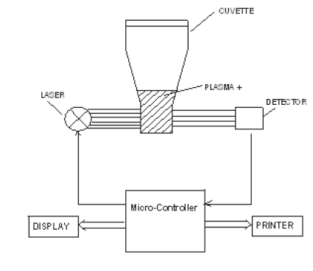
Principle of coagulation testing
Various coagulation analyzers use different ways to detect clotting.
Electromechanical
Formation of fibrin strands around a steel ball in reaction cuvette leads to change in the magnetic field, and the coagulation time is recorded.
Photo-optical
The turbidity during the formation of a fibrin clot is measured as an increase in scattered light intensity when exposed to light at a wavelength.
Transmitted Light Detection for Chromogenic assay
Color production leads to a change in light absorbance, which is detected as a change in transmitted light.
Transmitted Light Detection for Immunoassay
The change in light absorbance caused by the antigen antibody reaction is detected as the change in transmitted light. Over time, the change in absorbance per minute is calculated.
Nephelometry
Determination of the intensity of light scatter using a detector placed at right angles
Photo-optic clot detection
MoHFW /CDC / BD Partnership Project

Slide 6
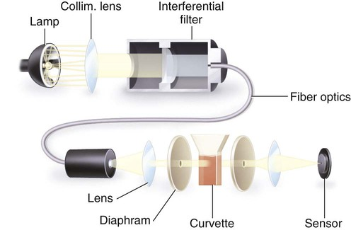
Optical Clot Detection (Turbidimetry)
Sample is added to a cuvette
A light source is directed through the cuvette
Initial absorbance of transmitted light is measured
Clot initiating reagents are added by the automated instrumentation
The plasma becomes more opaque when clotting is initiated, decreasing the light transmitted through the cuvette
The change in transmitted light is used to calculate the result

Slide 7
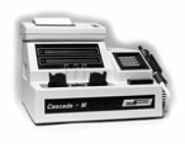
Cascade M-4
(Instruments at RRC)
Multiple (2 or 4) cuvettes can be analyzed at one time
Semi-automated Optical Clot Detection
  The user delivers the sample and reagents into the cuvette
  The changes in optical density are monitored
  Clot times determined by instrument

Slide 8
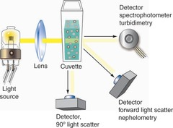
Nephelometric Clot Detection
Sample is added to a sample cuvette
The optically clear cuvette passes in front of light source
The clot initiating reagents are added
Light is scattered as the fibrin strands form
The light scatters at different angles and is measured by detectors
A clot curve is generated by consecutive readings until clot completion.

Slide 9
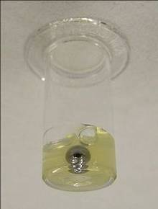
Mechanical Clot Detection
The sample is introduced to a cuvette that has a small steel ball inside
The cuvette continuously moves when testing begins
The clot initiating reagents are added to the sample
The fibrin strands begin to form and attach to the moving ball
An electrical circuit is either opened or closed when the ball moves away from the magnet because of the fibrin strands
Clot time is recorded.

Slide 10
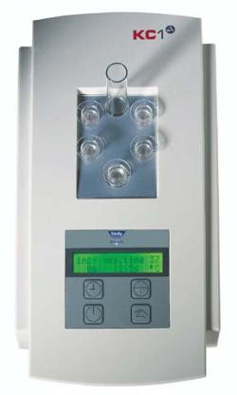
Mechanical Clot Detection
Semi-Automated Mechanical Clot Detection:
  The Ball Method uses a steel ball at the bottom of a cuvette that is held in place by a magnetic source.
  While the cuvette continuously rotates, the technician adds the sample and reagents, which starts the timer. T
  When true clot formation has occurred, the clot will incorporate the steel ball and pull it away from the magnetic source, stopping the timer.

Slide 11
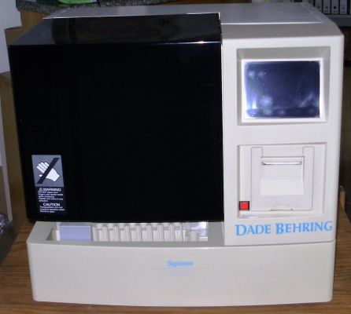
Tests that use a Clot Detection Method
PT
APTT
TT
Fibrinogen
Mixing Studies
Specific Coagulation Factor Assays
  FVIII
  FIX

Slide 12
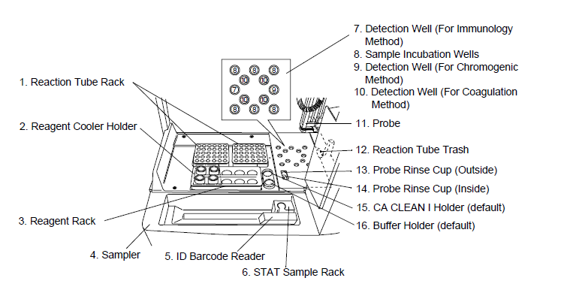
Key Components – Coagulation analyzer
CA-500

Slide 13
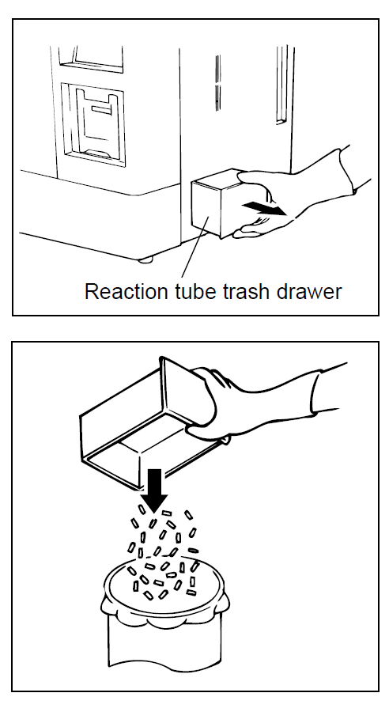
Maintenance of CA-500 (Example)
Daily Maintenance:
Clean sample probe
Discard Used Reaction Tubes
Dispose of Waste
Remove Dew from Reagent Rack
Monthly Maintenance:
LED Lamp Calibration
Yearly Maintenance:
Replace rinse filter
As Needed Maintenance:
Check Printer Paper Supply
Replace Fuse
Check and Drain Trap Chamber
Clean Instrument

Slide 14
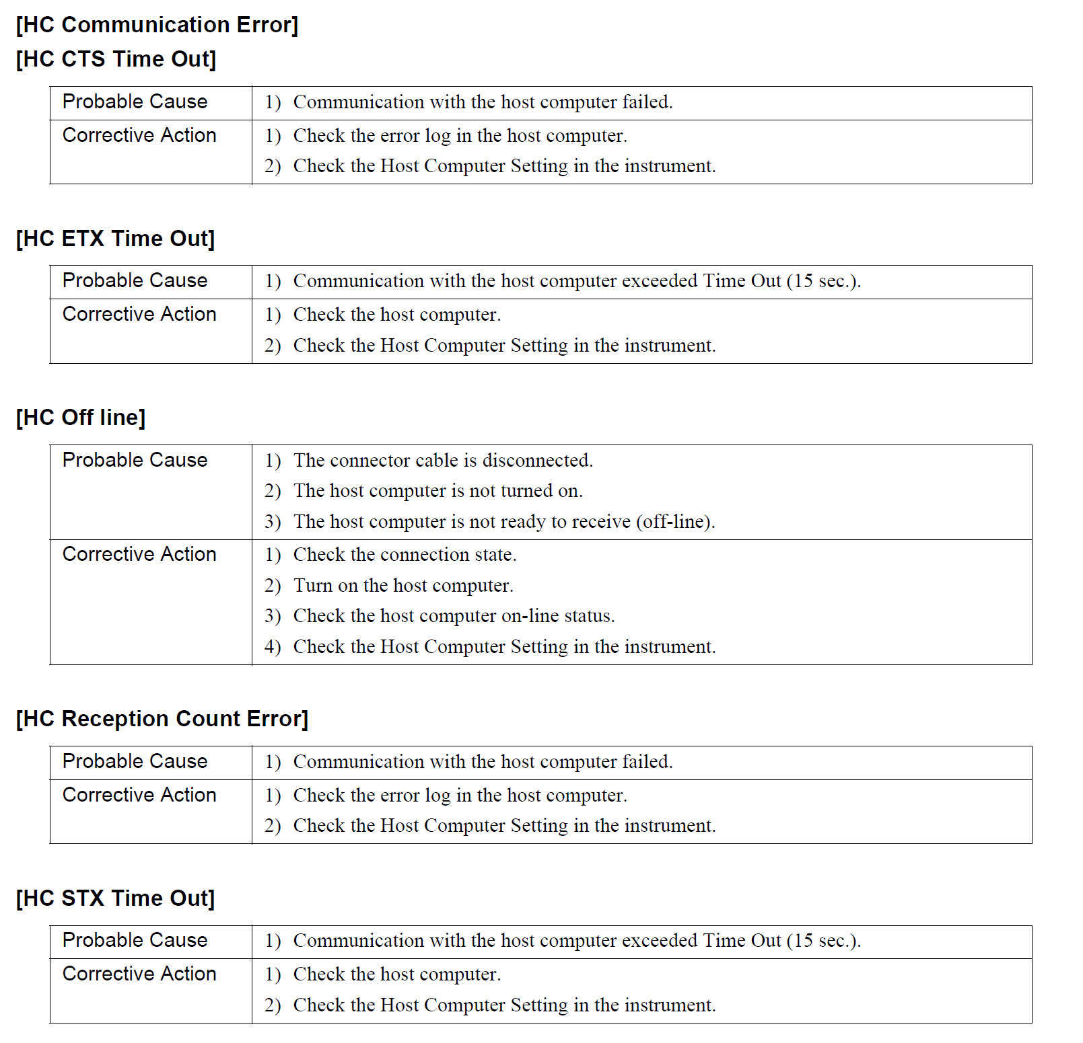
Troubleshooting in CA-500 (Example)
Be familiar with the key error messages and their causes
Follow step-by-step approach as discussed in troubleshooting session
Advanced analyzers have on-board self error detection capabilities

