Slide 1
Calibrations

Slide 2
Understanding calibrations
What is calibration?
  What are the systems that need calibrations?
Why calibrate?
When to calibrate? How to track calibrations?
How to calibrate?
  What to do before calibrations are done?
  Who Calibrates?
  With what?
How to verify calibrations?
What documents to maintain?

Slide 3
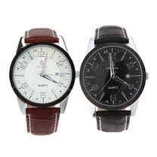
Which one is right??

Slide 4
1. What is Calibration?
The process of:
Testing and Adjustment
Equipment / Analyte ( Kit or test system)
To provide a known comparison between a Reference Value and a Measured Value

Slide 5
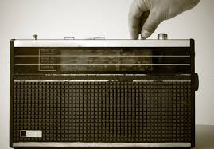
“Tuning* and Fine Tuning*”

Slide 6
What are the systems that need calibration?
All measuring systems need calibration
In a lab these will include
Equipment…………Tuning*
    Major (analytical)e.g. CBC counters, Biochemistry analyzers….
    Minor (ancillary) e.g. Pipettes, centrifuges etc
Analytes (Kits, reagents, test systems)….. Fine Tuning*
* Not standard terminology

Slide 7
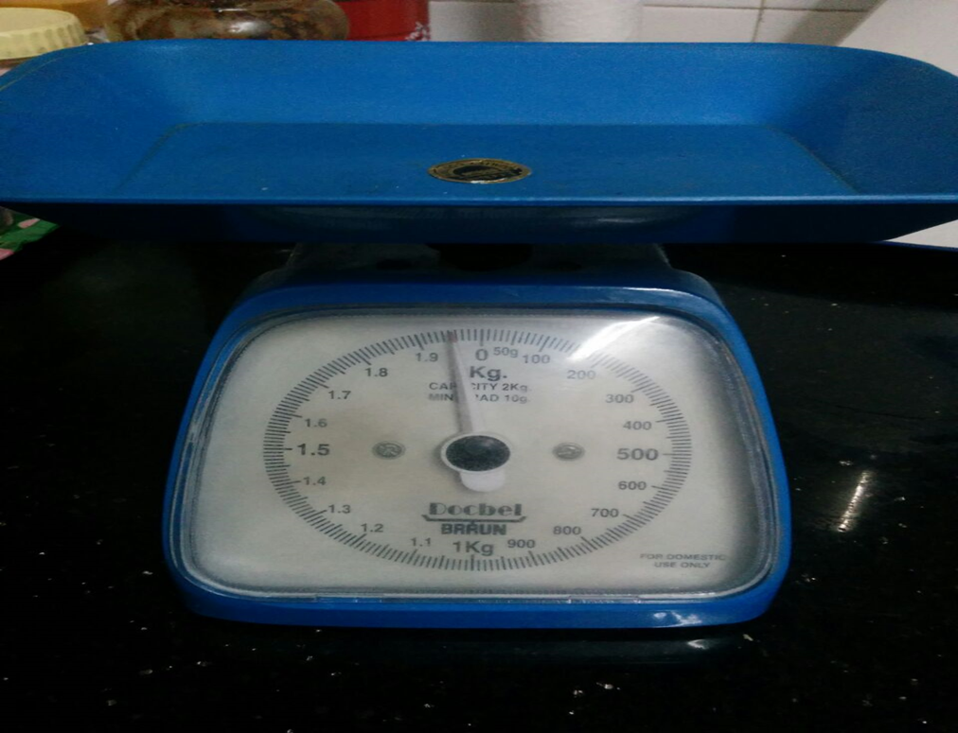
Why calibrate?

Slide 8
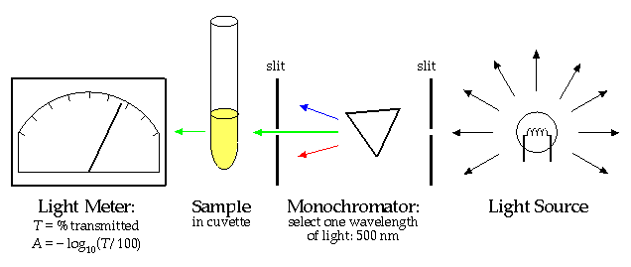
In biochemistry, why?
Notes:
Number of parts that can undergo wear and tear and deterioration. All need checking and readjustment.

Slide 9
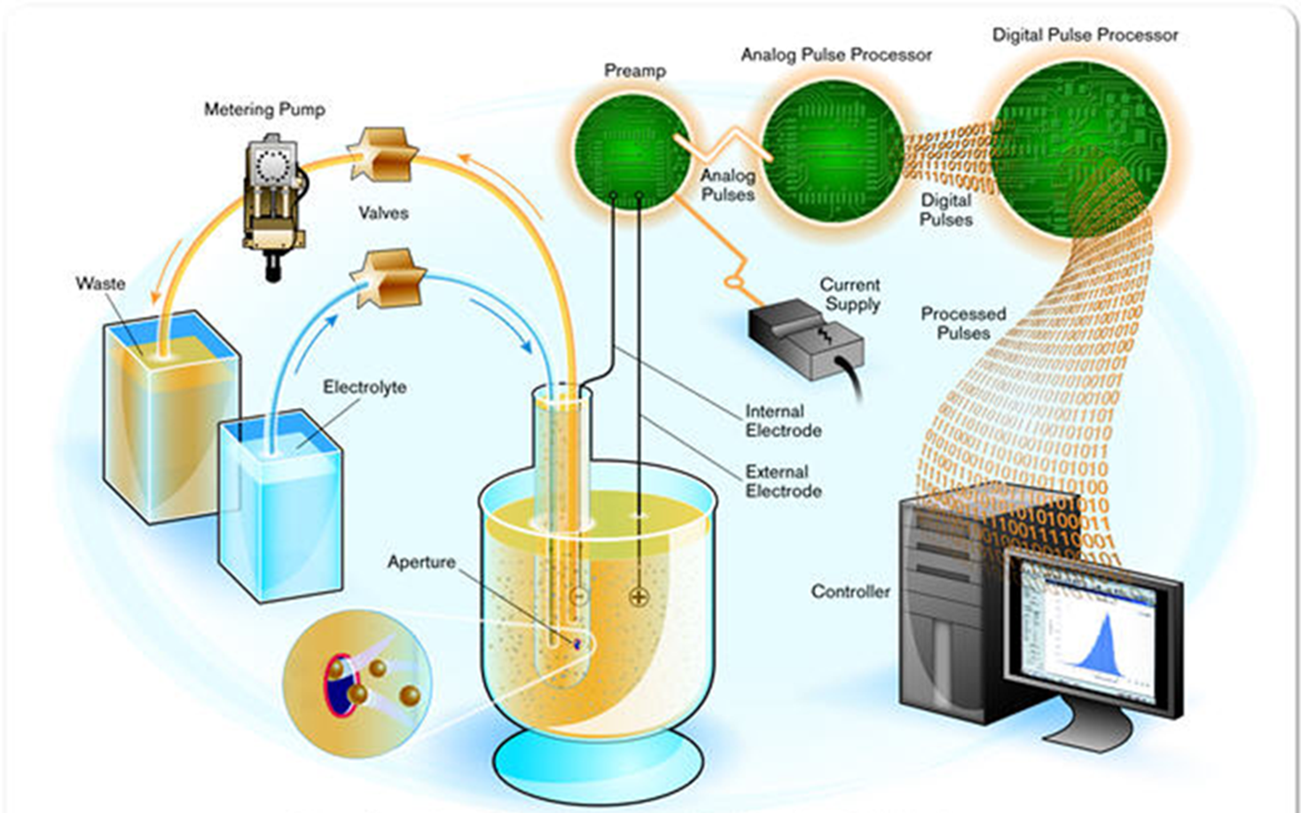
In hematology, why?
Notes:
Number of parts that can undergo wear and tear and deterioration. All need checking and readjustment.

Slide 10
Why Calibrate?…. Equipment
Wear and tear…
  Temperature
  Humidity
  Mechanical Stress (Pipettes, Centrifuges, tubing)
  Dust
  Loss of alignment
  Volume discrepancies
  Pressure discrepancies
  Major Maintenance

Slide 11
Why Calibrate?.. Analytes
Reagent Lot Changes
Reagent Deterioration
  Temperature
  Humidity
  Atmospheric CO2
  Other contaminants

Slide 12
What does Calibration Do? Equipment
    OPTICAL Calibration to ensure photometric accuracy.
    Calibration of Probes, Mixers, Wash Station for perfect alignment.
    Calibration of Volume & Pipetting accuracy.
    Calibration of Pressure, Vacuum, Temperature, aspiration time etc

Slide 13
What does Calibration Do? Analyte
    Re-measures OD
    Re-measures flow/pulse-heights
    Re-sets the factors for calculating results

Slide 14
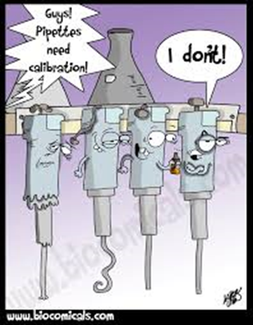
When to Calibrate? Who decides?

Slide 15
When to calibrate? Equipment
  As per the manufacturers' recommendations
  As per accreditation body requirements (e.g. NABL 112)
  After major maintenance processes
  Frequency will also depend on usage rate and conditions of use

Slide 16
Calibration Matrix: Equipment
Lab: DH Udaipur
Equipment name and ID | Date of Major PM | Date next due | Date Calibration done | Date next due | Comments | Signature
CBC Analyzer | 16/2/16 | 15/8/16 | 16/2/16 | 15/2/17 | -
Autopipette No 4 | - | - | 16/2/16 | 15/8/16
Notes:
It is a good practice to have a calibration matrix for ready reference

Slide 17
When to Calibrate? Analytes
  Manufacturer's recommendations
  Every new lot of reagent
  As part of corrective actions in QC outliers
    Internal Controls
    External Controls
  As per the lab policy derived from calibration monitoring protocol and calibration history

Slide 18
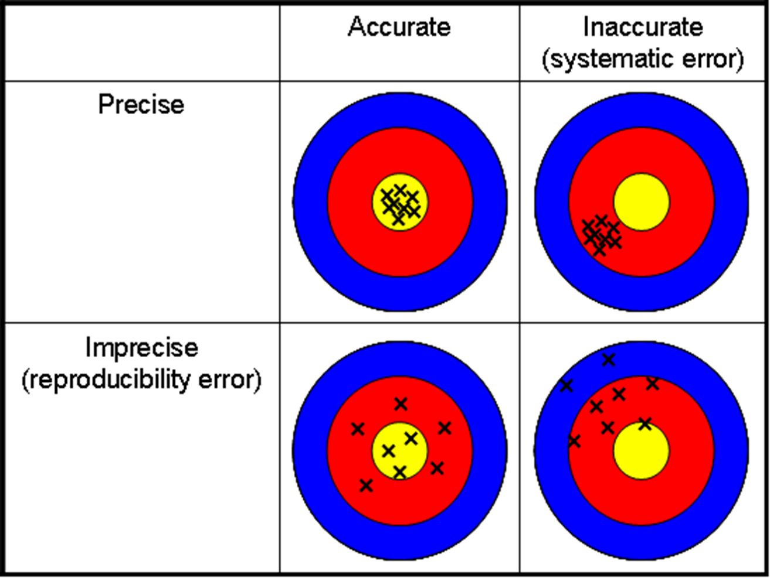
What are QC outliers?
Internal Quality Controls
External Quality Controls

Slide 19
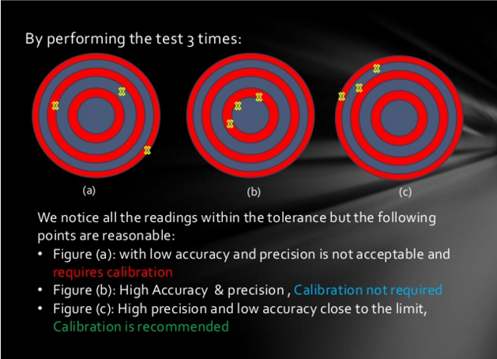
When….?
Neither precise, nor accurate: Recommended to correct imprecision and then re-calibrate
Acceptable accuracy and precision – no need for recalibration unless under recommended frequency
High precision, but low accuracy: Calibration is recommended

Slide 20
Calibration History Tracking: Manual: Analytes
Analyte: Glucose
Date | OD/Abs | Factor | Comments | Calibrated by
16/1/16 | 0.35 | 250
30/1 | 0.38 | 240
14/2 | 0.22 | 450 | Rejected/ Repeat

Slide 21
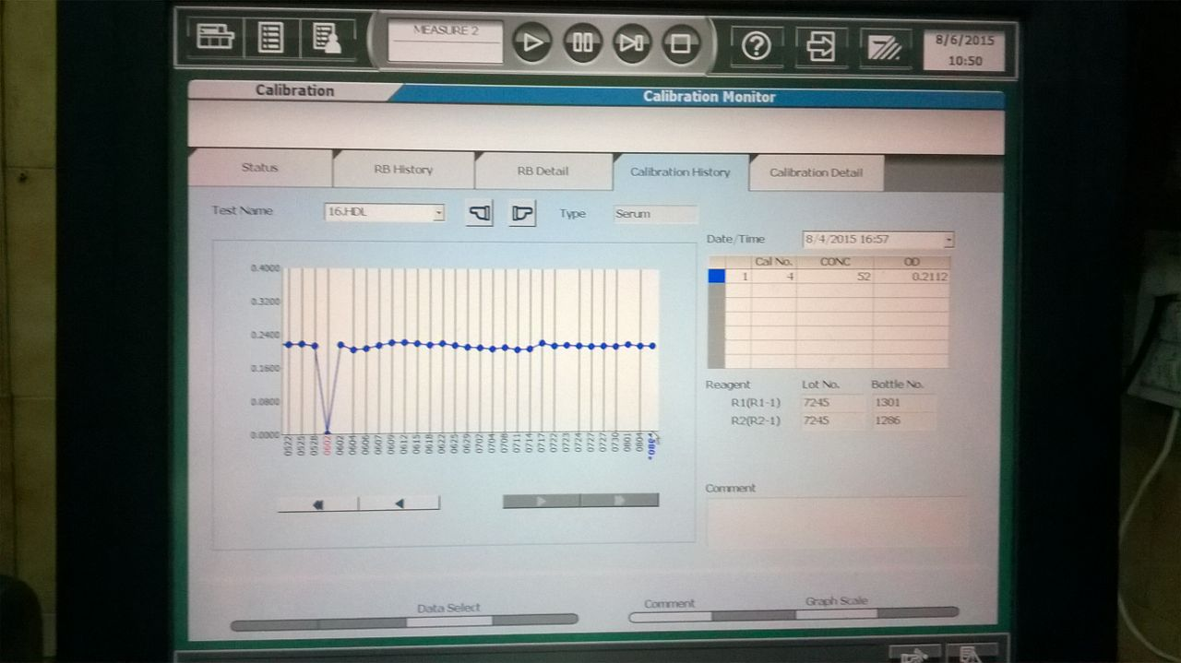
Calibration History Tracking, Automated: Analytes

Slide 22
How to calibrate? Equipment
Before Calibration…
Do the major preventive maintenance steps
Analyze the machine performance
E.g. in a Cell Counter …..Background, Carryover, Precision

Slide 23
How to Calibrate? Analyte
Before Calibration
Do Daily Maintenance
System Checks
Program the machine for the assigned value of the analyte

Slide 24
Who calibrates? Equipment
By the Manufacturer or;
Through an authorized agency, NABL accredited (ISO 17025 accredited) or;
3rd parties assigned by NHM

Slide 25
Who Calibrates? Analytes
Done by the user as per lab’s policy
Labs have to develop these depending on
  Manufacturer's instructions
  Lab validated reagent stability
  QC protocols

Slide 26
With what? Equipment and Analytes
Using equipment / material (calibrator) that involves processes that will demonstrate
Traceability (Unbroken Chain of Comparisons)
Uncertainty of Measurement

Slide 27
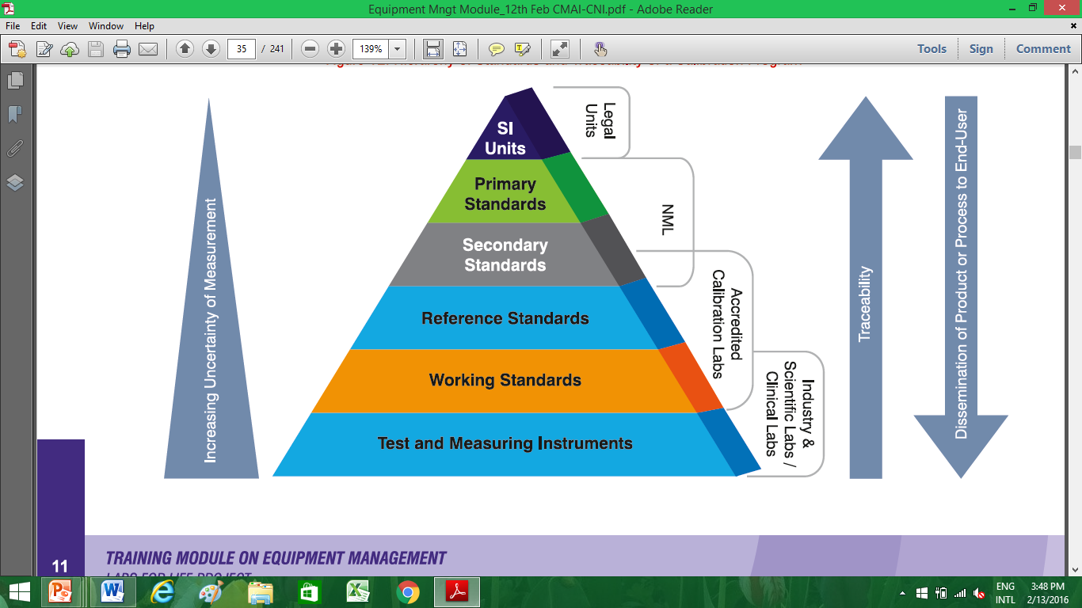
With what?…..Traceability: Unbroken Chain of Comparisons

Slide 28
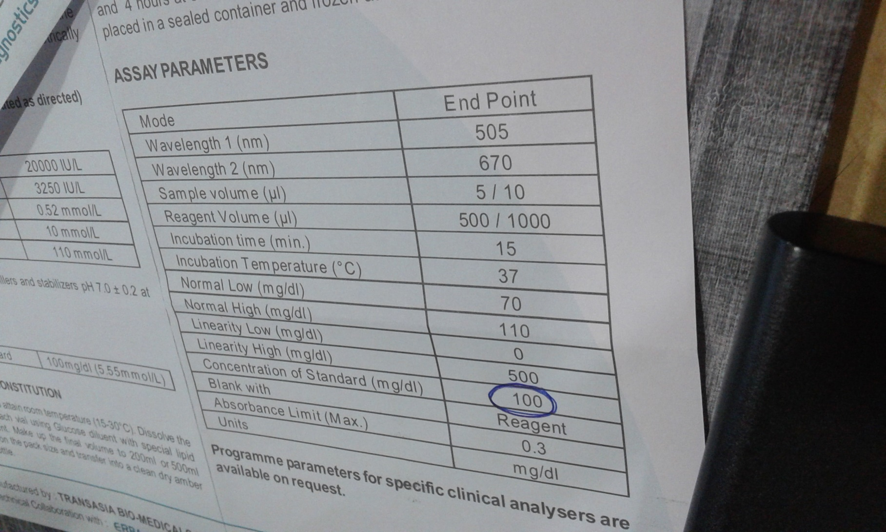
Calibrator also called Standard
Notes:
Standards provided by semi automatic analyser kits have a defined value, but generally do not state the traceability. Moreover, these are water based solutions and has no control over the matrix. So it is always better to procure a better calibrator than use the standard provided by these kits

Slide 29
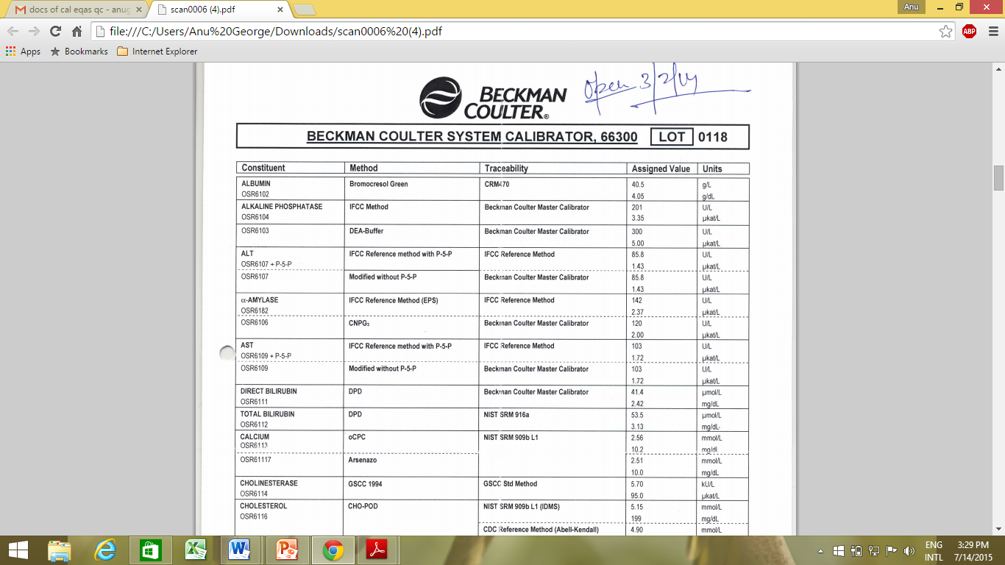
Notes:
A system calibrator showing traceability

Slide 30
Verification of Calibration (Post Calibration Processes) Equipment
Analysis of calibration data against set acceptance and rejection criteria
Application of correction factors
In analytical equipment
Precision exercises: Reproducibility
Verification: Material with known value: e.g. Internal Quality Control

Slide 31
Verification of Calibration (Post Calibration Processes) Analyte
Using material with known value: e.g.
Internal Quality Controls
Repeat samples

Slide 32
Documentation of Calibration: Equipment
Printouts/register entries of activities involved in the pre-calibration, calibration and post calibration processes (Raw Data)
Service reports or equivalent stating the components have been checked and have passed checks
Traceability to NPL systems
Additional documentation for CBC Analyzers:
Table of expected results
Any correction factor displayed on the equipment in question
Calibration Certificates
Traceability of Calibrators

Slide 33
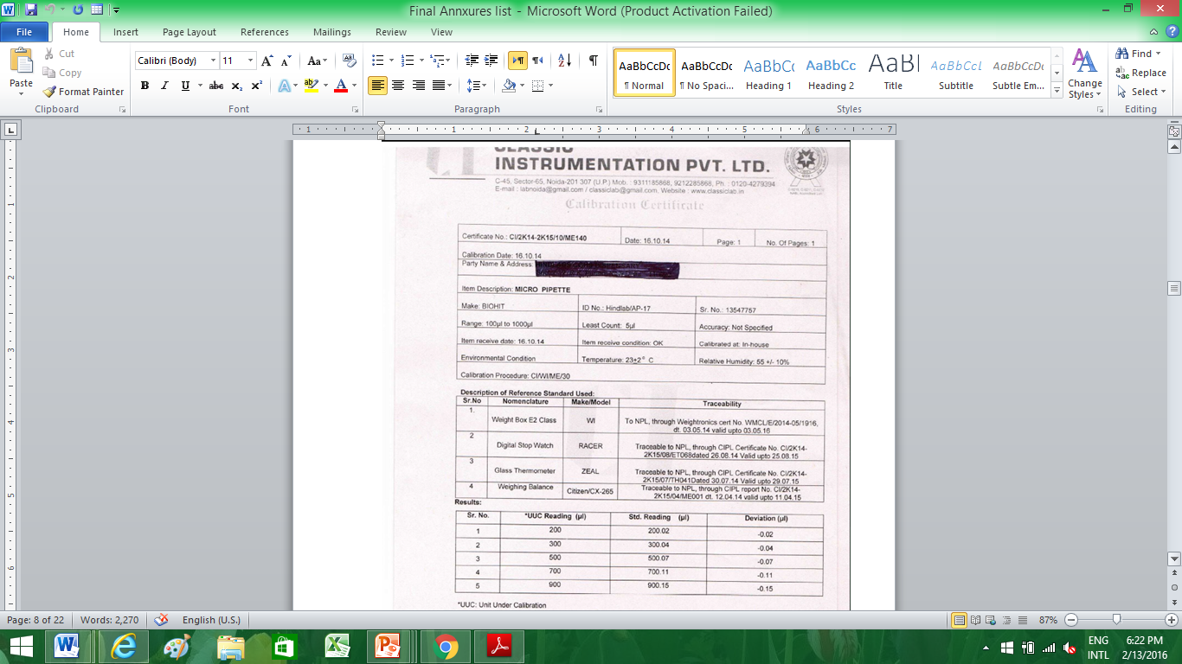
Notes:
Calibration certificate minor equipment

Slide 34
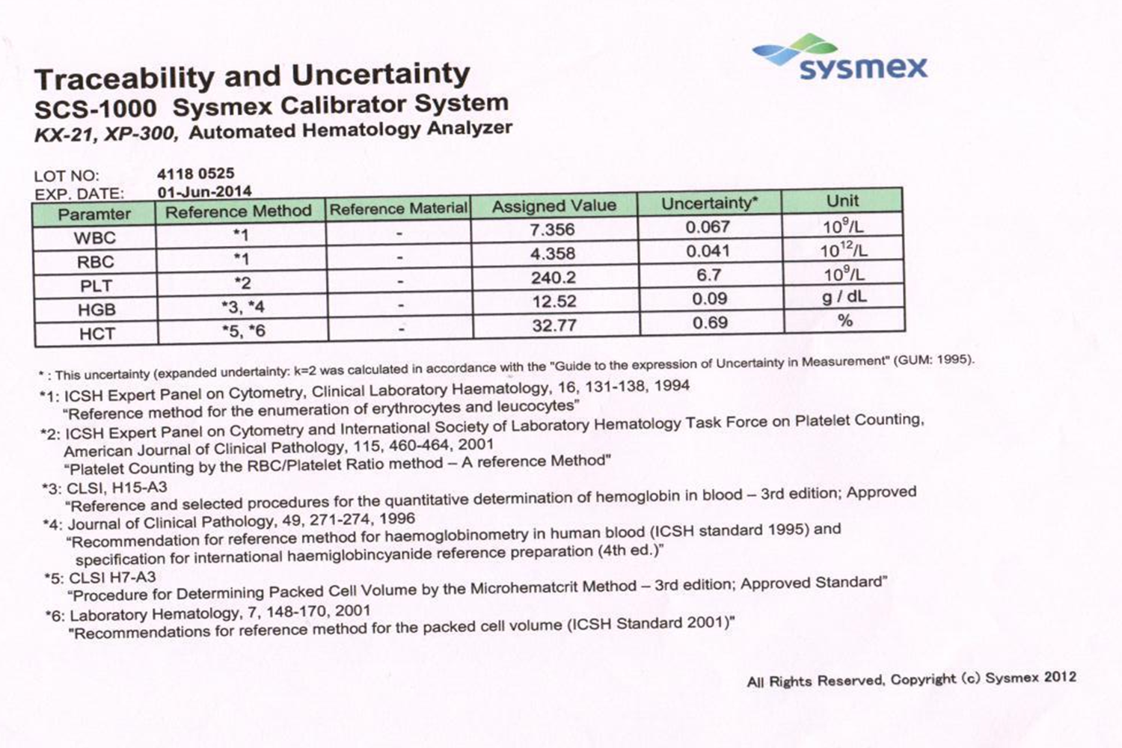
Notes:
Value sheet of a three-part haematology analyser

Slide 35
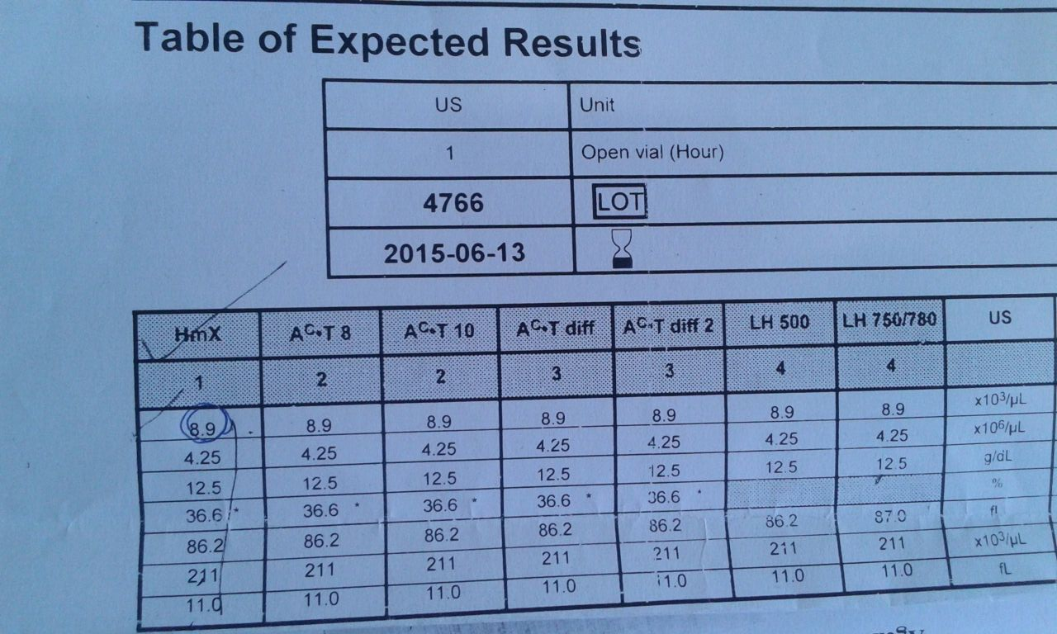
Notes:
Value sheet of a five-part haematology analyser

Slide 36
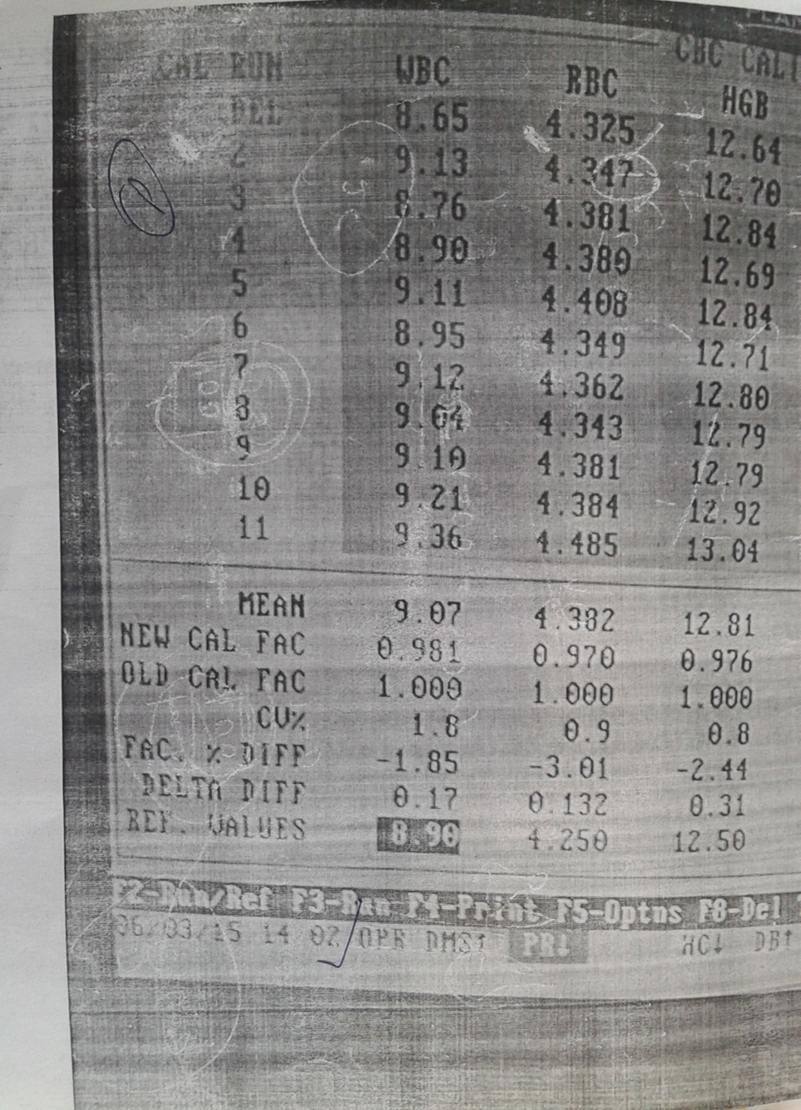
Raw Data
Notes:
Raw data observed for the above value sheet. See that the set value for WBC is 8.9, but the mean of 10 runs is 9.07. (There are 11 runs, but the first is discarded the mean of 10 is taken). Hence the software readjusts the settings by using a calibration or multiplication factor of 0.981. All values are higher than the set values and hence multiplication factors are applied on the final numbers.

Slide 37
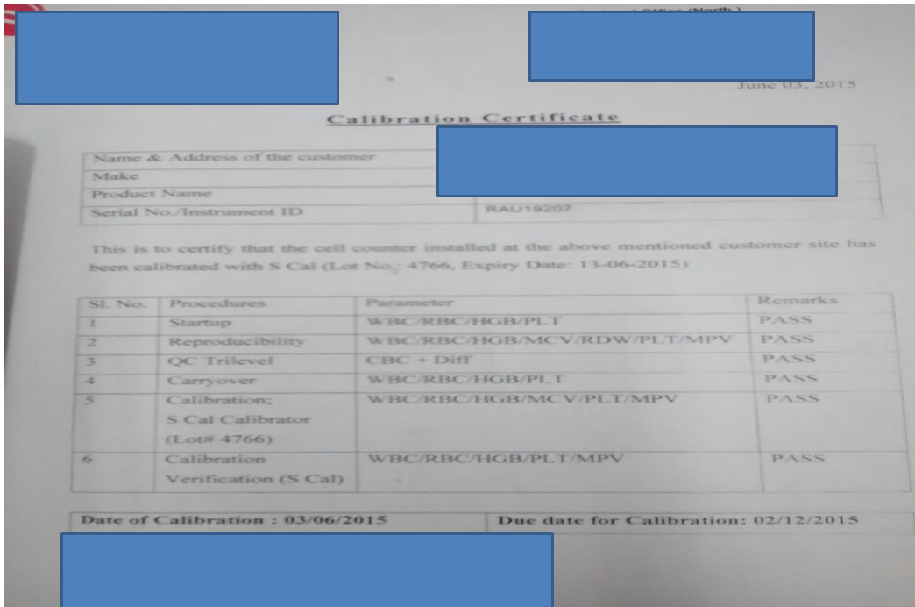
Get your certificate

Slide 38
Documentation of Calibration: Analytes
Lot-wise calibrator inserts with traceability
Dates of Calibration with OD tracking

Slide 39
Thank You

