Slide 1
Facility Management
& Safety
15189: 5.2

Slide 2
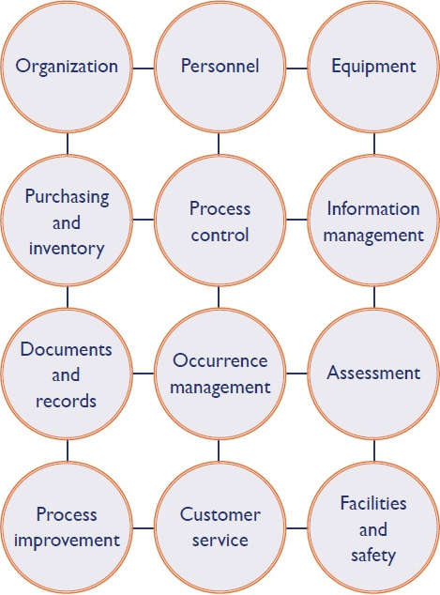

Slide 3
What is facility management?
  Facility Management and Safety are closely related and inseparable
  Managing Interdisciplinary fields devoted to optimization of workflow and safety in terms of:
      Space
      Infrastructure
      Resources
      Staff

Slide 4
What is facility management of a lab?
  The laboratory workspace and facilities must be such that the work can be performed:
      Without compromising on the quality of reports
      Without compromising the safety of
              Laboratory staff
              Other health care personnel
              Patients or the community
              Environment

Slide 5
Management Responsibilities
Defined under international standards of Medical laboratories ISO: 15189 and 15190
Calls for continuous engagement of the Higher Management in the laboratory activities
Leadership’s Commitment and Actions:
Leaders must demonstrate
a commitment to safety
in their decisions and behaviors.

Slide 6
Facility Management TO ENSURE SAFETY Involves:
Administrative Controls
Engineering Controls (Design Control)
Financial Outlay
Personnel Management Controls
Work Practice Controls: Safety Measures

Slide 7
The Crosscutting Role of Management
Engineering Controls
Administrative Controls
Work Practice Controls
Financial Outlay
Safety is essential in every step

Slide 8

EVERYONE
is responsible for quality and safety

Slide 9
Role of Higher Management
Overall Administrative
Establishment of a Safety System
Infrastructure Development
Financial Management
Provision of Safety
Training
Monitoring

Slide 10

Overall Administrative
Meet overall manpower requirement: To avoid haste and hurry
Manpower Motivation
Meet resource requirements: To avoid risky practices
Ensure optimum use of resources: To avoid waste
Liaison with regulatory bodies such as Pollution Control Bodies & AERB, emergency response bodies, disease surveillance bodies such as IDSP & IHR
Act and update on the policy changes

Slide 11
Establishment of a Safety System
Having a safety policy (State/ District/ Facility)
Designating safety officers (State/ District/Facility)
Having a facility specific safety manual: read and understood
Risk assessments
Defining safety indicators
Monitoring the safety indicators
Incident Reporting and Investigations
Implementing safety audits and making available the results to higher level management

Slide 12
Design Control
Essential to have design control
To minimize the error and make the best use of space
Lab space to be organised such that tasks can be performed without compromising quality of work, safety of personnel or patient care services
Evaluate layout for efficiency , optimal work flow, comfort, privacy, adequate storage space, accommodation for people with disabilities, emergency systems
Facilitate through Engineering and administrative controls
While designing or re-designing labs, take the help of experts in scientific floor planning

Slide 13
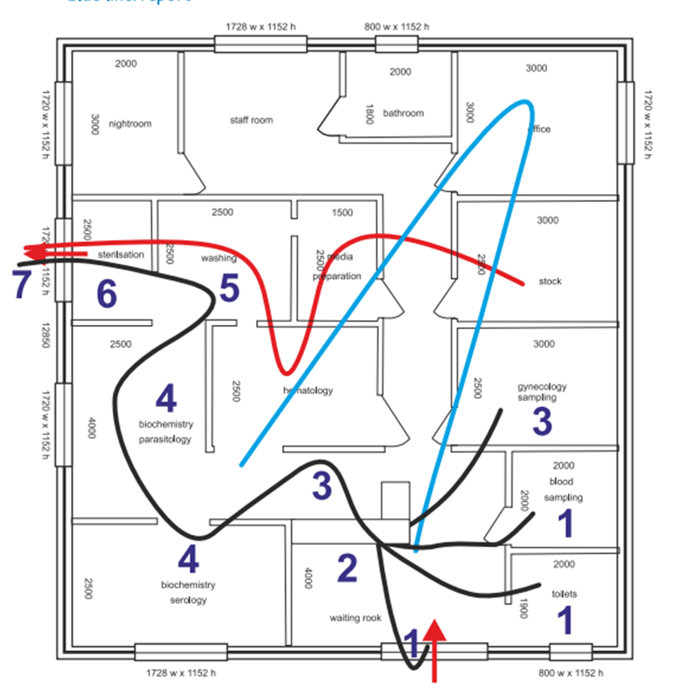
Laboratory Design
Path followed by the sample
  reception and registration of patients
  sampling rooms
  dispatch between different laboratories
  analysis of samples
Report delivery, filing
Service rooms

Slide 14
The Hierarchy of Safety Controls
Eliminate (Physically remove hazards)
Substitute( replace with less hazardous methods)
Isolate (Implement barriers between hazards and people)
Optimize (Infrastructure optimization for efficiency)
Establish Safety Protocols
Facilitate Safety Protocols
Follow Safety Protocols

Slide 15
“Providing Safety”; some key points
Bio-Safety
  Safe Phlebotomy Equipment, sharps management
  Personal Protective Equipment
  Vaccinations
  Post Exposure Prophylaxis
  First Aid
  Bio-Medical Waste Management
  Water, Sanitation and Hygiene
  Provision for Environment Cleaning
  Hand Hygiene
  Equipment Decontamination

Slide 16
“Providing Safety”; some key points
Fire-safety
Chemical Safety
Equipment Safety
Electrical Safety
Glassware Safety

Slide 17

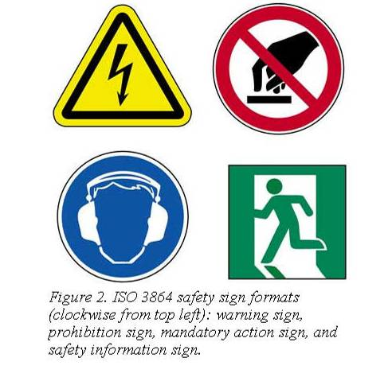
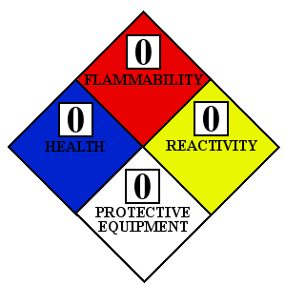
Safety Signs

Slide 18
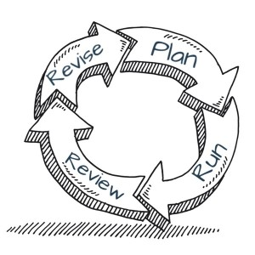
Financial outlay
Considering occupational safety (Employee, User, Environment) as an integral need while budget planning
Funds for contingencies in outbreaks or other emergency situations
Funds for regular safety mechanisms
Sanction of laboratory specific funds?

Slide 19
Thank You

