Slide 1
Method Evaluation
Quality Management of
Laboratory Material

Slide 2
Introducing a New Method
Understanding the Requirement for the test
Understanding & evaluating performance characteristics stated by kit manufacturers
Drafting of technical specifications for tests
Pre purchase assessment and judging fitness of purpose
Verification before introducing into service

Slide 3
ISO15189
ISO15189 clause 5.5.1.2
  Validated examination procedures used without modification shall be subject to independent verification by the laboratory before being introduced into routine use
  The lab shall document the procedure used for the verification and record the results obtained. Staff with the appropriate authority shall review the results and record the review.

Slide 4
Verification before Introducing Into Service
Manufacturer’s claims are derived under ideal conditions
The lab needs to demonstrate that they can get the same or acceptable results in their laboratory, with their personnel

Slide 5
Verification before Introducing Into Service
Mandatory:
Precision
Accuracy
Linearity
Biological Reference Interval
For other aspects, the manufacturer’s claims can be considered as adequate verification

Slide 6
Precision
A minimum of 20 replicates of the same sample
There are two methods
    Intermediate Precision: Using QCs
    Repeatability: Using Samples
Analyte concentrations at Clinical Decision Limits
Calculations:
  Mean
  Standard Deviation (SD)
  Coefficient of Variation (CV)

Slide 7
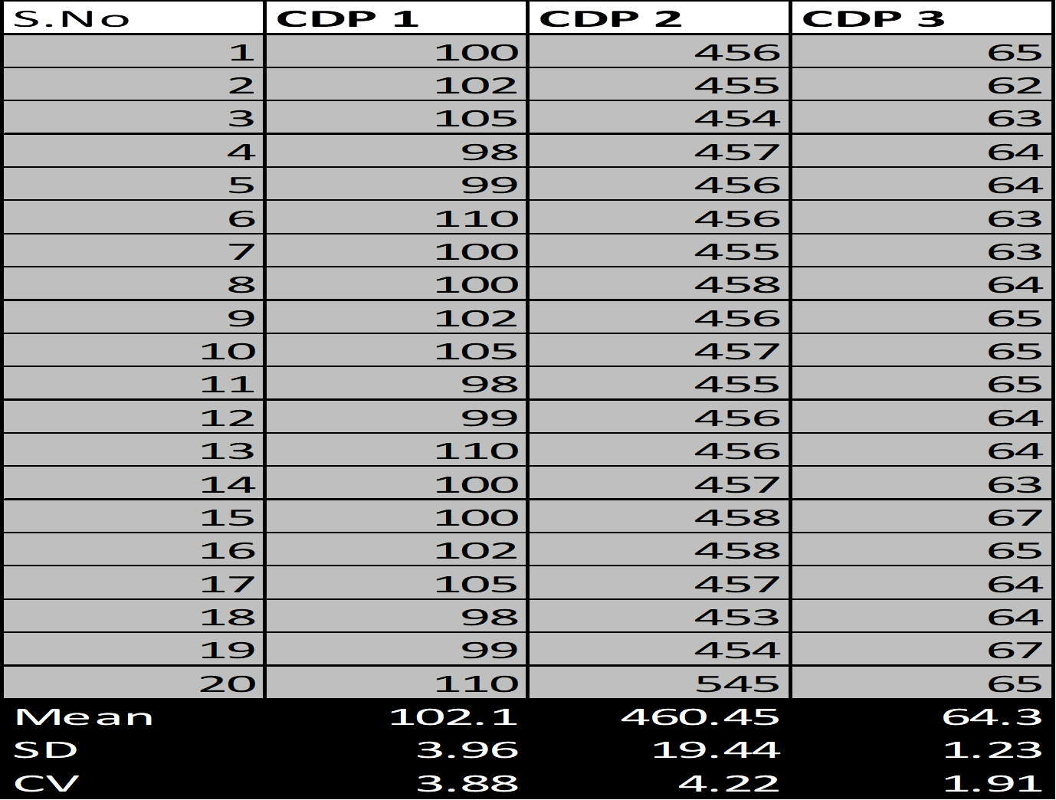

Slide 8
Precision: Acceptability criteria
Repeatability using patient samples
  Compare the CV to the manufacturer’s claims
  If it cannot be met, it is acceptable to attain precision that is
    ≤ 25% of the CLIA Allowable Error
    ≤ BV Desirable

Slide 9
  Precision: Acceptability criteria
Intermediate Precision using QC
  Compare to manufacturer’s stated claims
  If it cannot be met, it is acceptable to attain precision that is
    ≤ 33% of the CLIA Allowable Error
    ≤ BV Desirable
If the observed precision is unacceptable, consult the instrument’s manufacturer for technical assistance.

Slide 10

Exercise
Calculate the precision at the 2 CDPs using the data provided. Page 11, Inventory workbook 2
Judge acceptability

Slide 11
Accuracy or Trueness
(Measured as % Bias and “correlation studies”)
The comparisons and difference between results from the reference method
  An accepted reference procedure.
  Or the best-available comparative method
Calculations
  Regression analysis (Correlation coefficient, Slope, Intercept)
  Difference Plots

Slide 12
Accuracy or Trueness (Measured as Bias) (“correlation studies”)
Determine your comparison or reference method
  must be previously validated.
  must be currently performing successfully in EQA.
  Must be similar instrument / method.
  Comparison to an in-house method is preferred if the in-house instrument meets the above criteria.

Slide 13
Accuracy or Trueness
Sample Criteria
  A minimum of 20 samples that cover the measurement range of the method and include points near the Medical Decision Points.
  Patient, quality control, and proficiency testing materials may be used.
  50% of the selected samples must lie outside of the current Biological Reference Range.

Slide 14
Accuracy or Trueness
Testing
  Run each sample on each instrument.
  Retain the instrument print-outs.
  Remove the obvious outliers from the data set.
  A minimum of 5 separate days must be used for testing.

Slide 15
Accuracy or Trueness
  Difference Plots: Bias/ Difference, % Bias, Average
 | Reference Value X | Obtained Value Y | Mean | Difference | Difference % | Abs Difference
1 | 123 | 120 | 121.5 | -3 | -2.47 | 2.47
2 | 160 | 130 | 145 | -30 | -20.69 | 20.69
3 | 235 | 230 | 232.5 | -5 | -2.15 | 2.15
4 | 260 | 230 | 245 | -30 | -12.24 | 12.24
5 | 10 | 12 | 11 | 2 | 18.18 | 18.18
6 | 450 | 470 | 460 | 20 | 4.35 | 4.35
7 | 1090 | 1060 | 1075 | -30 | -2.79 | 2.79
 |  |  |  |  | Average | 8.98

Slide 16
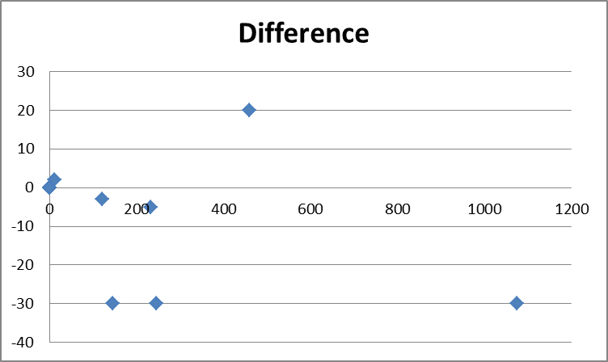
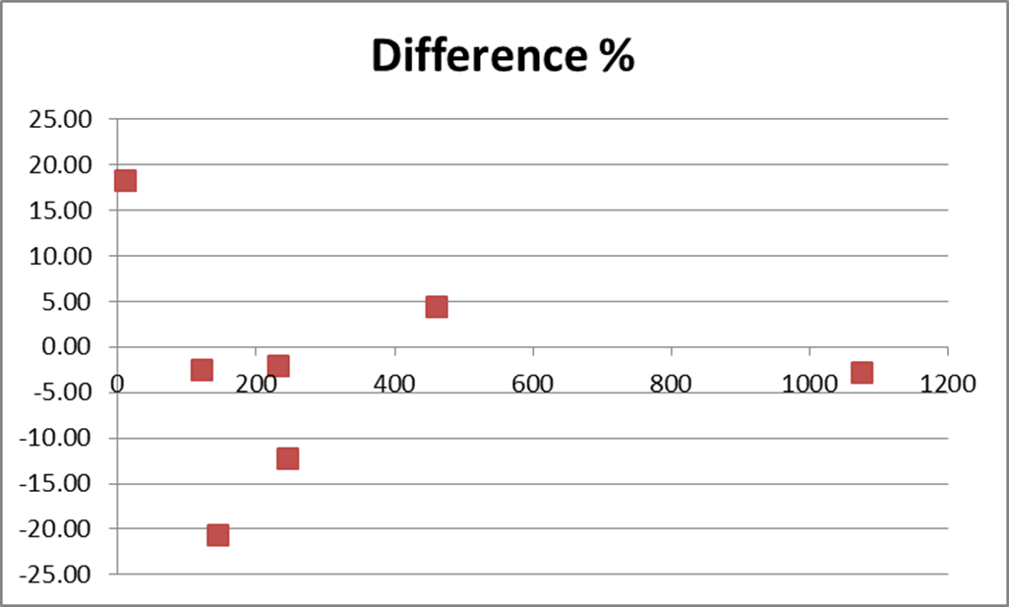

Slide 17
Accuracy or Trueness
  Regression Analysis: X is Comparative method or Current method. Y is your New method or Test method
 | Reference Value X | Obtained Value Y
1 | 123 | 120
2 | 160 | 130
3 | 235 | 230
4 | 260 | 230
5 | 10 | 12
6 | 450 | 470
7 | 1090 | 1060

Slide 18
Regression Analysis
Correlation: r & bias: mx+b
Reference | Test
1 | 3
11 | 10
21 | 23
31 | 29
41 | 43

Slide 19
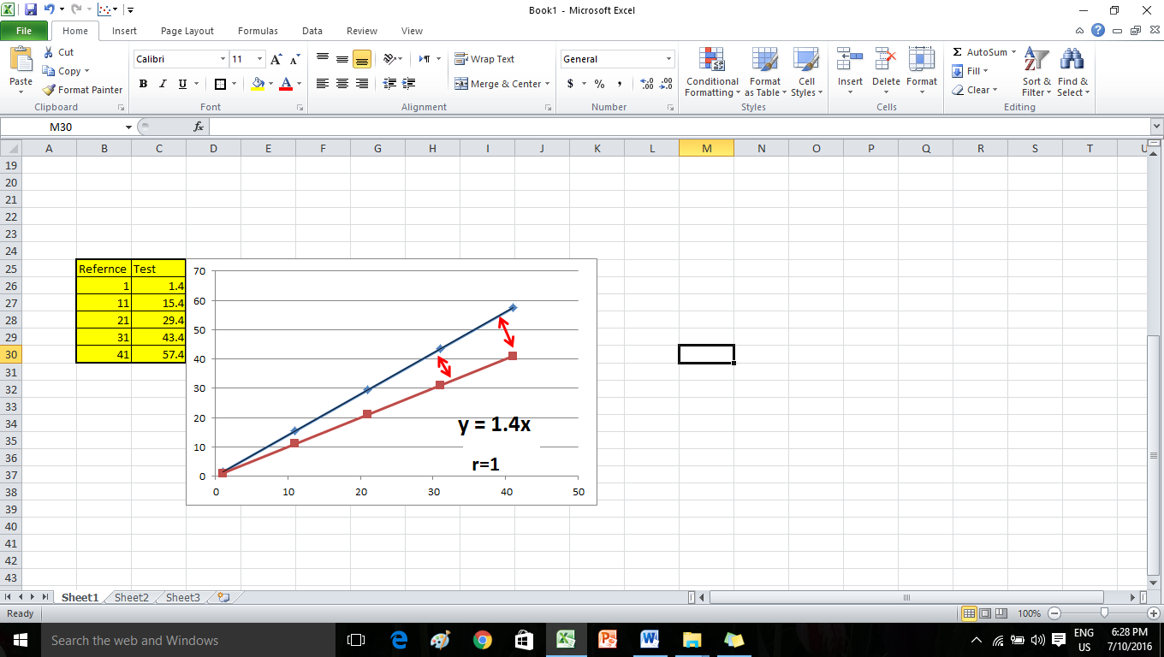
Regression: Proportional Error
Slope

Slide 20
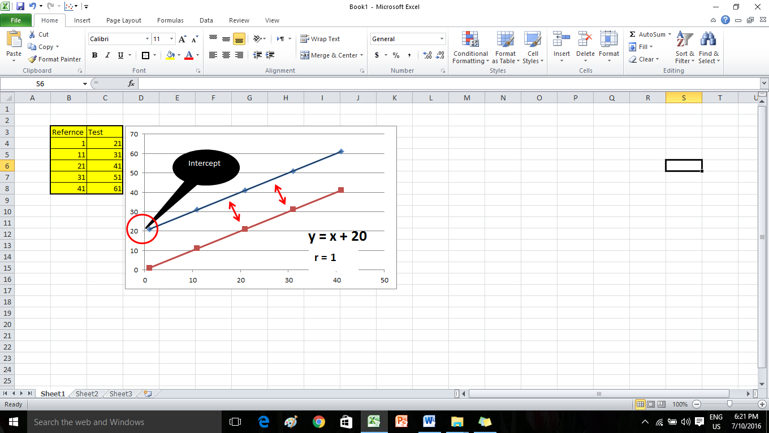
Regression: Constant Error
Intercept

Slide 21
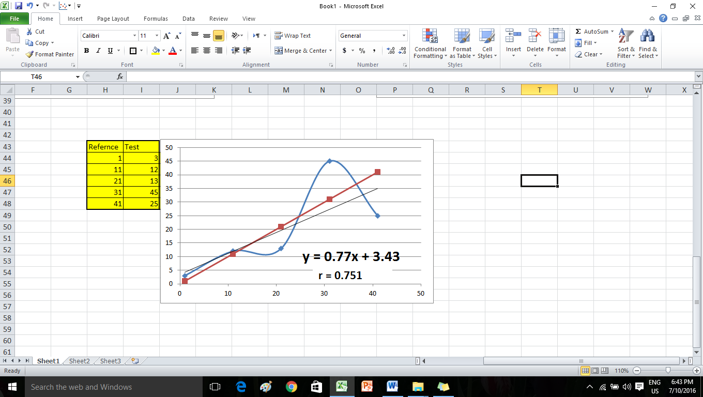
??

Slide 22
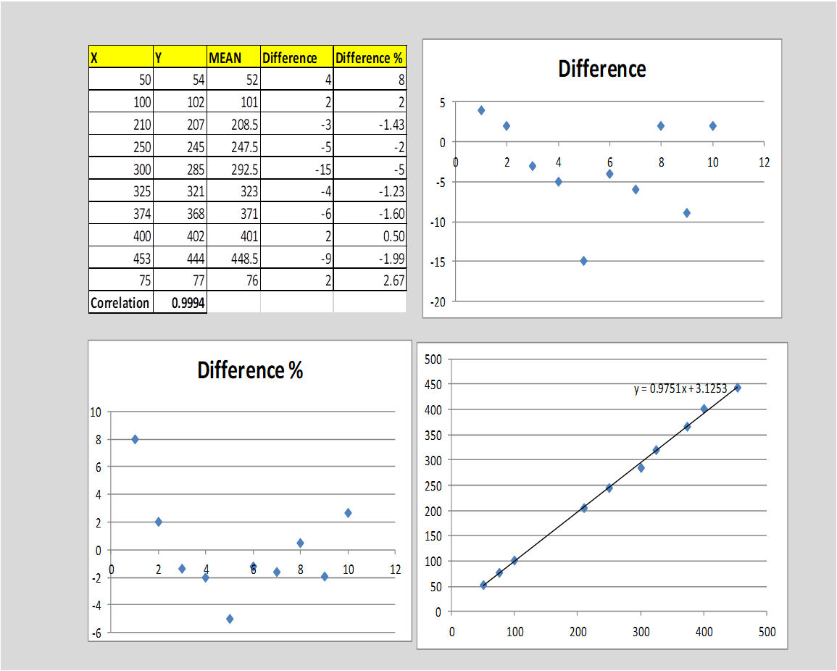
Blandt Altman Plot: Comparison and Difference Plot

Slide 23
Accuracy: Acceptability
r value: The “r” should be >0.975
Graphs: Linear Regression Analysis graph & Bias graphs
Visually inspect the comparison plot for linearity and outliers.
If an outlier is removed, then recalculate the regression statistics
Visually inspect the difference plots for constant scatter.
Visually scan for significant and dramatic differences at the upper and lower ends of the range

Slide 24
Exercise
Calculate the accuracy metrics using the data provided on page 11 of Workbook 2
Judge acceptability

Slide 25
Linearity
The Analytical Measurement Range (AMR) is the range of analyte values that a method can directly measure on the specimen without any dilution, concentration, or other pretreatment

Slide 26
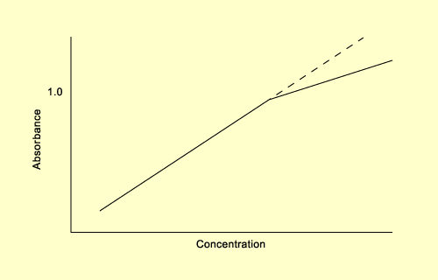
Linearity/ AMR
A dynamic range that extends from lower to upper limit
The best results (minimum overall error) are obtained when absorbance is in the range 0.2 to 0.8. For absorbance below 0.1 and above 1.0 considerable errors may be expected

Slide 27
Linearity/ AMR
AMR will be defined by the manufacturer
The lab must verify this
Verify linear relationship between different concentrations
  expected (X axis)
  measured (Y axis)

Slide 28
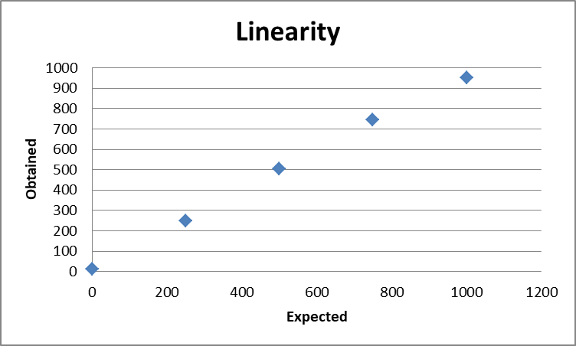
Linearity: An example
Linearity Stated= 0 - 1000
Expected X | Obtained Y
1000 | 950
750 | 745
500 | 505
250 | 248
0 | 10
Linearity Verified = 10 – 950

Slide 29
Linearity: material
What is the material that can be used?
Linearity Controls: High cost
Samples:
  High sample, near the upper range
  Low sample, near the lower range
  A minimum of 5 sample dilutions that cover the stated linearity
  Sufficient volume of each sample must be available to analyse in triplicate and for possible troubleshooting.

Slide 30
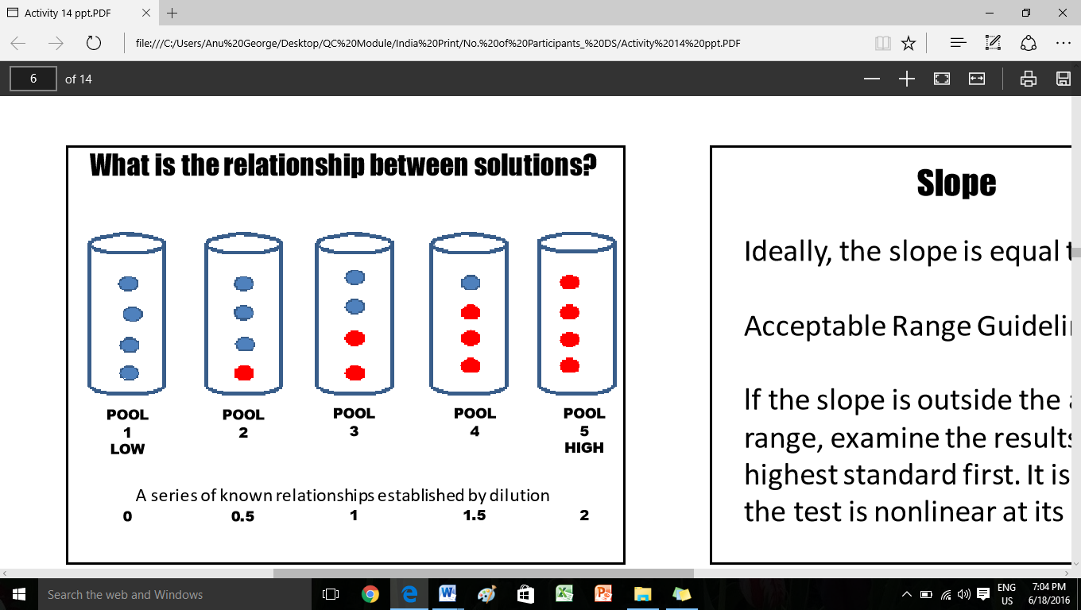

Slide 31
Linearity
Prepare 5 pools for testing as follows:
  Label the low specimen Pool 1 and the high specimen Pool 5.
  Prepare Pool 2 (75/25) with 3 parts Pool 1 + 1 part Pool 5.
  Prepare Pool 3 (50/50) with 2 parts Pool 1 + 2 parts Pool 5.
  Prepare Pool 4 (25/75) with 1 part Pool 1 + 3 parts Pool 5.

Slide 32
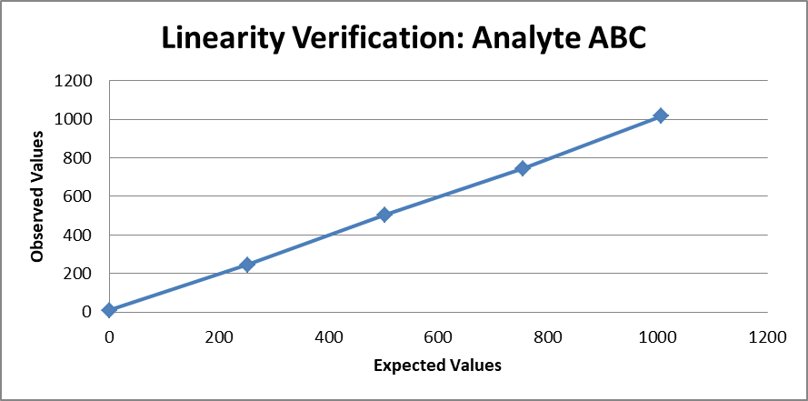
 | Y Observed values in Triplicate
X(Expected Values) | 1 | 2 | 3 | Y(Mean)
0 | 10 | 8 | 10 | 9
252 | 240 | 250 | 245 | 245
503 | 501 | 498 | 510 | 503
755 | 740 | 745 | 750 | 745
1006 | 1000 | 1040 | 1004 | 1015

Slide 33
Linearity: Acceptability
  A linear straight line graph
  The values should ideally be equidistant from each other (performance of recovery throughout the manufacturer’s stated range of the testing system)

Slide 34
Terms: AMR, Linearity, CRR
• The Analytical Measurement Range (AMR): (stated by the manufacturer). E.g. AMR: 0-1000 as in the case illustrated
• Linearity: The actual measurement interval verified by the lab. E.g. 9 to 1015
• Validated AMR: 9 to 1000: Within what is stated by manufacturer, but not to exceed it.

Slide 35
Terms: AMR, Linearity, CRR
The Analytical Measurement Range (AMR): range directly measured without any dilution
The Clinical Reportable Range/ Reportable Range (CRR): range that can be reported allowing for specimen dilution, concentration or other pretreatment used to extend the AMR.
The laboratory must specify the maximum dilution that may be performed to obtain a reportable numeric result.

Slide 36
Exercise
Find the validated AMR using data provided on page 13 of workbook 2
Judge Acceptance

Slide 37
Biological Reference Intervals
Interpretive information for laboratory test
The central 95% interval of results for a group of normal individuals
Notes:
For such analytes there is no need establish or verify the reference intervals.
For such analytes, there is no need to establish de novo or even verify the reference intervals. Rather laboratories must concern themselves with the accuracy of the results they report

Slide 38


Slide 39
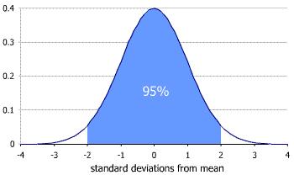

Slide 40
Biological Reference Intervals
When a new method is introduced, the Biological Reference Interval relevant for the target population should be determined.
Exceptions: analytes where reference interval have been replaced by decision limits established by international consensus. For example, cholesterol (NCEP) and HbA1c( ADA).
Notes:
For such analytes there is no need establish or verify the reference intervals.
For such analytes, there is no need to establish de novo or even verify the reference intervals. Rather laboratories must concern themselves with the accuracy of the results they report

Slide 41
Biological Reference Intervals
Procedures for establishing a reference interval are
  Verifying the suitability of a manufacturer-proposed reference interval
  Transference from the previously used reference interval by using the slope and intercept from the accuracy testing
  Establishing a new reference interval

Slide 42

Biological Reference Intervals
Verification of Reference Interval:
Sample
Qualify healthy volunteers. This is the most important step and can be done through a questionnaire or health assessment.
Obtain samples from 20 healthy participants
Test each sample immediately and evaluate.

Slide 43
Biological Reference Intervals
Verification of Reference Interval:
If | Then
≥ 90% of samples are within the reference range | The reference range is verified.
< 90% of samples are within the reference range | Re-evaluate the range being verified. Re-evaluate the healthy volunteer qualifications. Collect and evaluate 20 additional samples.
≥ 90% of the additional samples are within the reference range | The reference range is verified.
< 90% of the additional samples are within the reference range | Proceed Establishment of Reference Ranges or Transference of reference ranges

Slide 44
Biological Reference Intervals
Establishment of Reference Ranges
Obtain samples from 120 healthy participants
The 40 samples previously collected in step I above can be used as part of the 120 samples.
Test each sample immediately after collection and evaluate.
It is not advisable to collect and test all samples on the same day.

Slide 45
Biological Reference Intervals
Establishment of Reference Ranges
Evaluation of data
Eliminate outliers based on visual examination and clinical experience.
Use a non-parametric method to determine the reference range.
Rank (order by size) the values from lowest to highest.
123
116
120
118
123
126
149
125
114

Slide 46
Biological Reference Intervals
Establishment of Reference Ranges
Female Calcium Results (mg/dL) (Data from samples 6 - 115 omitted for example purposes)
Sample 1 | 8.8 | Sample 116 | 10.1
Sample 2 | 8.9 | Sample 117 | 10.1
Sample 3 | 8.9 | Sample 118 | 10.2
Sample 4 | 8.10 | Sample 119 | 10.3
Sample 5 | 8.11 | Sample 120 | 10.4

Slide 47
Biological Reference Intervals
Establishment of Reference Ranges
Lower end: Multiply the total number of samples +1 by 0.025
(120 + 1) x 0.025 = 3.025 = 3.
Value of sample 3 is the low end of BRI
Upper End: Multiply the total number of samples +1 by 0.975
(120 + 1) x 0.975 = 117.975 = 118
Value of sample 118 is the high end of BRI

Slide 48
Biological Reference Intervals
Establishment of Reference Ranges
Female Calcium Results (mg/dL) (Data from samples 6 - 115 omitted for example purposes)
Sample 1 | 8.8 | Sample 116 | 10.1
Sample 2 | 8.9 | Sample 117 | 10.1
Sample 3 | 8.9 BRI Lower | Sample 118 | 10.2 Upper
Sample 4 | 8.10 | Sample 119 | 10.3
Sample 5 | 8.11 | Sample 120 | 10.4

Slide 49
Biological Reference Intervals
Transference of Reference Ranges without Verification
Pediatric reference intervals because of the difficulty in obtaining sufficient specimens to establish or verify reference intervals
Calculated using
  the slope and intercept obtained from the accuracy experiment,
  the Lower and Upper Reference range from the previously validated method,
  the Y= mx+b equation

Slide 50
Biological Reference Intervals
Transference of Reference Ranges without Verification
If slope i.e. m is 0.97 and Intercept is i.e. b is 2.83, the current reference range is i.e. x is 12-50, then the new range is;
  Y, new range, lower = mx+b
  Low =(0.97*12)+2.83 = 14.5
  Y, new range, upper = mx+b
  High =(0.97*50)+2.83 = 51.0
The BRI for the new method will be 14.5 to 51.0 by transference method.
However, it is not advised to do it more than once, that is for one change with reference to one previous method.

Slide 51
Exercise
Establish the new Biological Reference range using
Non-parametric method
Transference method
Page 13 workbook 2

Slide 52
Verification of Qualitative Tests
Not mandated by accreditation bodies
Lessons learned from complaints??
In the lab’s interest to do a verification:
Suggested process: 5 positive and 5 negative samples counter checked by a reference method by your lab/ILC
Notes:
Dako antibody/ EQAS

Slide 53
Does your lab have a Method Evaluation/ Verification procedure yet?
Will you consider starting this as part of your QMS?

Slide 54
Quality Management
Introducing a new method
For tests already in use

Slide 55
Lot Performance Verification at Lot Changes: Acceptance testing
ISO 15189 Clause 5.3.2.3
Reagents: Each new formulation of examination kits with changes in reagents or procedure, or a new lot or shipment, shall be verified for performance before use in examinations.
Consumables that can affect the quality of examinations shall be verified for performance before use in examinations.

Slide 56
Acceptance testing:
For which materials?
Reagents,
Consumables, if indicated
Calibrators
Quality Controls
  Qualitative tests
  Quantitative tests

Slide 57
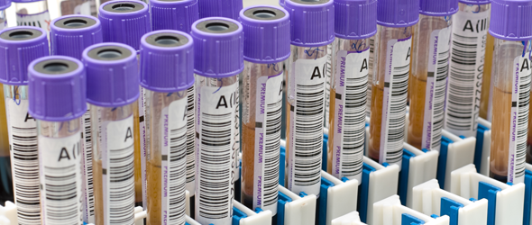
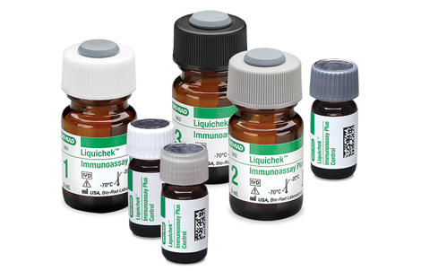
Lot verification of reagents
Sample
QC

Slide 58
Lot verification
Quantitative tests, Reagents using samples
2-3 concentrations depending on Clinical Decision Points
Run in triplicate using both old and new lots.
The means of the 3 runs on both lots, and the percentage difference between them are calculated.
As the sample volume may be an issue to afford 6 runs, pooled samples may be used.

Slide 59
Lot verification
Quantitative tests, Reagents
using samples
Any significant difference between the 3 values warrants repeat.
Limits of acceptance must be defined by the lab depending on the lab CVs and other available resources.
33% of CLIA PT guidelines may be used as guideline.
Many labs accept < 10% difference as the guideline.

Slide 60
Lot Verification using samples
 | Old Lot | New Lot
Run 1 | 104 | 99
Run 2 | 102 | 100
Run 3 | 102 | 102
Mean | 102.7 | 100.3
% Difference | 2.3

Slide 61
Lot verification of Qualitative tests
Though CV calculations are not available in qualitative testing, a suitable process must be evolved.
RDT
Stains
Media
Refer to QC module volume 2 on Qualitative Testing.

Slide 62
Lot Verification: Quality Controls
Verify for each analyte of interest
In parallel with the lot of control material in current use.
(Please see under the Training Module on Statistical Quality Controls for more on parallel testing. The reader is also directed to the statistical tool under QC Soft on Labs for Life, India website for this purpose)

Slide 63
Exercise
Find the percent difference between old and new lots at CDP 1 and CDP 2
Judge acceptance

Slide 64
Does your lab have a procedure for assessing the quality of new lots?

Slide 65
For more details:
  CLSI EP06
  CLSI EP 26 A
  CLSI EP15
  CLSI-EP09
  C28-A3
  Method Evaluation Chapter of Labs for Life QC Module
  QC Soft tool as well as the
  User Manual of QC soft

Slide 66
Thanks

