Slide 1
WHO guidance on Laboratory Safety
Dr Anuj Sharma

Slide 2
Outline
Is laboratory safety important?
WHO documents on laboratory safety
  Laboratory Biosafety Manual
LQSI online tool
Laboratory Assessment Tool (focus on safety)
  System and facility assessment

Slide 3
Laboratory hazards
Blood/blood products
Other samples
Chemicals
Waste
Design, air flow, environment
Notes:
Hands…
Gloves…

Slide 4
Is laboratory safety important?
Focus of laboratory safety
  Laboratory workers – infection, injury or poisoning
  Others who may come in contact with by-products
  Protect integrity of test products
  Protect the environment

Slide 5
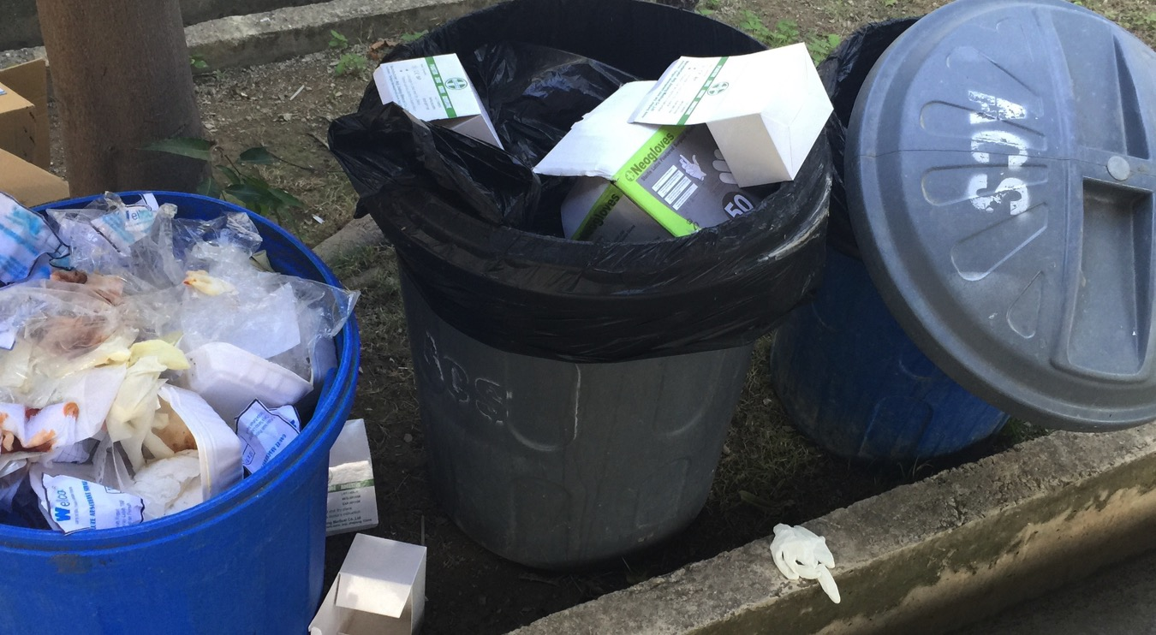

Slide 6
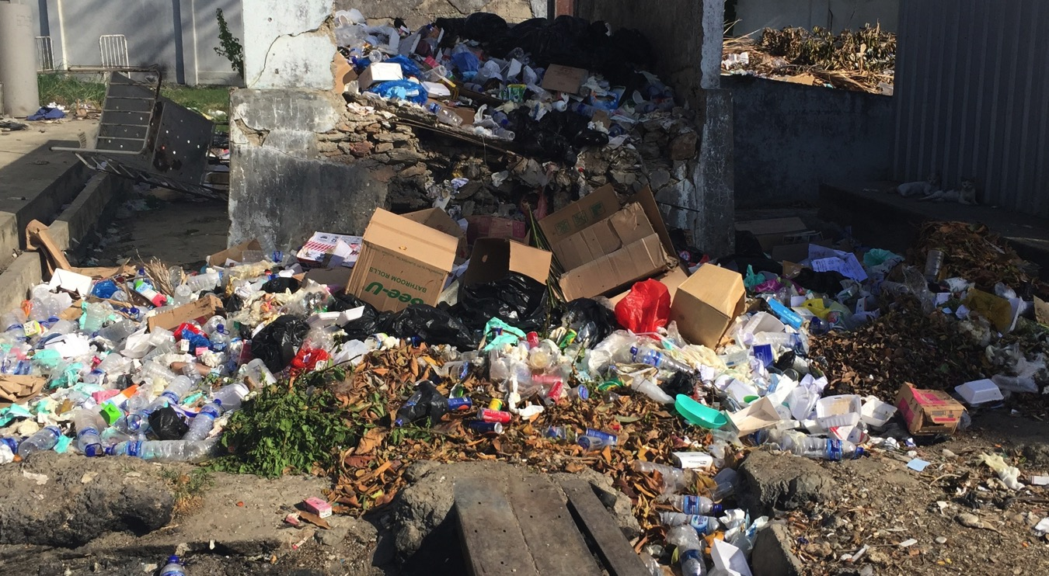

Slide 7
Is laboratory safety important?
Occupational safety requirements
Nuclear regulatory authority requirements for safe handling of radioactive isotopes
Environmental protection authority/regulations
Relevant national, state and local regulations
Requirements of accrediting bodies

Slide 8
Lab quality system
Organization
Personnel
Equipment
Purchasing & Inventory
Process Control
Information Management
Documents & Records
Occurrence Management
Assessment
Process
Improvement
Customer Service
Facilities & Safety
Notes:
Laboratory facilities and safety is an important component of the lab quality management system

Slide 9
Laboratory safety controls
Engineering controls
  Chemical fume hoods
  Biological safety cabinets (BSCs)
Administrative controls
  Developing a chemical hygiene plan
  Developing standard operating procedures (SOPs)
Work practices
  No mouth pipetting
  Chemical substitution where feasible
  Hand hygiene
Personal protective equipment (PPE)
  Gown, masks/respirators (N95), face shields, goggles, gloves
Laboratory Safety Guidance, Occupational Safety and Health Administration U.S. Department of Labor OSHA 3404-11R 2011

Slide 10

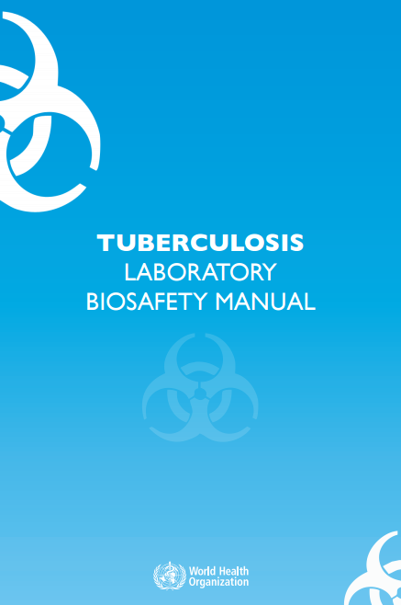
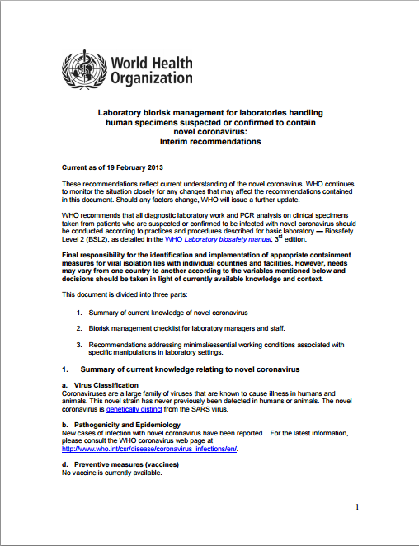
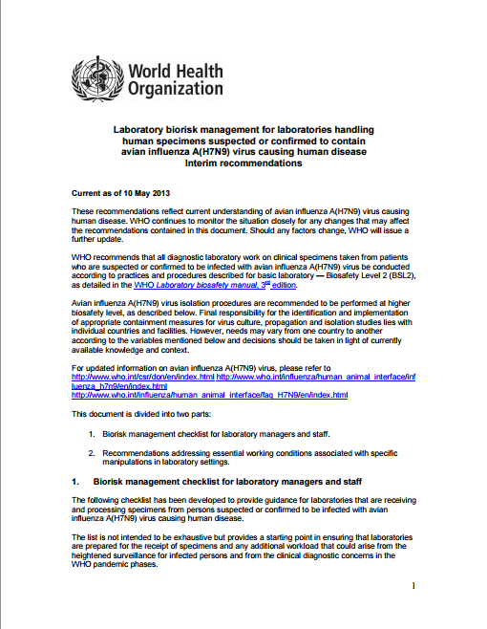
WHO documents
Notes:
Lab biosafety manual, 2004
TB lab biosafety manual, 2012
Coronavirus, Feb 2013
Avian Influenza, May 2013
Ebola, 2014

Slide 11
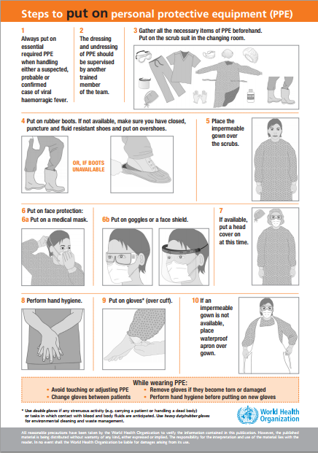
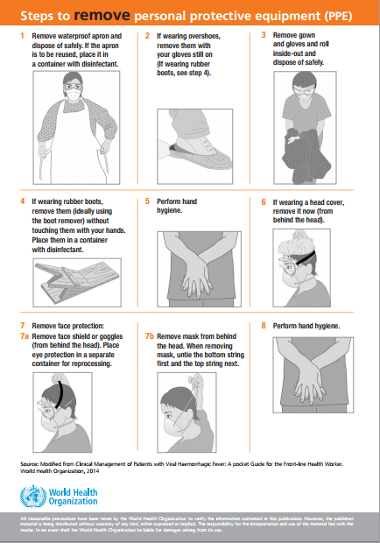

Slide 12
Laboratory biosafety manual
Microbiological risk assessment
Basic laboratories – Biosafety Levels 1 and 2
Containment laboratory – Biosafety Level 3
Maximum containment laboratory – Biosafety Level 4
Laboratory animal facilities
Guidelines for laboratory/facility commissioning
Guidelines for laboratory/facility certification
Laboratory biosecurity
Notes:
Lab biosecurity – institutional and personal security measures designed to prevent the loss, theft, misuse, diversion or intentional release of pathogens and toxins

Slide 13
Laboratory biosafety manual
Laboratory equipment
  Biological safety cabinets
  Safety equipment
Good microbiological techniques
  Laboratory techniques
  Contingency plans and emergency procedures
  Disinfection and sterilization
  Introduction to the transport of infectious substances
Biosafety and recombinant DNA technology

Slide 14
Category A “602 package”
Labels: UN 2814 UN 2900 Biohazard

Slide 15
Category B, “650 package”
UN 3373, No biohazard label

Slide 16
Laboratory biosafety manual
Chemical, fire and electrical safety
  Hazardous chemicals
  Additional laboratory hazards
Safety organization and training
  Biosafety officer and biosafety committee
  Safety for support staff
  Training programmes

Slide 17
Safety checklist
Laboratory premises
Storage facilities
Sanitation and staff facilities
Heating and ventilation
Lighting
Services
Laboratory biosecurity
Fire prevention and fire protection
Flammable liquid storage
Compressed and liquefied gases
Electrical hazards
Personal protection
Health and safety of staff
Laboratory equipment
Infectious materials
Chemicals and radioactive substances

Slide 18
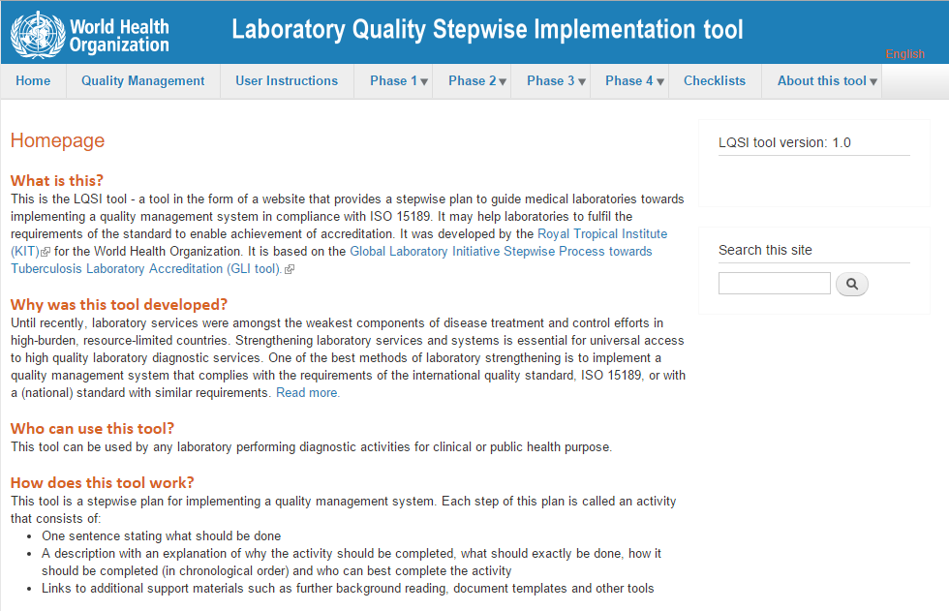
Notes:
Phase 1: Ensuring that the primary process of the laboratory operates correctly and safely
Phase 2: Controlling and assuring quality and creating traceability
Phase 3: Ensuring proper management, leadership and organization
Phase 4: Create continuous improvement and prepare for accreditation

Slide 19
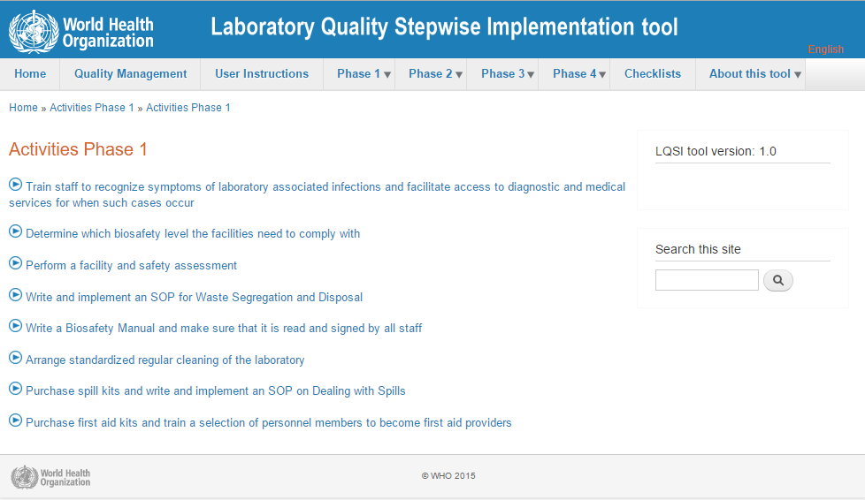

Slide 20
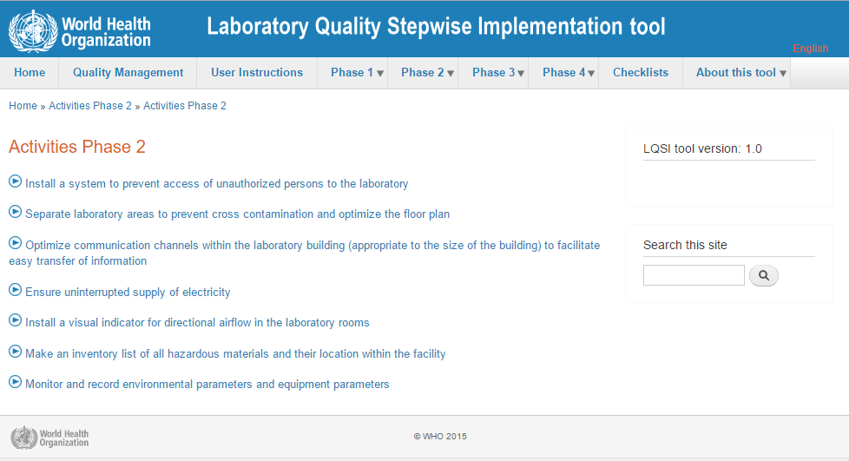

Slide 21
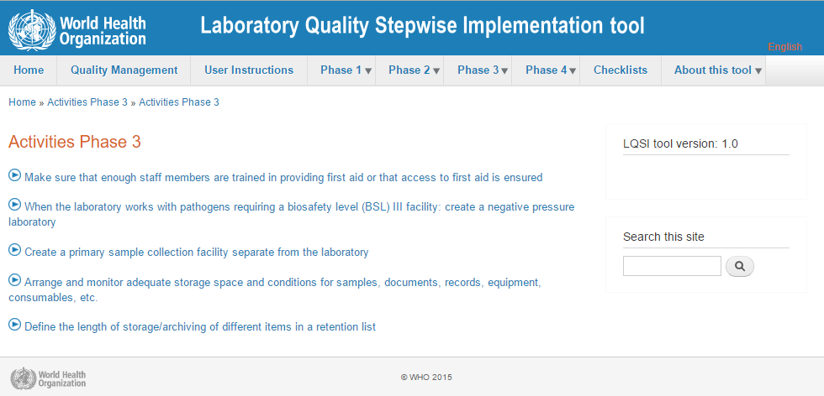

Slide 22
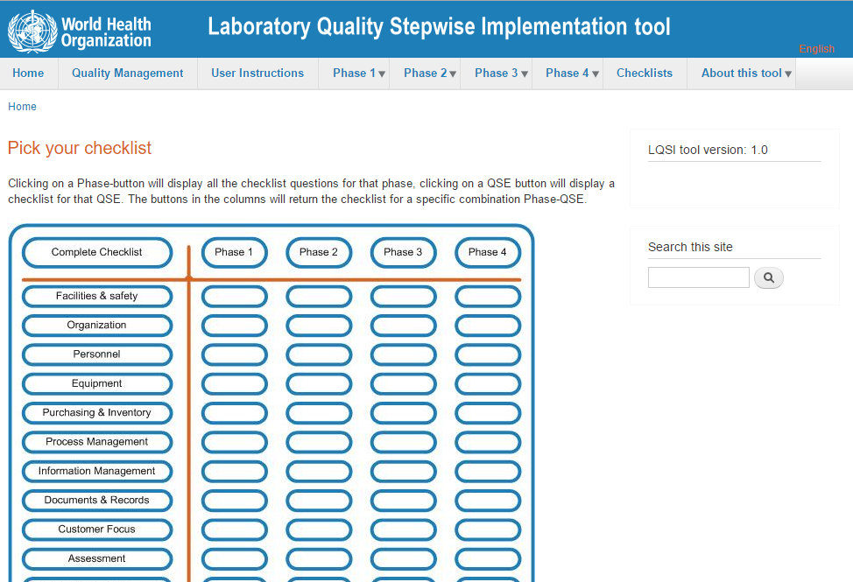

Slide 23
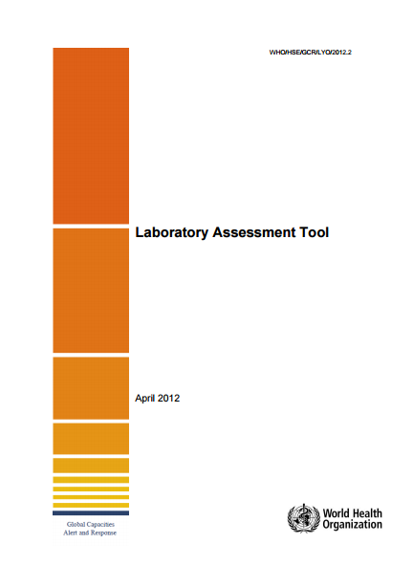
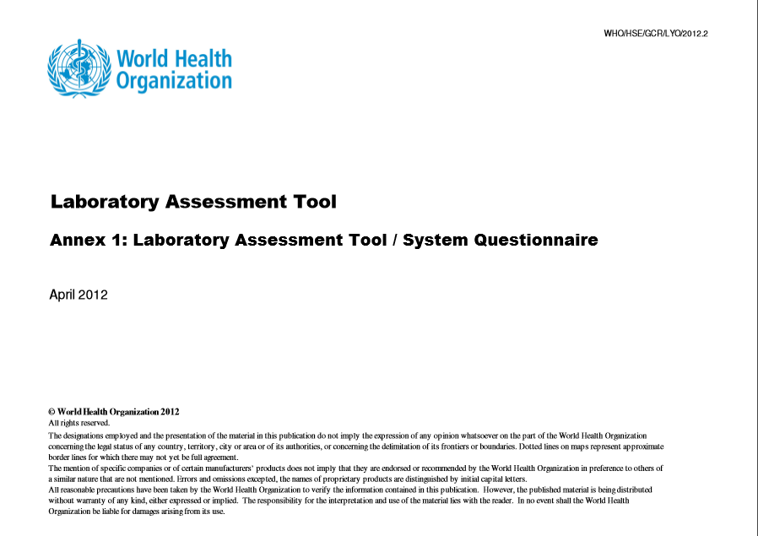
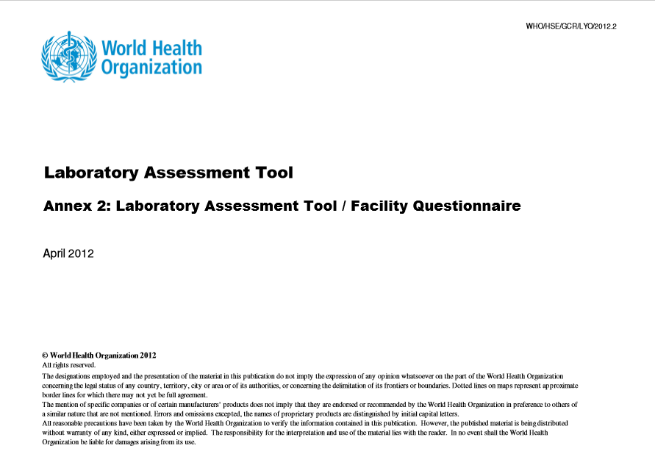
Laboratory Assessment Tool
System assessment
Facility assessment

Slide 24
Thank you
dr.anujsharma@gmail.com

