Slide 1
Levey-Jennings Charts
Graphically Representing your data
Labs for Life Project
Quality CONTROL TRAINING

Slide 2
Levey-Jennings Chart - History
W. Shewhart an American physicist, engineer and statisticianin 1931 proposed applying statistical based control charts to interpret industrial manufacturing processes.
In 1950 , S. Levey and E. R Jennings suggested the use of Shewhart`s control charts in the clinical laboratories.

Slide 3
99.7%
95%
68%
2.5%
13.5%
34%
34%
13.5%
2.5%
A Gaussian curve
Notes:
Normal distribution as we have seen. The Gaussian

Slide 4
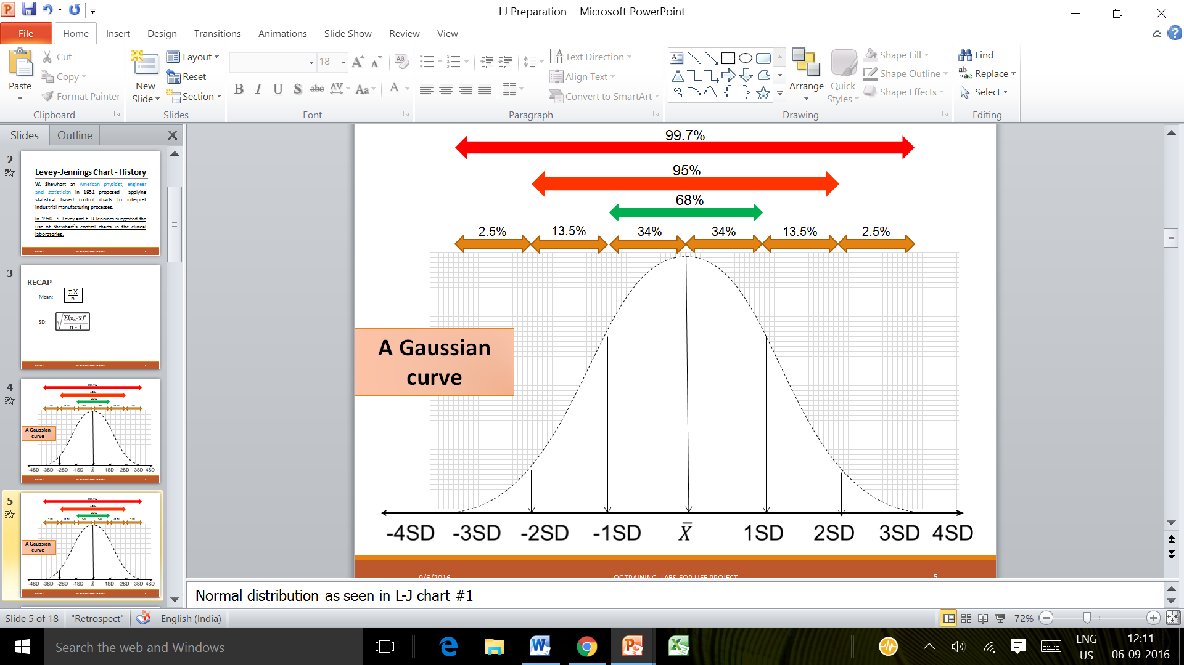
Turn the Gaussian on its side
Notes:
Turn it on its side

Slide 5
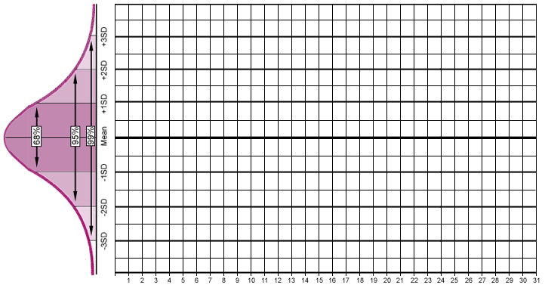
Draw lines (Y axis) through all the relevant points, mean and the ± 1, 2,3, (4) SDs.
Enter the frequency (Dates &/ or time) on the X axis
You have an LJ!!!

Slide 6
Label the Data Points
Control Limit - the defined limits or ranges expected due to random variation of the data points -- beyond those limits, some course of action involving investigation and troubleshooting are taken.
-3SD Control Limit
+3SD Control Limit

Slide 7
Write the values the mean, SDs
Plot daily control measurements
Mean: 190.5 & SD: 2.0
196.5
+3SD
194.5
+2SD
192.5
+1SD
190.5
MEAN
188.5
-1SD
186.5
-2SD
184.6
-3SD
1
2
3
4
5
6
7
8
9
10
11
12
13
14
15
16
17
18
19
Days
Notes:
7

Slide 8
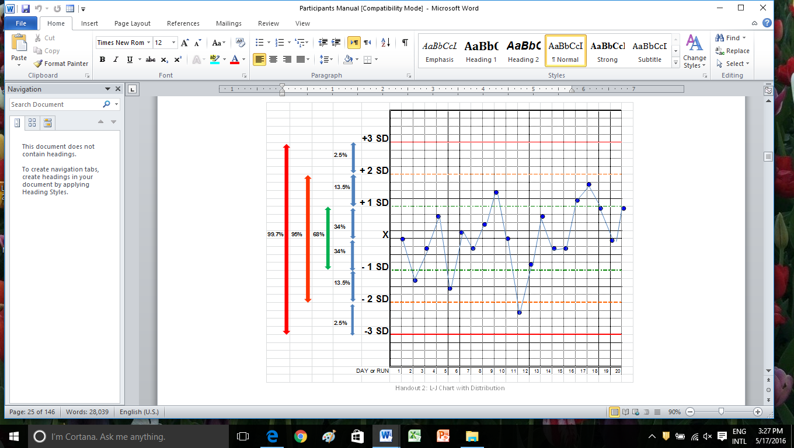
An LJ is basically a Gaussian on its side, separated by time as a frequency.

Slide 9
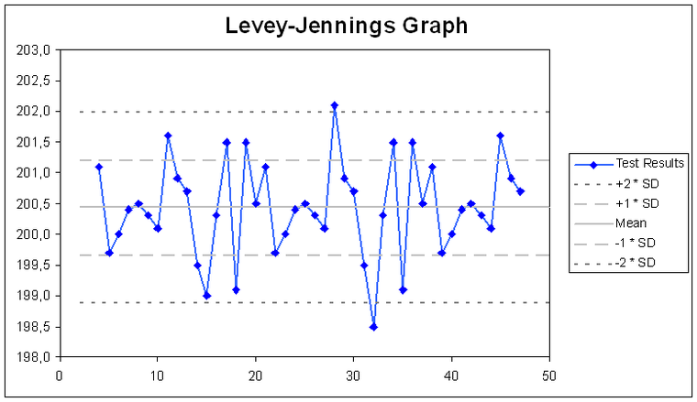
Levey–Jennings chart and SD
A chart is created for each test and level of control.
Cholesterol (mg/dL) ONE LEVEL QC

Slide 10
Levey–Jennings (LJ) chart
A graphical method for displaying control results and evaluating whether a procedure is in-control or out-of-control
Daily control values are plotted versus time
Lines are drawn from point to point to understand any trends, shifts, or random variations

Slide 11
Levey–Jennings chart and SD
The first step is to calculate decision limits.
Standard deviation is commonly used to set the limits
These limits are ±1SD, ±2SD and ±3SD from the mean.
A chart is created for each test and level of control.
Notes:
Point 6. QC software of some equipment (e.g Sysmex systems) plot the QCs with 2 SD limits. While this is adequate to detect errors if understood properly, the use of Westgard QC rules (discussed later) could become difficult

Slide 12
How to create LJ chart
Need tools for data management and analysis
  Manual methods
    Arithmetic Graph paper
    Calculator
  Computer system
    MS Excel software
    Quality software program like Westagrd QC, Labs for Life QC Soft

Slide 13
Notes:
Creating a L-J Chart
(Paper Plot)
Ideally you should have at least 20 data points to define your Mean and SD to define your Range.
Calculate Mean, SD, Range.
Now take chart and label X-axis as Time period used for Run.
Label Y-axis as Control values (Mean & SD).
Scale and label the Y-axis from lowest to highest expected control values so that:
the mean is located at the center of your graph.
the SD is the numerical value applied in an increasing/ decreasing fashion on either side of the mean, to denote ±1 SD, ±2 SD, ±3 SD, numerical values.
Write the numerical values obtained for ±1 SD, ±2 SD, ±3 SD, ±4 SD next to the correct label on the chart.
Draw lines for mean and SDs
Begin plotting analyzed QC results.

Slide 14
Two Level QC
Two levels of controls in AST.
20 Days run
Calculate Mean & SD
Calculate ±1 SD, ±2 SD, ±3 SD
Assign the mean and range on 2 charts

Slide 16
Excel
Plot LJ-
Glucose Level1 for the month of Nov 2015 from 1st Nov to 20th Nov.
  Mean: 100
  SD : 5
  Data points : 102, 104, 99, 89, 90, 105, 100, 101,105, 104, 101, 88, 94, 104, 101, 106, 100, 94,106, 107.
Notes:
We will teach the use of Excel software separately in a video. Please refer to that.

Slide 17
RECAP - An LJ is basically a Gaussian on its side, separated by time as a frequency.

Slide 18

Train Your Eyes to see, Train the Eyes of Your Staff to see!!!!

Slide 19


Slide 20


Slide 21

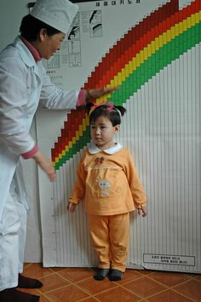
Set review Frequencies:
Daily Reviews, Periodic Reviews
Notes:
You might want to review a new born on a daily basis. A toddler at set frequencies, say monthly? QC monitoring also warrants review
Your lab must set review frequencies.
For random errors, daily monitoring is warranted. Your frontline worker should be able to check and understand the errors and take corrective actions.
Emerging systematic errors, can be more subtle. It requires more expertise to detect and should be done by technical supervisory staff. As it is important to detect emerging errors before patients are affected, the lab must set frequency of such reviews. We will talk about this in later sections. However, as a bottom-line, poorly performing parameters require more frequent review, say once in 2-3 days, whereas parameters showing good performance can be reviewed once 1-2 weeks

Slide 22
DOCUMENT!!!!!
4 main kinds of documentation audited by NABL are
Values of daily runs
Corrective action proof( evidence for remedial action in the event of QC failures)
LJ charts (Monthly)
CV% tracking for at least 6 months
As we learnt earlier 5.6 of the ISO deals with the assurance of the quality of examinations. Any non-conformance in this area is dealt with as a “Major” non-conformance. Hence documenting your QC related activity is very important

Slide 23


