Slide 1

Equipment Safety

Slide 2
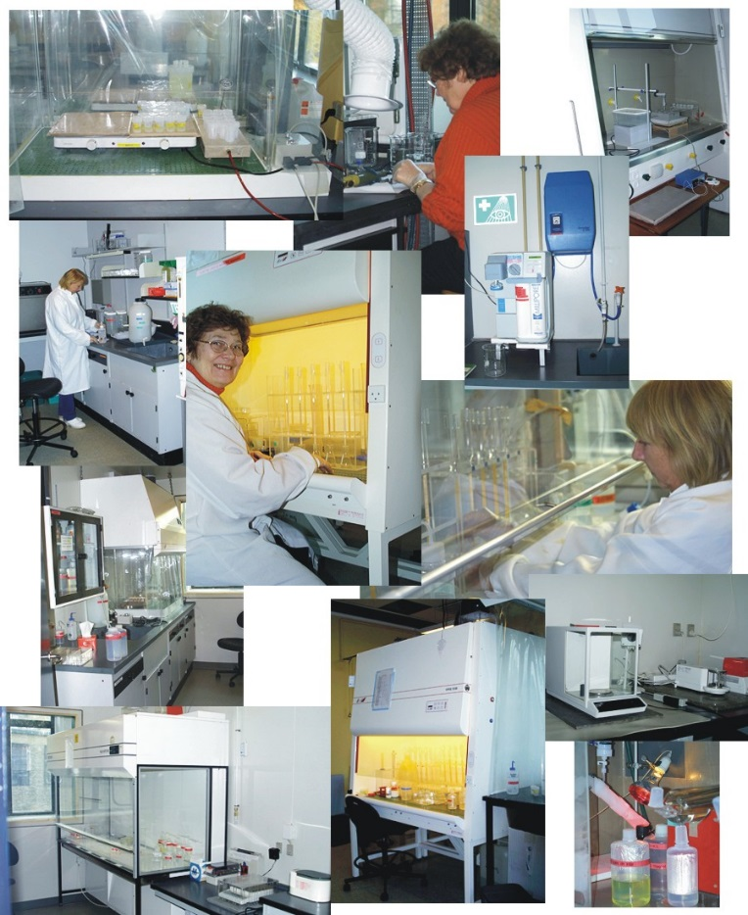
Laboratory Equipment
Never use any laboratory equipment unless you are trained & have been authorised to do so
As well as injuring yourself you may cause very costly damage

Slide 3
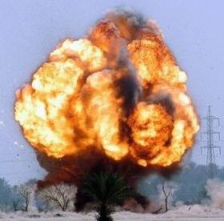
When in doubt – ASK!!!
Do not carry out a new or unfamiliar procedure until you have been fully trained & understand the precautions necessary for safe working
DO NOT GUESS!!!!

Slide 4
Equipment hazards!!
Mechanical
Electrical
Biological
Laser
UV
Chemical

Slide 5

Pictogram Speak!!!

Slide 6

Equipment Safety:
Mechanical
Understand hazards of each equipment
Design matters!!!!
  Audible/visible signals that equipment is operational
  Interlock or key/lock systems
  Permanent shielding

Slide 7

Equipment Safety:
Mechanical
Never defeat the safety features
  e.g. Never operate centrifuge with lid open
Keep doors, covers & panels closed/secured in place, while the instrument is in use
Use the proper tools when troubleshooting
Do only authorized maintenance procedures

Slide 8
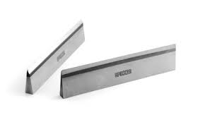
Some Equipment posing Mechanical Hazards
Microtome knives
Metallic probes of all equipment
Moving parts of all equipment
Sharp contours of all equipment
Heavy equipment not anchored or secured well

Slide 9
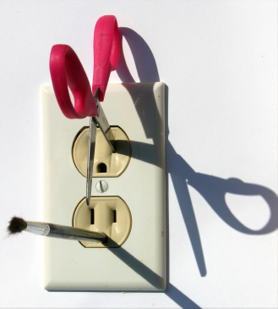
Equipment Safety:
Electrical
√ More than 3 ma -
Painful shock
√ More than 10 ma
Muscle contraction “no-let-go” danger
√ More than 30 ma
Lung paralysis- usually temporary
√ More than 50 ma
Possible ventricular fib. (heart dysfunction, usually fatal)
√ 100 ma to 4 amps
Certain ventricular fibrillation, fatal
√ Over 4 amps
Heart paralysis; severe burns. Usually caused by >600 volts
  Risk- Electrocution/Shock/Burns/Death

Slide 10
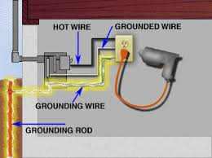
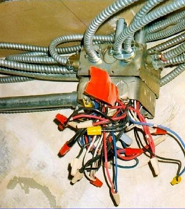
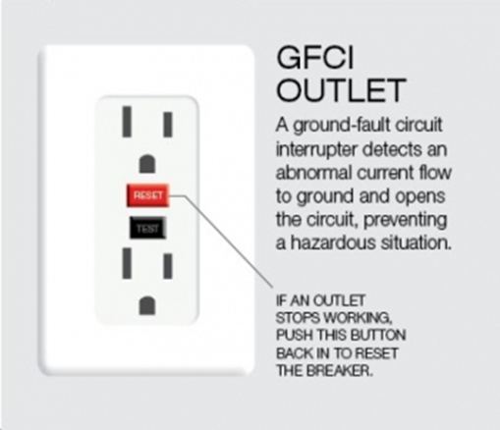
Equipment Safety: Electrical
Use Protections!!
  Grounding/ Earth
  Circuit Breakers
  Ground Fault Circuit Interrupters
  Guarding live parts
  Secure & check for insulation cracks

Slide 11
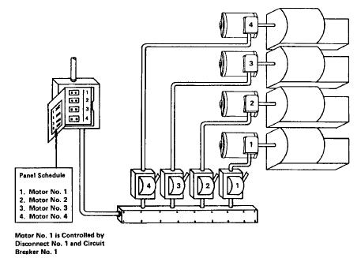
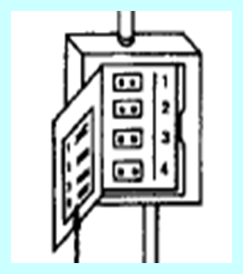
Equipment Safety
Electrical
  Labeling
  Each disconnecting means legibly marked to indicate its purpose
  Switches & circuit breakers clearly labeled to indicate its circuit’s function
  Mark on/ off positions of circuit breakers
Disconnect switch for
Equipment number 3
r Circuit breaker for 1,2,3,41,2,3,4

Slide 12
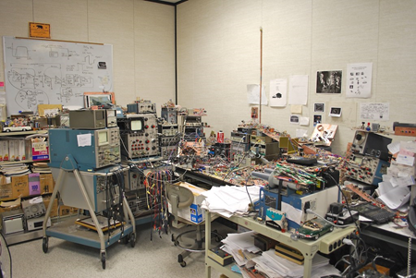

Equipment Safety :Electrical
Organize Working Space
Provide sufficient working space around equipment. Leave empty space within 3 ft of electrical panel/equipment
No storage, especially inflammable material (chemicals, card boxes, cleaning solutions, etc.) around equipment
Provide adequate illumination
Air conditioners should not be mounted above equipment- chance of water condensing

Slide 13

Equipment Safety Electrical
Personal precautions
No bare/wet hands when plugging or unplugging
No raising or lowering tools by the cord
No using in damp and wet locations, unless equipment is designed for it
No metal ladders for or near electrical work

Slide 14
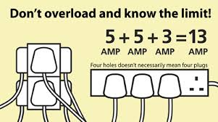
Electrical Safety
Extension Cords
Avoid extension cords if possible
Don’t secure with staples, nails or bare wire
Must have a ground pin
Inspect regularly
Don’t repair with electrical or duct tape
Don’t overload

Slide 15

Equipment Safety
Biological
  Equipment decontamination & cleaning protocols, audits
  Vaccinations & PEP…
  Disposal of equipment effluents
  Disposal of testing samples
  Decommissioning of equipment

Slide 16

Equipment Safety
Biological
Safe use of equipment
Aerosol generating equipment
    Centrifuges
    Homogenizers, Shakers, Vortex….
Storage of Infectious Materials
    Refrigerators & Freezers
Use of Pipettes: Avoid mouth pipetting
Use Bio-safety Cabinets wherever warranted

Slide 17
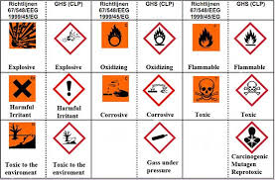
Equipment Safety
Chemical
MSDS sheets for all reagents used on equipment should be available and understood
Study Risk and Safety Phrases on reagents
Develop a Chemical Hygiene Plan (CHP) for all equipment

Slide 18


Equipment Safety
Laser, UV
Do not remove protective shields of Laser enabled equipment
UV lamps should be used with caution to avoid exposure
While using BSC UV light for decontamination remember to switch off the UV at least half an hour before use

Slide 19
Equipment Safety:
Noise
Noise
Continuous: constant level over time
Intermittent: levels vary over an area or start and stop
Impact: sharp burst of sound (nail gun, drilling hammer)

Slide 20
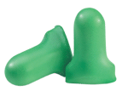
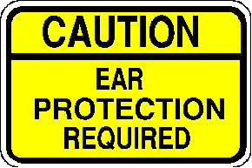
Equipment Safety:
Noise
Measured in decibels (dB)
  Whisper- 10-20 dB
  Speech- 60 dB
  Noisy Office- 80 dB
  Lawnmower- 95 dB (Lab Machines too?)
  Passing Truck- 100 dB
  Jet Engine- 150 dB
OSHA Limit - 85 dB

Slide 21
Equipment Safety:
Noise
Hearing Loss, Causes
    Disease
    Age
    Excessive Noise
      workplace
      environmental
Other Effects of Noise
    Elevated blood pressure, stress, sleeplessness

Slide 22


Equipment Safety: Noise
Hearing Protectors
Ear Plugs - preferred (NRR* 20-30 dB)
Ear Muffs - 2nd choice (NRR 15-30 dB)
Double Hearing Protectors (plugs and muffs) (NRR 30-40 dB) used for levels over 115 dB
(*NRR = Noise Reduction Rating - an approximate decibel reduction provided by the protector in lab conditions. Subtract 7 dB for approximate “real world” attenuation)

Slide 23
    Equipment Safety Program &
    Reporting of Equipment Adverse Incidents
Develop specific safety programs for specific equipment
Authorization for handling should be given only to trained staff
Periodic re-training & evaluation of staff is important
Any adverse incidents related to equipment safety should be reported, documented & appropriate corrective action taken

