Slide 1
INVENTORY MANAGEMENT
ISO 15189: 5.3

Slide 2
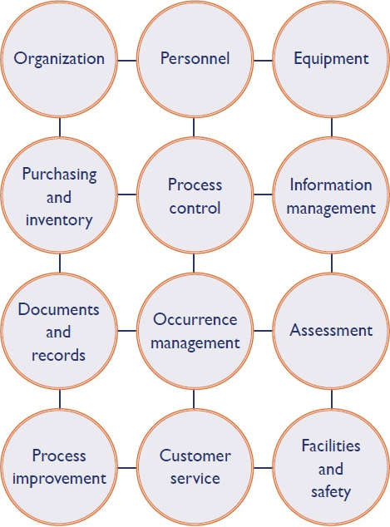

Slide 3
Quantity, quality, process
Quantity Management
Demand Forecasting & Planning
Inventory Movement Control
Consumption, Inventory and Operations Planning (CIOP)
Tools and techniques
Quality Management
Ensuring Fitness for purpose
Acceptance testing
Process Management
Receipt
Storage
Use
Safety
Discarding

Slide 4
Quantity Management
Balance Demand and Supply
Why??
Manage Supply Economics
Minimize Response Time
Cater to variability

Slide 5
Objectives of Inventory Planning
Making available supply of materials in specified quantity and quality and maintaining the continuity of supply at the most economic cost- to Demand Forecasting & Planning
Minimizing the investment in materials and inventory carrying cost - Inventory Planning & Control

Slide 6




Demand Forecast
Demand Forecasting is estimating future demand of a product, material or service
Demand forecast is used for:
Factors that Influence Demand
Planning of supply and ordering of materials
Planning of resources e.g. equipment, manpower
Budgeting of costs
Planning of new tests/ services
Historical Demand
External Factors
e.g. Weather, Epidemics
Health Campaigns and Programs

Slide 7
Basic Terms & Terminology
Re-order when stock reaches minimum level
Minimum stock - Amount of stock required to support testing operations until additional supplies are received
Lead time – Time between placing an order and receiving it
Maximum usage – number of test kits used in a given time period

Slide 8
Process of Demand, Forecasting and Inventory Management
1. Estimate & Plan Demand
2. Plan Inventory & Supply
3. Place Purchase Order
5. Store Material
4. Receive and Inspect Material
6. Issue Material
7. Review Performance

Slide 9
How to Implement Inventory Control
Assign responsibility
Maintain
inventory system
in all storage areas
Analyze
needs
INVENTORY CONTROL
Establish
system for
receiving, storing
Establish
minimum stock needs
Develop
forms and logs

Slide 10
Quality of Materials In Laboratory:
WHY technical inputs are required in inventory planning
Quality of Materials
Performance Characteristics
Operational Characteristics

Slide 11
Performance Characteristics
Things to assess before purchase
Consequences of failing to do this pre-purchase evaluation
Precision
Accuracy
Linearity (Analytical Range)
Analytical Sensitivity
Analytical Specificity
Biological Reference Interval
Unacceptable Imprecision leading to uncontrollable CVs
Failing Proficiency tests
False Negatives
False Positives

Slide 12
Operational Characteristics
Consequences of failing to do this pre-purchase evaluation
Things to assess before purchase
Test complexity,
Turnaround time (TAT)
Compatibility with current equipment/infrastructure/LIS
Type and quantity of sample required
Patient/sample preparation required
Pre-analytical acceptance criteria and possible errors
Sample storage criteria
Staffing/training requirements
IQC/EQA requirements
Effort and training intensive method
Delayed reports
Disturbed path of workflow, error
Compromised patient care

Slide 13
Process management
Activity | Management Involvement
Purchase of Materials or Services | √
Supplier Evaluation | √
Quantity Management | √
Reception of Material | -
Storage of Material | √
Acceptance Testing | -
Within Lab Inventory Management | -
Disposal of Unused And Expired Material | √
Documentation | -

