Slide 1


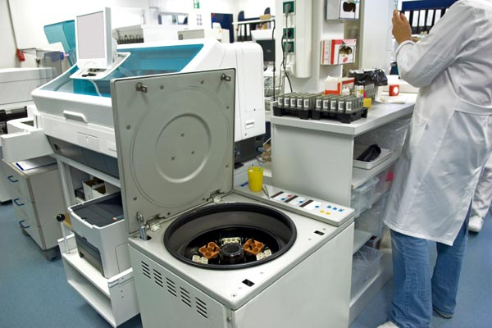



LABS FOR LIFE PROJECT - INDIA
Equipment Management
MoHFW /CDC / BD Partnership Project

Slide 2


  Maintenance Qualification (MQ)
MQ is used to describe and document regular maintenance and repairs.
MQ covers all necessary measures entailing cleaning, maintenance and repair.
Details of this are given in subsequent sections.
    Maintenance plan
    Preventive Maintenance
    Troubleshooting- Determining the source and cause of the problem

Slide 3
  Maintenance – GROUND RULE
The Daily, Weekly and Monthly maintenance procedures must be performed as per the manufacturer’s specifications

Slide 4
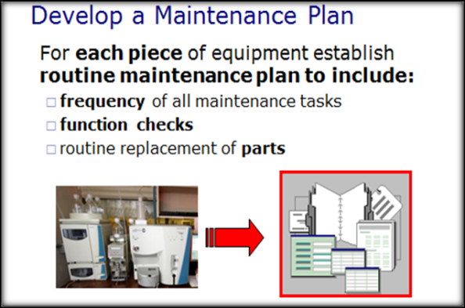
Maintenance Plan
A maintenance plan will include preventive maintenance procedures as well as inventory management, troubleshooting, and repair of equipment.

Slide 5
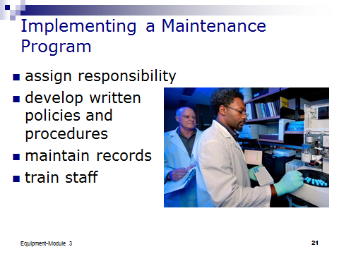
Maintenance Plan
When implementing an equipment maintenance program, some of the initial steps will include:
Assigning responsibility for equipment maintenance and calibration.
Training staff on the use and maintenance of the equipment, and assure that all staff understand their specific responsibilities.
Developing the format for records, logs and forms.

Slide 6
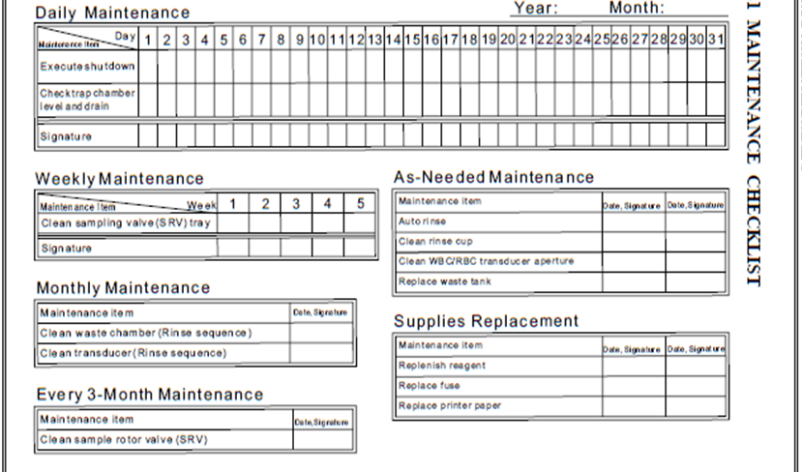
Maintenance Plan Worksheet

Slide 7

Preventive Maintenance
Preventive maintenance is defined as a plan of scheduled inspections of equipment and instruments resulting in minor adjustments or repairs for the purpose of delaying or avoiding major repairs and emergency or premature replacements.
Preventive maintenance schedules should be followed regularly for optimal performance of equipment.

Slide 8
Preventive Maintenance
Preventive maintenance schedules are usually prepared as per the manufacturers’ guidelines and may be conducted daily, weekly, fortnightly, monthly, biannually or annually.
preventive maintenance cannot serve as an alternative to the AMC or CMC for the lab equipment, which must be drawn with the concerned manufacturer on a regular basis and without fail.

Slide 9
Preventive Maintenance
Preventive maintenance provides the following advantages over breakdown maintenance.
Quality assured results.
Fewer interruptions in services and hence higher productivity
Timely identification and replacement of components showing excessive wear
Greater safety
Lower repair costs
Less stand by equipment requirements
Longer instrument life
Enhanced customer satisfaction

Slide 10
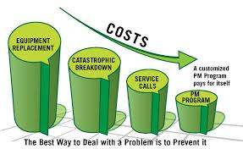
COST OF MAINTENANCE

