Slide 1
Westgard Rules
Detecting Changes in the Analytical System
Labs for Life Project
Quality Control TRAINING

Slide 2
Rules for what?
Westgard has formulated rules to decide whether an analytical run is in-control or out-of-control.
These rules can be applied as single rules and as a group of rules (multi-rules).
Westgard rules can be applied only if your QCs are plotted with the range of 3 SD*
Notes:
*QC software of some equipment (e.g Sysmex systems) plot the QCs with 2 SD limits. While this is adequate to detect errors if understood properly, the use of Westgard QC rules (discussed later) could become difficult

Slide 3
Rules for what?
Two key factors to keep in mind while selecting/ using rules are:
  Maximize Error Detection: Per cent error detection (P ed) >90%
  Minimize False Rejection: Percent False Rejection(P fr) < 5%
Notes:
False rejection means rejecting good runs because of doubts about the stability of the system

Slide 4
While talking about QC rule nomenclatures we have to understand 2 sets of nomenclatures.
N and L
Within/ across of Run/material.
We will talk about these now

Slide 5
Control Rule Nomenclature 1
N_{L}
N:L
or
N
= number of control measurements involved
L
= Limit Exceeded
Notes:
Control limits expressed as the ± a multiple of the SD, from mean assigned to the L-J chart, where the QC data point is located

Slide 6
Control Rule Nomenclature 2
Within –run/ Across Material: At 2/3 levels of QC in the same run
Across run/ Within- material: Same level (material) of QC but in 2 or more consecutive runs
Notes:
Remember what we talked about the 2 levels of QC being run daily? This is because some QCs have 2 or even 3 levels. Levels of QC are made available as per the clinical decision levels that need monitoring. So since you are running 2-3 levels (materials) simultaneously, errors detected are called within run - across material, implying the same run, but 2 or 3 different material.
But if the same level of QC shows errors in consecutive runs it is termed, across runs and within material
Need illustration please

Slide 7
Rule Violations
Now that we know 2 things
What happens in stable analytical systems (Gaussian with stable mean and stable SDs)
How rule violations are named
Let us proceed with looking for specific rule violations and the possible reasons for their occurance

Slide 8
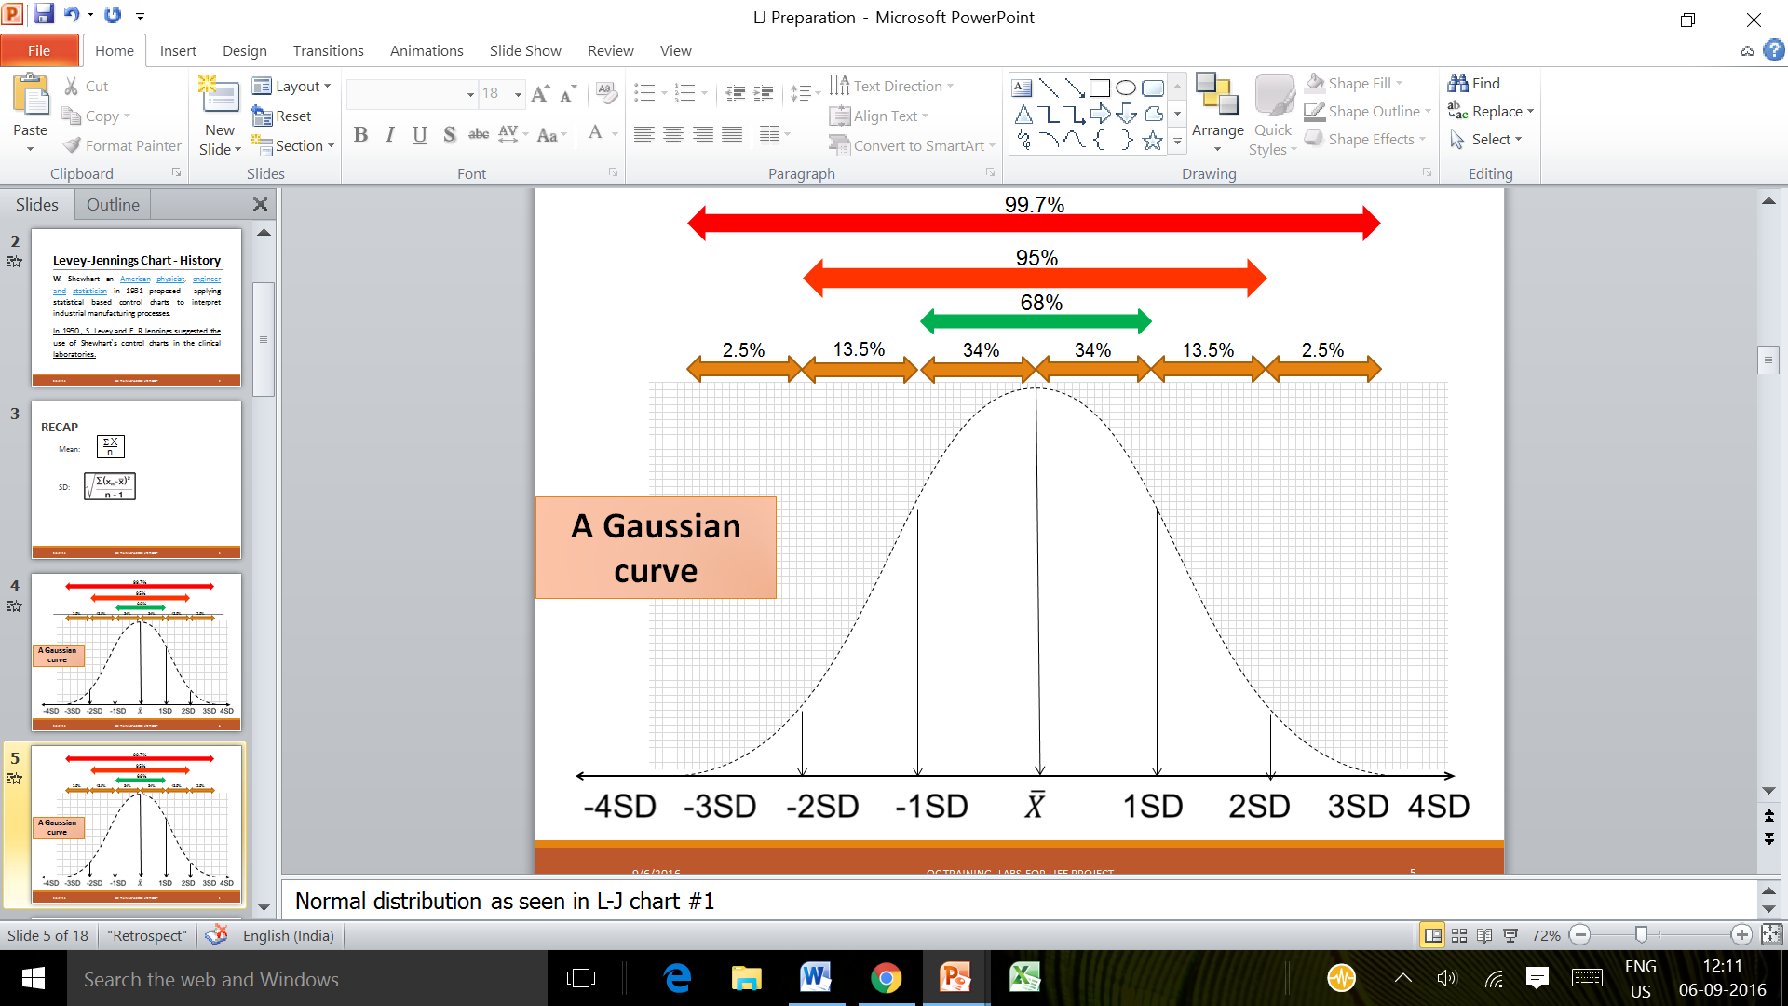
+ 3S region
+ 2S region
- 2S region
- 3S region
Notes:
Look at the indicated regions. Look at + 2S and -2S. Can these regions contain data points in a stable analytical system? Yes. approximately 2.5 on either side. Or 4.7% in all. So we look at data points in these regions as a warning. Again caveats are there. We will see these shortly

Slide 9
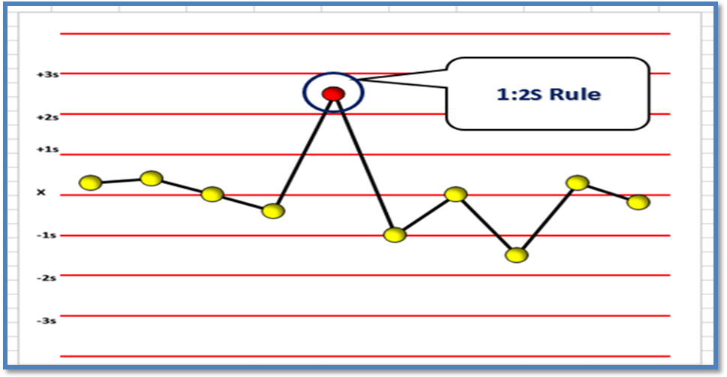
1 control exceeding the 2 SD limit is 1: 2S
Recap N_{L} (Here N (number of violation)=1 and L (the limit exceeded)= 2)
1:2s or 1₂s denotes a Random Error or the beginning of a Systematic Error
Notes:
In the next video, we are enumerating the causes for Random and systematic errors. The N is shown as the first number. L is shown ether as subscript or as :2S as shown in the label. S here means SD

Slide 10
1:2S
It can be both in plus and in minus direction*
Even in the absence of any analytical errors 4.5% of data points in the region of 1:2S region**
It may be considered a warning rule for a random or an emerging systematic error
IMPORTANT: If only one level of QC is being run in the Lab 1:2S has to be a rejection rule
Notes:
*Show
** As shown in the earlier slide

Slide 11
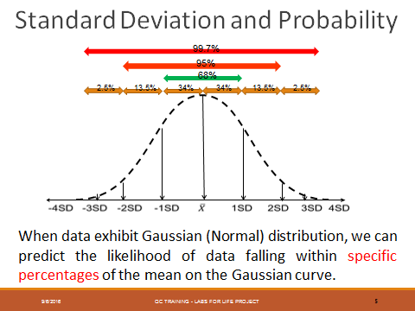
What about the P fr and P ed of 1: 2s?
Very good P ed as all runs going outside 2 SDs are considered outliers
Unacceptable P fr as:
4.7% good runs rejected if one control level is considered.
9.4% if 2 control levels
14% if 3 control levels

Slide 12
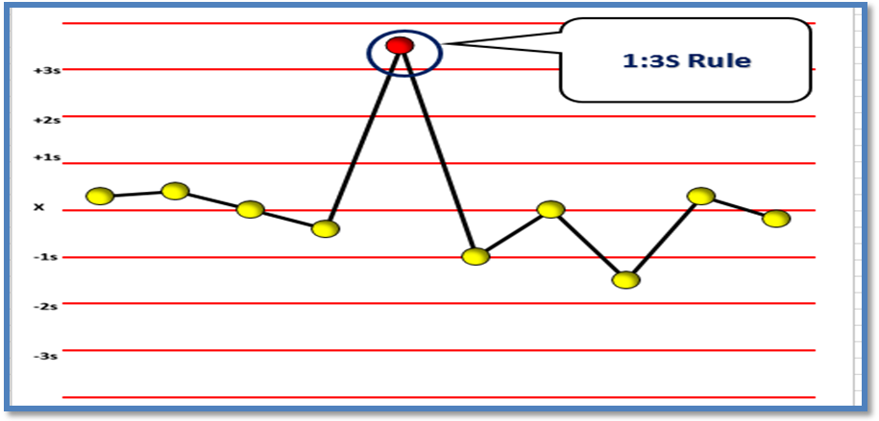
1 run, above 3 SD id 1:3 S
1:3s or 1₃s denotes a Random Error or a the beginning of a large Systematic Error

Slide 13
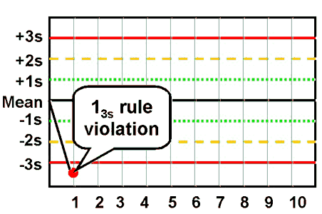
Xassign
1
2
3

Slide 14
1:3s or 1₃s
1:3s or 1₃s refers when the data point falls outside the set control limits of ± 3 SD
A run is rejected when a single control measurement exceeds the mean ±3SD control limit.
This rule identifies unacceptable
  random error
  possibly the beginning of a large systematic error.

Slide 15
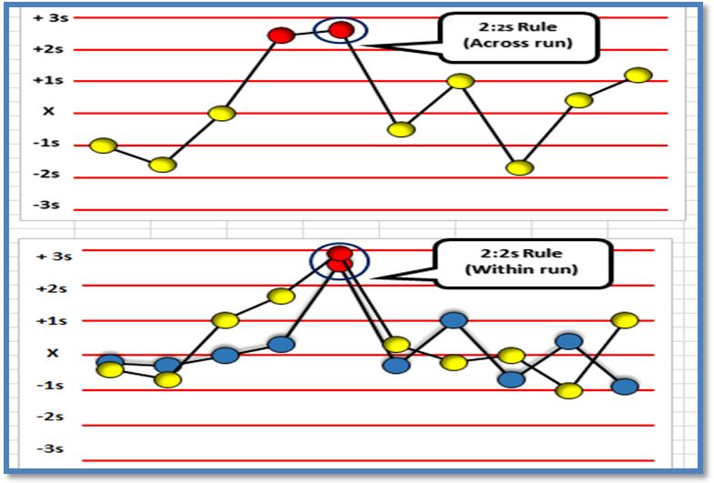
2 runs crossing 2 SD limits on the same side of the mean in 2 levels in the same run or 2 runs of the same material on 2 consecutive runs
2:2s or 2₂s denotes a Systematic Error
Notes:
2 violations of 2 SD limits. Here the yellow data points denote one level of control and the other the a second level. In the upper graph, two consecutive data points are in the 1:2S region (Across run, same material), whereas the lower graph shows both material in the 1:2S region in the same run (Within run, across material)

Slide 16
2:2s or 2₂s
Two consecutive QC results greater than 2s on the same side of the mean.
This rule identifies systematic error only.
There are two applications to this rule:
  within-run (in the 2 levels of QC in the same run)
  across runs (In the same QC in 2 consecutive runs).

Slide 17
Example of 2:2s
if a normal (Level I) and abnormal (Level II) control are
  >2s on the same side of the mean,
  this run violates the within-run application for systematic error.
If however, Level I is acceptable and Level II is 1:2s, the Level II result from the previous run must be examined.
If Level II in the previous run was
  at +2.0s or greater,
  then the across run application for systematic error is violated.

Slide 18
….2:2s
Violation of the within-run application indicates that systematic error is present and that it affects potentially the entire analytical curve (Multiple Clinical Decision Levels)
Violation of the across run application indicates that only a single portion of the analytical curve is affected by the error. (The corresponding Clinical Decision Level)
Notes:
What does that mean? Take for instance a TSH assay. TSH has 3 QCs; low, normal and high. Suppose you have found a 2:2s error in a low level QC. This could indicate that clinical decision level (Low, hence hyperthyroid) is affected. However, if the 2:2s is in 2 levels of QCs may indicate that the entire analytical curve is affected.

Slide 19
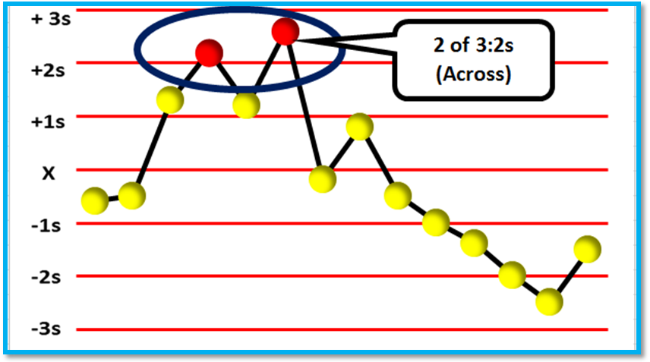
2 of 3₂S- when 2 out of 3 control measurements exceed the same
± 2 SD control limit;
2 of 3s denotes a Systematic Error
Notes:
2 of 3S is similar to 2: 2s in that, multiple 2S violations are happening, but with intermittent data points falling in the normal range. This should alert the operator to some systemic error

Slide 20
2 levels of control material with 4 SD difference between the 2 data points. R₄s denotes a Random Error
Notes:
This rule applies only within run.

Slide 21
R₄s
When 2 control measurements in a group exceeds the mean ± 2 SD on either side or if the sum of the SDs of the two material > 4 SDs
This rule should only be interpreted within-run, not across-run.
This rule identifies random error only, and is applied only within the current run.

Slide 22
…Example R:4s
assume both Level I and Level II have been assayed within the current run.
Level I is +2.8s above the mean and Level II is -1.3s below the mean.
The total difference between the two control levels is greater than 4s (e.g. [+2.8s – (-1.3s)] = 4.1s).
In the above example, though the Level II has not violated a -2 SD level, together the within run QC violates an R₄S.

Slide 23
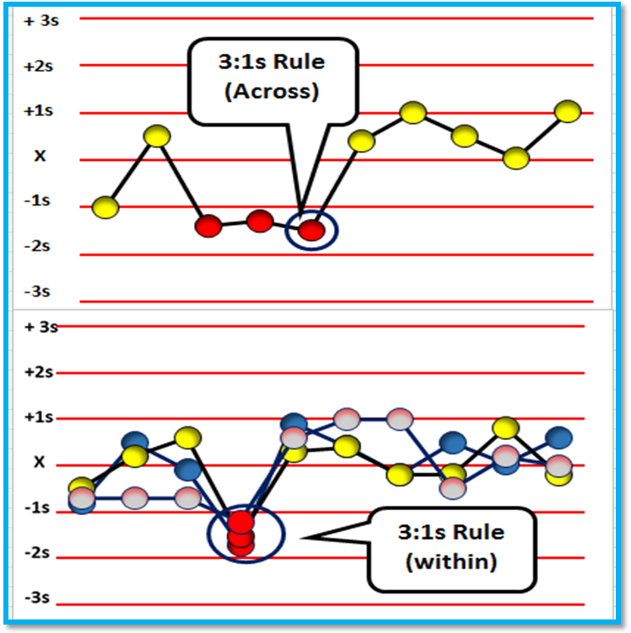
3₁S denotes a Systematic Error
Notes:
3 violations of 1SD limits. Across runs in 1 level of control (upper graph) or across materials in a trilevel control, in one run (lower graph)

Slide 24
3:1S or 3₁S
3 consecutive control measurements exceed the same mean plus 1s or mean minus 1s control limit.
3 consecutive results
Greater than 1s
On the same side of the mean

Slide 25
3:1s
These are within control material (e.g. all Level I control results) or across control materials (e.g., Level I, II, and III control results in combination when a tri-level control is used, n=3 or 6).
Within control material violations indicate systematic bias in a single area of the method curve while violation of the across control materials application indicates systematic error over a broader concentration.

Slide 26
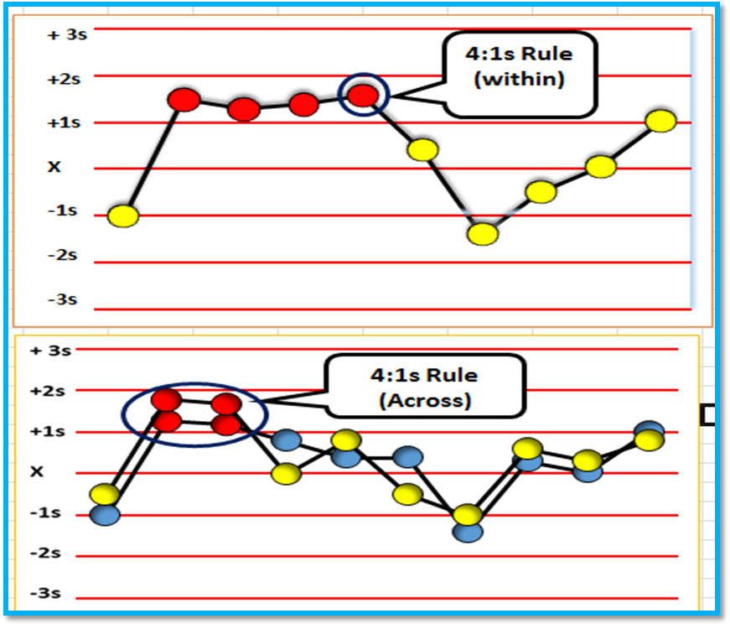
4₁S denotes a Systematic Error

Slide 27
4:1S or 4₁S
In analytes with 2 levels of controls
When 4 consecutive control measurements exceed the same mean plus 1s or the same mean minus 1s control limit.
Four consecutive results
Greater than 1s
On the same side of the mean

Slide 28
4:1s
There are two applications to the 3:1s and 4:1s rule.
These are within control material (e.g. all Level I control results) or across control materials (when n is 2 or 4).
Within control material violations indicate systematic bias in a single area of the method curve while violation of the across control materials application indicates systematic error over a broader concentration.

Slide 29
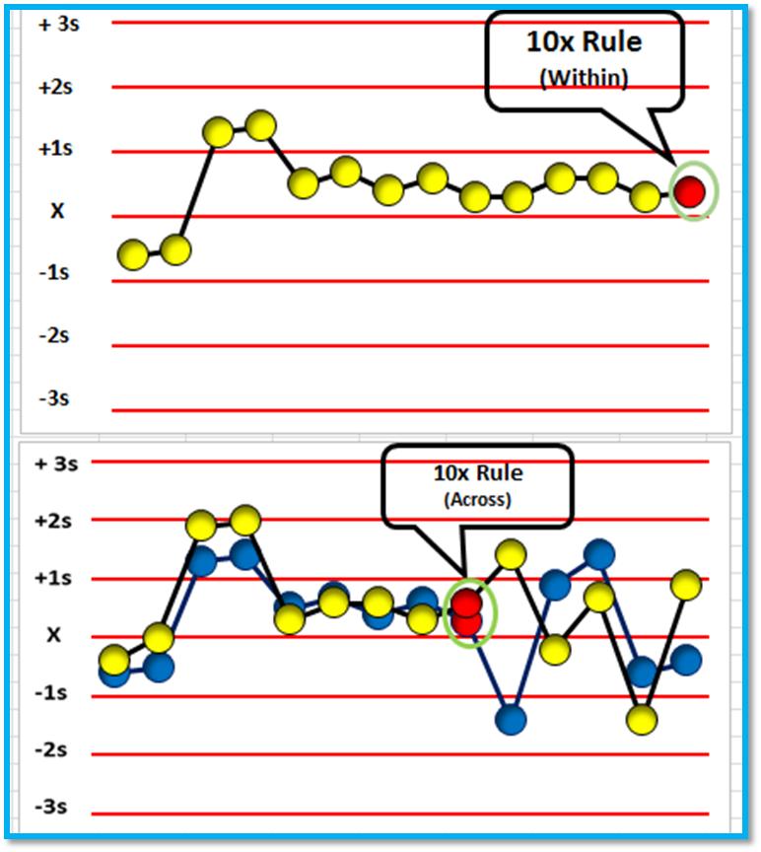
6x, 8x,9x, 10x, 12x denotes Systematic Errors
Notes:
Depending on whether the lab is using bi level or tri level controls, and depending on the number of data points, these violations can be detected. Note that these violations are termed x and not S. X here means mean, implying that all points are on one side of the mean

Slide 30
6x, 8x,9x, 10x, 12x
These rules are violated when there are:
6 or 8, or 9, or 10, or 12 control results on the same side of the mean regardless of the specific standard deviation in which they are located.

Slide 31
6x, 8x,9x, 10x, 12x Application
Each of these rules also has two applications:
Within control material (e.g., all Level I control results) or across control materials (e.g. Level I, II, and III control results in combination).
Within control material violations indicate systematic bias in a single area of the method curve while violation of the across control materials application indicates systematic bias over a broader concentration.

Slide 32
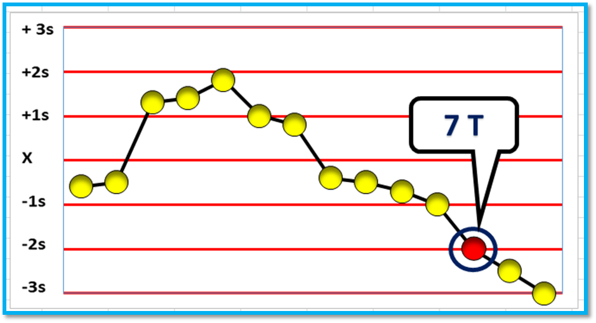
7T denotes a Systematic Error
Notes:
7 data points trending in any direction, upwards or downwards, crossing the midline. Here T stands for trends. We will talk about trends and shiftsin the next video

Slide 33
7_{T}
When seven control measurements trend in the same direction, crossing the mean, i.e., get progressively higher or progressively lower.
Applicable across run
  But whenever one level is trending, upward/ downwards for 5- 6 times, and other level doing the same thing, it should be investigated.

Slide 34
Rules Violation
Rule Violation | Systematic Error | Random Error
1:2s
X
X
2:2s
X
1:3s
X
X
4:1s
X
2 of 3:2s
X
3:1s
X
10x
X
7T
X
R:4s
X
Notes:
We will talk about errors and causes for the same in the next video, but please understand the rule violations indicating the errors. Most rule violations point to systematic errors. 1:2 S and 1:3 S in isolation indicated random changes. r4S always indicates random errors. R 4s is only valid within run and indicates a sudden random change. Very important pointer and hence the need for at least 2 levels of controls

Slide 35
Within run errors: The power of daily monitoring
Stop and take corrective action if a single point exceeds
  a 1:3s limit.
Stop and take corrective action if two levels of control exceed
  2:2s limit.
Stop and take corrective action if one point in the group exceeds
  a plus 2s limit and another exceeds a minus 2s limit: R₄s This is a range rule that is meant only to be applied within-run
Because N must be at least 2 to satisfy CLIA QC requirements, all these rules can be applied within a run

Slide 36
Across run errors: The power of periodic review
2:2s, 3: 1s, 4:1s and 6,8,9 & 10x must be used
  across runs
  within or across materials in order to get the number of control measurements needed to apply the rules and to pick up systematic errors.

Slide 37
Single rules and Multi-rules
How to use these rules in your QC planning?
Single-rules or Multi-rules may be employed as necessary (to be discussed in later presentations)

Slide 38
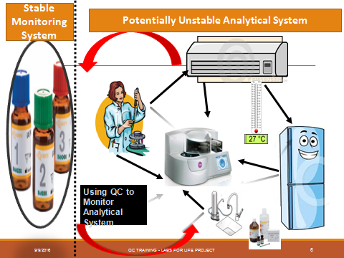

Slide 39
THANK YOU

