Slide 1
WORK PRACTICE CONTROLS
Dr Anu George

Slide 2
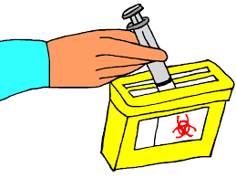

What are Work Practice Controls??
Behavioural changes to adapt to standard procedures
Altering the way in which a task is performed and reducing the likelihood of exposure

Slide 3


Slide 4
Who all are involved?
Technical Responsibilities
Technical: Supervisory
Technical: Bench level
House-keeping

Slide 5
Technical: Supervisory Team (HODs, Doctors…)
  Enable a safety System in their area
  Understand the standard practices
  Protocol every aspect
  Train the bench-level staff
  Train housekeeping staff
  Monitor and evaluate
  Liaison with the upper management
  Ensure emergency response measures
  Ensure Vaccinations
  Ensure Post Exposure Prophylaxis

Slide 6
Technical: Bench Level
  Understand the hazards
  Follow safe protocols in every aspect of their work
  Understand emergency protocols
  Understand location and operation of safety and emergency equipment
  Understand emergency reporting procedures
  Train new staff

Slide 7
Technical: Housekeeping
Understand and comply with institutional rules for environment cleaning and decontamination
Understand and comply with Bio-Medical Waste Management rules
Report Accidents

Slide 8

Work Practice Controls: Bio-Safety
Follow Standard Precautions
Vaccinations
Post Exposure Prophylaxis
Safe Work Practices to reduce aerosols
Bio-risk assessment
Optimum use of Biosafety cabinets
Understand Hospital Associated Infections, Anti Microbial resistance
Hospital antibiotic Policies and Antibiograms
Training

Slide 9
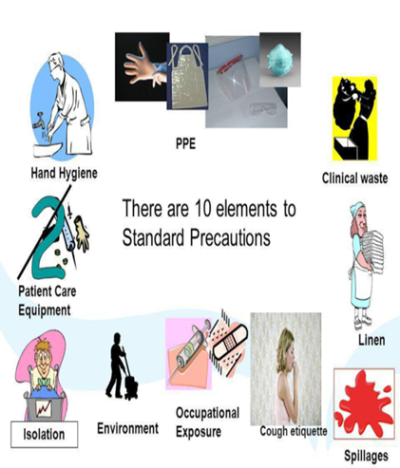
Standard Precautions
Hand hygiene
Personal Protective Equipment
Gloves.
Facial protection
Gown
Prevention of NSIs
Respiratory hygiene and cough etiquette
Linens Handling, transport
Waste disposal
Patient care equipment
Environmental cleaning including Spillages

Slide 10
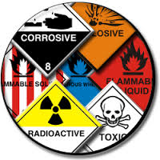
Work Practice Controls: Chemical Safety
Understand your chemicals
Have a labeling system
Have an MSDS Library
Restricting Inventory
Mitigation Strategies
Safe Storage
Safe Disposal
Training

Slide 11

Work Practice Controls:
Fire Safety
Preventing fires
Fire Fighting equipment; availability
Fire training
Types of fire and the extinguishers to be used
Handling emergencies
Evacuation Protocols

Slide 12

Work Practice Controls:
Electrical Safety
Understand the basics of electricity
Understanding the effects of electricity on human body
Applying control mechanisms like grounding, circuit breakers, Ground Fault Circuit Interrupters
Electricity Training

Slide 13

Work Practice Controls:
Glassware Safety
Selecting glassware
Safe handling
Working with glassware in vacuum / under pressure, heat /cold
Cleaning glassware
Disposal and spill clean up

Slide 14

Work Practice Controls:
Equipment Safety
Understanding the equipment
Understanding the inbuilt safety features
Understanding the hazards
Safe operations

Slide 15


Work Practice Controls:
Physical & Compressed Gas Safety
Understanding the mechanical hazards in your lab and facility
Remedial and preventive measures
Compressed gas; storage and transportation

Slide 16
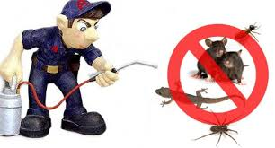
Work Practice Controls:
Pest Control
Engineering Controls
Integrated Pest management
Building Maintenance Protocols

Slide 17

Work Practice Controls
Reporting
All injuries or unusual incidents should be reported immediately to the supervisor
Encourage Reporting
Investigate Incidents/Accidents/ Non- Conforming Events

Slide 18
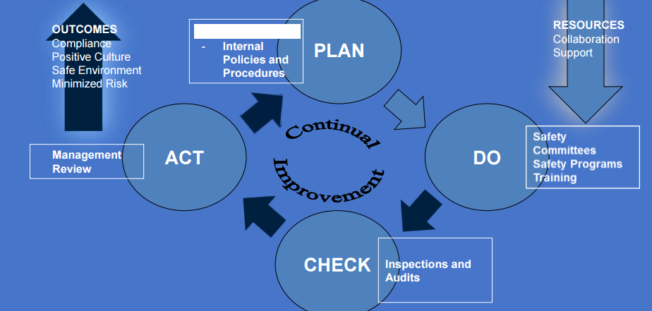
Work Practice Controls
Safety Plan, Audits

Slide 19
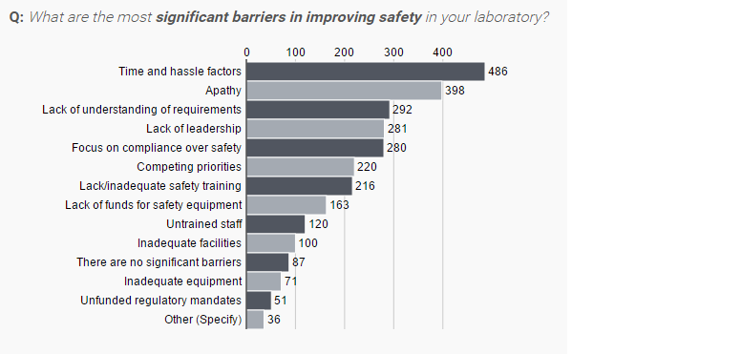
Barriers to Safety:
An International Study

Slide 20
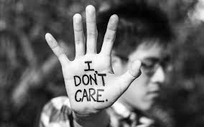

Slide 21
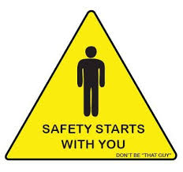

Slide 22


Slide 23
THANK YOU

