Slide 1
ERRORS
(SYSTEMATIC Vs RANDOM)
Labs for Life Project
Quality Control Training

Slide 2
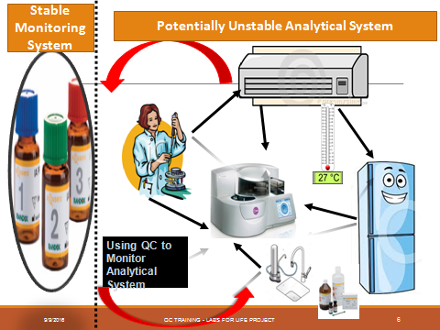

Slide 3
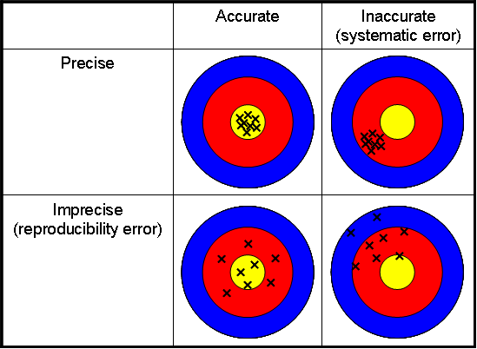
Errors

Slide 4
Accuracy and Precision
Inaccurate but Precise
Inaccurate and Imprecise
SD
BIAS
Accurate and Precise
Notes:
The reliability of a method is thus judged in terms of accuracy and precision which contributes to the Total Error. A simple way to portray precision and accuracy is to think of a target with a bull’s eye.
The bull’s eye represents the accepted reference value which is the true, unbiased value. If a set of data is clustered around the bull’s eye, it is accurate. The closer together the hits are, the more precise they are. If most of the hits are in the bull’s eye, as in the figure on the left, they are both precise and accurate.
The values in the middle figure are precise but not accurate because they are clustered together but not at the bull’s eye. The figure on the right shows a set of hits that are imprecise. Measurements can be precise but not accurate if the values are close together but do not hit the bull’s eye. These values are said to be biased. The middle figure demonstrates a set of precise but biased measurements.
The purpose of quality control is to monitor the accuracy and precision of laboratory assays before releasing patient results.

Slide 5
Let us examine inaccuracies first.
We have looked at the rules that indicate shifting accuracies
We have seen that shifting accuracies are denoted by shifting means
We have seen that inaccuracies are indicated by bias in the LJ graphs.
Before we go to the changes in the analytical system that produces these errors, we have to understand the kinds of systematic errors that can happen

Slide 6
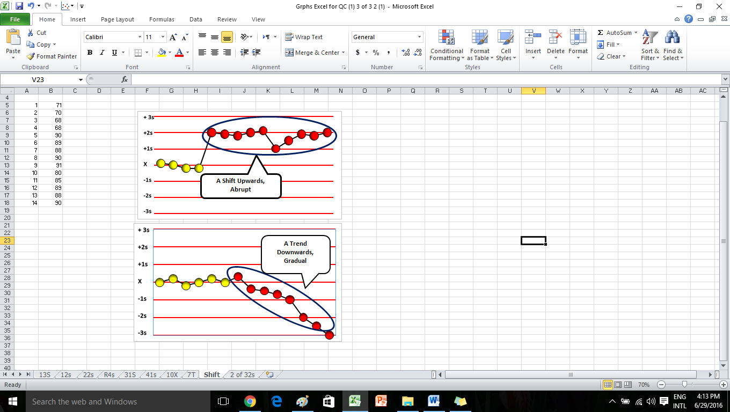
Types of Systematic Errors
Shifts Trend
Notes:
Animate on an LJ

Slide 7
Shift: Systematic Error
Shift: Abrupt changes in the control mean
a sudden and dramatic positive or negative
change in test system performance.

Slide 8
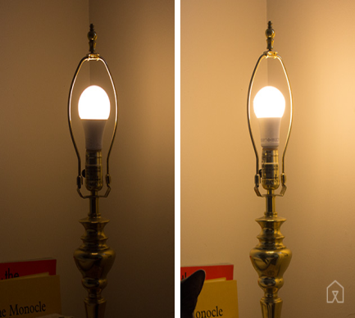
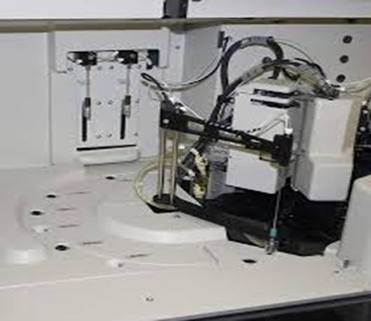
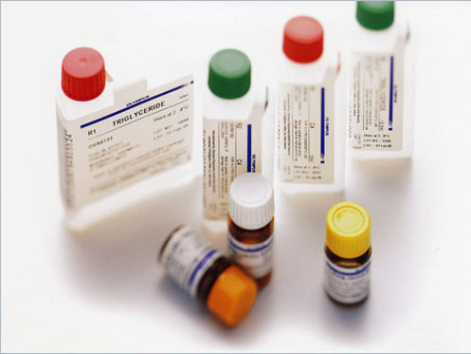
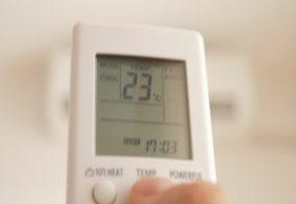
Causes for Shifts: Sudden Changes/ Failures
Light
Reagent Formulation
Major Instrument Maintenance
Incubation temperature (enzymes)
Room Temperature
Failure in the sampling system/reagent dispensing
change in reagent formulation
reagent lot
major Instrument maintenance / change in room temperature or humidity
Failure in the sampling system/reagent dispense/inaccurate calibration or recalibration

Slide 9
Trend: Systematic error
Trend :gradual loss of reliability in the test system
Cause :
Deterioration of the instrument light source
Gradual accumulation of debris in sample /reagent tubing
Aging of reagents
Gradual deterioration of control materials
Gradual deterioration of incubation chamber temperature(enzymes only)
Gradual deterioration of calibration

Slide 10
Recap…..
Notes:
In brief, there is a shift away from the mean, with emergence of a new mean, either gradual or abrupt, with specific causes, pointing you towards appropriate remedial action. We will come to more examples later

Slide 11
Random ERROR: Imprecision
Precision is the amount of variation in the measurements, a random deviation away from an expected result (computed as Random Error; to be discussed later)
Notes:
Animate on a n LJ. There is a certain amount of inherent variation or randomness. An allowable limit to the degree of imprecision. But if that limit is violated, it indicates some error in the analytical system. We have already looked at rules that indicate imprecision. 1:2S, 1:3s, r4s. Of this we have seen that 1: 2s and 1:3s can be both random errors or the beginning of systematic errors

Slide 12
REASONS
Improperly mixed /dissolved reagents
Air bubbles in reagents and reagents lines, sampling or reagents syringes.
Pipette tips is not fitting properly.
A clogged pipettor (Clot).
Unstable temperature and incubation.
Unstable power supply.
Poor operator technique.
Improper mixing of processed samples.
Incorrect reconstitution of the control material.
Notes:
Thus we

Slide 13
Thanks

