Slide 1


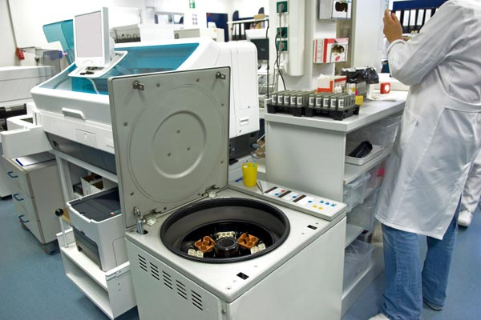



LABS FOR LIFE PROJECT - INDIA
Equipment Management
MoHFW /CDC / BD Partnership Project

Slide 2


Trouble shooting
Determining the source and cause of the problem
It is important to teach operators to troubleshoot equipment problems in order to quickly get the equipment functioning and resume testing as rapidly as possible.
When an operator observes instrument drift, it is important to repeat the preventive maintenance procedures as a first step to resolve the problem. If this does not work, proceed with troubleshooting

Slide 3
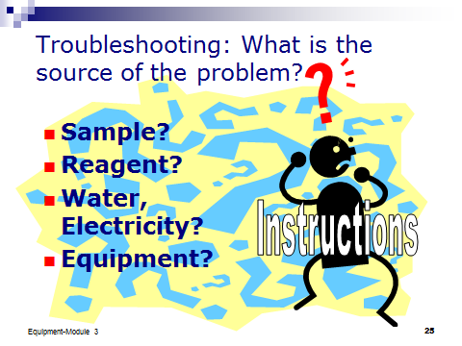
Troubleshooting
Manufacturers frequently provide a flowchart that can help determine the source of problems.

Slide 4
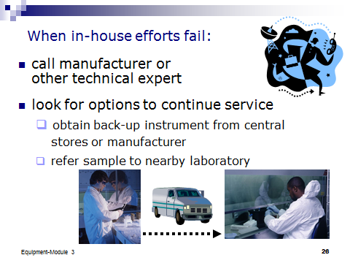
Troubleshooting
When problems cannot be corrected in-house, attempt to find a way to continue testing until the equipment can be repaired. Some ways to achieve this are as follows:
• Arrange to have access to back-up instruments
• Ask the manufacturer to provide a replacement instrument during repairs.
• Send the samples to a nearby quality assured laboratory for testing.

Slide 5
Troubleshooting Flags
It must be clarified by the manufacturer/supplier during training as to what instrument flags and alerts should the lab personnel watch out for. Also, it should be clearly known to what extent/step the equipment troubleshooting can be done by the lab personnel and which snags are to be addressed by the manufacturer only.
The manufacturer must provide single point of contact/helpline for troubleshooting as effectively and in as timely a manner as possible.

