Slide 1
General Safety Measures
&
Standard Precautions

Slide 2
  Learning Objectives
The importance of lab safety
The technical responsibilities/ Work Practice Controls
The first-aid measures
The culture of safety

Slide 3
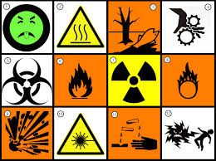
  Importance of Lab Safety
Laboratory an area of risk for exposure to various hazards
Define these hazards and formulate plans for their prevention and control
LABORATORY SAFETY PROGRAM:
  employees and patients,
  laboratory equipment and facilities,
  environment.
Active Steps:
  safety training to all staff,
  conduct safety awareness programs, and
  ensure fire safety drills and regular safety audits.

Slide 4


    General Laboratory Safety
Providing infrastructure sup­port
Designating a safety officer
Safety Program with specific protocols and preventive and remedial measures for each kind of hazard
Safety manual
Safety Indicators and Safety Objectives
Safety audits
First-aid and Eye-Wash
Maintain general laboratory cleanliness

Slide 5
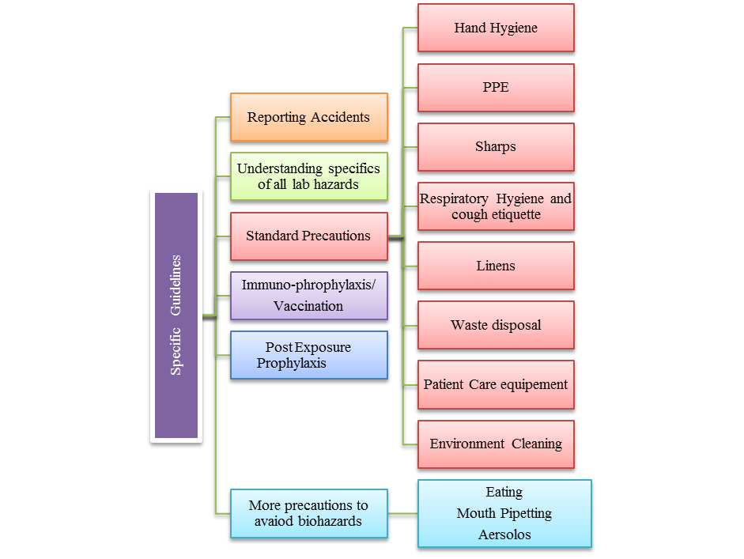
Specific Guidelines: Work Practice Controls
Notes:
Let us examine these under five specific guidelines for work practice, each with several sub-components.

Slide 6


Specific Guideline
Reporting Accidents
All injuries or unusual incidents should be reported immediately to the supervisor.

Slide 7
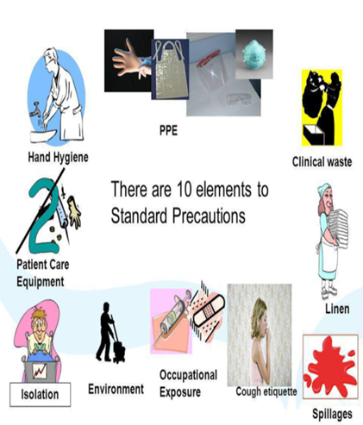
Specific Guideline
Standard Precautions
Hand hygiene
Personal Protective Equipment
Gloves.
Facial protection
Gown
Prevention of NSIs
Respiratory hygiene and cough etiquette
Linens Handle, transport
Waste disposal
Patient care equipment
Environmental cleaning including Spillages

Slide 8

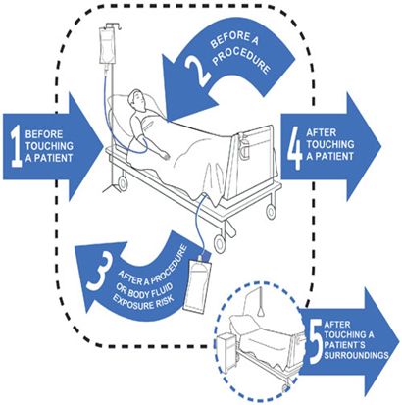
Standard Precaution
Hand Hygiene
Moments for Hand Hygiene

Slide 9
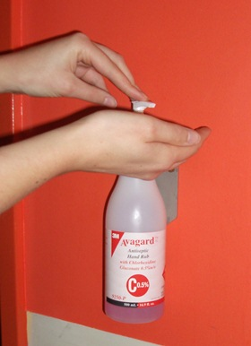
Hand hygiene procedures
Alcohol-based Hand Rub
Preferred method except when hands visibly soiled or after caring for patients with known or suspected infectious diarrhea (e.g., Clostridium difficile, Norovirus); soap and water should be used.
Dispense the recommended volume
Apply to palm of one hand
Rub hands together, covering all surfaces of hands and fingers until they are dry; at least 20-30 seconds (no rinsing is required)

Slide 10
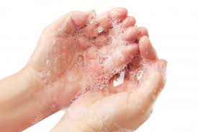
Hand-washing with Germicidal Soap & Water
(40 -60 seconds)
Wet hands first with water (avoid
hot water)
Apply soap to hands
Rub hands vigorously for at least 15 seconds, covering all surfaces of hands and fingers
Rinse hands with water and dry thoroughly with clean towel
Use towel to turn off water faucet if elbow operated taps are not available

Slide 11
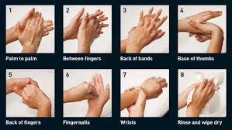
Steps of Hand-Washing

Slide 12
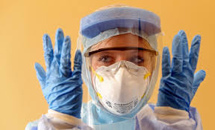
Standard Precaution
Personal Protective Equipment
(PPE)
Selection of PPE based on nature of patient interaction and potential for exposure to hazards
Review of available PPE to be performed periodically
Engineering controls always the first line of defense

Slide 13
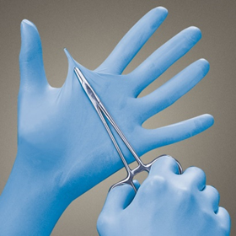
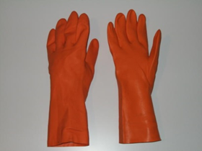
PPE 1: Gloves
Wear gloves whenever potential contact with blood, body fluids, mucous membranes, non-intact skin or contaminated equipment, while handling chemicals.
Clean examination gloves sufficient for phlebotomy and other laboratory practices. Sterile gloves not required.
Appropriate fit necessary
Do not wear the same pair of gloves for more than one patient
Perform hand hygiene before and immediately after

Slide 14
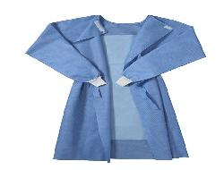
PPE 2: Gowns
During procedures or activities where contact with blood, body fluids, chemicals is anticipated.
If feasible do not wear the same gown for the care of more than one patient
Remove gown and perform hand hygiene before leaving the patient’s environment (e.g., exam room)

Slide 15
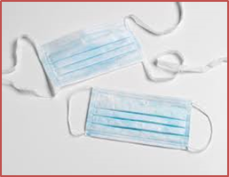
PPE 3: Facemasks (Procedure or Surgical Masks)
Whenever potential of contact with respiratory secretions and sprays of blood or body fluids
May be used in combination with goggles or face shield
When placing a catheter or injecting material into the spinal canal or subdural space (to protect patients from exposure to infectious agents carried in the mouth or nose of health care personnel)

Slide 16
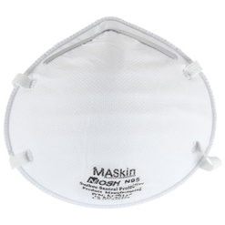
PPE 4: Respirators
Surgical masks are not respiratory PPE
If available, wear N95-or higher respirators
N-, R-, and P-series filters:
  No oil particles: N, R-, or P-series.
  If oil particles (e.g., lubricants, cutting fluids, glycerin): R- or P-series filter.
  Note: N-series filters cannot be used if oil particles are present.
  Oil particles are present, and the filter is to be used for more than one work shift: only a P-series filter.
N for Not resistant to oil,
R for Resistant to oil,
P for Oil Proof.

Slide 17
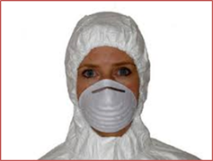
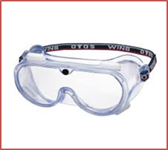
PPE 5: Goggles, Face Shields
  Potential splash or spray of blood, respiratory secretions, or other body fluids.
  Personal eyeglasses and contact lenses are NOT considered adequate eye protection
  May use goggles with facemasks, or face shield alone, to protect the mouth, nose and eyes

Slide 18
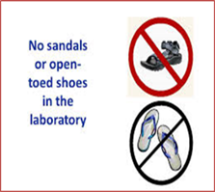
PPE 6: Foot protection:
Closed-toe comfortable shoes that have low heels in the laboratory or other areas where chemicals are present.
Reduces injuries that may occur from spills, splashes, falling objects, slipping, and broken glass.

Slide 19
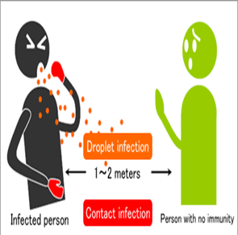
Standard Precaution
Respiratory Hygiene and Cough Etiquette
Place acute febrile respiratory symptomatic patients at least 1 meter (3 feet) away
Post visual alerts at entrance
Make tissues and masks available in common areas
All persons with signs and symptoms of a respiratory infection instructed to:
  Cover mouth and nose with tissue when coughing/sneezing;
  Dispose used tissue in the nearest waste bin
  Perform hand hygiene after contact with respiratory secretions and contaminated objects/materials

Slide 20
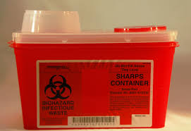
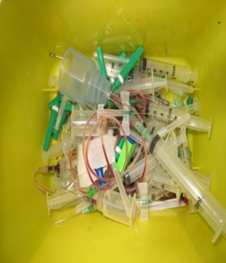
Standard Precaution
Sharps/ Occupational Exposure
Disposal of sharps generated in the RNTCP lab:
  Used slides: Disinfected in 5% phenol/ 40% phenolic compound diluted to 5%, 30 min pit for sharps/ outsourced
  Used chemical solution should be drained away in the hospital drain.
Cuts or puncture wounds promptly washed with disinfectant soap and water for 15 minutes.
Report a needle-stick injury, any other skin puncture, to the supervisor immediately

Slide 21

Standard Precaution
Linens
Handle, transport, and process used linen in a
manner which:
  Prevents skin and mucous membrane exposures and contamination of clothing.
  Avoid transfer of pathogens to other patients and or the environment.

Slide 22
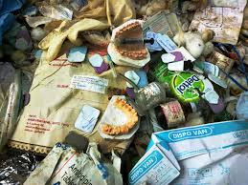
Standard Precaution
Bio Medical Waste disposal
(Already Discussed)
Segregate waste at source
Use PPE when handling BMW
Handle sharps with care
Do not fiddle with waste
Keep facility clean inside and out
Know steps for treating injuries (first aid)
Get fully immunized against tetanus and hepatitis B
In case of injury go for immediate evaluation to get post-exposure prophylaxis

Slide 23

Standard Precaution
Equipment Decontamination
Clean, disinfect and reprocess reusable equipment appropriately.
Follow the Manufacturer’s Instructions for equipment decontamination
Refrigerators and freezers to be regularly inspected for the presence of broken vials or tubes containing infectious agents.
More in detail in subsequent lectures

Slide 24

Standard Precaution
Environmental Cleaning
Cleaning and disinfection of all patient-care areas is important for frequently touched surfaces (e.g., bedrails, bedside tables, commodes, doorknobs, sinks, surfaces and equipment in close proximity to the patient)
Environmental reservoirs of pathogens during outbreaks due to failure in following recommended procedures for cleaning and disinfection
HBV is stable in dried blood for at least seven days and can be transmitted directly from contaminated surfaces to the skin or mucous membranes

Slide 25
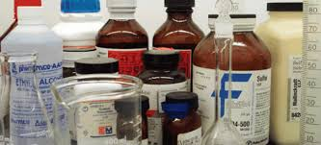
Environmental Cleaning
Disinfection (Chemical and Physical)
Chemical Disinfection
a. Definitions
  Antimicrobial
  Antiseptic
  Decontamination
  Sporicide
  Sterilization

Slide 26

b. Cleaning the Laboratory
Pre-cleaning essential to achieving proper
disinfection or sterilization.
It is removal of dirt, organic matter, and stains (brushing, vacuuming, dry dusting, washing or damp mopping).
Work benches and floors: wiped with 1% hypochlorite routinely after working with infectious agents or clinical specimens or after spills/ splashes.
Surface then wiped with 70% isopropyl or ethyl alcohol to inactivate the bleach and prevent corrosion.
Other areas scheduled for cleaning on a weekly or monthly basis

Slide 27
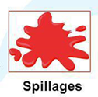
c. Decontamination of spills
Prepare bleach solution fresh daily and keep it in a closed container
Wear gloves
Cover with absorbent material e.g. gauze/cotton
Pour 1% sodium hypochlorite or equivalent disinfectant
Leave for 30 minutes
Wipe off the soaked absorbent material from the area
Throw the wiped material into black bag
Finally, wipe the surface with 1% Sodium hypochlorite again
Mop up to leave a clean area

Slide 28
d. Common Chemical Germicides used in labs
  70% isopropyl alcohol
    surface disinfectant (70% )
    NOT the choice for decontaminating spills.
  Chlorine (sodium hypochlorite)
    activity considerably reduced by organic matter (protein).
    effective general disinfectant - 1% dilution in water
    wipe down area with 70% alcohol to inactivate bleach
  Phenolic compounds:
    effective against spores, viruses, moulds and gram-positive and gram-negative bacteria.

Slide 29
Physical Disinfection Methods
a. Heat disinfection and sterilization
b. Autoclaving
c. Incineration

Slide 30
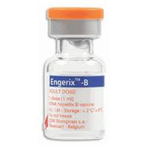
Specific Guideline
Immuno-prophylaxis
Hepatitis B vaccination to all employees with occupational exposure to blood and body fluids.
Verify sero-protection after completion of the three-dose vaccination series, i.e.
Antibodies to HBsAg at least 10 mIu/ml
Fourth dose of to be offered if antibody titre below 10 mIU/ml.

Slide 31
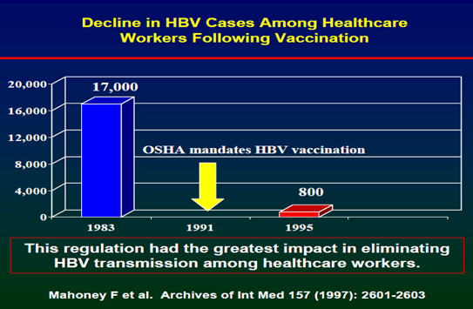

Slide 32

Specific Guideline
Post-exposure Prophylaxis (PEP)
PEP for HIV exposure best: <2 hours
Little benefit after 72 hours
Needs to be continued for 28 days.
No recommended PEP for exposure to HCV: testing of source patient & HCW maybe helpful (research ongoing)
Laboratory follow-up for NSI is mandatory (NACO guidelines)

Slide 33
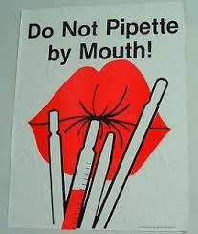
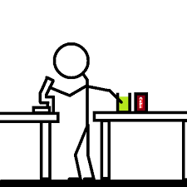
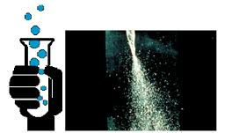
Specific Guideline
Other Specific Precautions to Avoid Bio-hazards
Eating
Mouth pipetting
Aerosols

Slide 34

Any Questions???

