Slide 1
Process Control
ISO 15189
5.4, 5.5, 5.6, 5.7, 5.8, 5.9, 5.10

Slide 2
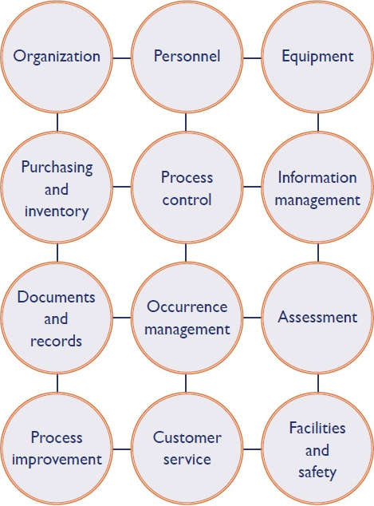

Slide 3
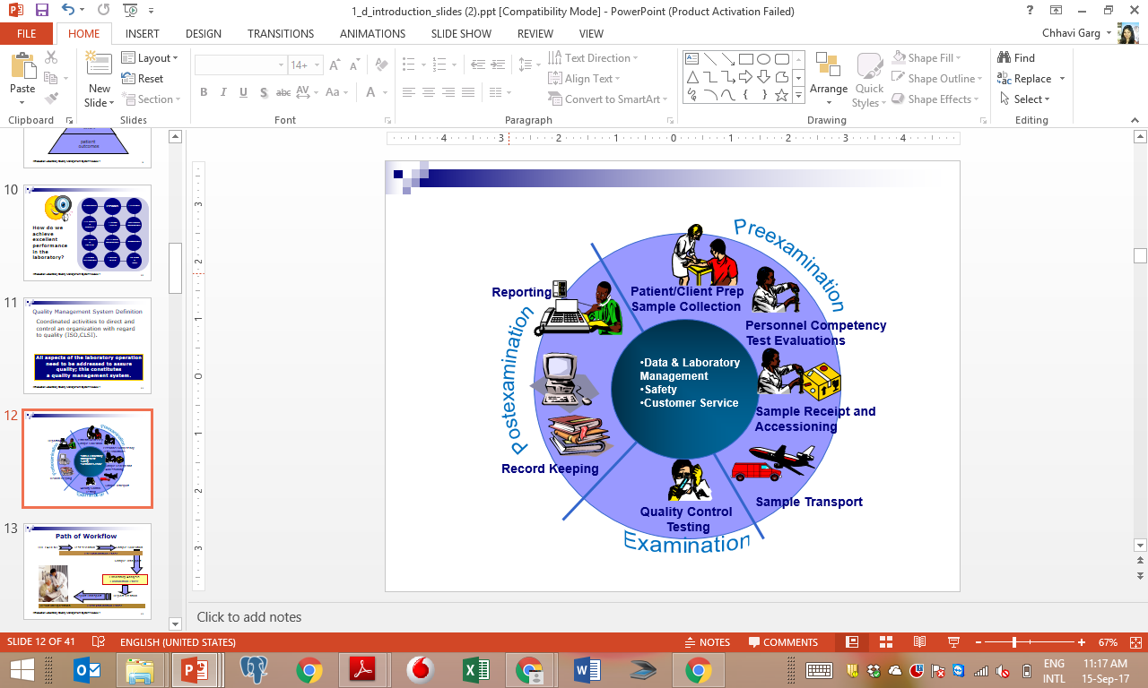
Process Workflow in a Laboratory

Slide 4
Pre Analytic
46- 68% of Laboratory Errors are pre-analytical
Test Prescription: Manual/ Lab Information Systems
  Test Request Form
  Patient Identifiers
  Test Registration: Manual/ Lab Information Systems
  Demographics
  Previous reports
  Consent forms
Sample Collection: Premises/ PPEs/ Safe Collection Equipment/ PEP
  Wrong labelling
  Wrong tube
  Haemolysis, compromised samples
  Adverse events: patient/HCW

Slide 5
Pre Analytic (Contd.)
46- 68% of Laboratory Errors are pre-analytical
  Sample Preparation
  Sample Integrity: Wrong centrifuge speeds/ sample mix up
  Sample Transportation
  Sample Integrity: no cold chain
  Sample packing: Inadequate Packing
Documentation
  Sample Collection manual
  Log books/Formats
  Staff Training
  Pre-analytical best practices for sample integrity and safety
  Non conformance tracking

Slide 6
Analytical
7-13%* Errors happen in analytical phase
Accommodation and Environment
  Temperature, humidity requirements
  Electrical requirement
  Water Quality
  Equipment Management
  Daily maintenance
  AMC/CMC
  Calibration/Calibration verification
Notes:
*Assumption here is that the lab is using adequate error detection mechanisms like IQCs and EQAS

Slide 7
Analytical (Contd.)
7-13% Errors happen in analytical phase
Reagent
  Fitness for purpose
  Storage requirement
  Lot to lot verification
  Internal Quality Controls
  Control materials: retained patient sample/commercially purchased/ in-house
  Review and trend analysis: Daily/Monthly/quarterly/six monthly/annually

Slide 8
Analytical (Cond.)
7-13% Errors happen in analytical phase
External Quality Assurance
  Participation in EQA
  Corrective actions
  Documentation
  Availability of SOPs
  Availability of formats
  Staff Training
  Analytical standard practices and safety
  Non conformance tracking

Slide 9
Post analytical
18-47% Errors happen in the post analytical phase
Retention of samples
  For repeat testing
  Validation of retained samples
Discarding of samples
  Following Bio medical waste management rules
  Solid waste and liquid waste
  Safety to workers, users, environment

Slide 10
Post analytical (Contd.)
18-47% Errors happen in the post analytical phase
Reviewing the reports and verification
  Availability of supervisory staff
  Interpretation of results
Release of reports
  Turn around time
  Critical reports
  Biological reference Intervals

Slide 11
Post analytical (Cond.)
18-47% Errors happen in the post analytical phase
Data Archival
  Lab Information System
  Manual Archival
  Documentation
  Availability of SOPs
  Availability of Formats
  Staff Training
  Post analytical best practices sample discarding and data archival
  Non conformance tracking

