Slide 1
Chemical Safety
Dr. Anu George

Slide 2
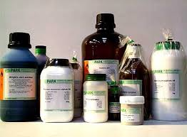

Slide 3


Slide 4
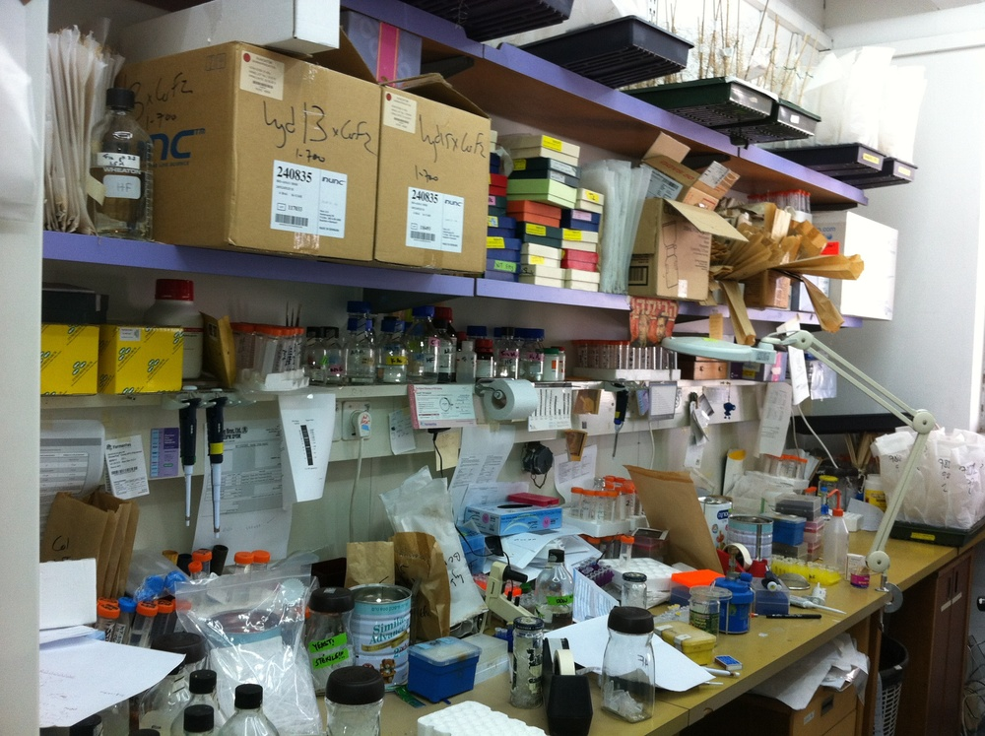

Slide 5
Developing a Chemical Safety Plan
Have a written Hazard Communication program for employees.
Properly label hazardous chemical containers
Have MSDS / SDS (Material Safety Data Sheets) on file for each hazardous chemical available
Safe Storage of Chemicals
Safe Disposal of Chemicals
Using mitigating strategies such as chemical fume hoods, formalin monitoring devices
Train employees about potential hazards.
NCE / Incident/ Accident Reporting
Maintain records about the entire program.
Important chapter in the Lab Safety Manual which has to be read and understood

Slide 6

1. HAZARD COMMUNICATION:
Right to Know

Slide 7
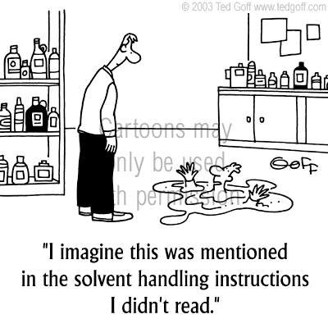

Slide 8
MSDS
LABELS
GHS (Globally Harmonized System of classification and labeling of Chemicals) Hazard and Precautions phrases:
H and P Phrases
Risk and Safety phrases:
R and S Phrases.
(are being phased out in favor of H and P Phrases of GHS)
Hazard Communications; Verbal

Slide 9
Hazard Communications; Visual
Pictograms (GHS, EU Directive..)
NFPA (National Fire Protection Association) Diamond
HMIG (Hazardous Material Identification Guide) Color Bar.

Slide 10
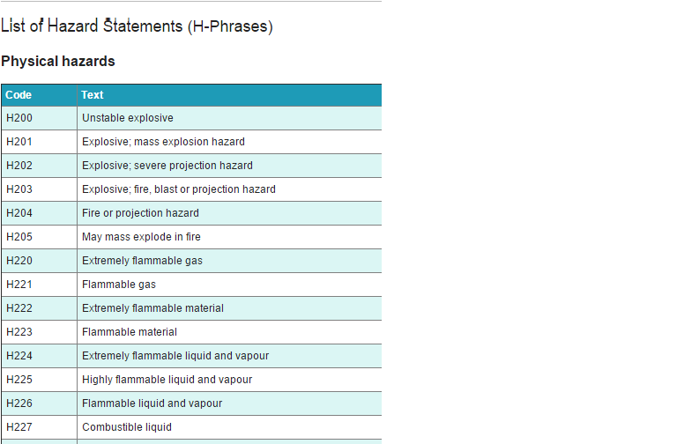

Slide 11
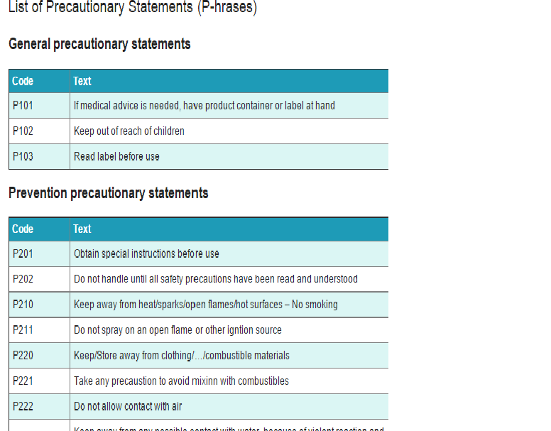

Slide 12
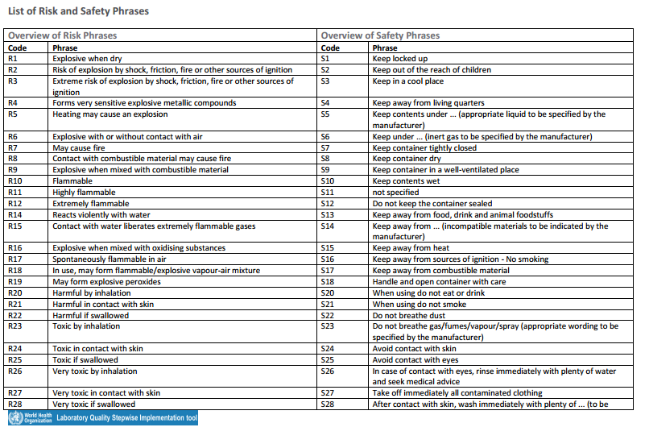

Slide 13
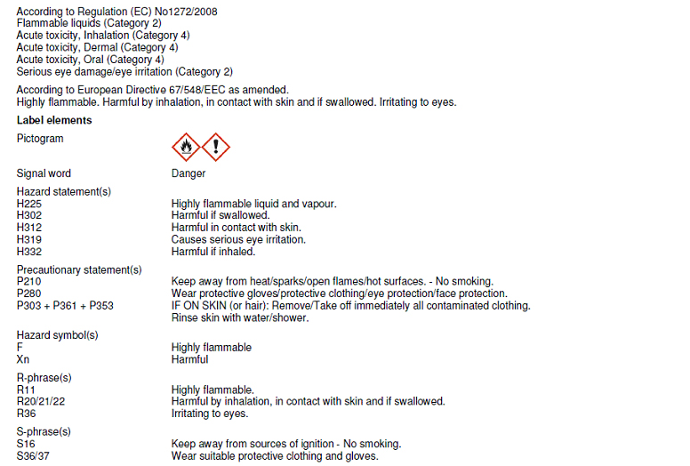

Slide 14
Hazardous Chemicals Classification (GHS)
        Physical (H & P / R & S)
        Health (H & P / R & S)
        Environmental (H & P / R & S)

Slide 15
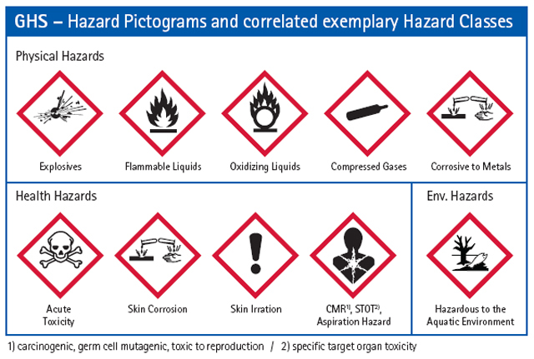
Hazard CommunPictograms

Slide 16
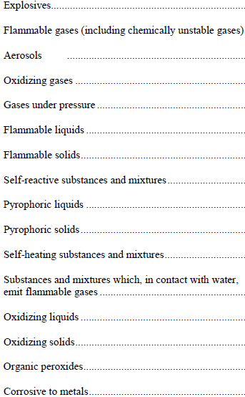
Hazard categorization: Physical

Slide 17
Hazard categorization: Physical cont.

Slide 18
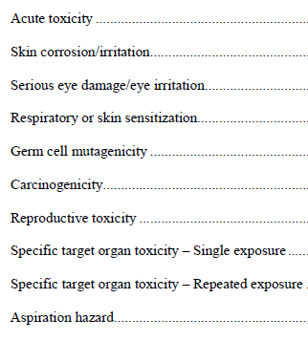
Hazard categorization:
Health

Slide 19

Environment Hazards

Slide 20
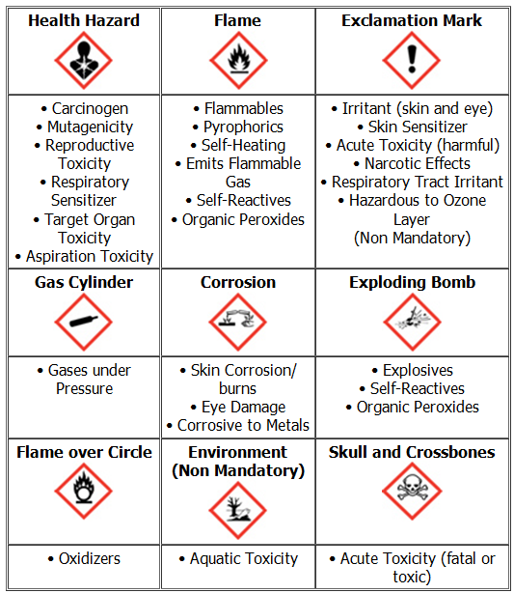

Slide 21
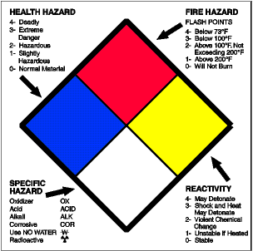
NFPA Diamond
(National Fire Protection Association)

Slide 22
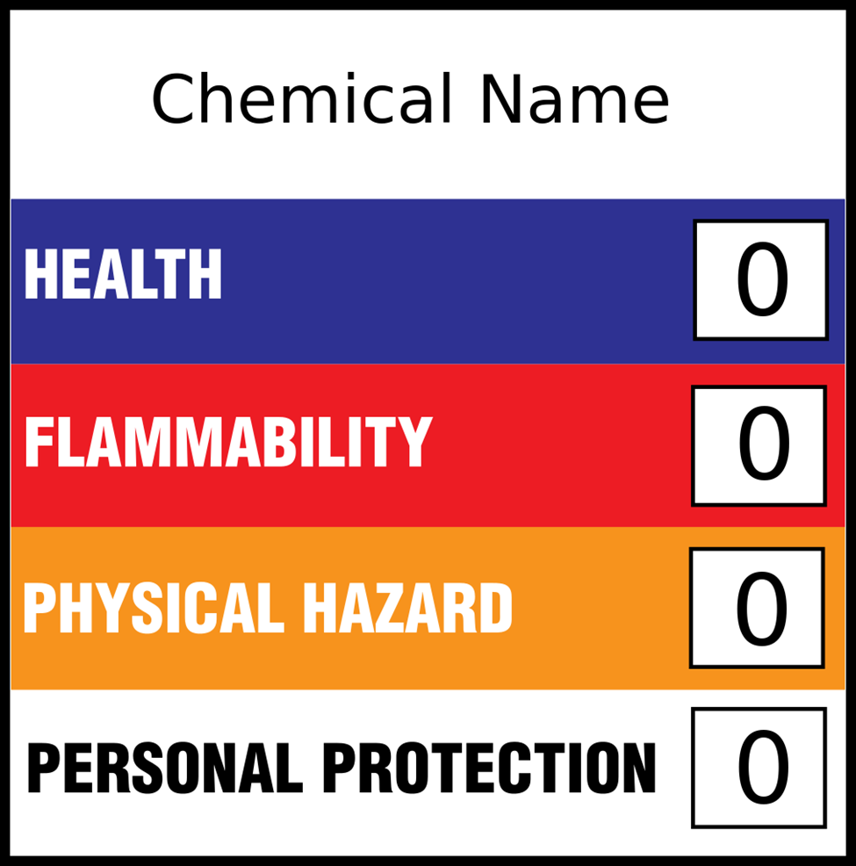
HMIG Color Bar
(Hazardous Material Identification Guide)

Slide 23
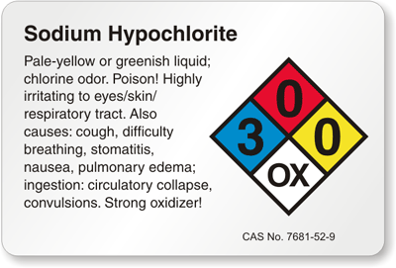
NEPA Diamond for Sodium Hypochlorite

Slide 24
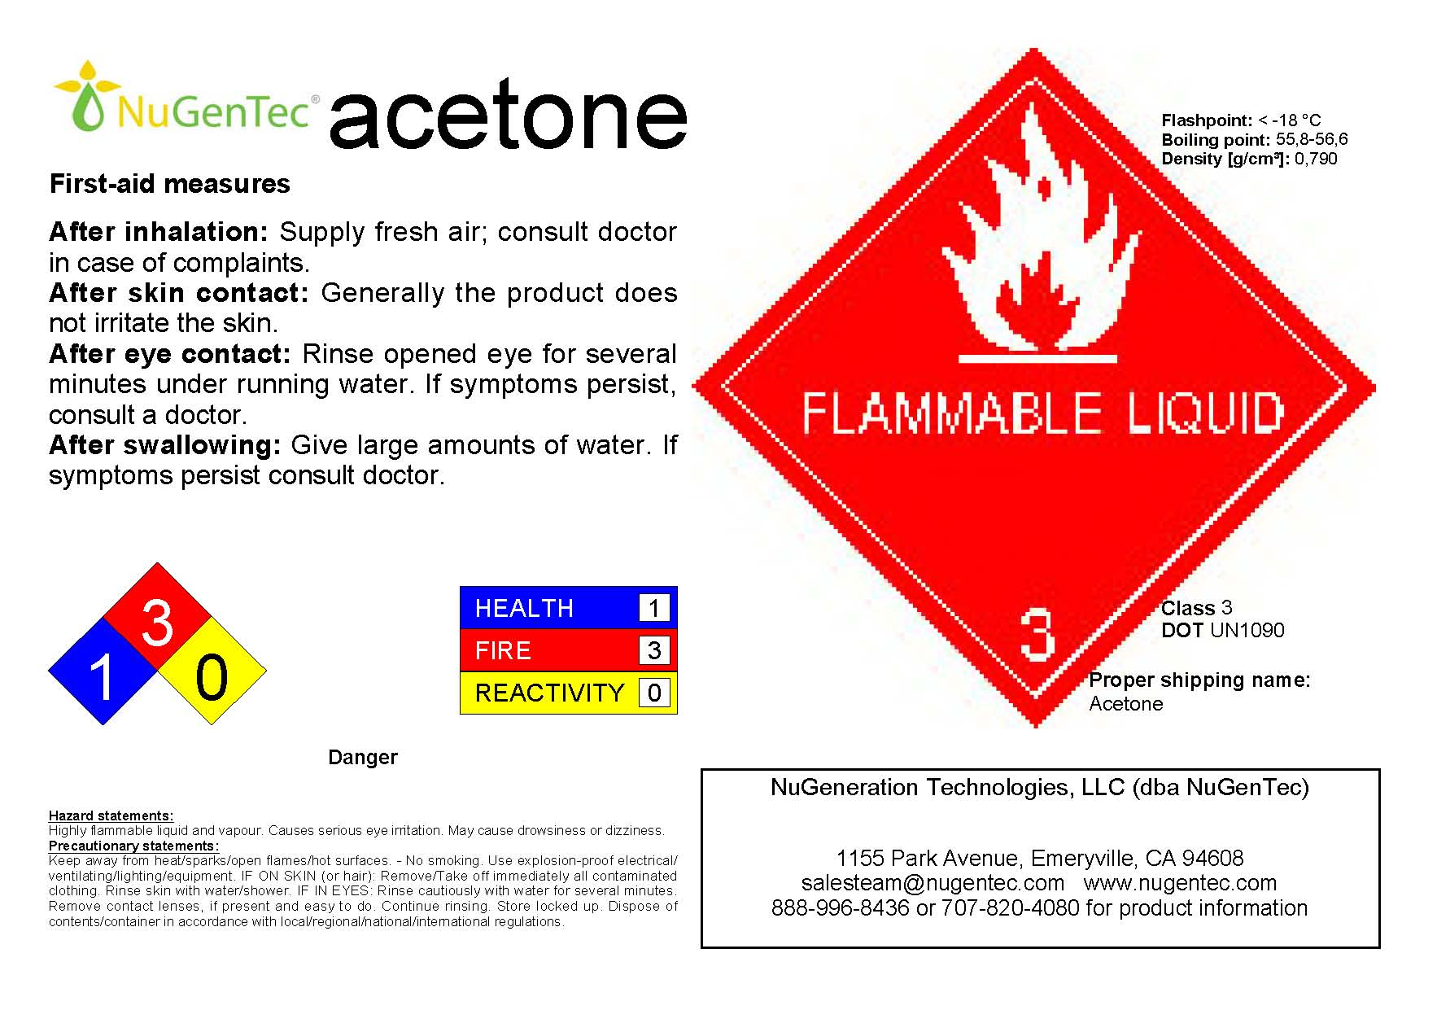

Slide 25
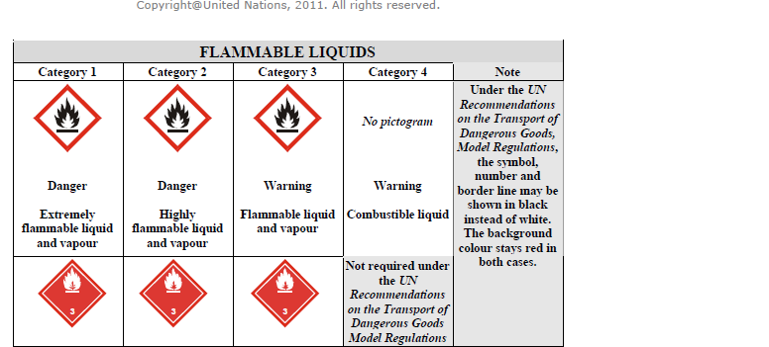

Slide 26
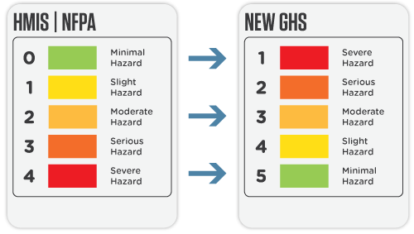

Slide 27
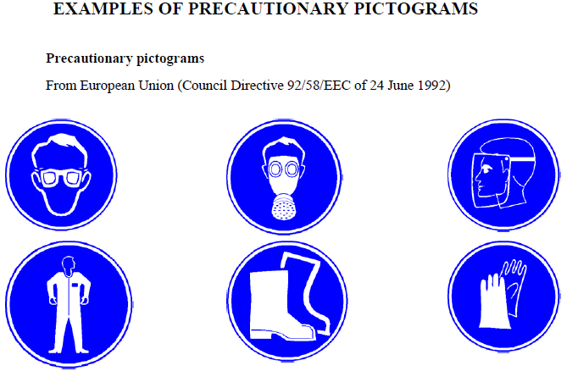
Safety/ Precautionary Phrases, Pictograms

Slide 28
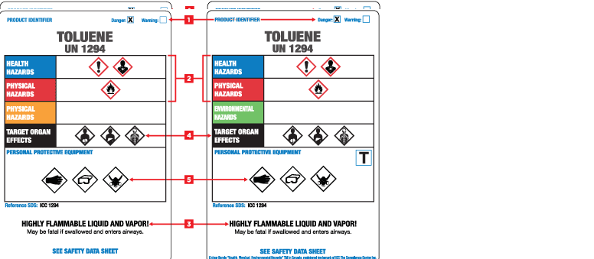

Slide 29
2. Labeling
The identity or contents of the container.
Appropriate hazard warnings, including words, pictures, symbols, or combinations that convey the health and/or physical hazards of the container’s contents
The name and address of the chemical manufacturer and the emergency telephone number.
Containers that are too small to be labeled should be kept in a labeled larger container
Any secondary container into which hazardous chemicals are transferred should be labeled fully
Existing labels on containers carrying hazardous chemicals should not be removed or defaced
Date of preparation and/or date placed in service and where appropriate, the date of expiration wherever warranted
Unlabeled containers of chemicals should not be opened.

Slide 30
Labeling

Slide 31
3. MSDS
GHS Directives
1: Identification of the substance/mixture and of the company/undertaking
2: Hazards identification
3: Composition/information on ingredients
4: First aid measures
5: Firefighting measures
6: Accidental release measures
7: Handling and storage
8: Exposure controls/personal protection
9: Physical and chemical properties
10: Stability and reactivity
11: Toxicological information
12: Ecological information
13: Disposal considerations
14: Transport information
15: Regulatory information
16: Other information

Slide 32
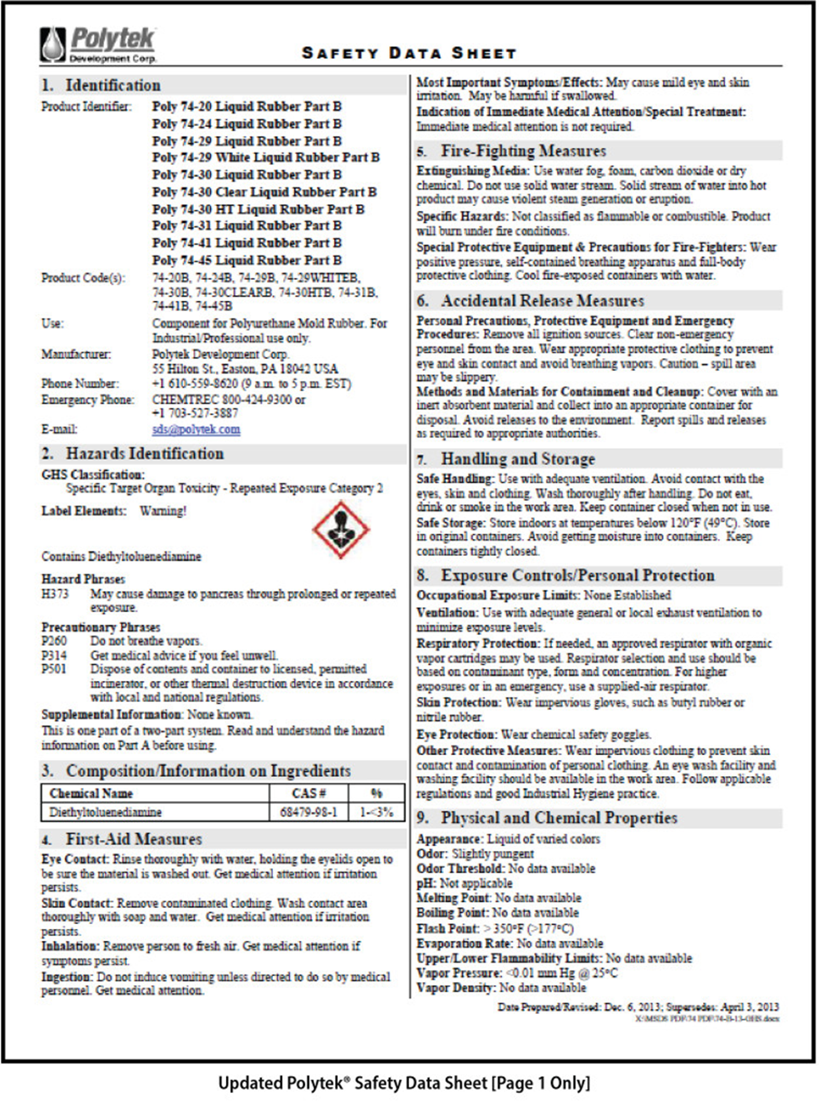

Slide 33
4. Safe Storage of Chemicals
Read storage instructions on MSDS of all your chemicals
Minimize quantities kept in the lab.
Bulk stocks should be kept in specially designated rooms or buildings.
Chemicals should not be stored in alphabetical order.
Keep glass containers off the floor, away from possible collisions with people and equipment
Store chemicals away from sources of heat and direct sunlight
Do not store hazardous liquids on shelves above eye level
Place solvents requiring refrigeration in special flammable storage refrigerators and Store flammable liquids in flammable storage cabinets
Never pour flammable liquids down the drain because they can cause an explosion.

Slide 34
Storage instructions…Please Read
Store …………..
In a dry place
In a well ventilated place
In a closed container
Locked up
In a corrosive resistant container
Protected from sunlight
At temperatures not exceeding….
Do not expose to temperatures exceeding…
Away from other material

Slide 35
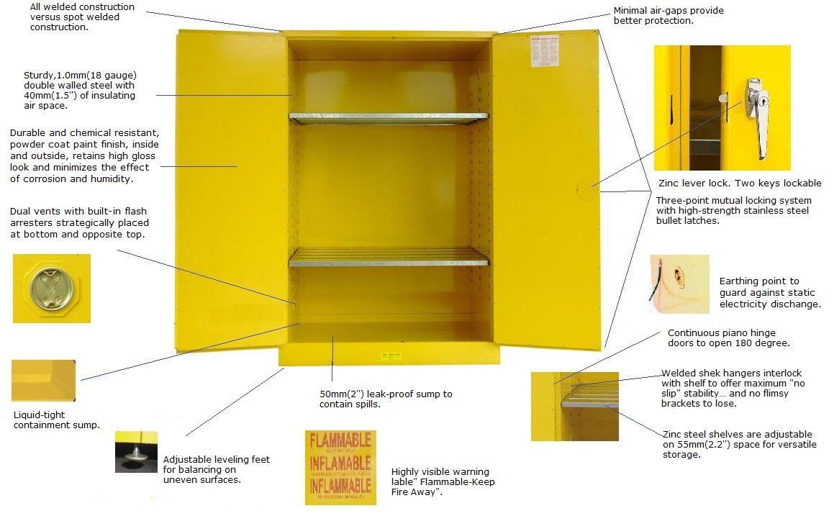
Flammable Storage Cabinet

Slide 36
5. Safe Disposal
Dispose of unwanted chemicals promptly
Follow Local regulations; 2015 rules: Black bags with cytotoxic logo, disposal by incineration at 1200◦ C
Do not pour chemicals into the drain
Refer to Manufacturer/ supplier for recovery and recycling

Slide 37



Cytotoxic Hazards & Logo

Slide 38
6. Mitigation; chemical fume hoods formalin hoods

Slide 39

Mitigation cont.; Formalin badges
Indoor air quality, a maximum level of 0.1 ppm.
Measurement of personal exposure by clipping the monitoring badge near the breathing zone.
The concentration for an 8 hour period must be less than 0.75 ppm.
The maximum exposure during any 15 minute interval must be less than 2.0 ppm.

Slide 40
7. Training
Have a calendared training program especially in areas that use chemicals
Have evaluation of training

Slide 41

5. Reporting
Start an Non Conforming Event/ Incident/ Accident reporting system
Encourage reporting
Do chemical safety audits and discuss with higher authorities

Slide 42


Slide 43
Thank You

