Slide 1
EQUIPMENT DOCUMENTATION
AND
RECORD MANAGEMENT

Slide 2
PURPOSE

Slide 3
This presentation provides the guidance for documentation requirements of laboratory equipment as per ISO 15189:2012.
Documents and Records include instrument related information such as: description of operation, preventive maintenance, repairs, calibration and verification.

Slide 4
WHAT ARE DOCUMENTS?
Documents communicate information to all personnel
Needs to be updated and maintained
Establish formats for recording and reporting information
by standardized formats
Documents can change as per the requirements
Documents are “ live”

Slide 5
Equipment Documents
SOPs
User Manuals
Bench Aids
Kit Inserts

Slide 6

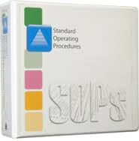

Slide 7
WHAT ARE RECORDS?
Are collected/ captured information produced by the
laboratory in the process of performing and reporting tests
A format becomes a record once used to document
elicited data
They need to be easily retrieved or accessed
Contains information that is permanent and cannot be edited
Needs to retained as per standard guidelines and lab policy

Slide 8
EQUIPMENT RECORDS, e.g.
Certificates
Machine Print-Outs
Log books
Reports

Slide 9
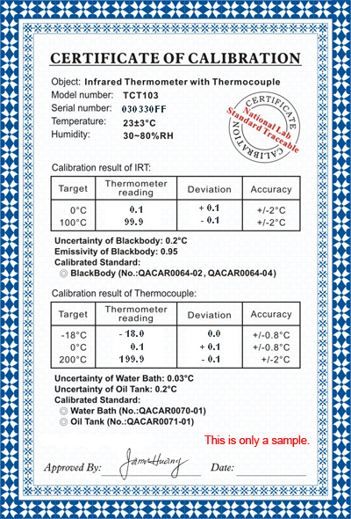
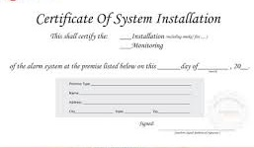
02
FEB
16
ABC
Rajni

Slide 10
EQUIPMENT LIFE
PURCHASE
&
INSTALLATION
ROUTINE OPERATIONS
DE-COMMISSIONING
DOCUMENTS
RECORDS

Slide 11
DOCUMENTS FOR EQUIPMENT PROCUREMENT, INSTALLATION, ACCEPTANCE TESTING..

Slide 12
USER MANUAL AND TECHNICAL MANUAL
KIT INSERTS
STANDARD OPERATING PROCEDURE
SYSTEM SUPPORT SOFTWARES

Slide 13
RECORDS FROM EQUIPMENT
PROCUREMENT, INSTALLATION
ACCEPTANCE TESTING…..

Slide 14
DOCUMENTS FOR ROUTINE OPERATIONOF EQUIPMENT

Slide 15
IQ / OQ / PQ RECORDS
EQUIPMENT ACCESSORIES CHECK LIST
TRAINING CERTIFICATES
UNIQUE IDENTIFICATION, LABELLING
CALIBRAION AND TRACEBILITY CERTIFICATE

Slide 16
SOPs &BENCH AIDS
CALIBRATION SCHEDULE
MAINTENANCE SCHEDULE
FLAGS
SEFTY INSTRUCTIONS
BASIC TROBULESHOOTING GUIDE

Slide 17
RECORDS FROM ROUTINE OPERATION OF EQUIPMENT

Slide 18
MANTINANCE LOGS
CALIBRATION LOGS
QUALITY CONTROL RECORDS
BREAKDOWN LOGS
TEST REPORTS
ADVERSE INCIDENT RECORDS

Slide 19
DOCUMENTS FOR EQUIPMENT DECOMMISSIONING

Slide 20
STATE POLICY
INFORMATIONS OF REGULATORY BODY
CONDEMNATION FORMS
MANUFACTURER’S RECOMMENDATIONS
FOR SAFE DISPOSAL

Slide 21
RECORDS FROM EQUIPMENT DECOMMISSIONING

Slide 22
EQUIPMENT HISTORY SHEET WITH REASON
FOR CONDEMNATION
RECOMMENDATION OF MAINTENANCE COMMITTEE
APPROVAL OF COMPETENT AUTHORITY
PROOF OF FOLLOWING PROTOCOL FOR
DECONTAMINATION, SAFE DISPOSAL
FIANANCIAL RECORDS

Slide 23
DOCUMENTS AND RECORDS GENERAL AND EQUIPMENT RELATED (ISO 15189)

Slide 24
DOCUMENT CONTROL
(Clause 4.3 of ISO 15189)
All Documents (in this case, pertaining to
equipment) should be under document control
Any revision or amendment should be done by
authorized persons only
All revisions and amendments should be
documented

Slide 25
CONTROL OF RECORDS
(Clause 4.3 of ISO 15189)
All records (in this case, equipment related) should
be created concurrently along with performance
of the activity
Should be readily retrievable
Check sub clauses a-v for list of equipment related
records

Slide 26
EQUIPMENT RECORDS
AS PER CLAUSE 5.3.1.7 of ISO 15189

Slide 27
Identity and location of equipment
Manufacturer’s name, model and serial no or other
unique identification
Contact information of the supplier or the
manufacturer
Date of receiving and date of entering in to service
Condition when received
(e.g. new, used or reconditioned)
Manufacturer’s instructions

Slide 28
Records that confirmed the equipment’s initial
acceptability for use when equipment is
incorporated in the laboratory
Log of maintenance and calibration carried out
and the schedule for preventive maintenance
Equipment performance records that confirm the
equipment’s ongoing acceptability for use
Records of damage to, or malfunction,
modification, or repair of the equipment

Slide 29
If it is not written down, it was not done”

Slide 30
THANK YOU !!!

