Slide 1
What Errors can be detected on LJ
Labs for Life Project
Quality CONTROL TRAINING

Slide 2
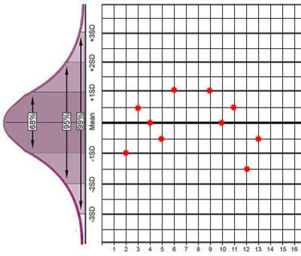
Levey-Jennings Chart
Notes:
2

Slide 3
What will you look for on the LJ chart?
Mean
SD
Rules
    Using them as single rules
    Using them in groups multi-rules
Rule Violations

Slide 4
How will you interpret rule violations?
Rule Violations
    The power of daily monitoring
    The power of periodic monitoring
    The power of daily monitoring + periodic monitoring

Slide 5
The Gaussian is the Key

Slide 6
The Gaussian is the Key

Slide 7
Standard Deviation and Probability
99.7%
95%
68%
2.5%
13.5%
34%
34%
13.5%
2.5%
When data exhibit Gaussian (Normal) distribution, we can predict the likelihood of data falling within specific percentages of the mean on the Gaussian curve.
Notes:
A recap. 68% points fall between mean and 1 SD, 27% between 1 and 2 SD. Around 5% between 2 and 3 SD. Lets check this out on an LJ

Slide 8
Quiz Time
Detect Errors…………….
+4SD
+3SD
+ 2SD
+ 1SD
X
-1SD
- 2SD
-3SD
-4SD
Run
1
2
3
4
5
6
7
8
9
10
11
12
13
14
15
16
17
18
19
20
21
22
23
24
25
26
27
28
29
30
Value
93
84
90
93
88
86
88
95
92
94
88
90
89
87
91
90
94
88
97
90
91
95
90
85
91
94
89
91
85
89

Slide 9
Notes:
What would you call this? A shift. You see shifting accuracy What wa the original mean? X. the black line. What would be the mean now? The original 1 SD, the double line…

Slide 10
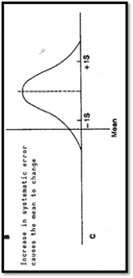
1 SD Shift

Slide 11
2 SD Shift

Slide 12

A new population of data points is emerging due to a SMALL change in accuracy. 1 SD shift
Notes:
1 SD shift has occurred below the mean

Slide 13
Comments?
=New Population
A new population of data points is emerging and a larger change in accuracy. 2 SD shift
= Original population

Slide 14
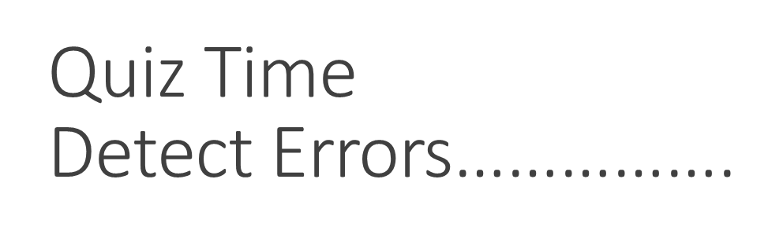
3
X assigned
90
SD assigned
3
102.0
+4SD
99.0
+3SD
96.0
+ 2SD
93.0
+ 1SD
90.0
X
87.0
-1SD
84.0
- 2SD
81.0
-3SD
78.0
-4SD
Run
1
2
3
4
5
6
7
8
9
10
11
12
13
14
15
16
17
18
19
20
21
22
23
24
25
26
27
28
29
30
Value
93
85
90
93
88
87
89
96
92
95
88
90
89
87
92
90
94
88
90
84
85
86
81
86
92
89
86
82
89
86
Notes:
1 SD shift has occurred below the mean

Slide 15

X assigned
90
SD assigned
3
102.0
+4SD
99.0
+3SD
96.0
+ 2SD
93.0
+ 1SD
90.0
X
87.0
-1SD
84.0
- 2SD
81.0
-3SD
78.0
-4SD
Run
1
2
3
4
5
6
7
8
9
10
11
12
13
14
15
16
17
18
19
20
21
22
23
24
25
26
27
28
29
30
Value
93
85
90
93
88
87
89
96
92
95
88
90
89
87
92
90
94
88
90
84
85
86
81
86
92
89
86
82
89
86
Notes:
1 SD shift has occurred below the mean

Slide 16
Troubleshoot!!!
Deterioration of the instrument light source
Gradual accumulation of debris in sample /reagent tubing
Aging of reagents
Gradual deterioration of control materials
Gradual deterioration of incubation chamber temperature(enzymes only)
Gradual deterioration of calibration

Slide 17
Notes:
Increase in imprecision, mean did not change

Slide 18
The Gaussian is the Key

Slide 19
1
+4SD
+3SD
+ 2SD
+ 1SD
X
-1SD
- 2SD
-3SD
-4SD
Run
1
2
3
4
5
6
7
8
9
10
11
12
13
14
15
16
17
18
19
20
21
22
23
24
25
26
27
28
29
30
Value
93
84
90
93
88
86
88
95
92
94
88
90
89
87
91
90
94
88
97
90
91
95
90
85
91
94
89
91
85
89
Notes:
Stable analytical system; observed mean and SD = assigned mean and SD

Slide 20
2
X assigned
90
SD assigned
3
102.0
+4SD
99.0
+3SD
96.0
+ 2SD
93.0
+ 1SD
90.0
X
87.0
-1SD
84.0
- 2SD
81.0
-3SD
-4SD
78.0
Run
1
2
3
4
5
6
7
8
9
10
11
12
13
14
15
16
17
18
19
20
21
22
23
24
25
26
27
28
29
30
Value
93
84
90
93
88
86
88
95
92
94
88
90
89
87
91
90
94
88
95
90
96
91
87
82
96
85
88
101
82
91
Notes:
Increase in imprecision, mean did not change

Slide 21
2
X assigned
90
SD assigned
3
102.0
+4SD
99.0
+3SD
96.0
+ 2SD
93.0
+ 1SD
90.0
X
87.0
-1SD
84.0
- 2SD
81.0
-3SD
-4SD
78.0
Run
1
2
3
4
5
6
7
8
9
10
11
12
13
14
15
16
17
18
19
20
21
22
23
24
25
26
27
28
29
30
Value
93
84
90
93
88
86
88
95
92
94
88
90
89
87
91
90
94
88
95
90
96
91
87
82
96
85
88
101
82
91
Notes:
Increase in imprecision, mean did not change

Slide 22
Troubleshoot!!!
Improper mixed /dissolved reagents
Air bubbles in reagents and reagents lines, sampling or reagents syringes.
Pipette tips is not fitting properly.
A clogged pipettor (Clot).
Unstable temperature and incubation.
Unstable power supply.
Poor operator technique.
Improper mixing of processed samples.
Incorrect reconstitution of the control material.

Slide 23
QC data points are a FACT
If we do not like the value produced by the analytical system, then we must look to our processes, people, or tools. Facts are not ignored in a quality laboratory.

Slide 24
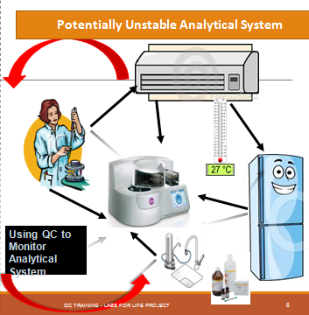
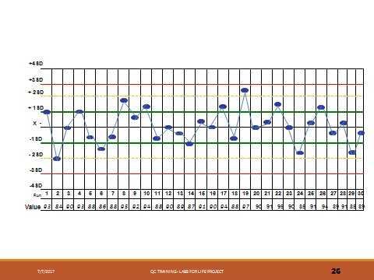
Notes:
Using is QC means, largely, looking at your LJ graphs. Every data point is important !

Slide 25
Thanks

