Slide 1
HEALTHCARE ASSOCIATED INFECTIONS

Slide 2
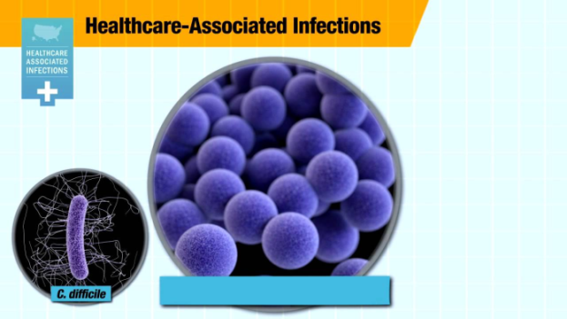
DEFINITION
A localized or systemic condition resulting from an adverse reaction to the presence of an infectious agent(s) or its toxin(s) that:
1. Occurs in a patient in a healthcare setting,
2. Was NOT found to be present or incubating at the time of admission unless the infection was related to a previous admission to the same setting

Slide 3
The patient must have been admitted for reasons OTHER than the infection.
He or she must also have shown NO signs of active or incubating infection.
  These infections occur:
  up to 48 hours after hospital admission
  up to 3 days after discharge
  up to 30 days after an operation
  in a healthcare facility when a patient was admitted for reasons other than the infection
Earlier referred to as Nosocomial or Hospital Acquired Infections

Slide 4
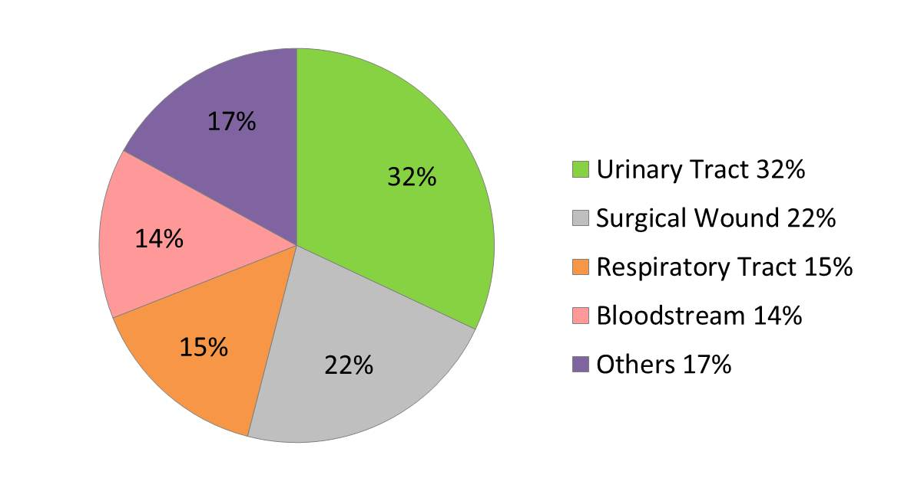

Slide 5
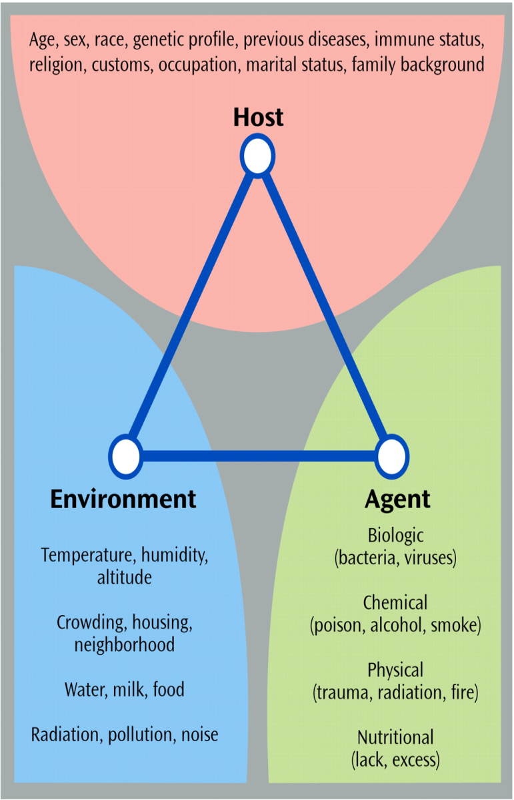
Sources of infection
Patient
HCW’s
Attendants and visitors
Environment
  Air
  Water
  Equipment
  Food, medicines
  I/V fluids
  A/C , ventilatory equipment
  Blood products

Slide 6
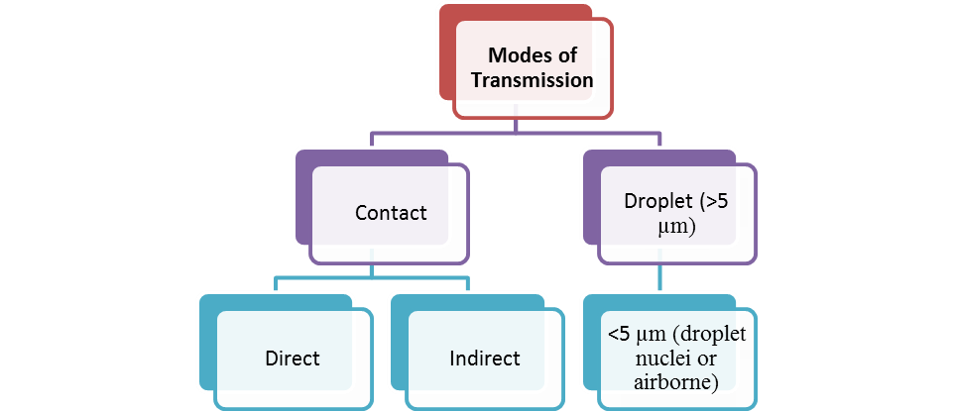
Mode of spread

Slide 7
One-to-one contact | Direct | Direct physical contact Examples of transmission: Shaking hands Precautions: Hand hygiene, masks
 | Indirect | Infectious agent deposited onto an object or surface (fomite) Examples of transmission: Not washing your hands between patients, contaminated instruments, needle-stick injuries Precautions: Sterilizing instruments, disinfect surfaces
 | Droplet | Contact, but transmission is through the air. Droplets are relatively large (>5 µm) and projected up to about one metre. Examples of transmission: Sneezing, coughing, during suctioning Precautions: Masks, cover mouth

Slide 8
Non-contact | Airborne | Via aerosols (airborne particles <5µm) that contain organisms in droplet nuclei Examples of transmission: Via ventilation system in a hospital Precautions: Masks; negative pressure rooms in hospital
 | Vehicle | A single contaminated source spreads the infection Examples of transmission - Point source: Food-borne outbreak from infected batch of food; IV fluid; medical equipment. Common source: Cases may be widely dispersed due to transport & distribution of the vehicle Precautions: Normal safety and disinfection standards. Package medicines in tamper-proof containers.
 | Vector-borne | Transmission by insect or animal vectors. Example of infections: Mosquitoes and malaria. Precautions: Protect via barriers (window screens, bed nets); insect sprays; culling animals.

Slide 9
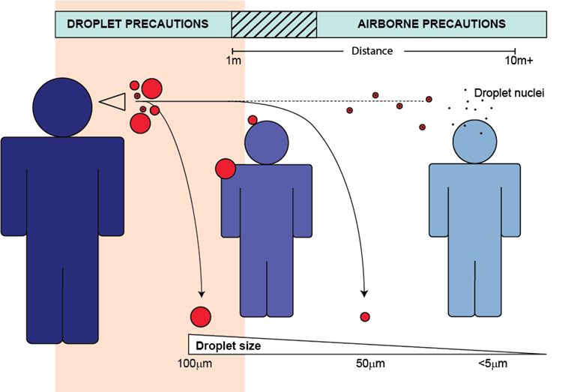
Droplet Transmission

Slide 10
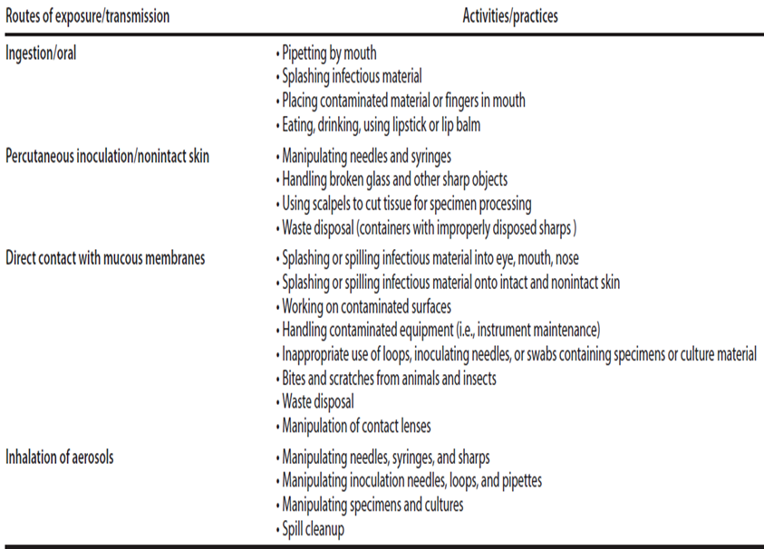
Laboratory Practices Leading to Exposure to Infectious Agents

Slide 11
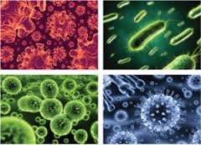
Important organisms in HAI
Methicillin-resistant Staphylococcus aureus (MRSA)
Vancomycin-intermediate S. aureus (VISA)
Vancomycin-resistant enterococcus (VRE)
MDR Pseudomonas aeruginosa
MDR Acinetobacter baumannii
MDR Mycobacterium tuberculosis
ESBL producing bacteria
Clostridium difficile
Legionella sp.,
Aspergillus sp.

Slide 12
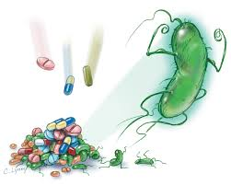
Antimicrobial Resistance in HAI
MRSA, VISA, VRSA, VRE, ESBL- producing organisms
Microorganisms with unusual patterns of resistance
  1st isolate of Burkholderia cepacia complex
  Quinolone-resistant strain of Pseudomonas aeruginosa
Difficult to treat because of innate or acquired resistance to multiple classes of antimicrobial agents (Stenotrophomonas maltophilia, Acinetobacter spp.)
Association with serious clinical disease
leads to increased morbidity and mortality

Slide 13

Fundamental Elements for
Prevention of HAI
Administrative Measures:
  Incorporating infection control into the objectives of the organization’s patient and occupational safety programs.
Infection Control Team Liaison:
  Bedside caregiver with training in basic infection control and having frequent communication with the infection control team

Slide 14

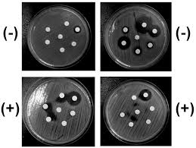
Clinical microbiology laboratory support:
  Promptly detection & reporting
  Identifying emerging patterns of antimicrobial resistance,
  Assessment of effectiveness of recommended precautions to limit transmission

Slide 15

Infection Control Committee (ICC)
Multidisciplinary committee responsible for monitoring program policies implementation and recommend corrective actions.
Representatives from different concerned hospital departments & management.
Establishes standards for patient care,
it reviews and assesses IC reports and
identifies areas of intervention.

Slide 16

ICC Members
As a minimum, the committee should include:
Chief executive, or hospital administrator or his/her nominated representative.
ICD or hospital microbiologist (chairperson).
Infection Control Nurse (ICN).
Infectious Diseases Physician (if available)
Director of nursing or his representative.
Occupational Health Physician (if available).
Representative from the major clinical specialties.
Additionally representatives of any other department (pharmacy, central supply, maintenance, housekeeping…etc) may be invited.

Slide 17

The ICC has the following tasks:
To review and approve the annual plan for infection control
To review and approve the infection control policies.
To support the IC team and direct resources to address problems as identified
To ensure availability of appropriate supplies
To review epidemiological surveillance data and identify area for intervention
To assess and promote improved practice at all levels of the health care facility
To ensure appropriate training in infection control and safety.
To review risks associated with new technology and new devices prior to their approval for use.
To review and provide input into an outbreak investigation

Slide 18

Surveillance for HAIs
Ongoing, systematic collection, analysis, interpretation, and dissemination of data regarding a health-related event for use in public health action to reduce morbidity and mortality and to improve health.

Slide 19
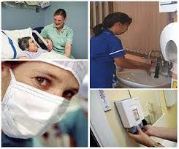
Essential tool for case-finding of single or clusters of patients
Detection of epidemiologically important organisms:
  S. aureus,
  S. pyogenes
  Enterobacter-Klebsiella spp;
  MRSA, VRE,
  C. difficile
  RSV; influenza virus

Slide 20

HAI Surveillance
Routine HAI surveillance to be conducted.
Active, patient-based, prospective, priority-directed
Active and passive
Active surveillance
a) Trained personnel, mainly ICPs, vigorously look for HAI
b) Information accumulated by using a variety of data sources
2. Passive surveillance
Persons who do not have a primary surveillance role, such as ward nurses or respiratory therapists, identify and report HAI

Slide 21
B. Patient-based and laboratory-based
Patient-based
a) Count HAI, assess risk factors, and monitor patient care procedures and practices for adherence to infection control principles
b) Requires ward rounds and discussion with caregivers
Laboratory-based
a) Detection is based solely on the findings of laboratory studies of clinical specimens
C. Prospective and retrospective
Prospective surveillance: Monitor patients during their hospitalization
Retrospective surveillance: Identify infections via chart reviews after patient discharge

Slide 22
D. Priority-directed and comprehensive
1. Priority-directed (also called targeted, focused, or Surveillance by Objective)
a) Objectives for surveillance are defined
b) Focus is on specific events, processes, organisms, and/or patient populations
2. Comprehensive
a) Continuous monitoring of all patients for all events and/or processes
b) Highly personnel resource intensive if done manually

Slide 23
E. Risk-adjusted rates and crude rates
1. Risk-adjusted rates
a) Rates are controlled for variations in the distribution of major risk factors associated with an event’s occurrence
b) Such rates allow inter- and intra-facility rate comparisons
2. Crude rates
a) Rates assume equal distribution of risk factors for all events
b) Such rates cannot be used for inter-facility comparisons
F. Incidence and prevalence
1. Incidence: Count only new events occurring during some defined time period
2. Prevalence: Count all events (new and previously existing) occurring at either a point in time or during some defined time period

Slide 24

Key Functions Of The Clinical Microbiology Laboratory
Rapid communication: rapid communication is crucial and is the base of any good collaboration between microbiology laboratory and infection control
Participation in outbreak management:
  early isolation of a new or unusual microorganism
  Reporting of cluster of infections (two related isolates in different patients in the same time frame)
  Isolation, identification to the species level and bacterial typing.
  microbiological tests of blood products, environmental surfaces, disinfectants and antiseptics, air, water, hands of personnel, nostrils of personnel.

Slide 25
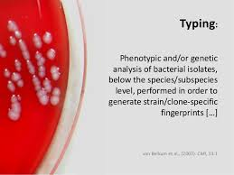
Accurate speciation and typing of isolated pathogen:
  epidemiological analysis of small clusters
  outbreaks of HAI if pathogenic bacteria are involved (e.g. Salmonella enteritidis food poisoning outbreak originating from hospital kitchen).
  opportunistic pathogens (e.g. S. aureus, E. coli, Enterobacter cloacae, enterococci etc)
Two methods of typing:
  a) phenotyping
  b) genotyping

Slide 26
Phenotyping
  Determining characteristics expressed in the bacterial culture
  • Antigenic structure (serotyping)
  • Physiologic properties/metabolic reactions (biotyping)
  • Susceptibility to antimicrobial agents (resistotyping)
  • Susceptibility to colicines (colicinotyping)
  • Susceptibility to bacteriophages (phage typing)
Genotyping
• Relatedness or difference between two isolates of the same species very precisely
• Diagnosis is rapid: not dependent on waiting for bacterial growth in cultures
• Sophisticated and expensive equipment and well trained staff.
Examples: PFGE, gene sequencing, PCR

Slide 27
Participation in resistance surveillance:
  Policies for antibiotic use with the ultimate goal to decrease resistance (Hospital Antibiotic Policy).
Education of HAI prevention personnel and other healthcare workers
Microbiologist as a member of Infection Control Committee (ICC)/Infection Control Team (ICT) and Antibiotic Committee (AC)

Slide 28
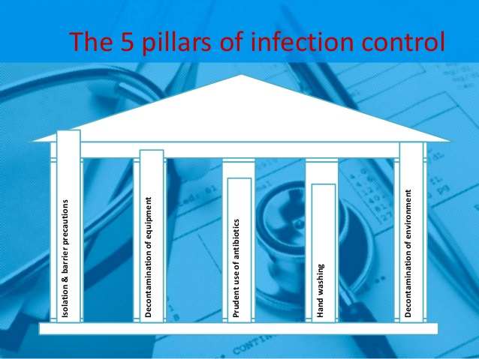

Slide 29

Hospital Antibiotic Policy
To minimize morbidity and mortality due to
antimicrobial-resistance; and
To preserve effectiveness of antimicrobial agents
Scope: for prophylaxis, empirical and definitive therapy.
  The hospital antibiotic policy shall be based upon:
  spectrum of antibiotic activity;
  pharmacokinetics/pharmacodynamics of these medicines;
  adverse effects;
  potential to select resistance;
  cost;
  special needs of individual patient groups.

Slide 30

Set levels for prescribing antibiotics:
  First choice antibiotics: prescribed by all doctors
  Restricted choice antibiotics: prescribed after consulting the HOD or the antimicrobial team (AMT) representative.
  Reserve antibiotics: prescribed only by designated experts.

Slide 31


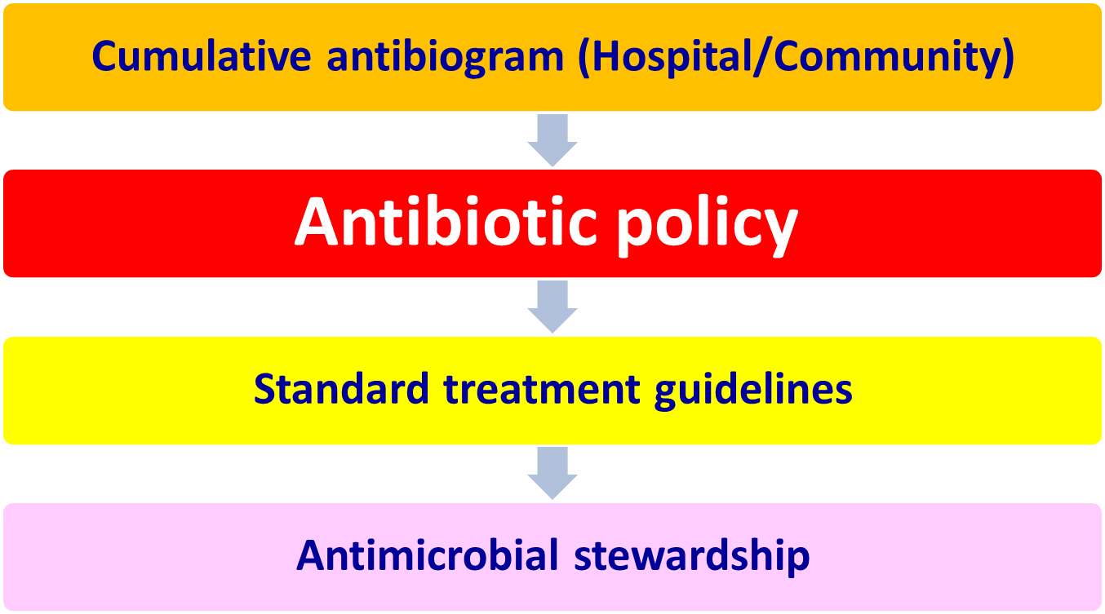
Process For The Development Of Hospital Antibiotic Policy
Hospital acquired infection
Surveillance of antimicrobial resistance/ Antibiotic consumption

Slide 32
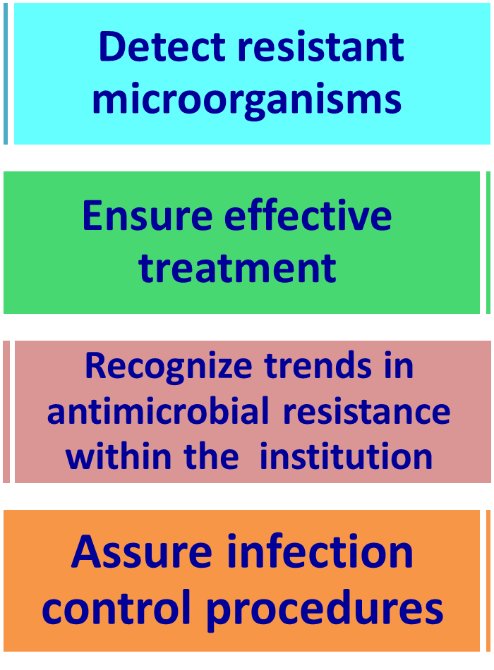
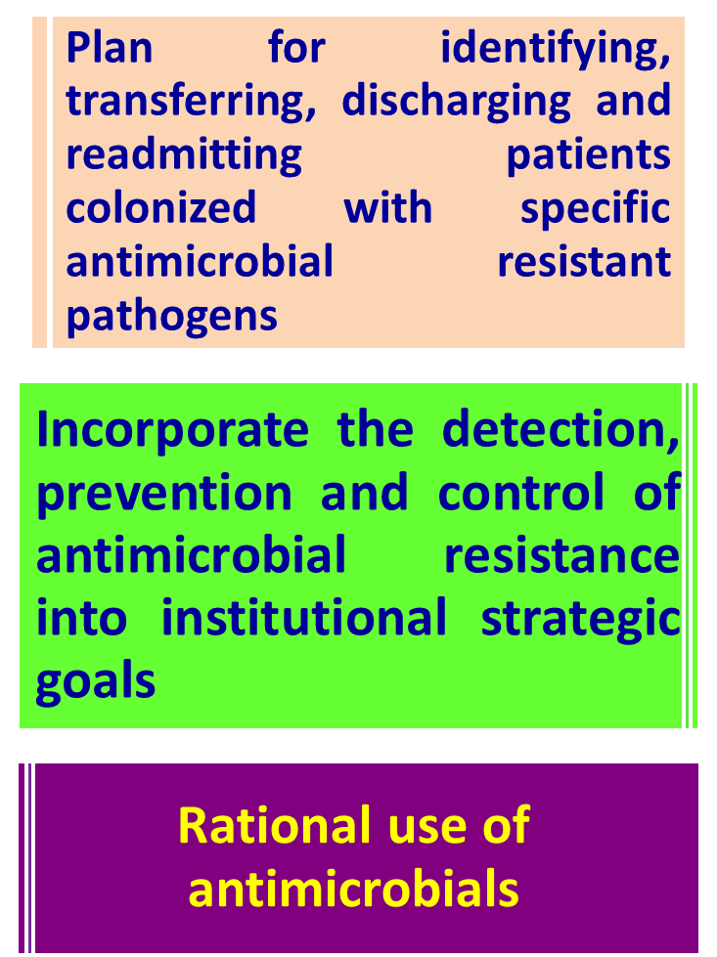
Objectives of Antibiotic Policy

Slide 33

Multidisciplinary Antibiotic Management Team (AMT)
6–10 members with expertise and experience in different subjects:
  Infectious diseases,
  Internal medicine,
  Surgery,
  Pediatrics,
  Clinical microbiology,
  Pharmacology and
  Hospital pharmacy.

Slide 34
Functions Of AMT
Developing hospital antimicrobial policy (HAP)
Monitoring implementation of HAP
Receiving feedback, assessing outcome and discussing with clinicians,
Conducting revision of the policy every year
Antimicrobial susceptibility profiles, and setting audit targets.

Slide 35
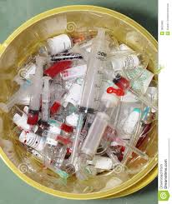
Reducing Risk of Infection from Bio-Medical Waste
Segregate waste at source
Use PPE when handling biomedical waste
Handle sharps with care
Do not fiddle with waste
Keep facility clean inside and out
Know steps for treating injuries (first aid)
Get fully immunized against tetanus and hepatitis B
In case of injury go for immediate evaluation to get post-exposure prophylaxis

Slide 36


