Slide 1

It Begins with the Right Chart
Labs for Life Project
Quality Control Training

Slide 2

Assigned ≠ Observed
“Theoretically, laboratory QC is easy. Simply calculate the mean and SD for a set of data and use one or more QC rules to warn when data fall outside the acceptable range. Unfortunately, many pitfalls exist that may lead to incorrect conclusion about method performance.”
Brooks, Zoe C. Performance-Driven Quality Control, 2001, p 70.

Slide 3
2 reasons for more data points to lie farther from the mean
A change in accuracy or precision
  Systemic changes; imprecision and shifting accuracy
  More than 5% of the measurements will exceed ± 2SD
The mean and/or SD are not assigned correctly on the L-J chart
  Assigned values ≠ Observed values
  More than 5% of the measurements will exceed ± 2SD
Notes:
We saw in the previous slide about imprecision or shifting accuracy and more data points falling in the SD areas more than the specified percentages. Such events denote errors in the analytical system. However, there is a more critical and often overlooked reason for his happening. Carelessness in assigning the right values on the chart. Let us understand more

Slide 4
Rendering QC rules ineffective.
  Assigned Mean ≠ Observed Mean
  Assigned SD is ≠ Observed SD
Notes:
2 cardinal errors made by even well meaning operators!

Slide 5
MEAN obs
MEAN ASSIGNED
Notes:
The mean assigned on the chart is depicted by the black dotted line. 1SD green lines, 2 Sd the red lines. The QCs are being run diligently, but all data points are above the mean. The expected Gaussian is here, but the actual Gaussian is there. So what is the problem? A wrong mean. Conseqently what would the lab do? Look at these points. Multiple points falling outside 2 sd, even 3 sd and continuous false rejections

Slide 6


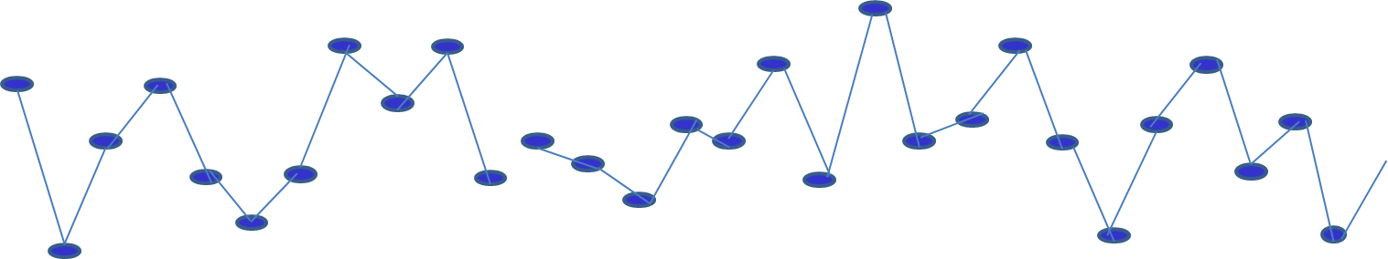
93
3
90
3
False Accept
True Accept
False Reject

Slide 7
Notes:
Assigned mean ≠ observed mean

Slide 8
This is WHERE WE EXPECTED TO BE – based on the assigned values of the chart
It’s a Fact – this is WHERE WE ARE
False Rejects
False Accepts
Mean observed
Mean assigned
Notes:
Assigned mean ≠ observed mean

Slide 9
  Assigned SD ≠ Observed SD
Rendering our QC rules ineffective.

Slide 10
MEAN obs
SD obs
SD assigned
Notes:
False accepts, too wide SDs. Wrong chart

Slide 11
Notes:
SD assigned is greater than observed SD

Slide 12
5
False Accepts
False Accepts
True Accepts
WHERE WE ARE
SD observed
SD assigned
Notes:
SD assigned is greater than observed SD

Slide 13
Notes:
SD assigned is less than observed

Slide 14

6
False Rejects
False Rejects
SD observed
SD assigned
Notes:
SD assigned is less than observed

Slide 15



For Each QC Data Point We Need to Decide…
SYSTEM IS STABLE
SYSTEM IS UNSTABLE – SIGNIFICANT CHANGE
NO RULE VIOLATION
True Accept – system is stable and no QC rule violations occurred - report patients
False Accept – system is unstable and no QC rule violations occurred –wrong results may be reported
RULE VIOLATION
OCCURRED ON L-J CHART
False Reject– system is stable and a QC rule violation occurred due to inherent randomness- waste of time, effort, and
True Reject – system is unstable and a QC rule violation occurred – begin investigation and troubleshooting

Slide 16
Quiz Time!!!

Slide 17
It Begins with the Right Chart
Does this look like an error to you?
Pitfalls encountered when assigned values that do not reflect current observed values on our charts

Slide 18
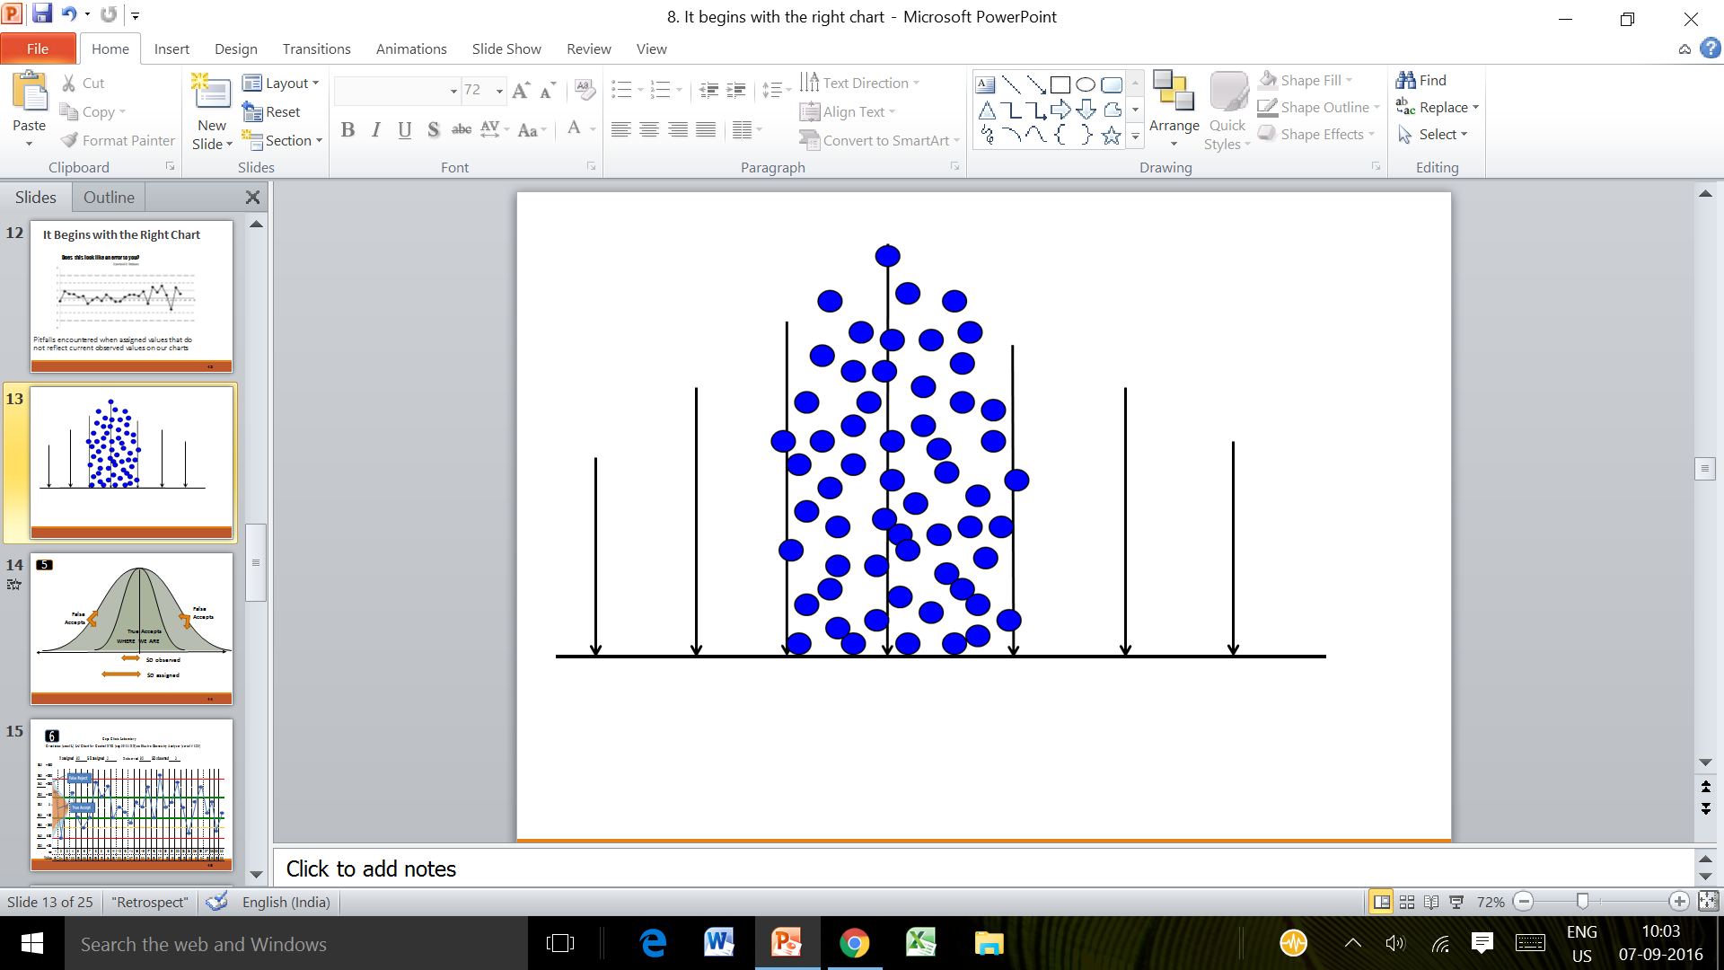

Slide 19
Notes:
Let us see the same values plotted with 2 means. The right mean is 72. if the lab assigns 67 as shown in the second graph, what will happen? Look at the 3rd and 4th values. It is a 2:2s, but will the lab pick it up? No. False acceptance. Look at eh 12th value. It was a 1: 2s warning which became a 1:3s rejection

Slide 20
Notes:
Wrong SD. Too wide. Right SD 5. Wrong SD 10. No warnings, no rejections. False accepts.

Slide 21
Notes:
Wrong SD. Too narrow. Right SD 5. Wrong SD 2.5.. False rejects.

Slide 22
Assigned vs. Observed – What is the difference?
Mean _{assign} SD _{assign}
Mean _{observed} SD _{observed}
May or may not be based on fact
Values applied to the L-J Chart
Sources often chosen other than currently observed performance include:
  Past data points before a change
  Cumulative values
  Package insert values
Mathematically calculated using data points (facts)
Answers WHERE WE ARE in terms of accuracy and precision of the method
Specific to your method’s performance

Slide 23
When Do You Create a New LJ Chart?
Lot changes
  Controls (parallel testing)
  Reagents
  Reference solutions
Major component changed on the instrument
Change in the testing process, usually manufacturer-directed.

Slide 24
Thank you

