Slide 1
Personnel
Dr J.A Iravane
Associate Professor & I/c C&DST
GMC, Aurangabad

Slide 2
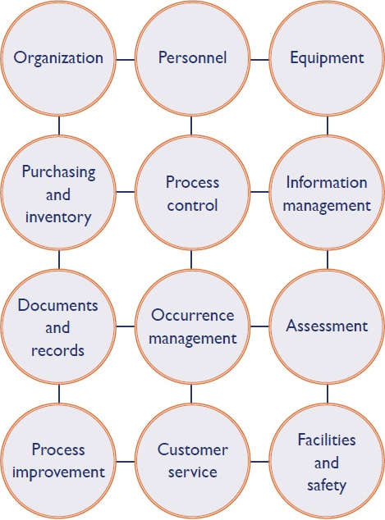

Slide 3


Slide 4
ISO 15189 Clause 5.1
Personnel qualifications
Job descriptions
Orientation
Training
Competency assessment
Professional development
Continuing education

Slide 5
Qualifications

Slide 6
Lab Director
Overall responsibility of all the parameters- technical and management related.
Minimum of five years of experience
Should fulfill other ISO 15189 responsibilities.
Lab can have more directors, but one will be available to ensure all responsibilty

Slide 7
Quality Manager
Training in 4-days Quality Management as per ISO 15189.
Full time employee
Can be delegated with additional responsibilities.
Needs a deputy

Slide 8
Other designations
Deputy Quality Manager
Technical Manager
Safety Officer
Authorized Signatories

Slide 9
Lab Technician-1 As per NABL 112
Graduate in Medical Laboratory Technology
Diploma in Medical Laboratory Technology with a course of at least two years duration
Certificate in Medical Laboratory Technology with a course of at least one year duration and two years of experience in a medical laboratory.
Graduate in Science with one year experience in a medical laboratory.

Slide 10
Lab Technician-2
Ensure that all technical persons are given appropriate training
NABL may relax its criteria -25% of the staff having matriculation with science subjects and at least 10 years experience in a Medical laboratory.

Slide 11
Personnel Introduction to the Lab-1
A small meeting with a welcome
A tour to the workplace with brief introduction of each area.
Instructions for the pattern of working, timings, leaves etc.
Information about making the personal file
Base line health checkup
Enrollment for vaccination/antibody titre if required

Slide 12
Personnel Introduction to the Lab-2
Basic training schedule to be initiated
Confidentiality
Code of ethics
Plan for Vaccination and estimation of antibody titer.

Slide 13
 | Topic | Date | Trained by
1 | Introduction to QMS
2 | Introduction to ethics and confidentiality
3 | Introduction to laboratory specific Laboratory Safety Manual: Location and contents.
4 | Introduction to laboratory specific Standard Operating Procedures (SOP’s

Slide 14
 | Topic | Date | Trained by
5 | Review modes of transmission, epidemiology and symptoms of pathogenic microbes
6 | Review emergency information: Spills, Personal Injury, Fire
7 | Accident reporting and investigation procedures

Slide 15
Training log
Date | Nature of training attended | Signature of staff | Signature Supervisor

Slide 16
Training calendar
Scheduled plan
Spread over months
Table displayed
Presentations made ready
Post training evaluations to be done

Slide 17
Lab safety program

Slide 18
Safety areas | Comment | Sign and date
Hepatitis B vaccination
General: Good housekeeping Universal safety precautions
Bio-safety training
Sample discarding and waste management

Slide 19
Safety areas | Comment | Sign and date
Accident management procedures: Location of first aid boxes Use of eye wash stations
Fire: What to do in event of fire Training on use of fire extinguishers
Security: Controlled Access laboratory

Slide 20
Name: ____________________________________ Designation: ___________
Permanent/Contractual ___________________ Section: _____________
Date: ________________________ Project: ______________
Specimen Signature ___________
Issue PPE: Laboratory Shoes. ___/___/____
HBV Vaccination
1st dose ___/___/____
2nd dose ___/___/____
3rd dose ___/___/____
Booster ___/___/____
Additional booster’s ___/___/____
Personnel file ___________
Bio-safety training ___/___/____
GCLP training ___/___/____
Initial Competency ___/___/________________________
Lab In-Charge/Designee

Slide 21
Competence assessment
Decide the frequency
At least twice for a new recruit
Once for all others
For every new test and procedure

Slide 22
MICRO/QSP/2/3: Competency Assessment Record
Employee Name______________________________________ Year____________
Initial Training Six month Competency Yearly Other ____
Remediation:______________________________________________________________________________________________________________________________________________________________________________________________________
Competency Passed or failed:___________________
Supervisor Review:___________________________
Date: ______________________________________

Slide 23
Competency Category | Task/ Test/ Instrument | Lab performance indicator | Assessment Tool | Date/Evaluator | Competent Y/N
Sample handling |  | Knowledge of correct specimen type and rejection criteria | Observation
Test Performance |  | Demonstrate correct steps and timings | Observation
Quality Control |  | Perform correct # QC | Document & check
Instrument operation |  | Technical questions | Observation
Instrument management |  | Calibration & maintenance | Document & check Observation
Problem solving skill |  | Document corrective action | Document & check Observation
Safety

Slide 24
Methods-1
Direct observation of routine work processes and procedures, including all applicable safety practices
Direct observation of equipment maintenance and function checks
Monitoring the recording and reporting of examination results

Slide 25
Methods-2
Review of work records
Assessment of problem solving skills
Examination of specially provided samples, such as previously examined samples, inter-laboratory comparison materials, or split samples.

Slide 26
Reviews of staff performance
Train the person reviewing
If methods for training and competence are appropriate
Any changes need to be made
Criteria for assessments can be reviewed

Slide 27
Continuing Education
Create your policies
Attending seminars/Trainings/CMEs
Research papers/projects
Participation in conferences

Slide 28
Personal Records-1
Educational and professional qualifications
Copy of certification or license
Previous work experience
Job descriptions
Introduction of new staff

Slide 29
Personal Records-2
Training in current job
Competency assessment
Record of continuing education
Review of staff performances
Records of accidents
Immunization status

Slide 30
Take home messages
Complete personal files
Complete the QSP on personnel
Gear up the team for the rapid accreditation process
Provide petty items for completion of basic printing/filing works
Designate people and responsibilities
Plan and initiate trainings & competency assesment

Slide 31


Slide 32
QUALITY IS AN ONGOING PROCESS ,
NOT A DESTINATION
gear up your team ……………….

