Slide 1
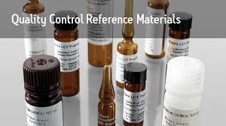
New Lot QC
Parallel testing
Labs for Life Project

Slide 2
When Do You Create a New LJ Chart?
QC Lot changes
Major component change on the instrument
Change in the testing process, usually manufacturer-directed.

Slide 3
Having the Right Control Chart
Detects measurement errors with:
  Minimum false accepts (an outlier accepted because the chart did not flag it as an outlier)
  Minimum false rejections (a valid run rejected because the chart flagged it as an outlier)

Slide 4
How SQC Works
SD obs
MEAN obs
We did expect this point
We did NOT expect this point(s)
We compare today’s observed value with the past history of previous results to determine if the system is stable or undergoing a change.

Slide 5
Overview: Introducing a New Lot Number into Service
+2 SD
+1 SD
MEAN obs
Assigned MEAN
SD obs
-1 SD
-2 SD
To obtain data to calculate the mean and SD
In parallel with the lot number currently in-use

Slide 6
Evaluate your
QC
with a stable analytical system
before your QC can evaluate your analytical system for instability!
True Democracy!

Slide 7
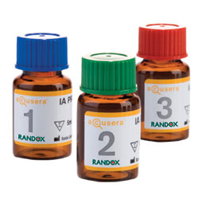



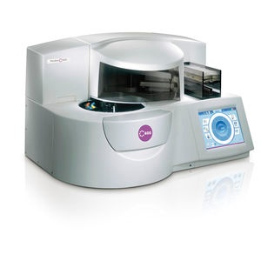


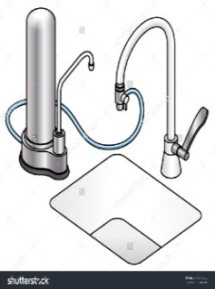
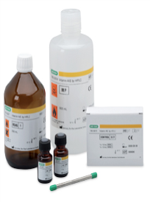
Under evaluation!
Stable Analytical System
Using QC to Monitor Analytical System

Slide 8
Why Parallel testing?
Collecting data of the New Lot QC material In Parallel With The Currently (In-use)Lot of QC
Manufacturer stated mean and SD are to be verified before the QC material is used for patient reporting
System Should be Stable
Old/ running lot is run to assure that the system is stable
  For patient results reporting
  For validating the data from new lot
New Lot: To collect history (data points). A mean and an SD to use the new lot for monitoring the system
Parallel testing is performed whether the control is assayed or un-assayed

Slide 9
How?
Ideally a minimum of at least 20 measurements20 (to know inherent variability of the system) is ideal, to be done on separate days when the measurement system is known to be stable( based on QC results from existing lots)
Establish the Mean and SD and transport to a new LJ chart
Once verified and values are confidently assigned, the QC can be now used to monitor your analytical system’s performance

Slide 10
An alternative : What if lab does not have the time or the resources for 20 parallel runs?
Using the analyte’s old %CV and the new mean of 4-5 runs
Get 4-5 values of the new QC
Find the Mean and
Derive the SD by using the formula
SD = CV (from old lot) * Mean (from new lot)
Apply on the new control chart
Ensure that the System is stable
Mean not drifting
Notes:
20 measurements: to know inherent variability of the system

Slide 11
Why use the mean from 4-5 runs and not the SD of those runs?
An SD means dispersion to capture the variables of the lab
Lab variables can be captured by the too few runs
4-5 runs’ SD will be too narrow, too unrealistic, will rise to false alerts.
Hence using this CV on a reasonably accurate mean of 4-5 runs will alert you to both inaccuracy and imprecision with minimum false alerts
The initial standard deviation value obtained by the calculation may be replaced with a more robust estimate when data from a longer period of stable operation become available
Notes:
The QC stability after opening a control product should also be considered

Slide 12
Again, why use the CV from before but not the SD?
SD is too dependant on the mean as it is an absolute value.
SD can change with concentration of the analyte, i.e the mean
Using the % equalizer, the CV, will eliminate this

Slide 13
Some checkpoints:
Sampling from at least a few reconstituted vials will include any errors of reconstitution and capture more lab variables for a more robust mean and realistic SD
For liquid stable quality control products, fewer bottles may be required, since such materials are expected to exhibit less vial to vial variation
When an opened bottle of QC material will be used for more than one day, the same bottle should be assayed on several days to allow analyte stability to be reflected in the mean value

Slide 14
Recommendation for parallel testing: NABL 112
CBC and coagulation: Run new QC 4-6 data points in 2 days(depending on stability)
Clinical chemistry: 2-3 time a day for 2-10 days for at least 20 data points
Qualitative and semi-quantitative: At least 3 patient samples (neg, low pos, high pos) should be run along with old and new lot

Slide 15
Summary steps of parallel testing
Step 1: Using the package insert information:
  Set the initial control limits, usually a ±2 SD range, for the new lot # of control.
  Use this range as a guideline only to ensure that the control material is acceptable (shipped and stored correctly)
Step 2: For each day of parallel testing:
  Test current lot number of control to confirm that the instrument/method is performing within quality specifications.
  Analyze the new control material and ensure that the data point falls between the ±2 SD range.
  Handle the new lot number material in the same manner to encompass the normal day-to-day sources of variability (inherent randomness) routinely encountered, such as:

Slide 16
Summary steps of parallel testing
Step 3: Serial testing of new lot number of control material
  Collect a minimum of 20 data points from the new lot number
    Preferably over a 20 day period
    If a shorter time frame: collect 20 data points over a 10 day period by analyzing the new lot number twice a day
    Record data points and keep instrument printouts if applicable
Step 4:Calculate your observed mean and SD for the new lot number
Step 5: Calculate your control limits (± 1 SD, ±2 SD, ± 3 SD, and ± 4 SD)
Step 6: Create your L-J chart
Step 7: When your current lot number expires or is consumed,
  Replace the L-J charts with the new-to-be current charts
  Retain the old charts according to your record retention schedule

Slide 17
Thanks

