Slide 1
Process Improvement &
Occurrence management
4.9,4.10,4.11,4.12

Slide 2
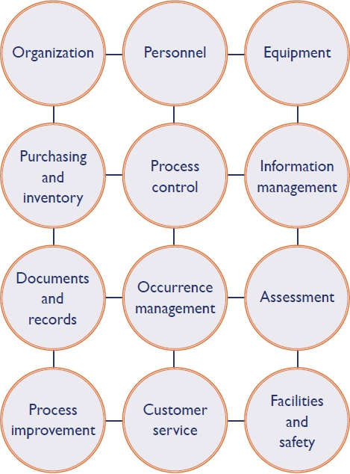

Slide 3
Contents
Non-conformances
Quality Indicator & Selection of Quality Indicator
Monitoring of QI
Tools for process Improvement (PDCA, RCA, Process Mapping, 5S, FMEA, Trend analysis)

Slide 4
Occurrence / Non conforming event management
Have a program to:
Identify occurrences: Capture all NCE/ Incident/ Accident
Investigate
Immediate action
Corrective Action
Root Cause analysis
Preventive action
Document and Review

Slide 6
Process Improvement Goals
Understanding an existing process/s
Introduce process changes to improve quality, reduce costs, or accelerate schedules
Defect reduction and prevention
Notes:
Patient care and patient safety

Slide 7
Quality Indicators (Qis)
QIs are indicators of quality improvement:
are used to gauge performance of all lab phases: pre analytical/post analytical/analytical
QIs are evidence based: They can be rate- or mean-based, providing a quantitative basis for quality improvement
create basis for continuous quality improvement and prioritization
Notes:
Blood tube rotator example

Slide 8
Data collection for monitoring QIs
Formulate a system
Develop formats for data capture
Monitoring: monthly, trend over a period of time
Action plan
Management Review

Slide 9
Examples of Quality Indicators
Pre- Analytical Indicators
Incomplete requisition
Patient Identification accuracy
Analytical Indicators
IQC failure
Post Analytical Indicators
TAT
Cross Cutting
Phlebotomy efficiency
Sample acceptability rates
Accuracy of collected samples
Inappropriate sample transport or storage
EQA failure
Equipment failure
Inventory shortage
Technical problems
# of amended reports
Unavailability of archived samples
Documentation related errors
Customer complaints
Numbers and types of non-conformances
Uncertainty of Measurement
Number of laboratory accidents

Slide 10
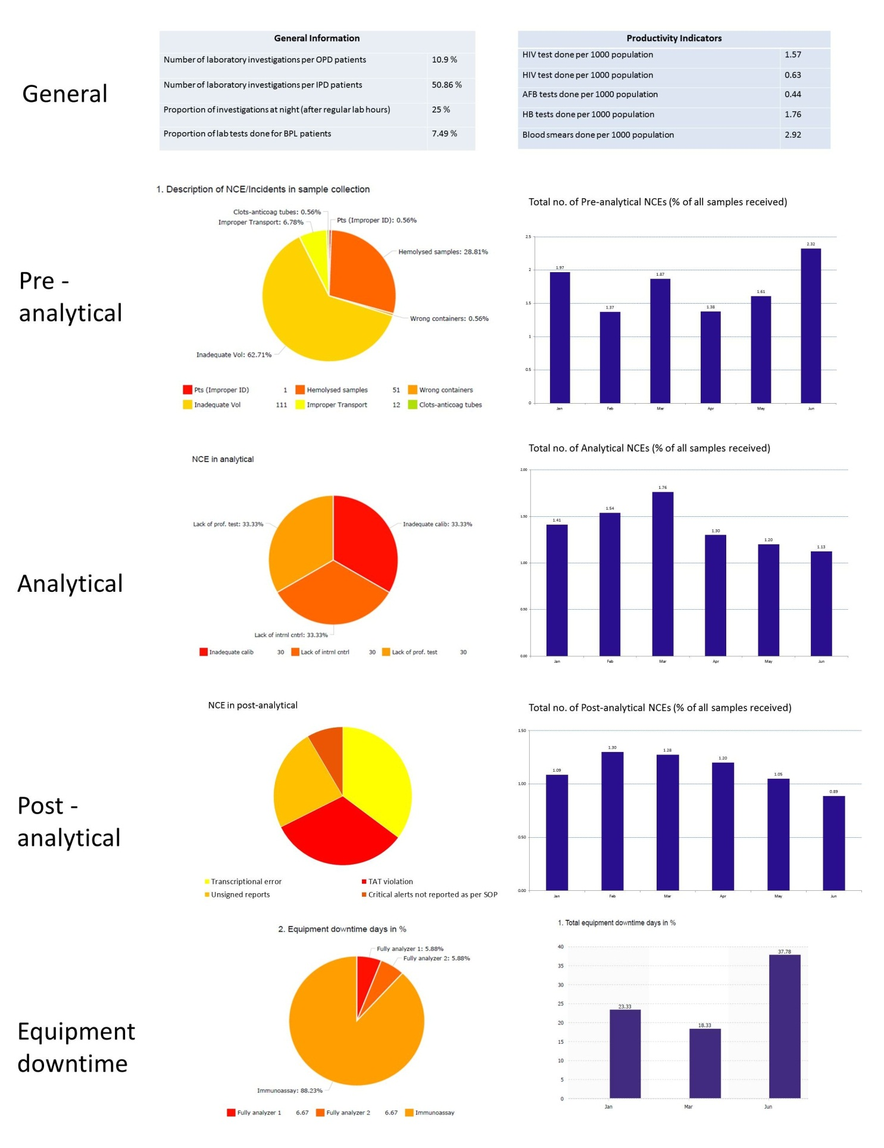
Notes:
Labs for Life QC tool: on-going bar-graphs for each area, Monthly pie charts for sub-components

Slide 11
Tools for process Improvement
Lean
PDCA
RCA
5S
Six Sigma
Lab can choose any of the tool based on the need and purpose
Notes:
Refer to QC module volume 1 for details

Slide 12
The tool or strategy selection should be based on the
- - Identification of the bottlenecks
and address the issue
Uses Team approach and Involve all levels of staff

Slide 13
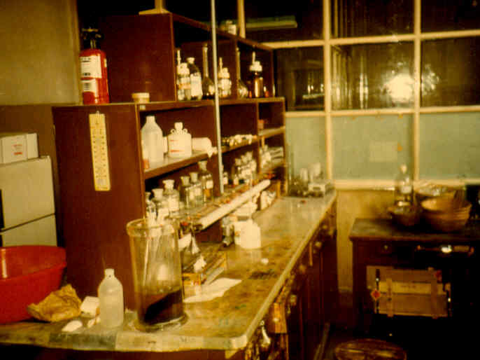

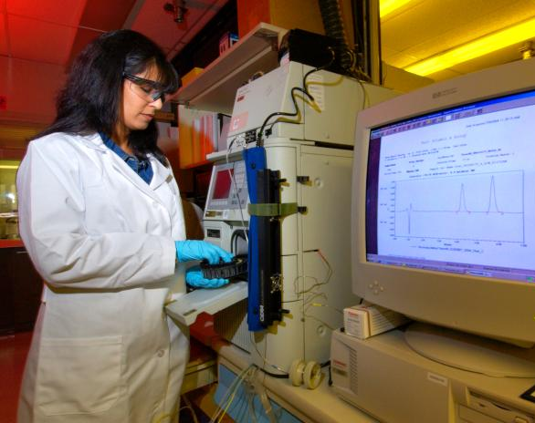
Improvement Tools
Lean
Optimizing space,
time, and activity to improve the physical paths of workflow.
Notes:
Creating more value for the customer with minimum resources, minimizing waste

Slide 14
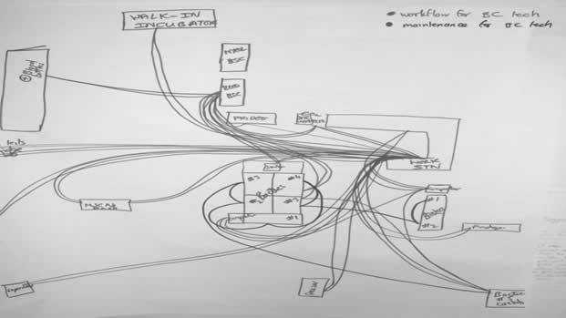
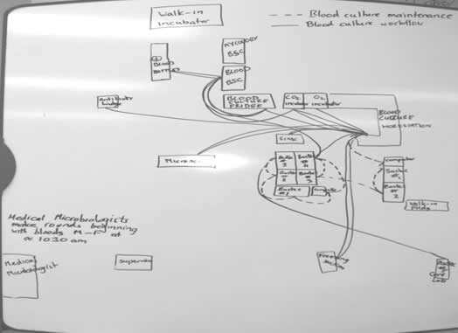
Path of workflow and maintenance by
blood culture technologist
Pre Lean Post Lean

Slide 15
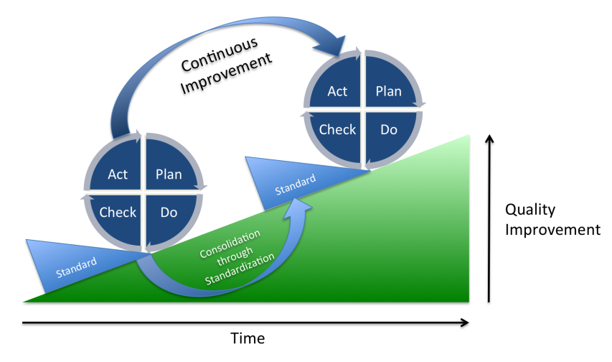
Deming Plan-Do-Check-Act
The (PDCA) Cycle is the best way to confirm continual improvement It is a four step looping process:
Plan — identify the problems and potential sources of any system weakness or error by implementing a regular structured review.
Do— implement the plan and put it into action.
Check — this refers to the monitoring process to assess the effectiveness of the action using focused review and audit.
Act — Implementing the action plan in accordance with the review and audits. Take a corrective action and re-check to ensure its effectiveness.
Notes:
Example of quality planning

Slide 16
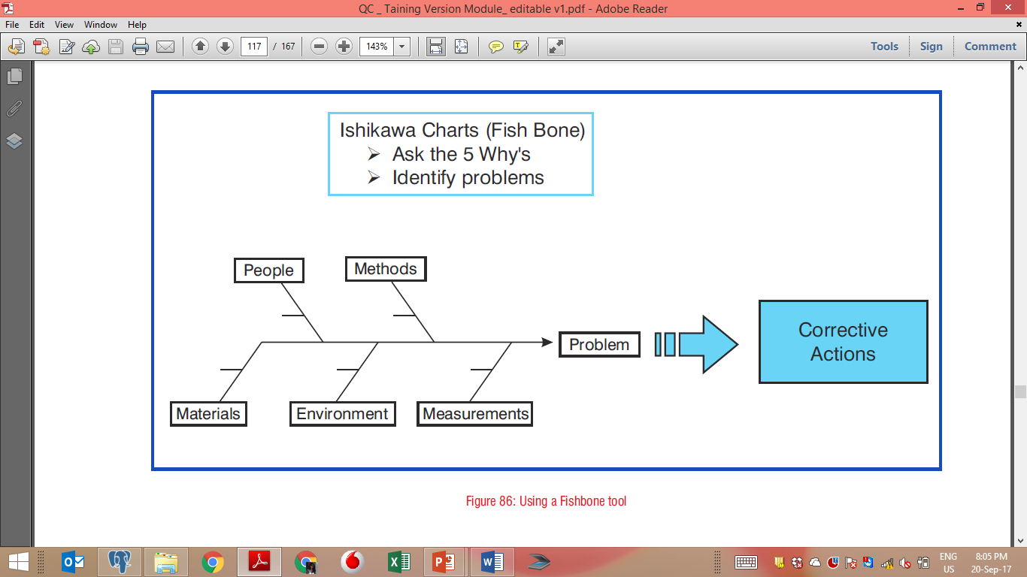
ROOT CAUSE ANALYSIS (RCA)
Four Major Steps in RCA
The RCA is a four-step process involving the following:
1. Data collection.
2. Causal factor charting
3. Root cause identification.
4. Implement corrective action

Slide 17
Trend ANALYSIS
Why Do Trend Analysis
• Comparing one time period to another
• Comparing one group to another
• Making future projections
• Comparing with other organizations
Applications in Laboratory Medicine with an example
- Consumptions of Reagents over a period (daily, weekly, monthly, and annually)
- Peer group analysis (EQAS reporting) – comparison with many labs
- To observe patient load in laboratory department wise, test wise etc.
- To see the trend of CV of various parameters to see the quality

Slide 18
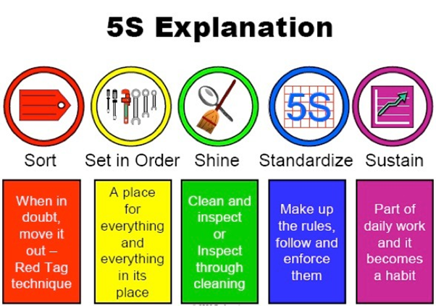
5 S
5S was developed in Japan and was identified as one of the techniques that enabled Just in Time (JIT) manufacturing, aimed at reducing turnaround time.
The goal of 5S is to create a work environment that is clean and well-organized. It consists of five elements:
Sort (eliminate anything that is not truly needed in the work area)
Set in Order (organize the remaining items)
Shine (clean and inspect the work area)
Standardize (create standards for performing the above three activities)
Sustain (ensure the standards are regularly applied)

Slide 19
Acknowledgement
The material in this PPT has been compiled from multiple open sources such as Textbooks, Manuals, National and International Guidelines, Review Articles and related Websites. It has also drawn from Labs for Life Training Modules. All sources are duly acknowledged.

